Slide 1
SmartEAF™
Electric Arc Furnace
Digital Twin & Process Optimizer
A first-principles static + dynamic model, operator console and decision-support platform that helps steelmakers cut energy, raise yield and lift productivity — validated against plant data.
Extractmet Private Limited
Deep-tech metallurgical solutions · process modelling · decarbonisation · AI-assisted operations

Slide 2
THE PROBLEM
The EAF is powerful — and hard to run well
Energy-intensive
Tightly coupled
The most energy-hungry unit in the shop. A few % of kWh/t, across millions of tonnes, is a very large cost and CO₂ line item.
Electrical, thermal and chemical phenomena all interact — intuition alone is an unreliable guide to the best practice.
Poorly observable
Variable inputs
The interior is hostile to sensors; bath temperature and carbon arrive late and intermittently. Much know-how stays tacit.
Scrap quality, DRI metallisation and gangue, and charge mix swing heat-to-heat — set-points that worked yesterday may not today.
SmartEAF™ · Extractmet Private Limited
2

Slide 3
WHAT IT COSTS TO OPERATE ON HEURISTICS
Recoverable value is left in every heat
10–40
1–3%
5–10%
↓ CO₂
kWh/t recoverable energy
metallic yield at stake
tap-to-tap time
and electrode/refractory
better chemical-energy use, foaming & fewer delays
controlled bath oxidation & slag practice
shorter, more repeatable heats = more throughput
lower emissions and consumables per tonne
SmartEAF turns sparse measurements and first-principles physics into a continuous, quantitative picture of the heat — so those gains become visible and actionable.

Slide 4
THE SOLUTION
SmartEAF™ — a digital twin of your furnace
What it is
1
Static balance
A validated software model of the EAF that runs a per-heat static mass & energy balance and a second-by-second dynamic simulation of the whole heat.
It predicts temperature, chemistry, slag, energy and losses over time — and tells the operator what to change to hit aim safely and cheaply.
Runs fully offline in a browser, as a desktop console, or on-prem next to Level-2 — no cloud dependency required.
plan the heat
2
Dynamic twin
see the trajectory
3
Guidance
act on set-points
4
Sensitivity
find the best levers
SmartEAF™ · Extractmet Private Limited
4

Slide 5
MODEL CAPABILITIES
Rigorous physics, not a black box
⚙
Mass & energy balance
⚙
Thermochemistry & kinetics
⚙
Heat & mass transfer
Elemental balances (C, Si, Mn, P, Fe, Cu…) and a full energy balance at every time step.
Decarburisation (O₂- & diffusion-limited), Si/Mn/P oxidation, FeO formation & reduction, post-combustion — as rate laws toward equilibrium.
Arc-to-bath transfer, burner input, immersion melting, mass-transfer-limited refining.
⚙
Scrap melting & dissolution
⚙
Refractory heat loss
⚙
Slag & foaming
Continuous heating/melting split; lime dissolution builds basicity over time.
Coupled conduction–convection–radiation through working/safety/insulation/shell layers; shell & interface temperatures.
Slag chemistry, basicity and a CO-driven foaming index that modulates arc-transfer efficiency.
SmartEAF™ · Extractmet Private Limited
5

Slide 6
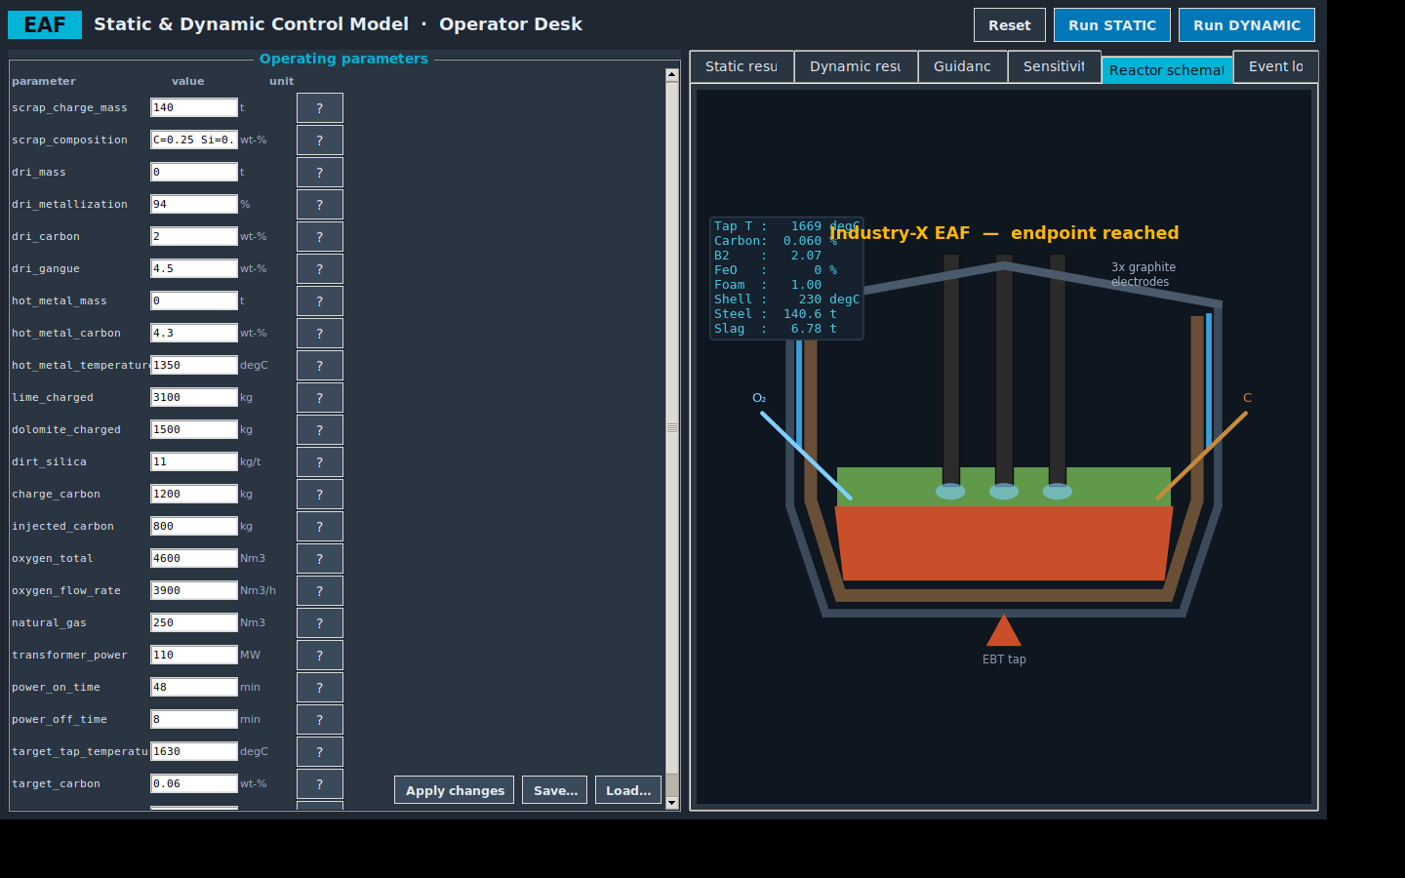
THE OPERATOR CONSOLE
An interactive reactor twin on the desk
Live cross-section
Interactive reactor schematic with electrodes, arc, bath, foaming slag, refractory, water panels, O₂ lance, carbon injection and EBT tap
Live readouts: tap temperature, carbon, basicity, FeO, foam, shell temperature and weights
Separate Static and Dynamic sections, an editable parameter panel with help on every input, and an event log with timings
Two front-ends: an offline web app and a native Python desktop console

Slide 7
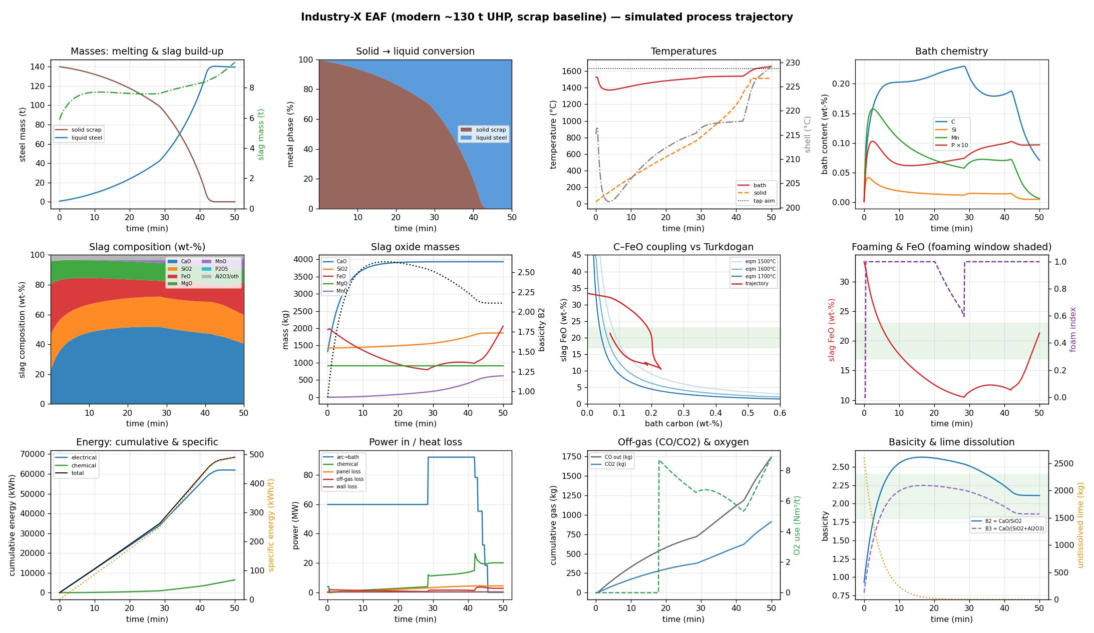
PROCESS TRAJECTORIES
Second-by-second process insight
Every heat, visualised
Melting & slag build-up
Bath, solid & shell temperatures
C / Si / Mn / P refining
Slag evolution & basicity
Energy & foaming
Power-in vs heat-loss breakdown
SmartEAF™ · Extractmet Private Limited
7

Slide 8
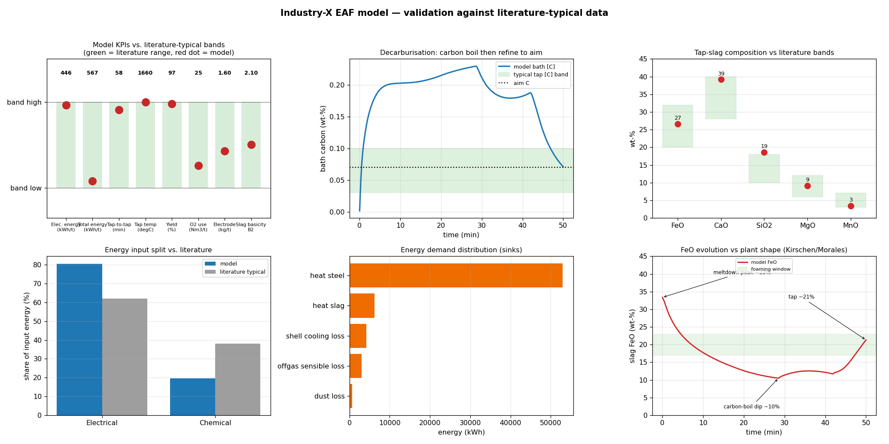
VALIDATION
Validated against literature-typical plant data
Reference: Industry-X (modern ~130 t UHP)
The model reproduces the KPIs steelmakers care about, within published ranges:
Electrical
~446 kWh/t
Total energy
~567 kWh/t
Tap-to-tap
~52 min
Yield
~97%
Basicity B2
~2.1
O₂ use
~35 Nm³/t
All customer references are anonymised as Industry-X.
SmartEAF™ · Extractmet Private Limited
8

Slide 9
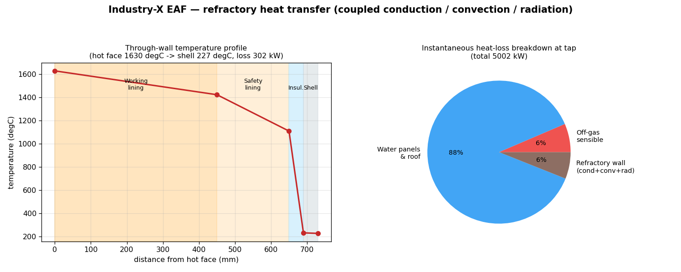
ENGINEERING DEPTH
Furnace design & refractory heat transfer
Coupled conduction through the multi-layer lining, plus external convection and radiation, gives shell and interface temperatures and a real heat-loss breakdown — configurable to your refractory thickness and properties.
SmartEAF™ · Extractmet Private Limited
9

Slide 10
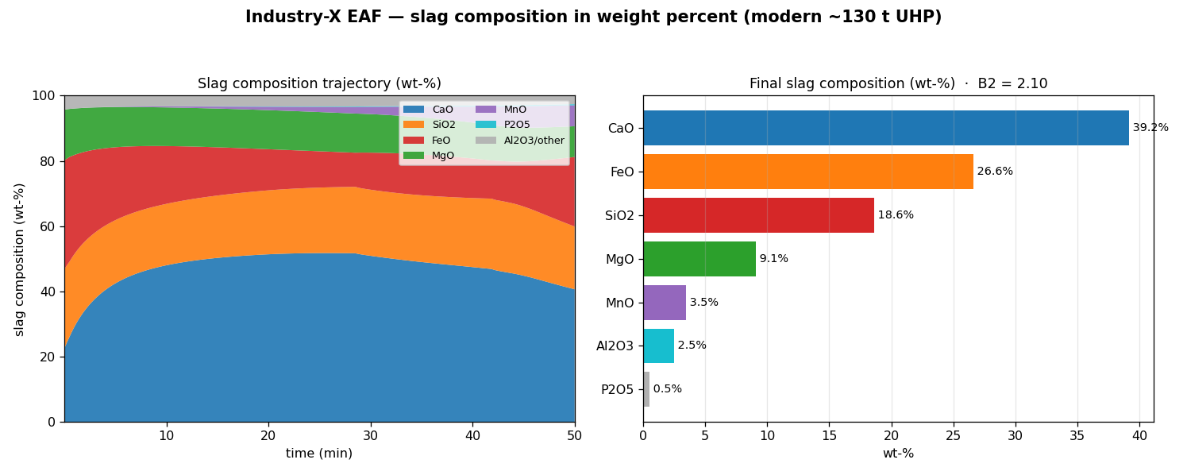
SLAG CHEMISTRY
Slag composition in weight percent
Composition of every slag oxide (CaO, SiO₂, FeO, MgO, MnO, P₂O₅) as weight percent over the whole heat, plus the final slag analysis — the practical read on basicity, FeO control, foaming and dephosphorisation.
SmartEAF™ · Extractmet Private Limited
9

Slide 11
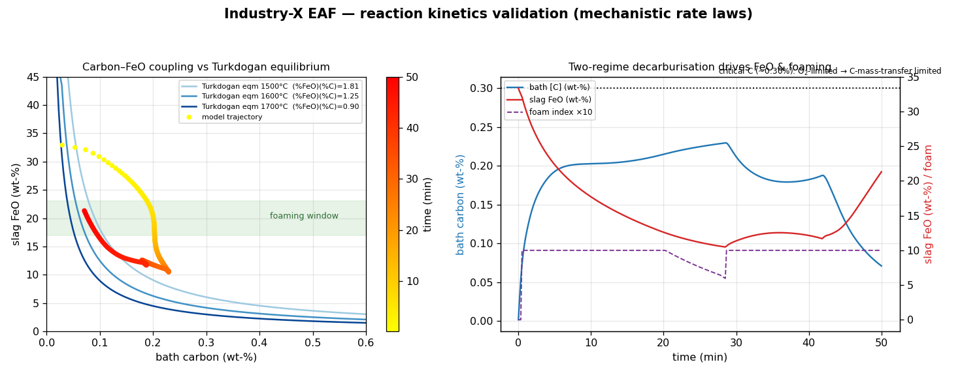
REACTION KINETICS
Mechanistic reaction kinetics
Decarburisation, FeO formation/reduction, flux dissolution and melting are solved as rate laws — not fitted curves. Bath carbon and slag FeO are coupled through the Turkdogan product (%FeO)(%C)=K(T), so the FeO peak at meltdown, the dip through the carbon boil and the rise to tap all emerge from the kinetics.
SmartEAF™ · Extractmet Private Limited
9

Slide 12
BENEFITS & RETURN ON INVESTMENT
Pays for itself in a single line
Lower energy
Higher yield
More throughput
Cut kWh/t via better foaming, chemical-energy use and fewer delays.
Control bath oxidation and slag to recover iron units.
Shorter, more repeatable tap-to-tap times.
Fewer consumables
Lower emissions
Faster know-how
Reduce electrode and refractory wear per tonne.
Less energy and dust → lower CO₂ footprint.
Train operators & engineers safely on the twin.
Illustrative: a 100 t shop saving just 15 kWh/t at industrial power tariffs recovers well over its annual licence in electricity alone — before any yield or productivity gain.

Slide 13
DEPLOYMENT
Deploys the way your plant works
ZERO-FOOTPRINT
WINDOWS / LINUX
INTEGRATION
Offline web app
Desktop console
On-prem / Level-2 link
Single self-contained HTML — opens in any browser, no install, no internet. Ideal for the pulpit and for training.
Native Python operator desk with embedded plots, schematic, guidance and sensitivity studies.
Calibrated to your furnace and connected to historian / PLC data for live estimation and advice.
SmartEAF™ · Extractmet Private Limited
11

Slide 14
COMMERCIAL
Packages
POPULAR
Assess
Operate
Integrate
Pilot engagement
Annual licence
Enterprise
Model calibrated to 2–3 of your heats
Baseline vs best-practice study
Energy/yield opportunity report
Web app (offline)
Everything in Assess
Desktop + web operator consoles
Sensitivity & scenario studies
Quarterly re-calibration & support
Everything in Operate
Level-2 / historian data link
Live soft-sensing & advice
Custom KPIs & on-site training
Indicative packaging — final scope and pricing tailored per furnace and data availability.
SmartEAF™ · Extractmet Private Limited
12

Slide 15
WHY EXTRACTMET
Metallurgy-first, software-strong
Extractmet Private Limited is a deep-tech metallurgical solutions company specialising in pyrometallurgical process modelling, optimisation and decarbonisation.
SmartEAF is built by process metallurgists — the physics is real, the closures are calibratable to your furnace, and the guidance is grounded in mass and energy balances, not correlations alone.
We partner with plants to study their processes, quantify opportunities and deliver tools their operators actually use.
Process modelling
Decarbonisation
Waste valorisation
Critical minerals
AI-assisted operations

Slide 16
Let's run your furnace on physics.
Start with an Assess pilot: send us 2–3 anonymised heats and we'll calibrate SmartEAF and quantify your energy, yield and productivity opportunity.
Book a pilot
Extractmet Private Limited
IIT Madras Research Park, Chennai · www.extractmet.com · contact@extractmet.com
SmartEAF™ figures are for guidance; the model is calibrated to each furnace before operational use. Customer references anonymised as Industry-X.

