Slide 1
EXTRACTMET
SmartMelt
A hybrid physics + machine-learning mathematical model for
real-time melt control in Indian MSME steel plants
MATHEMATICAL MODEL DOCUMENTATION · PYTHON REFERENCE IMPLEMENTATION · OPERATOR CONSOLE
Prepared for Dr. Ajay Kumar Shukla · Centre for Pyrometallurgy, IIT Madras

Slide 2
WHY A MODEL, NOT A DASHBOARD
Every melt shop already has a control system.
None of them have a plant.
50–120 kWh/t
±15–25 °C, ±0.02–0.05 %C
2,000+ heats
recoverable energy loss per heat — the gap between average practice and the plant's own best heats, same equipment, same scrap
typical endpoint scatter on manual practice — driving over-refining, reblows, and reject heats
of Industry-Y BOF data behind the validated endpoint model this system's approach is built on
The gap is not measurement — it's a model of the heat that turns sparse, noisy sensor readings into a trustworthy prediction of what the bath is doing right now, and what it will do if nothing changes.
SMARTMELT — MATHEMATICAL MODEL & OPERATOR SYSTEM
02

Slide 3
SYSTEM ARCHITECTURE
Three layers, one principle: ML corrects physics, it never replaces it
01
Physics core
Coupled mass, energy, species and lining ODE. Thermochemical equilibria, kinetics, slag model. Runs in microseconds — the load-bearing structure that never drifts silently.
फिजिक्स कोर
02
ML residual layer
Learns y_measured − f_physics only. Gaussian-process + gradient-boosted residual, maturity tiers from cold-start (200 heats) to calibrated (2,000+). Bounded extrapolation by construction.
एमएल अवशिष्ट परत
03
Estimation & control
Extended Kalman Filter fuses sparse sensors into a live state estimate. Charge-mix optimiser and receding-horizon MPC issue advisory recommendations — no PLC write path.
अनुमान और नियंत्रण
SMARTMELT — MATHEMATICAL MODEL & OPERATOR SYSTEM
03

Slide 4
MATHEMATICAL MODEL — LAYER 1
The physics core: 30 governing equations, one state vector
E1–E5
E6–E13
E14–E19
Balances
Equilibria
Endpoints
Mass (metal + slag species), bath & solid energy, N-node radial lining conduction
logK for [C],[Si],[Mn] oxidation, slag optical basicity, activity coefficients, h_O
%C/%Si/%Mn equilibrium floors, Healy P-partition, sulphide capacity, L_S
E20–E23
E24–E30
E50–E60
Energy
Kinetics
Diagnostics
Theoretical melt floor, IF coupling vs. fill, EAF arc efficiency, converter losses
Rate laws for decarburisation, Si/Mn/P/S transfer, oxygen ledger with slag saturation
Standing-loss UA test, identifiability, energy audit closure, calibration bounds
Every plant-specific number — furnace geometry, lining thickness, coupling efficiency, sensor suite — lives in one YAML config. The equations never change between an IF Lite install and an EAF/BOF Pro install.
SMARTMELT — MATHEMATICAL MODEL & OPERATOR SYSTEM
04

Slide 5
MATHEMATICAL MODEL — LAYERS 2 & 3A
y = f_physics(x,θ) + g_ML(features) + ε — and why that order matters
Residual learning (E31–E39)
State estimation (E32–E33)
Matern-3/2 Gaussian process on the physics residual, clipped to a physically bounded correction
Quantile gradient-boosted trees (HistGBM) for endpoint intervals as data accumulates
Maturity tiers: cold-start (<200 heats, physics-led) → deployable (1,000) → calibrated (2,000+)
Population Stability Index + MAPE drift monitor — flags regime change (new scrap supplier) before it silently degrades advice
Tramp-element soft sensor (Cu, Sn, Cr): mass-balance prior + Ridge correction
Extended Kalman Filter over an augmented [state, θ] vector — joint tracking of bath conditions and slow plant parameters
θ = {η_electrical, UA_lining_scale, k_C_scale, ...} — the same parameters an offline calibration fits, now tracked online
Finite-difference Jacobians, Joseph-form covariance update for numerical stability
Sensor masking: a Lite install (immersion TC only) and a Pro install (+ off-gas, sub-lance) share one filter — just a different observation model
SMARTMELT — MATHEMATICAL MODEL & OPERATOR SYSTEM
05

Slide 6
MATHEMATICAL MODEL — LAYER 3B/3C
From estimate to action: least-cost charge, receding-horizon control
Charge-mix optimiser (E40–E45)
Melt MPC (E50–E53)
min Σ price·mass s.t. grade chemistry window, hard tramp-element walls, integer lot sizes
Receding-horizon SLSQP over piecewise-constant power/O2/addition blocks (4–6 per horizon)
Projects onto the furnace's real discrete tap-power levels — no continuous setpoint a controller can't realise
Refractory and overheat barrier terms keep recommendations inside safe operating envelope
tap_time_advice(): the single number an operator actually wants — output is a recommendation, not a setpoint write
Deliberately advisory-only in this phase: builds the trust and the logged-outcome dataset a future closed-loop mode would need
Solved as an LP/MILP (scipy linprog/milp) — plant-agnostic; only the material table and constraints change per client
Hard walls on Cu/Sn/Cr recovery=1 (no metallurgical sink) — the constraint a spreadsheet mix can't enforce
Shadow prices reported per tramp-element constraint: the ₹/t value of relaxing it — the number that sells the case for better scrap sorting
Pays back from heat #1 — no training history required, unlike the ML layer
SMARTMELT — MATHEMATICAL MODEL & OPERATOR SYSTEM
06

Slide 7
VALIDATION DISCIPLINE
±15 °C and ±0.02 %C only mean something with three qualifiers attached
1-sigma, 2-sigma, or max?
endpoint_hit_rate() reports hit-rate at a stated tolerance plus bias, p95 error — never a bare number
On what split?
time-ordered train/test only — heats 1..N train, N+1..M test. Random k-fold leaks the lining campaign and the scrap regime
Against what reference?
σ_model² = σ_observed² − σ_reference² — a drop-cell has its own ±3–5°C, and that's not the model's error
Plus one cheap experiment: a 20–30 min standing-loss hold (power off, full bath) directly identifies UA_lining_scale and de-correlates it from η_electrical in every later fit — the difference between a fitted model and a curve-fit.
SMARTMELT — MATHEMATICAL MODEL & OPERATOR SYSTEM
07

Slide 8
WHAT THE OPERATOR SEES
One screen: where the heat is, where it's going, what to do
Heat clock
INDUSTRY-X IF · HEAT H-1042
GREEN
Radial dial: elapsed / remaining time, live process stage — charging, melting, refining, tap-ready
Live trends
Bath temperature and carbon vs. tap aim ± tolerance band, updating from the state estimate
Si
Mn
P
S
31
0.204%
0.331%
0.034%
0.027%
Instrument grid
Si / Mn / P / S / slag B2 / FeO — each tile colours green / amber / red against its own tolerance
MIN LEFT
BATH TEMPERATURE (°C)
Energy audit
Where every grid kWh went this heat: useful melt vs. lining, cooling, radiation, converter loss
Advisory feed
Bilingual (EN/Hindi) recommendation log with the reason attached — never a bare instruction
Static reference — the shipped console (SmartMelt_Operator_Console.html) is a live, playable HTML dashboard driven by the physics engine.
SMARTMELT — MATHEMATICAL MODEL & OPERATOR SYSTEM
08

Slide 9
WHERE THIS GOES NEXT
Economics are conservative by construction, and the roadmap is honest
Every saving number is a disputed line, shown
Roadmap
Achievable target = the plant's OWN best-decile heat, same scrap, same equipment — not a vendor benchmark
savings_attribution(): regression-adjusts for charge mass / carbon / tap-T drift between the before/after windows before crediting SmartMelt
Payback shown with tariff, opex, and carbon-credit lines broken out — capex ÷ net annual, in months
5-year NPV at 12% discount reported alongside payback, not instead of it
Now
Advisory-only Phase 1: physics core + charge-mix optimiser ship from heat #1, no history needed
200–1,000 heats
ML residual layer moves cold-start → deployable; drift monitor active from day one
2,000+ heats
Calibrated tier; MPC recommendations tighten; shared-savings evidence log mature enough to bill against
Future
Closed-loop PLC write path — only after the advisory log demonstrates sustained trust
SMARTMELT — MATHEMATICAL MODEL & OPERATOR SYSTEM
09

Slide 10
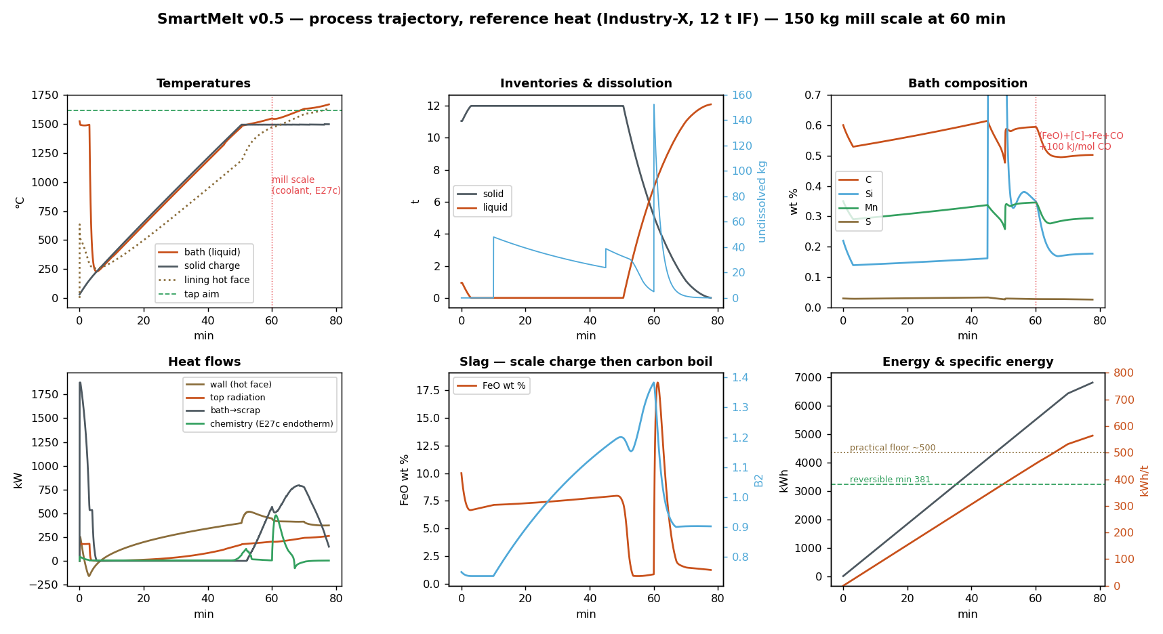
MODEL OUTPUT — LAYER 1
Process trajectory — one reference heat (Industry-X, 12 t IF)
Charge-in freeze and recovery, isothermal melt-down, superheat-gated dissolution, and — at 60 min — 150 kg of mill scale: (FeO)+[C]→Fe+CO (E27c) cuts carbon, returns iron to the bath, and cools it. Verified thermochemistry: +100 kJ/mol CO = 1.39 MJ/kg FeO endothermic; Fe credit within 0.2 % of the stoichiometric ceiling. Element ledger < 1 %, first-law closure ≈ 3 %.
SMARTMELT — MATHEMATICAL MODEL & OPERATOR SYSTEM 10

Slide 11
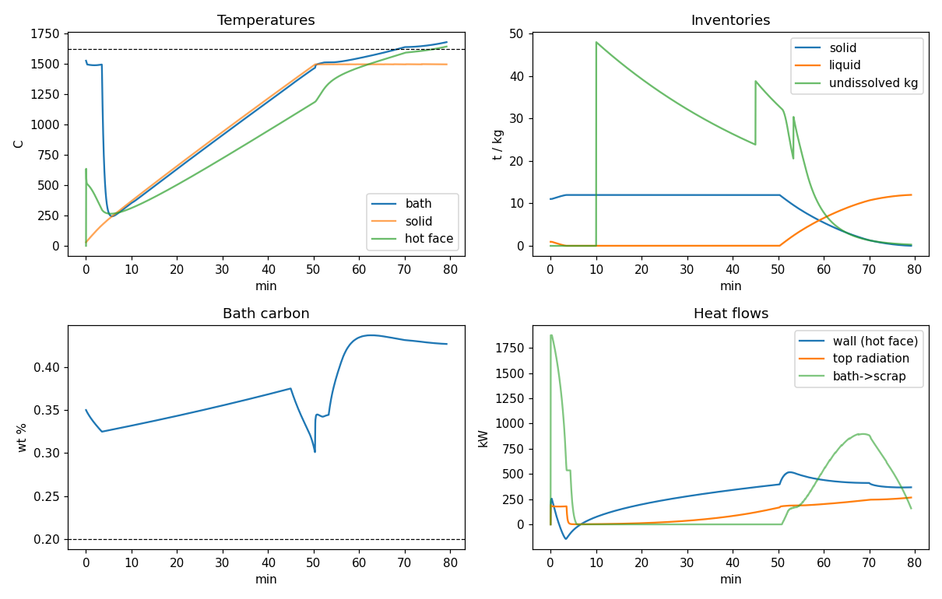
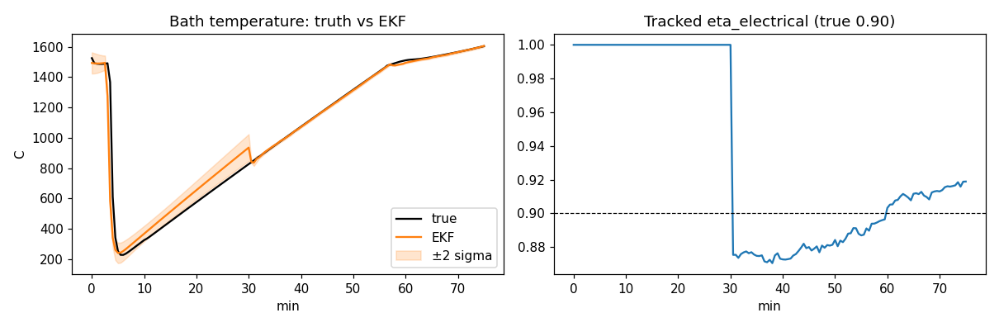
MODEL VALIDATION
Simulated heat & EKF tracking on a deliberately mismatched plant
EKF vs hidden plant (η = 0.90, worn lining):
σ_T collapses 35 → 4 °C on three immersion dips; η̂ converges to 0.91 within one heat; final bath-temperature error +1.6 °C.
Left — the full reference heat:
temperatures, inventories with undissolved additions, bath carbon against aim, and the heat-flow split (wall, radiation, bath→scrap).
SMARTMELT — MATHEMATICAL MODEL & OPERATOR SYSTEM 11

