Slide 1
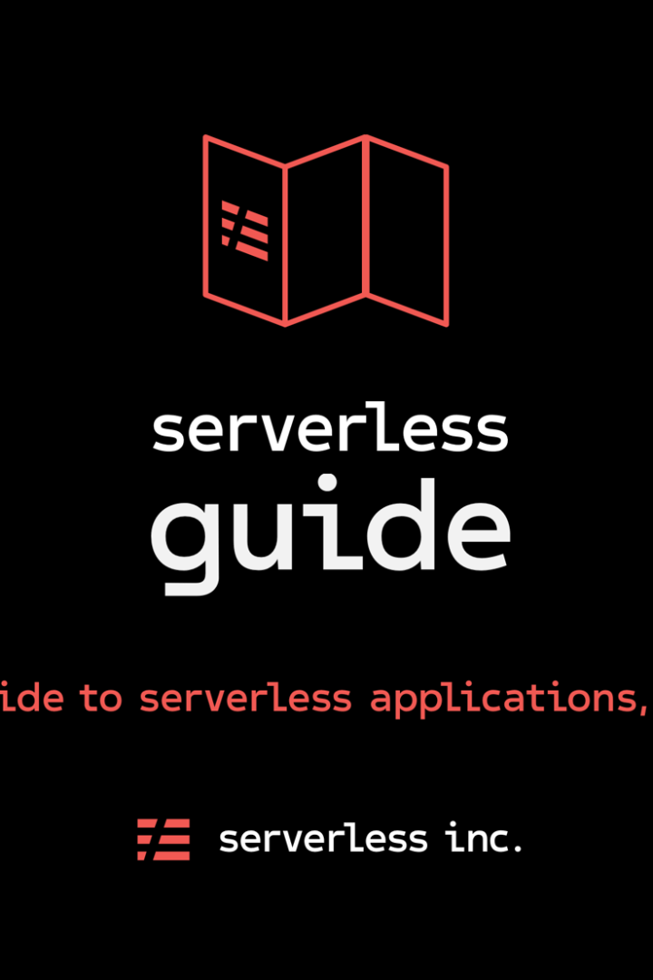
Building a Serverless IoT Data Processing Solution
Learn how to create a powerful serverless IoT data processing solution using IBM Cloud Functions and device integration. This guide will walk you through the process of integrating smart devices and setting up data collection.
PM
SAKTHIVEL MURUGAN S

Slide 2
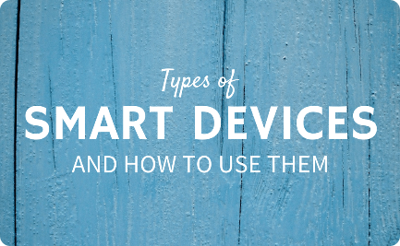

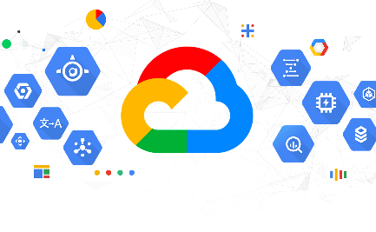
Step 1: Device Integration
Start by integrating your smart devices into the system. Connect each device securely and ensure they can communicate with the cloud platform. This will allow for seamless data collection and processing.
Connect Devices
Collect Data
Cloud Integration
Integrate your smart devices and ensure secure connections.
Gather data from each device to be processed and analyzed.
Integrate your devices with an efficient cloud platform for data storage and processing.

Slide 3
Step 2: Data Collection
With the devices integrated, it's time to set up data collection. Define the types of data to be collected and establish data gathering protocols. Ensure that the collected data is accurate, reliable, and in the desired format for further processing.
1
Define Data Types
Determine the specific types of data to be collected from each device.
Gathering Protocols
2
Establish protocols and methods for gathering data effectively.
3
Accuracy Validation
Verify the accuracy of the collected data to ensure reliability.

Slide 4
Step 3: Data Processing
Now that the data is collected, it's time to process it. Use IBM Cloud Functions to create serverless functions that will analyze and transform the collected data. Leverage the power of cloud computing to perform complex calculations and extract valuable insights.
Data Analysis
Data Transformation
Insight Extraction
Analyze the collected data to identify patterns, trends, and anomalies.
Transform the data into a format that is suitable for further analysis.
Extract valuable insights and actionable information from the processed data.

Slide 5
Step 4: Real-time Monitoring
Enable real-time monitoring of the IoT data. Set up alerts and notifications based on predefined rules and thresholds. Ensure that any anomalies or critical events are immediately detected and appropriate actions are taken.
1
Alerts and Notifications
Set up alerts and notifications for real-time detection of anomalies.
2
Rule-Based Monitoring
Define rules and thresholds to monitor the data in real-time.
3
Actionable Response
Take appropriate actions in response to detected anomalies or critical events.

Slide 6
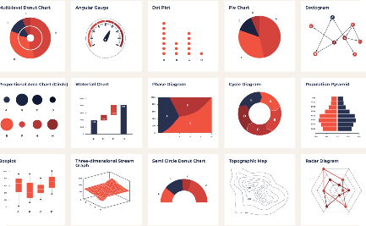
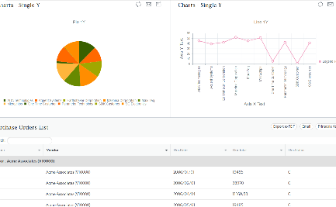
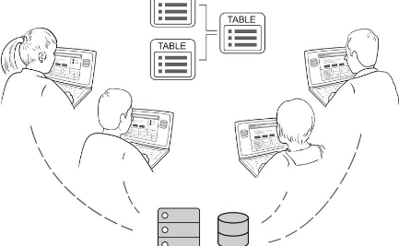
Step 5: Data Visualization
Visualize the processed data to gain meaningful insights and facilitate decision-making. Use charts, graphs, and dashboards to present the data in a clear and concise manner. Allow users to interact with the visualizations to explore the data further.
Charts and Graphs
Data Dashboard
Interactive Interface
Present the processed data using visually appealing charts and graphs.
Create a user-friendly dashboard to display key metrics and insights.
Enable user interaction with the visualizations to explore data in detail.

Slide 7

Step 6: Actionable Insights
Once the data is visualized, extract actionable insights from it. Identify trends, make predictions, and optimize processes based on the derived insights. Use the power of data-driven decision-making to drive innovation and improve efficiency.
1
Trend Identification
2
Predictive Analysis
Identify trends and patterns in the data to gain a deep understanding of the system.
Use predictive models to forecast future outcomes and make informed decisions.
3
Process Optimization
Optimize processes based on the insights gained from the data analysis.

Slide 8
Step 7: Continuous Improvement
Building a serverless IoT data processing solution is an iterative process. Continuously monitor and evaluate the system's performance. Identify areas for improvement and implement necessary changes to enhance efficiency, reliability, and security.
Performance Monitoring
System Optimization
Security Enhancements
Implement changes and optimizations to enhance system efficiency and reliability.
Regularly monitor the system's performance to identify bottlenecks or areas of improvement.
Strengthen the security measures to protect the system from potential threats.

Slide 9
Step 8:DEVICE INTEGRATION AND DATA INTEGRATION
# Example code for data collection from a motion sensor
import paho.mqtt.client as mqtt
def on_connect(client, userdata, flags, rc):
print("Connected with result code "+str(rc))
client.subscribe("motion_sensor")
def on_message(client, userdata, msg):
print("Received message:", msg.payload.decode())
Client = mqtt.Client()
client.on_connect = on_connect
client.on_message = on_message
client.connect("broker.example.com", 1883, 60)
client.loop_forever()

Slide 10
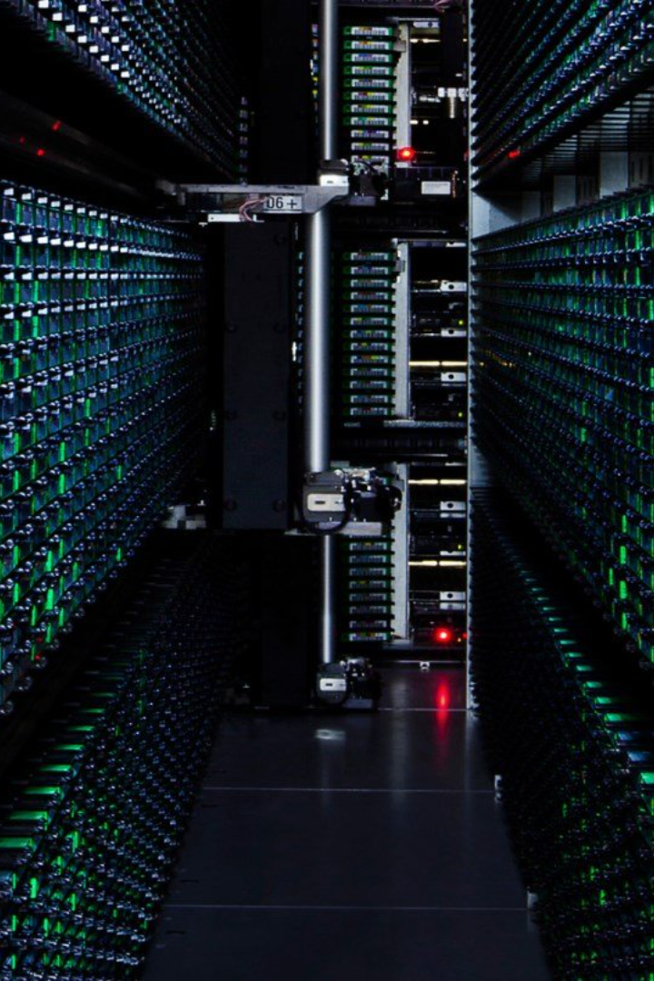
Conclusion
In conclusion, building a serverless IoT data processing solution using IBM Cloud Functions and device integration can empower your organization with valuable insights and enable data-driven decision-making. Follow the outlined steps to create a powerful system that extracts maximum value from the collected IoT data.

