Slide 1

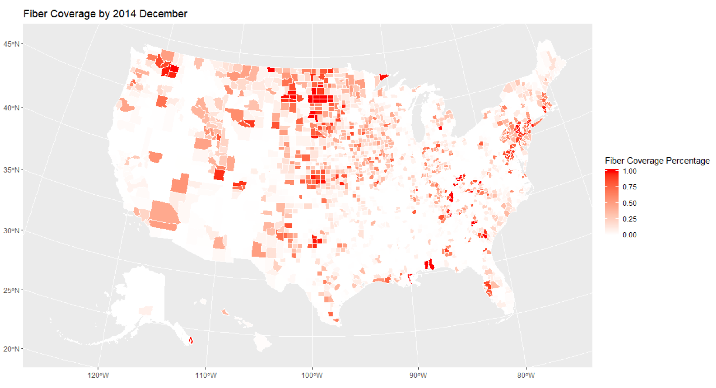
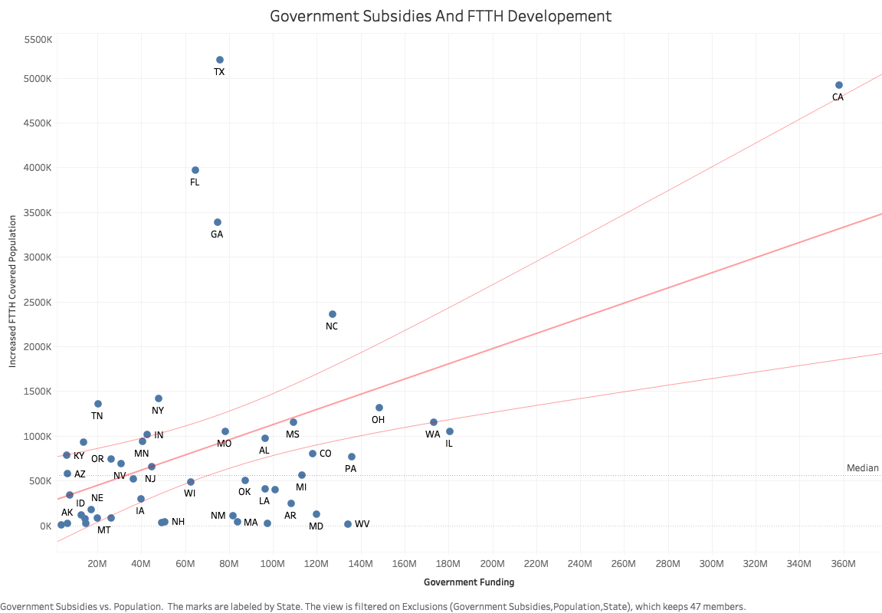

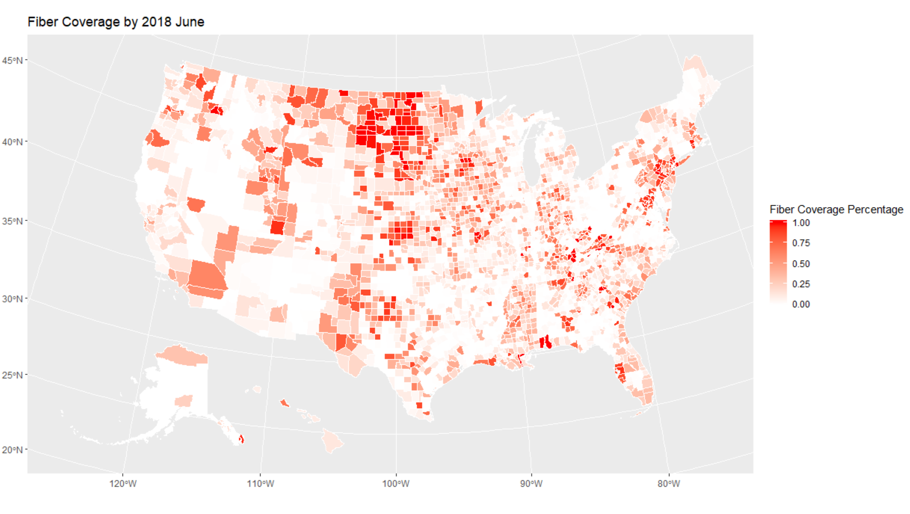
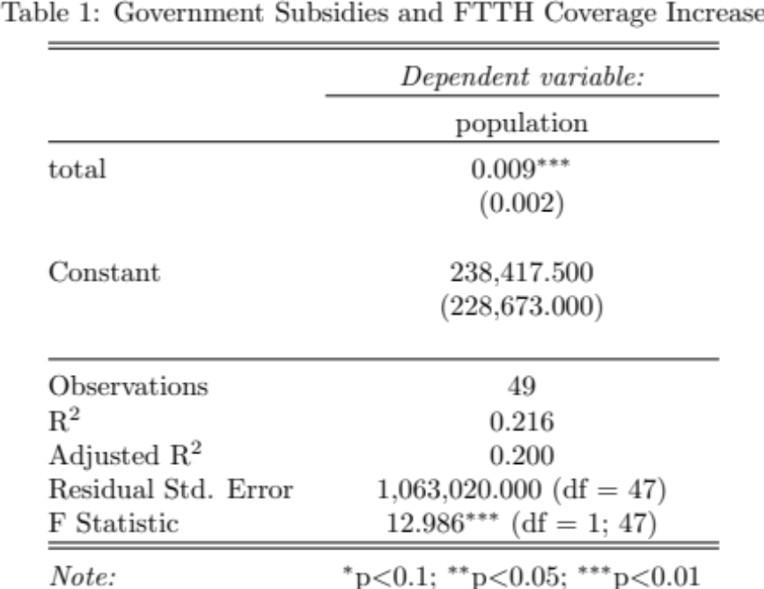

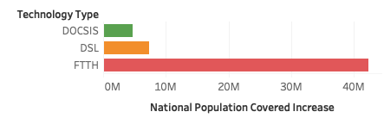
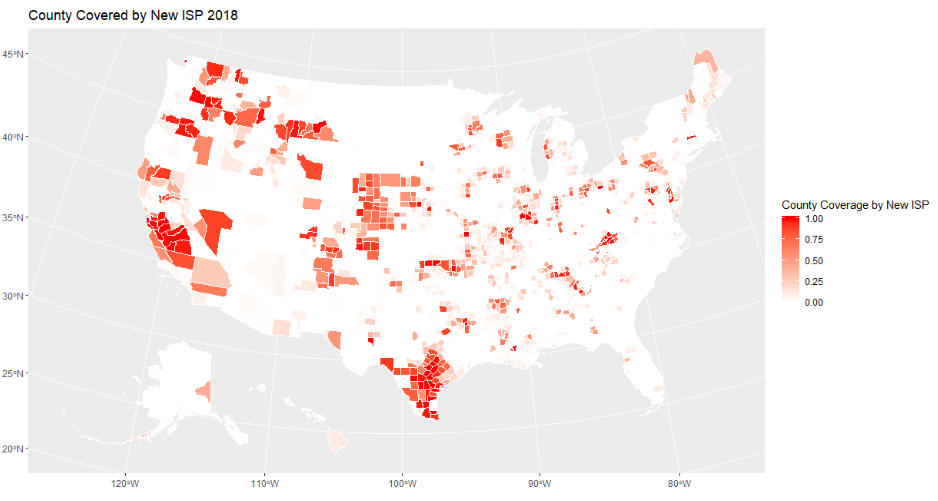
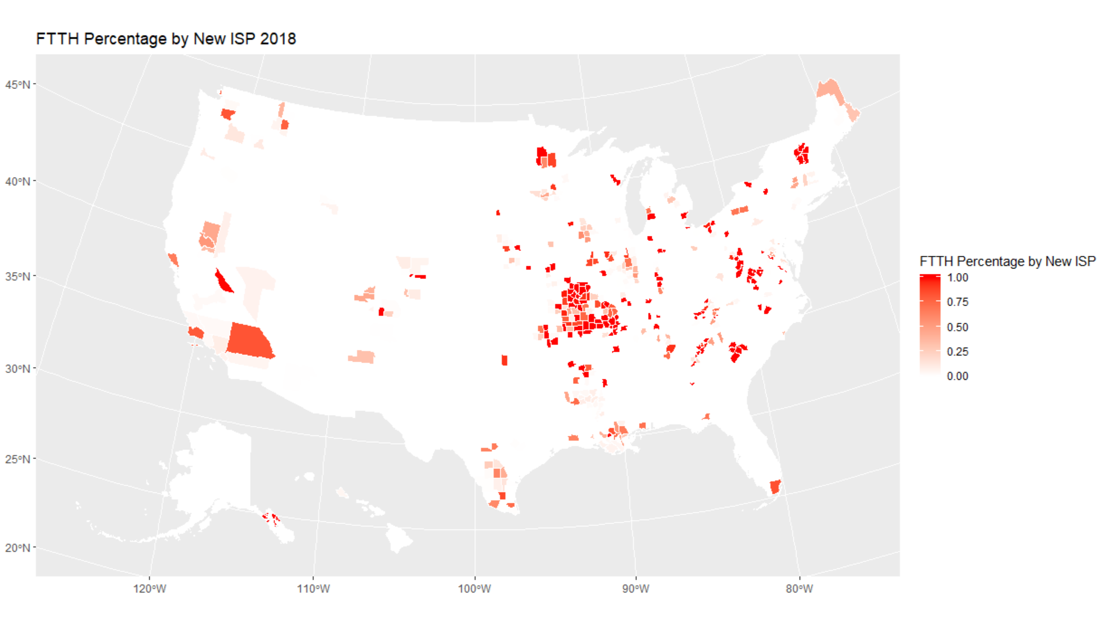
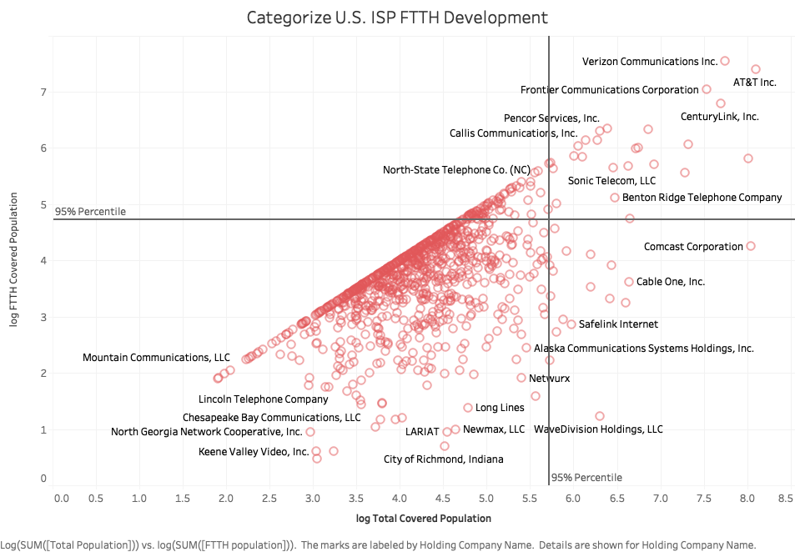
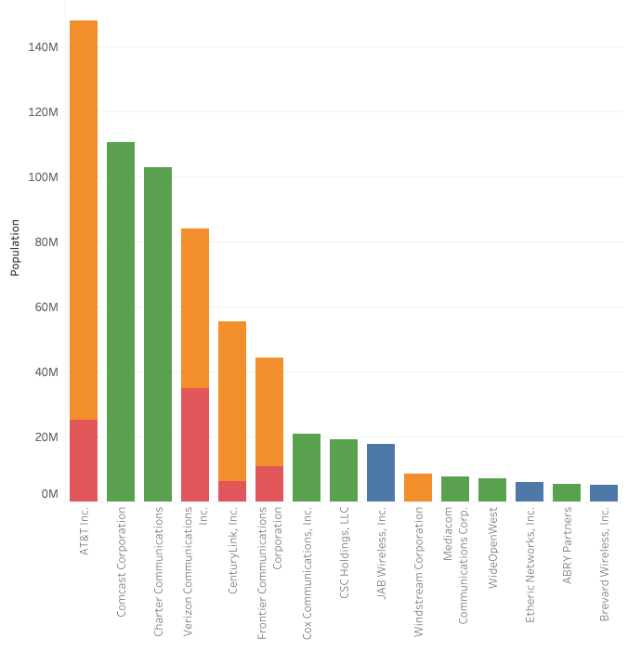
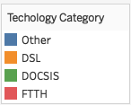
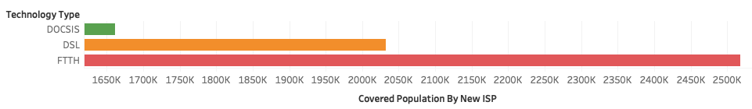
Fiber to the home (FTTH) Development in The United States
Aishen Li, Kunpeng Liu, Yinheng Li, Xiaowei Zhao, Mingfeng Li
Henning Schulzrinne
Data Science Capstone Project
with Henning Schulzrinne
FTTH Development in Geography View
Fiber to the home (FTTH) is the advanced method to connect to the internet nowadays, and we want to figure out the FTTH development in the United States and find factors relevant to FTTH development to help better the government develop FTTH.
Government Funding
Government funding combined federal infrastructure grants and broadband initiatives. We found the government funding helps more population to get covered by FTTH technology.
Figure 1. FTTH Covered Population Percentage Change From 2014 to 2018
Figure 3. FTTH covered population change with government funding in each state
Internet Service Providers (ISP) on FTTH Development
AT&T is the largest ISP in the U.S., Verizon is the largest player in FTTH. Large ISP such as Comcast and Charter (Spectrum) are focusing on DOCSIS. The ISP status is shown by the total and FTTH covered population. We divided ISPs into four quadrants by 95 percentile marks. ISPs in the 1st quadrant are a big player with big moves on FTTH, 2nd is smaller ISP emphasis on FTTH, 4th is a large ISP that reluctant on FTTH.
FTTH Development by New ISP – Geography view
This figure shows the new ISPs coverage distribution at a county-level. The left graph shows the population percentage covered by the new ISPs. The right graph shows the portion of the population covered by the new ISPs that use FTTH technology.
Figure 4. New ISP Coverage Heat map
Conclusion
From 2014 to 2018, we observed substantial development of the FTTH technology in the U.S. Many large ISPs are pioneering in FTTH deployment, and new ISPs also have significant contributions in some areas. Government funding played an essential role in increasing FTTH coverage.
Figure 2. U.S. ISP current status on FTTH
Acknowledgments
Special thanks to Professor Schulzrinne
References
Federal Communications Commissions (FCC.gov) &US Census Bureau (census.gov)

