Slide 1
KNN-Powered AI Assistant for Automated Resume Screening
CAPSTONE PROJECT
Presented By:
PATTAN MAHAMMAD SALMAN KHAN
KL University Department of AI & DS

Slide 2
OUTLINE
Problem Statement (Should not include solution)
Proposed System/Solution
System Development Approach (Technology Used)
Algorithm & Deployment
Result
Conclusion
Future Scope
References

Slide 3
Problem Statement
The process of screening resumes conventionally can be quite a tiresome and ineffective approach. Recruiters usually spend a considerable amount of time sifting through a large number of resumes manually and rely on keyword searches and their intuition to identify potential candidates. However, this method can be biased and may overlook competent individuals who do not meet all the specific keywords or align with the recruiter's preconceptions. This can result in missed opportunities to hire the best possible candidates for the job.

Slide 4
Proposed Solution
This project proposes an AI-powered assistant for automated resume screening using the K-Nearest Neighbors (KNN) algorithm. KNN leverages machine learning to identify similar data points based on their proximity. In this context, it can:
Classify Resumes: The KNN model, trained on labeled resumes and job descriptions, categorizes new resumes based on their similarity to labeled ones for similar roles. This automates initial screening, saving recruiters time.
Reduce Bias: KNN relies on objective data analysis, mitigating unconscious bias present in human judgment. This leads to a fairer and more equitable evaluation process.
Improve Efficiency: Automating initial screening frees recruiters to focus on deeper interviews and candidate evaluation, streamlining the hiring process.
Solution Components:
Data Collection: Gather a diverse dataset of labeled resumes and job descriptions from online portals, company websites, and collaborations. Ensure data cleaning and anonymization.
Data Preprocessing: Extract relevant features like skills, keywords, experience, education, and job titles. Convert text data into numerical representations using methods like TF-IDF or word embeddings.
KNN Algorithm Implementation: Train the KNN model using the preprocessed data and optimize hyperparameters for performance.
Deployment: Develop a user-friendly application or API where recruiters upload resumes and job descriptions. The model displays recommendations, highlighting the most relevant candidates.
Evaluation: Continuously monitor and evaluate the model's accuracy, fairness, and user feedback. Fine-tune the model to address any shortcomings and enhance performance.

Slide 5
System Approach
System requirements :
Processor: Intel Core i3 or above, AMD Ryzen 3 or above (server requires 4 cores or above)
Memory: 8GB RAM
Operating System: Windows, macOS, or Linux
Software: Python 3, Jupyter Notebook installed
Library required to build the model
Scikit-learn
matplotib

Slide 6
Algorithm & Deployment
Algorithm Selection:
Our AI Assistant uses K-Nearest Neighbors (KNN) algorithm to automate resume screening. KNN predicts relevant job categories or scores for each resume, ensuring fairness and efficiency in the recruitment process. Its simplicity, adaptability, and inherent fairness make it an excellent tool for this task.
Data Input:
Input Features : The feature includes a Resume section, which showcases your work experience, skills, completed projects, educational qualifications, and other relevant information.
Training Process:
The training phase meticulously prepares our AI assistant for the real world. We analyze data distribution, refine resume content, and encode job categories for clarity. Leveraging TF-IDF, we translate resumes into numerical representations, enabling KNN to learn patterns and relationships. Extensive testing ensures accuracy and equips the assistant to confidently identify suitable candidates.
Prediction/Classification Process:
The process of predicting or classifying job categories is based on analyzing and extracting key features from a candidate's resume such as their skills, experience, and projects. These features are then matched against predefined patterns to determine the most suitable job category for the candidate

Slide 7
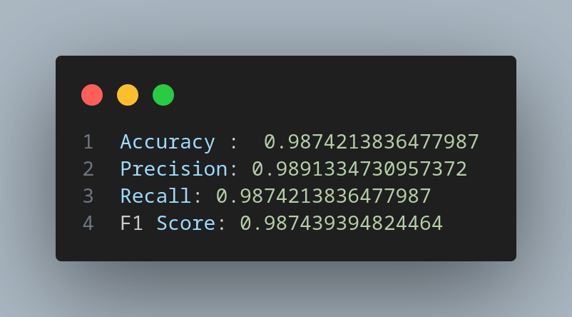
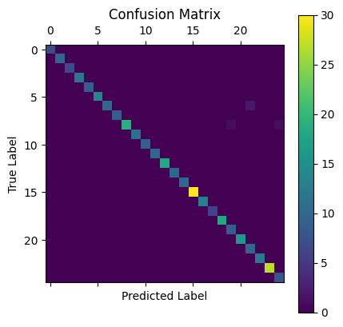
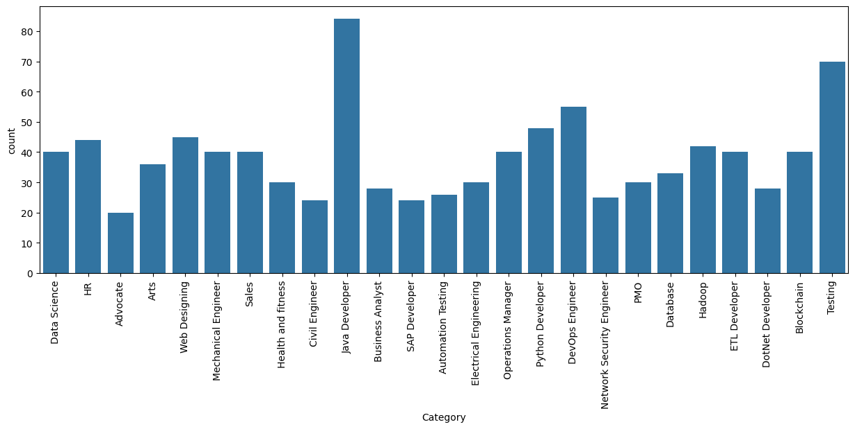
Result

Slide 8
Conclusion
Summarize the findings and discuss the effectiveness of the proposed solution. Highlight any challenges encountered during the implementation and potential improvements. Emphasize the importance of accurate bike count predictions for ensuring a stable supply of rental bikes in urban areas.

Slide 9
Future scope
Discuss potential enhancements and expansions for the system. This could include incorporating additional data sources, optimizing the algorithm for better performance, and expanding the system to cover multiple cities or regions. Consider the integration of emerging technologies such as edge computing or advanced machine learning techniques.

Slide 10
References
List and cite relevant sources, research papers, and articles that were instrumental in developing the proposed solution. This could include academic papers on bike demand prediction, machine learning algorithms, and best practices in data preprocessing and model evaluation.

Slide 11
THANK YOU

