Slide 1
BUAN 6320 Database Foundations for Business Analytics
Retail Store Management
Project Group Members:
Saloni Sandeep Juwatkar
Joshita Sairupa Allu
Jingyi Guo
Bryan Lee
Priyank Chilamkuri

Slide 2
Introduction
This Database definition document explains the design and implementation of the database that has been created to store data of various constituents involved in a Retail Store. The database will enable the creation and maintenance of retail stores which will increase the efficiency of the store management.
Project Purpose
The purpose of Retail Database Management System is to amplify the efficiency, sales and quality of the Retail Store services. It will simplify the process of maintaining data related to the inventory trends, orders, customers, employee management and finances. This system will not only help to overcome the manual errors but also keeps the store organized for better customer service.

Slide 3
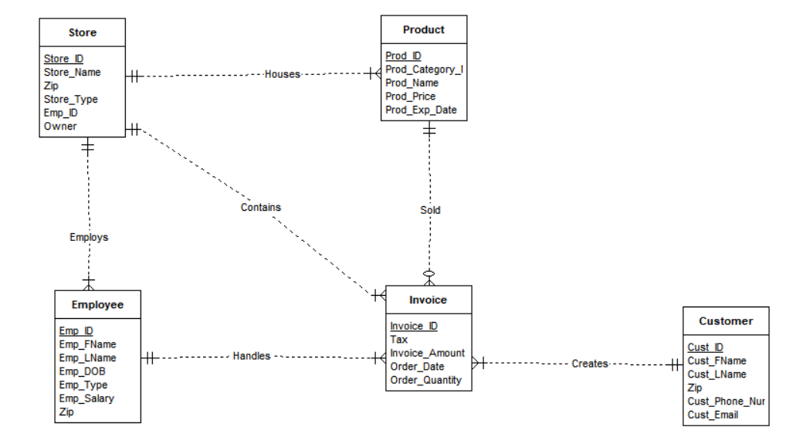
ERD Diagram

Slide 4
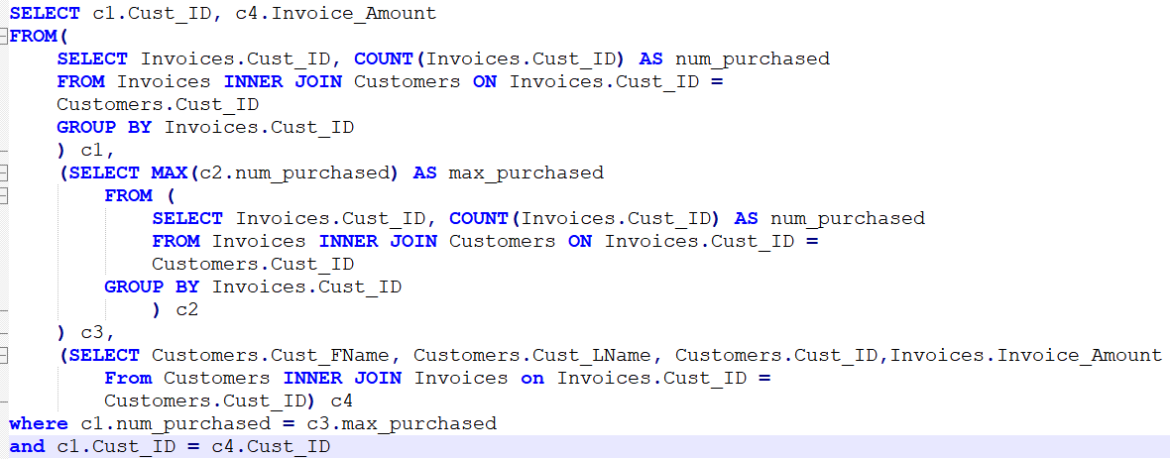

Advanced Queries
Find the customer who purchased the most often and show their ID and the amount of that purchase.
Output:

Slide 5
Trigger and Sequence
Business purpose: The TRG_Stores trigger automatically assigns a sequential user ID to a newly-inserted row in the Stores table, as well as setting the join date to the current system date and assigning appropriate values to the created_by and date_created fields. If the record is being inserted or updated, appropriate values are assigned to the modified_by and modified_date fields. | Sequence starts the ID for INVOICE at 1000000 and increments by 1 as needed
CREATE OR REPLACE TRIGGER TRG_Stores BEFORE INSERT OR UPDATE ON Stores FOR EACH ROW BEGIN IF INSERTING THEN IF :NEW.Store_ID IS NULL THEN :NEW.Store_ID := SEQ_Stores_Store_ID.NEXTVAL; END IF; IF :NEW.created_by IS NULL THEN :NEW.created_by := USER; END IF; IF :NEW.date_created IS NULL THEN :NEW.date_created := SYSDATE; END IF; End IF; END; | CREATE SEQUENCE SEQ_Invoices_Invoice_id INCREMENT BY 1 START WITH 81000000 NOMAXVALUE MINVALUE 81000000 NOCACHE;

Slide 6
Challenges Faced During Project Implementation
Cross platform issues between Apex and Oracle
Initially an issue as the SQL written was split between Apex and Oracle and would cause errors when importing SQL between applications
This issue was fixed by rewriting the SQL to ensure that it could work and run on both applications

