Slide 1
AI01: HireShark
Fall 2025
Deployed Project: https://salt-lab-human-ai.github.io/project-check-point-1-ai01/upload
GitHub: https://github.com/SALT-Lab-Human-AI/project-check-point-1-ai01
Ashwin Shanmugam, Changho Jung, Kevin Xia, Ramprasath Loganda Sureshbabu

Slide 2
Contents
Problem Statement / Targeted Users
Live Demo
Design Decisions & Challenges
Safety, Privacy & Reliability
Next Steps

Slide 3
Problem Statement / Targeted Users
Problems:
It takes time to find jobs matching preferences
Job seekers may suffer from subjective decisions based on unconscious biases of recruiters
Occur time lost on searching and applying for jobs that seekers want
Target Users:
Job seekers!
How:
Automatically extract info from resume
Automatically score and show most matching job with resume
Automate information retrieval process with score -> faster!

Slide 4
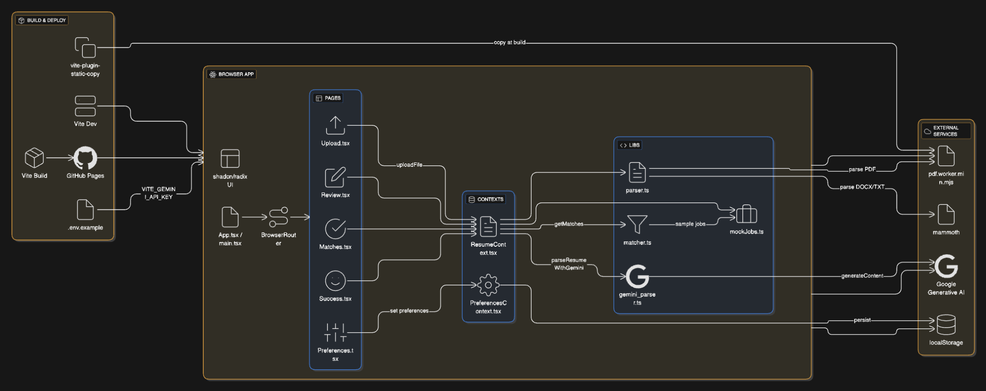
Architecture

Slide 5
2. Live Demo
https://salt-lab-human-ai.github.io/project-check-point-1-ai01/
Notes:
Demo: Resume upload, LLM scan and information retrieval, job list by highest matching score
Handling error: Prompt for enforcing LLM to precisely retrieve information

Slide 6
3. Design Decisions & Challenges
AI used: Gemini API (Gemini Flash 2.5) retrieve information from resume
Having Rate per Day/Minute limits and token limits
Collected data / usage of data
Currently, no data collected. Seeing customer as product is BAD.
Challenges
Some teammate have zero bases on website building on both frontend and backend -> Get helped from AI (GitHub Copilot/Gemini Client)
Scoring not showing up correctly -> Changed to word vector calculation for skill matching
Getting data for jobs was challenging -> Adzuna API
Deployment on Github required extra steps -> Customize github page deploy scripts & repo private key

Slide 7
4. Safety, Privacy & Reliability
Not saving personal data, resume data stays local
Parsed resume and job ideation tasks done by Gemini, not stored in HireShark
API keys: VITE_GEMINI_API_KEY, VITE_ADZUNA_APP_ID, and VITE_ADZUNA_APP_KEY
Keep them as secret
Adzuna API used for only parsing job descriptions, not sending resume info to the API
API calls using Gemini may be blocked if quota limits are exceeded or by TOS of Gemini

Slide 8
5. Next Steps
One of main goal is reducing job finding time accurately
HireShark retrieve information (skills, educations, experiences, etc.) more concisely
Provide job lists that job seekers finds useful (likely to submit applications)
All these processes takes shorter than manual searching and submit application(s)

Slide 9
Appendix
Thanks to all teammates for their efforts:
Ashwin Shanmugam: Added working prototype to repo & Implemented Unit Tests & Code documentations
Changho Jung: Assist prompt folder & Slide preparation & Attempt to work on matching scoring
Kevin Xia: Website Implementation & API Integration & Quality Control & Skill Match Scoring
Ramprasath Loganda Sureshbabu: Website design & Attempt to API Integration for job description

