Slide 1
Sensitivity Analysis
Jon Herman | ECI 289I 11.29.17

Slide 2
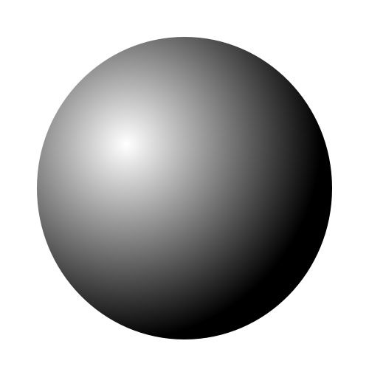
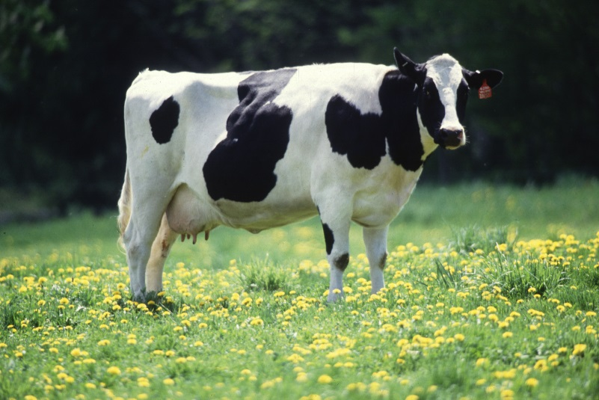




Modeling is abstraction
$$≃$$
$$≃$$

Slide 3
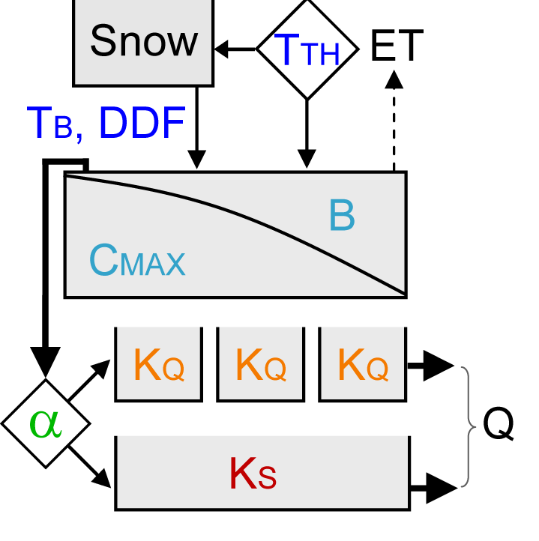
Example: rainfall-runoff Modeling
Model
Forcing (Precip,
Temp, Wind)
Q
Model parameters are uncertain
For conceptual models, you may not be able to measure them directly

Slide 4
Why sensitivity analysis?
Some parameters control model performance more than others.
This tells us how the model represents “dominant” processes.
This changes in space and time.

Slide 5
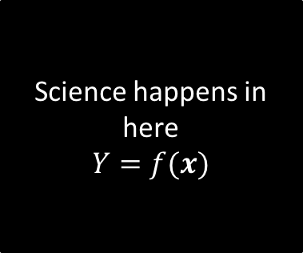
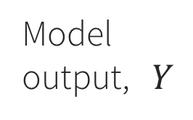

Think of a model as a “black box”*
Science happens in here
$$Y=f(x)$$
Parameter Set, $x=[x_{1},…,x_{k}]$
Model output, $Y$
*scientists usually take offense at this term

Slide 6
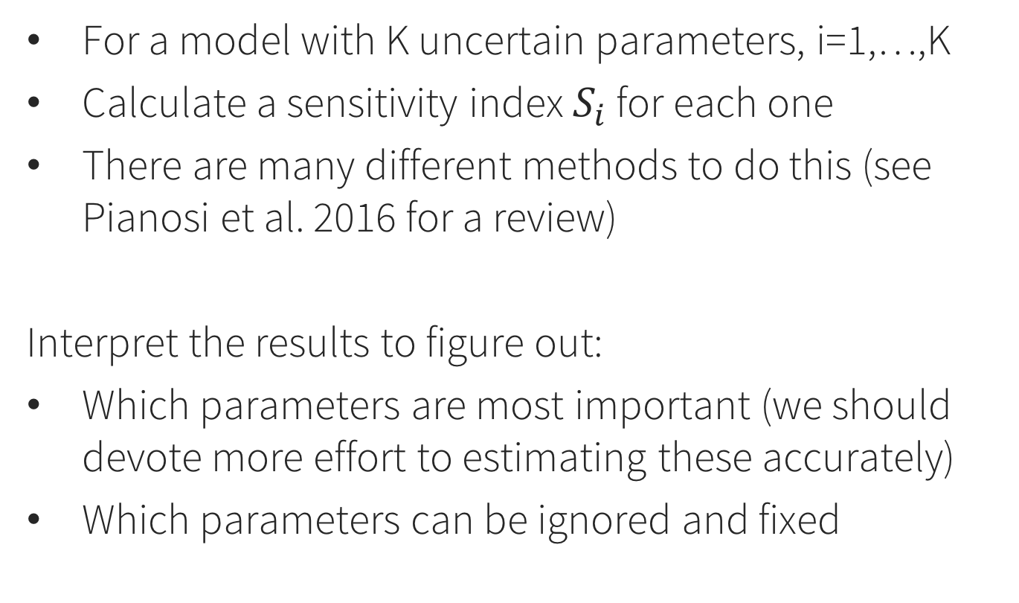
SA: The general idea
For a model with K uncertain parameters, i=1,…,K
Calculate a sensitivity index $S_{i}$ for each one
There are many different methods to do this (see Pianosi et al. 2016 for a review)
Interpret the results to figure out:
Which parameters are most important (we should devote more effort to estimating these accurately)
Which parameters can be ignored and fixed

Slide 7
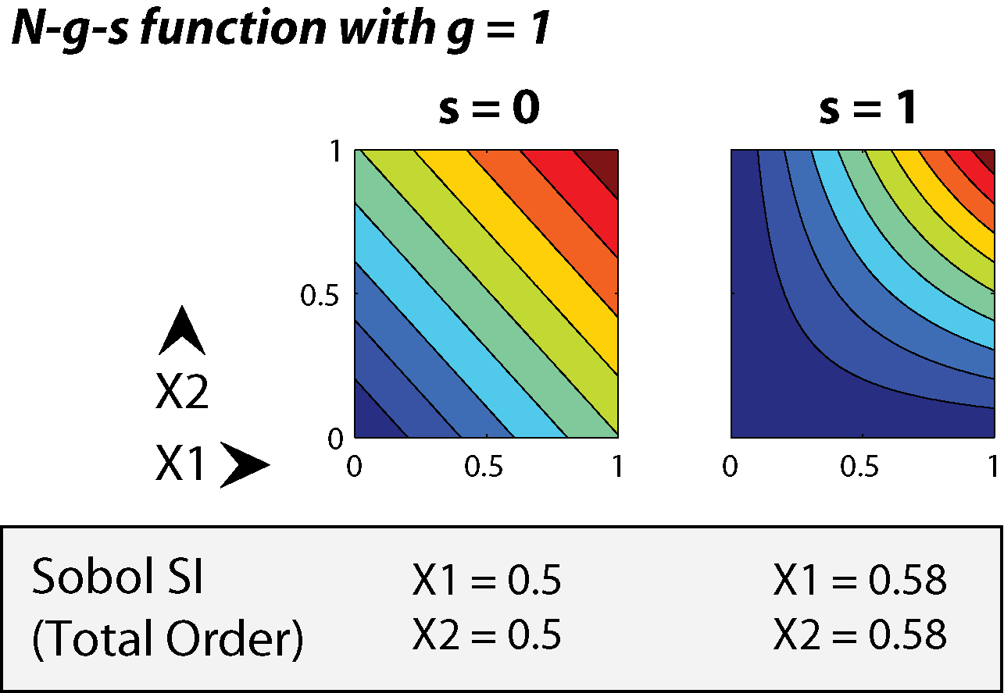
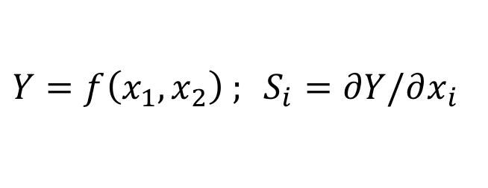
Local SA: Derivatives at a point
$Y=f\left(x_{1},x_{2}\right) ; S_{i}=∂Y/∂x_{i}$
Problem: Which point to use? Misses interactions.

Slide 8

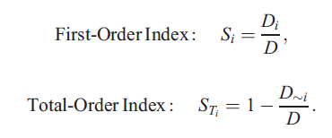
Global SA: Sample throughout the space
Variance Decomposition
These can be estimated with numerical integration of the global sample
→ Saltelli et al. 2008 “Global SA: The Primer”

Slide 9
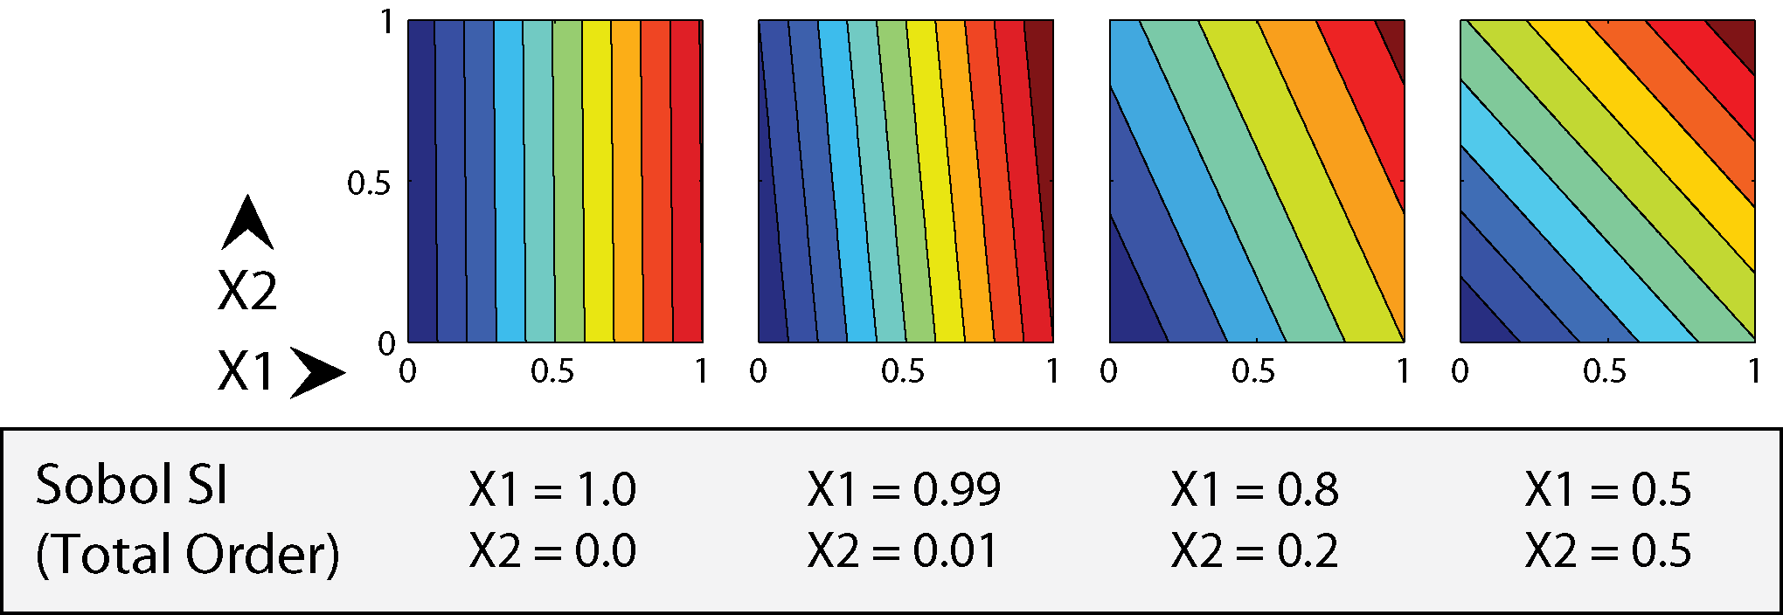
Example Sobol sensitivity indices for linear (separable) functions
No interactions: total-order indices sum to 1

Slide 10
Example Sobol sensitivity indices for separable and non-separable functions
With interactions, sum > 1 because interactions are double-counted

Slide 11
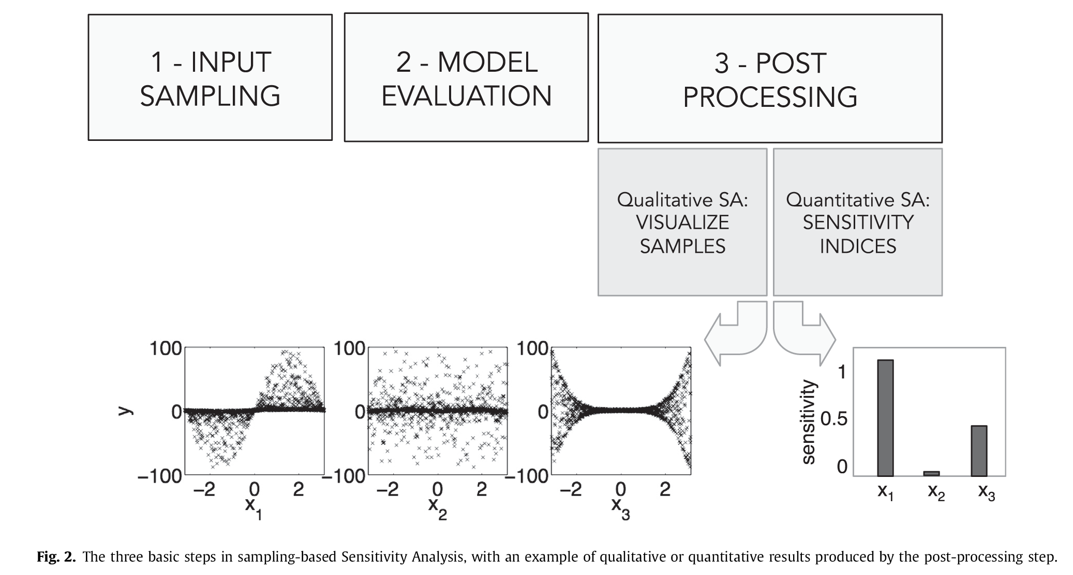
Three main steps (Pianosi et al. 2016)

Slide 12
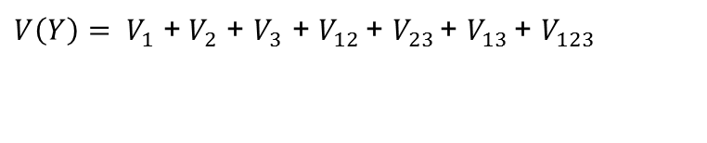
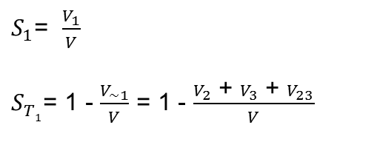
First-order index: the fraction of total variance that a parameter is responsible for by itself
Total-order index: the fraction of total variance that a parameter is responsible for, including interactions with other parameters
For a simple example, with three uncertain parameters:
Total variance:
First order sensitivity index for Parameter 1:
Total order sensitivity index for Parameter 1:

Slide 13
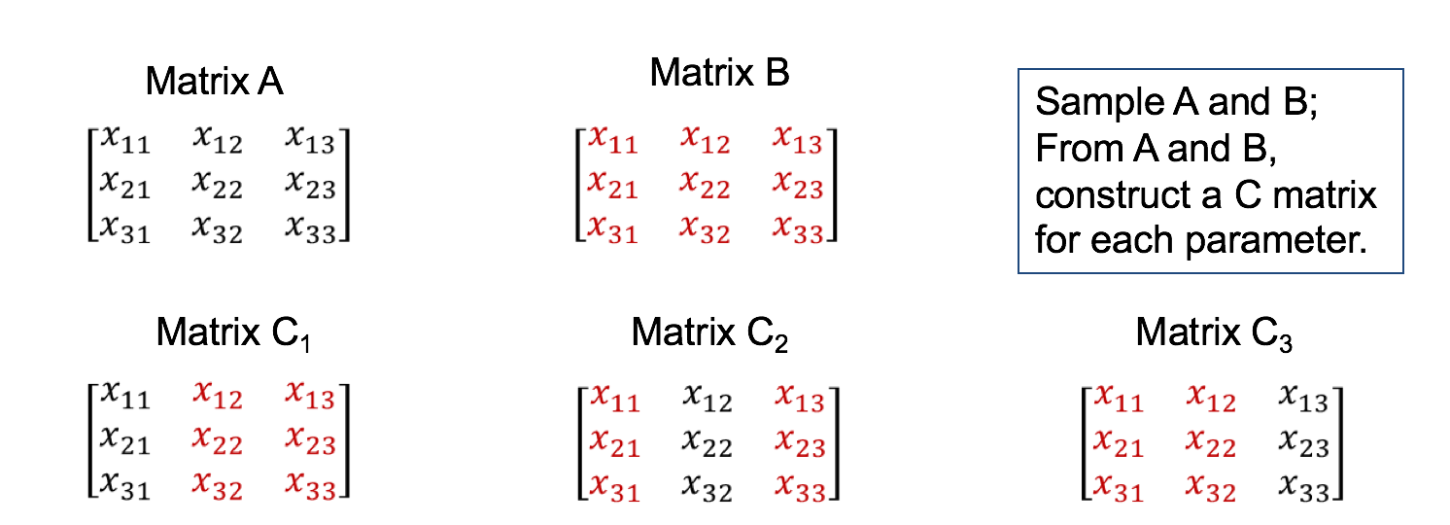
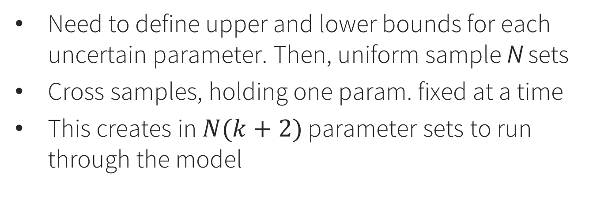
Step 1: Sample parameters (Sobol method)
Need to define upper and lower bounds for each uncertain parameter. Then, uniform sample N sets
Cross samples, holding one param. fixed at a time
This creates in $N(k+2)$ parameter sets to run through the model

Slide 14
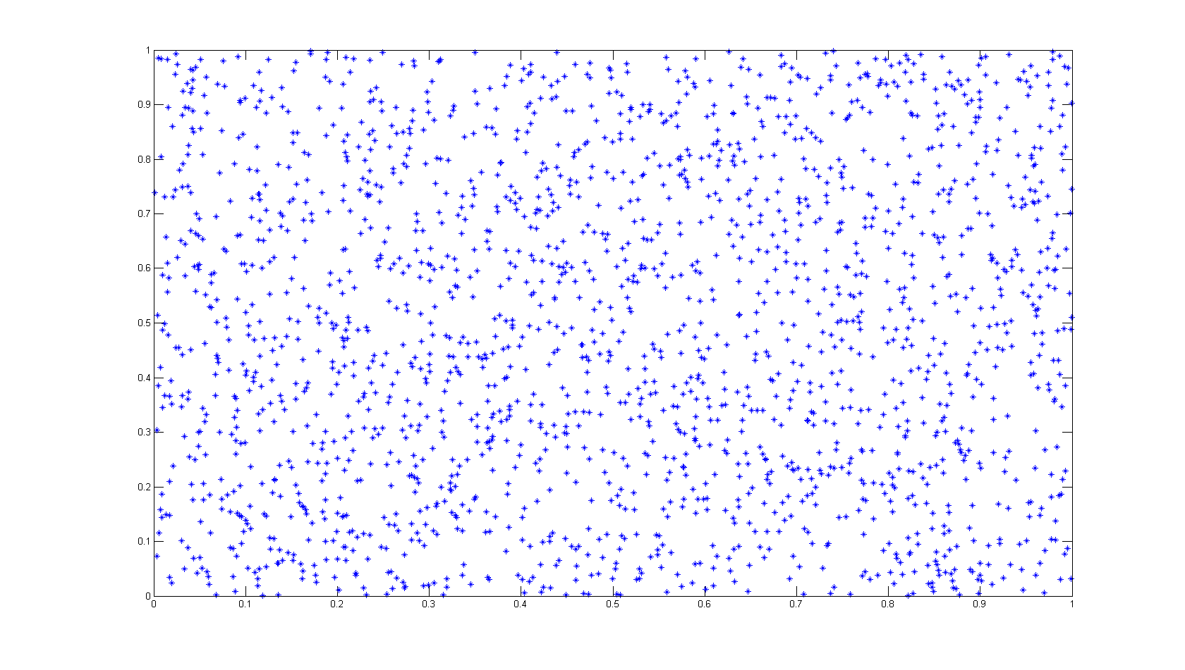
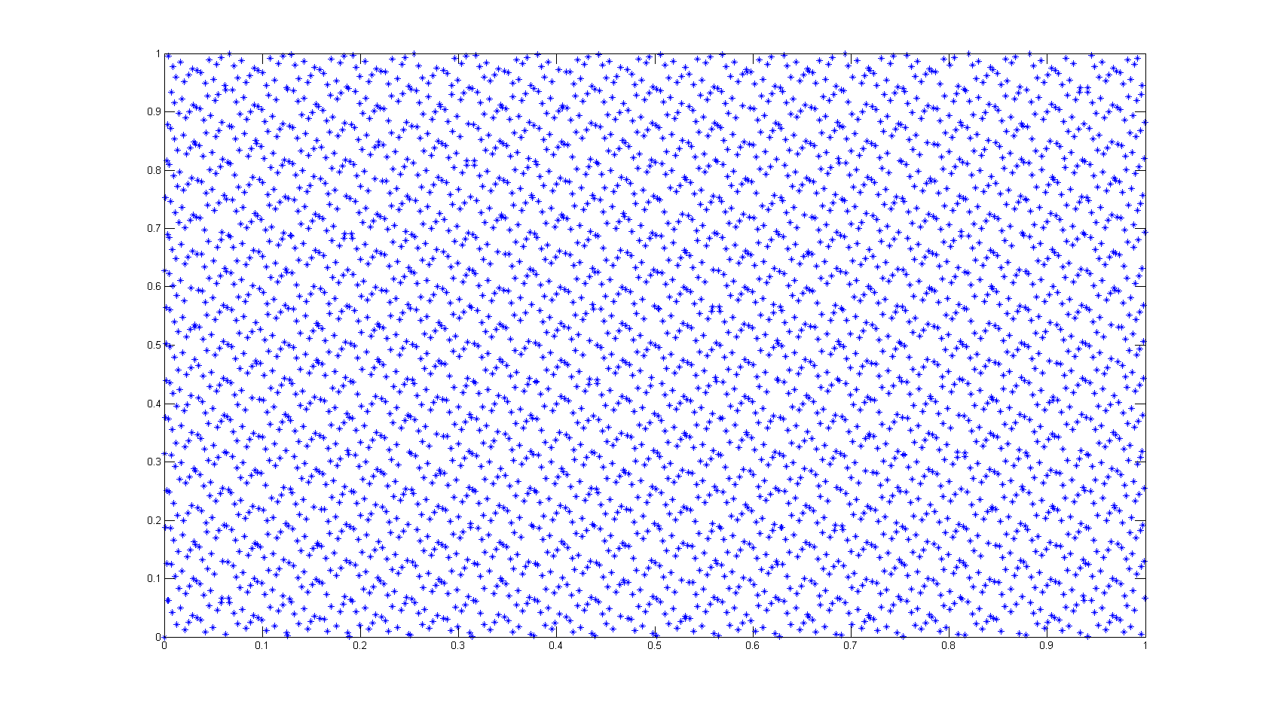
Uniform Random Monte Carlo Sampling vs. Sobol Sequence Sampling (“quasi-random”)
Error Growth Rate
for estimating variance

Slide 15
Step 2: Run your model for all samples in the matrices A, B, and C_*. Save the output Y.
This step is user-specific and decoupled from everything else. Could even be in a different language.

Slide 16
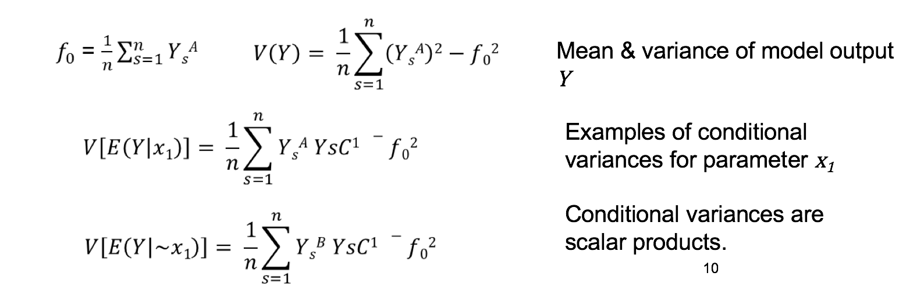
Step 3: Use the model output Y to estimate conditional variances
Different estimators exist. People write papers about which ones are better (i.e., converge faster with N)

Slide 17
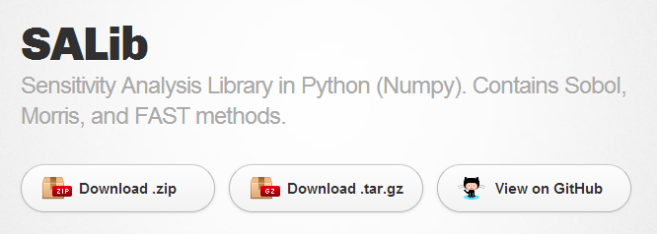
Sensitivity Analysis Library (SALib)
http://SALib.github.io/SALib

Slide 18
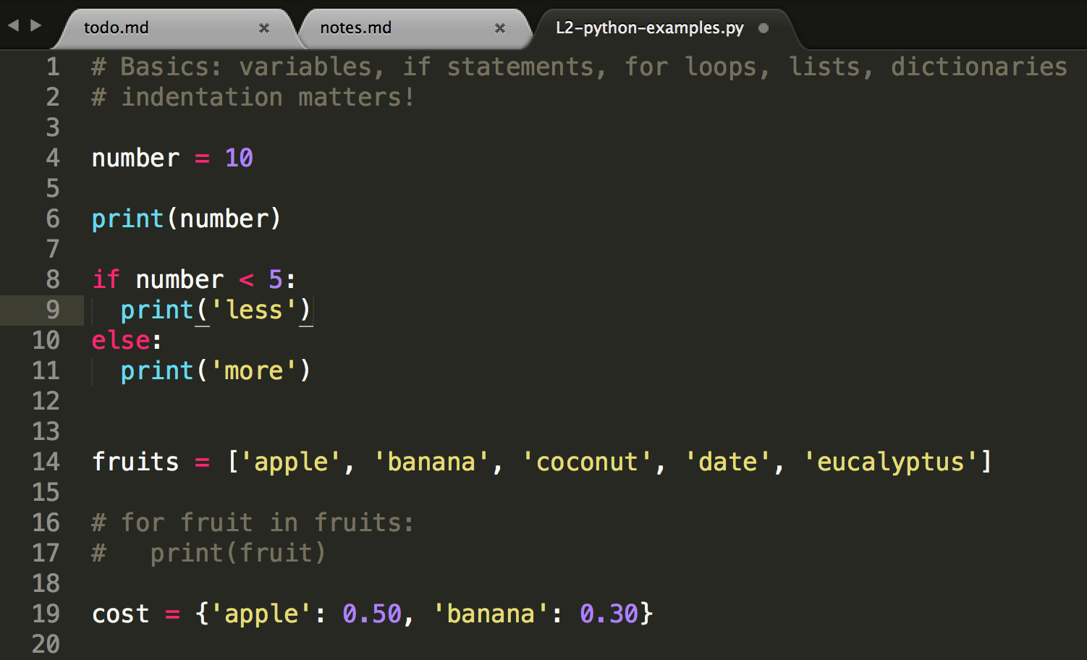

Python
Modern, clean, readable, free, cross-platform
Great libraries for scientific computing
I recommend Anaconda, which contains the Python language and the most common libraries
Get the Python 3 version for your OS
Text editor or IDE?
https://www.continuum.io/downloads

Slide 19
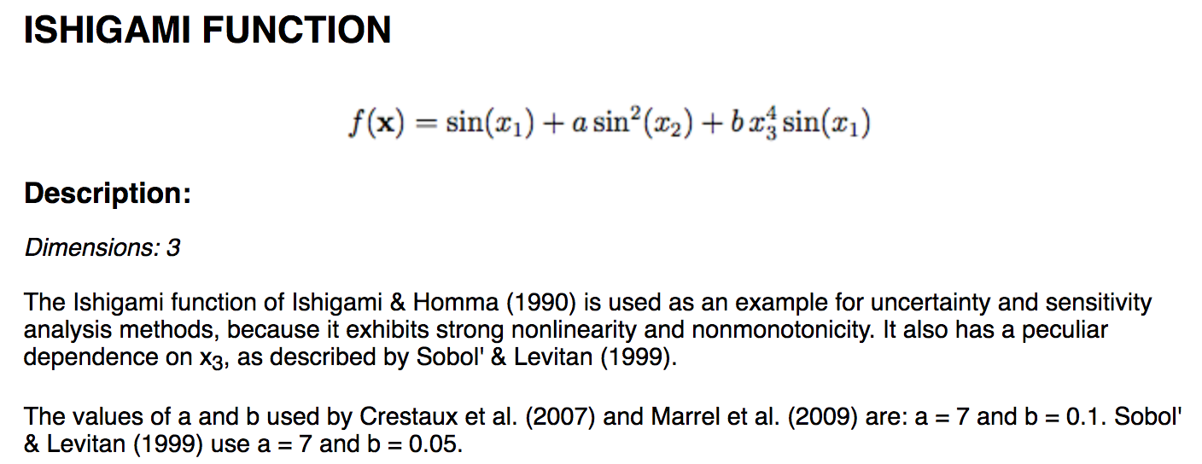
Example: Ishigami function
This is a “test function” used for SA method benchmarking, because we know what the answer should be.

Slide 20
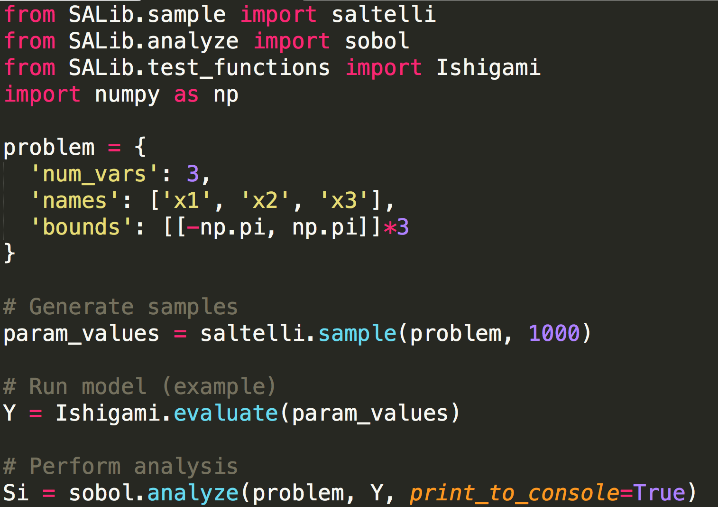
Example
First “pip install SALib” on the command line. Then:

Slide 21
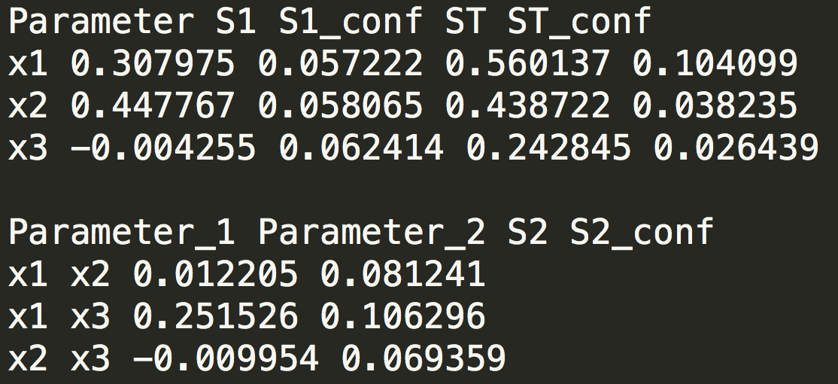
Results: reading the tea leaves
X1 and X3 interact (second-order)
This is reflected in the difference between their respective first- and total-order indices
Confidence intervals should shrink as N increases
Negative values are not possible – they are zero.

Slide 22
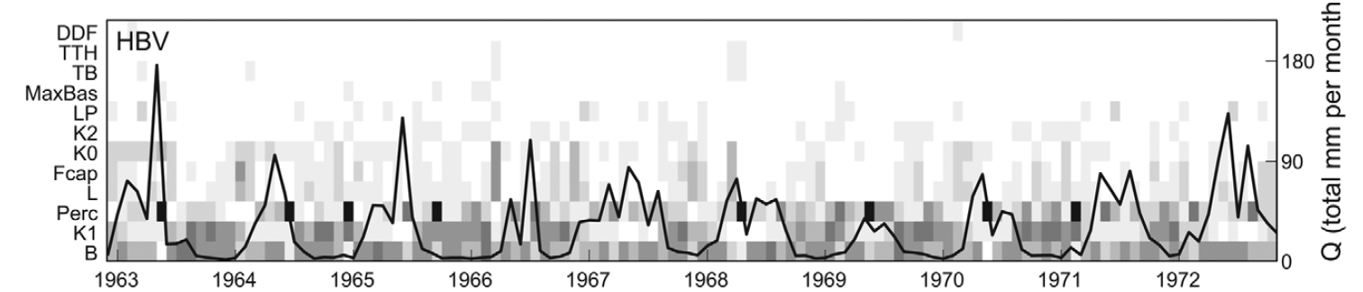
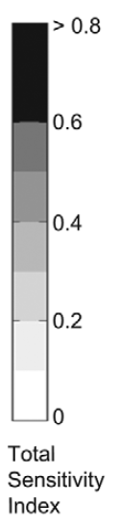
Example results from other studies
From a hydrologic model, at each timestep
It’s common to calculate the sensitivity of model error (RMSE, etc.) to the parameters
Any problems with doing this over a time series of model outputs?

Slide 23
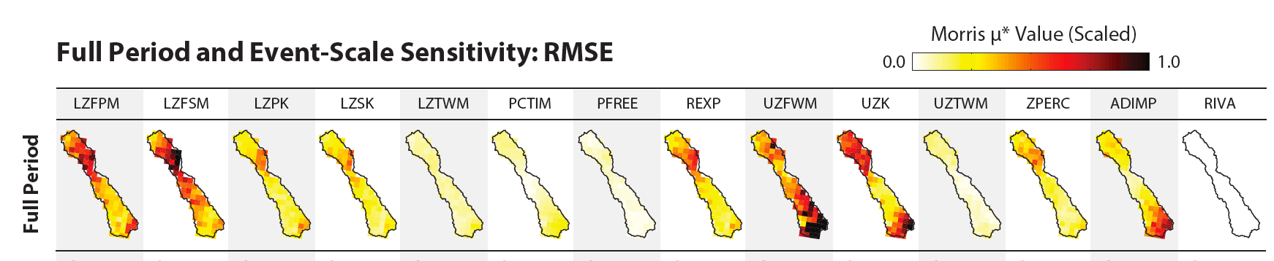
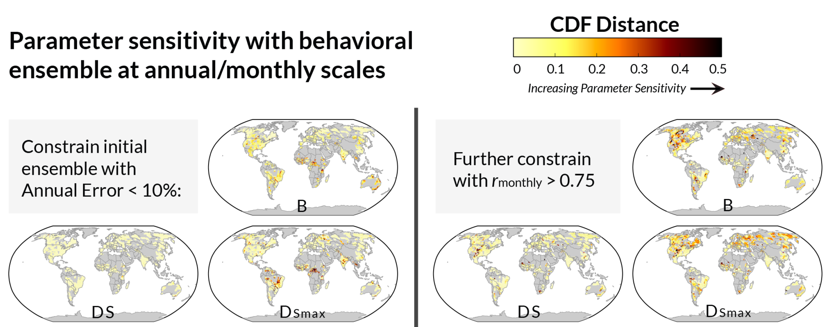
More example results: spatially distributed hydrologic models (watershed & global scale)

Slide 24
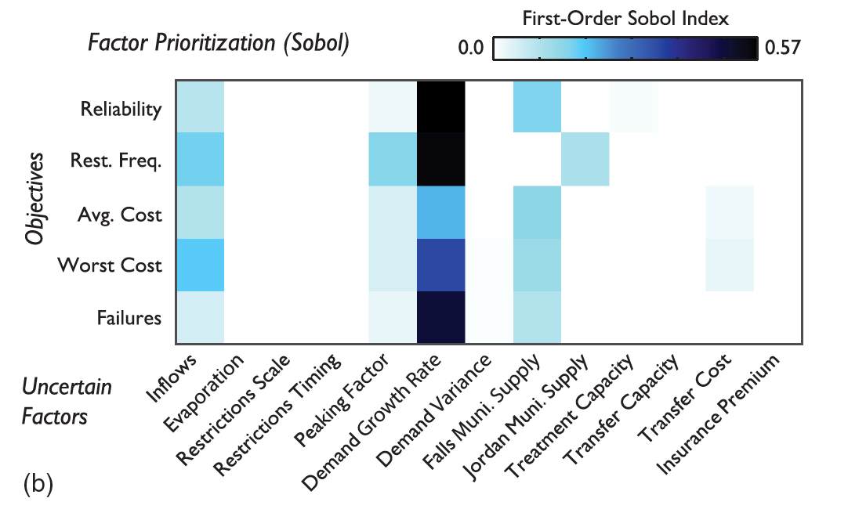
Example results: urban water supply model

Slide 25
Hack time: reactive advection-diffusion model
Important questions:
Which model output should we use?
What are the input parameter ranges?
Do any of them vary over orders of magnitude?
Science happens in here
$$Y=f(x)$$
Uncertain parameters (6 of them, see code)
Model output, $Y$

