Slide 1
Sensitivity Analysis with SALib (Python)
DMDU Tutorial - Nov. 13, 2018
Jon Herman
Civil & Environmental Engineering, UC Davis

Slide 2
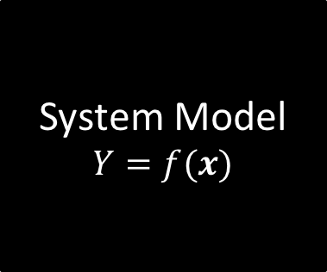
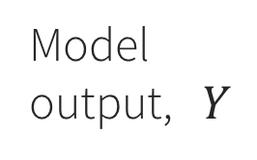
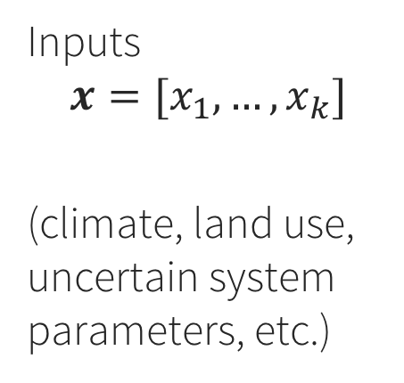
Which uncertain inputs have the most influence on system performance?
System Model
$$Y=f(x)$$
Model output, $Y$
Inputs
$$x=[x_{1},…,x_{k}]$$
(climate, land use, uncertain system parameters, etc.)

Slide 3
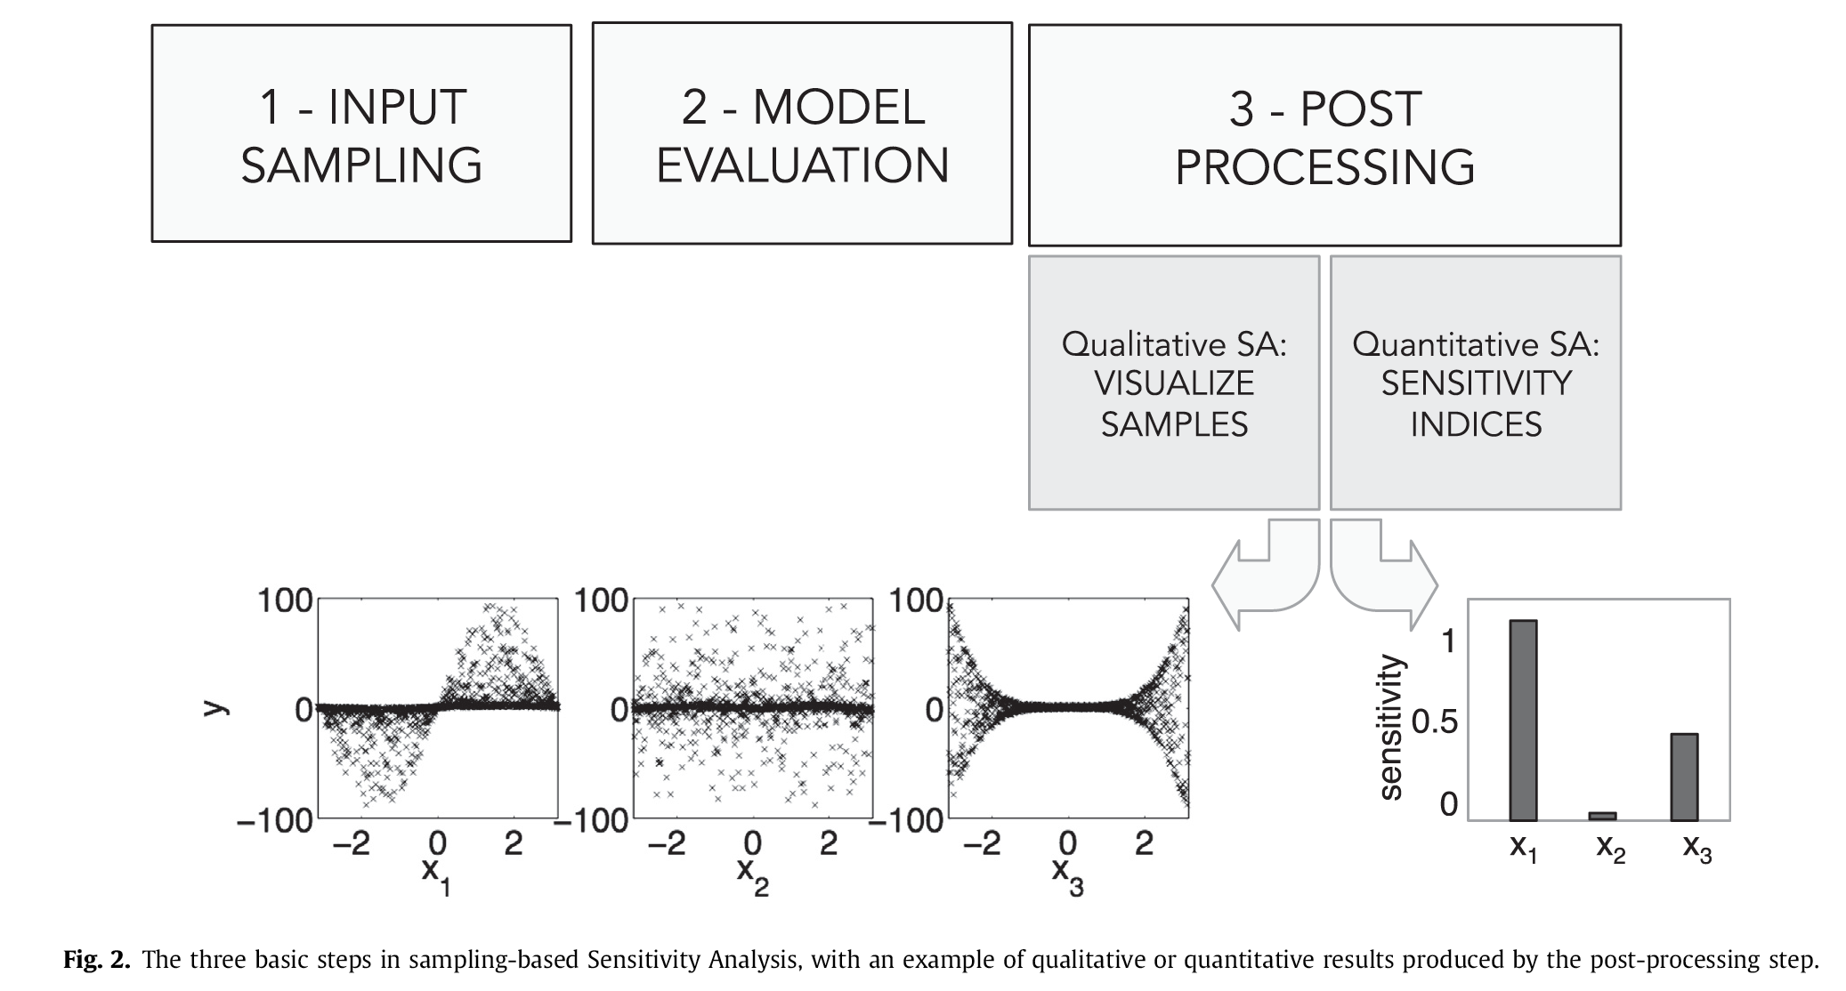
Three main steps (Pianosi et al. 2016)

Slide 4
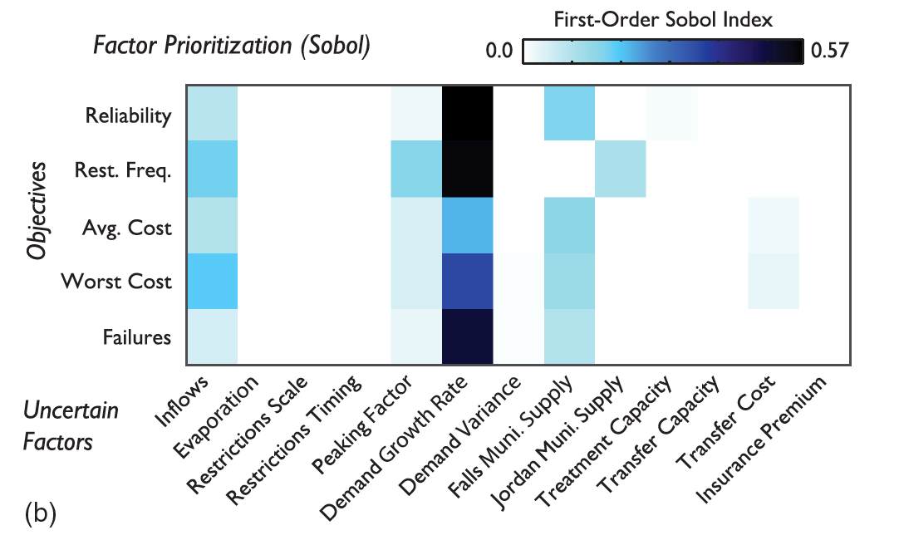
Example results: urban water supply model

Slide 5
Sensitivity Analysis Library (SALib)
Library: https://github.com/SALib/SALib
Installation: pip install SALib
Tutorial materials: https://github.com/jdherman/DMDU-2018-SALib-Tutorial
Requirements: Python, NumPy, SciPy
Tutorial: intro-level, 45 minutes

