Slide 1
Sensitivity Analysis with SALib (Python)
DMDU Tutorial - Nov. 13, 2018
Jon Herman
Civil & Environmental Engineering, UC Davis

Slide 2
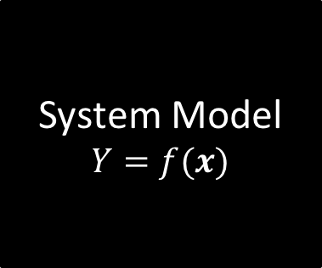
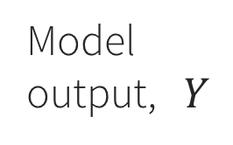
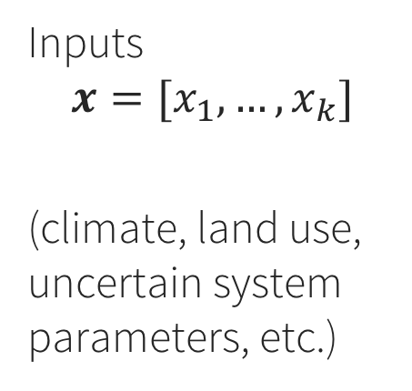
Which uncertain inputs have the most influence on system performance?
System Model
$$Y=f(x)$$
Model output, $Y$
Inputs
$$x=[x_{1},…,x_{k}]$$
(climate, land use, uncertain system parameters, etc.)

Slide 3
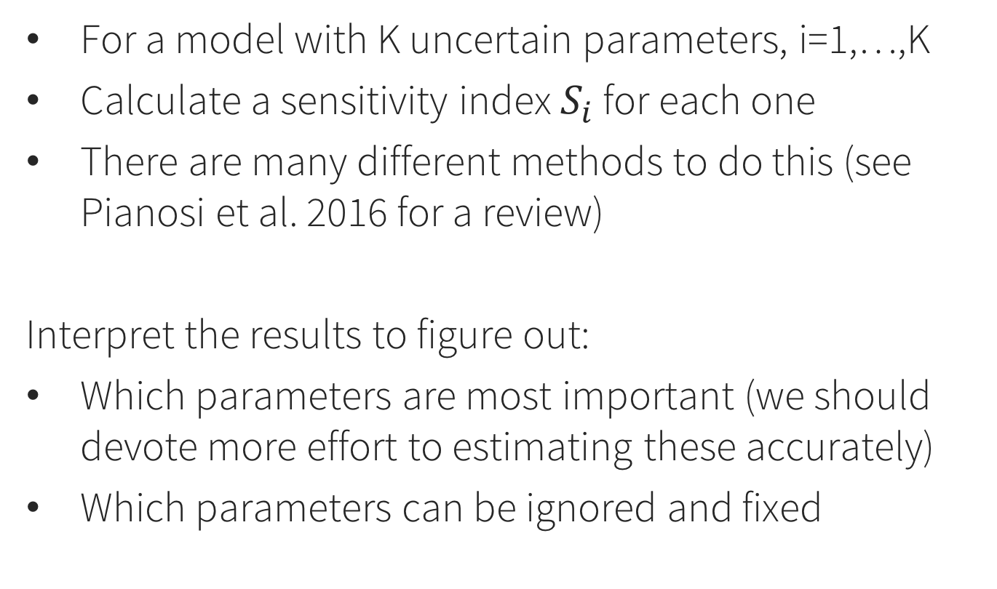
SA: The general idea
For a model with K uncertain parameters, i=1,…,K
Calculate a sensitivity index $S_{i}$ for each one
There are many different methods to do this (see Pianosi et al. 2016 for a review)
Interpret the results to figure out:
Which parameters are most important (we should devote more effort to estimating these accurately)
Which parameters can be ignored and fixed

Slide 4
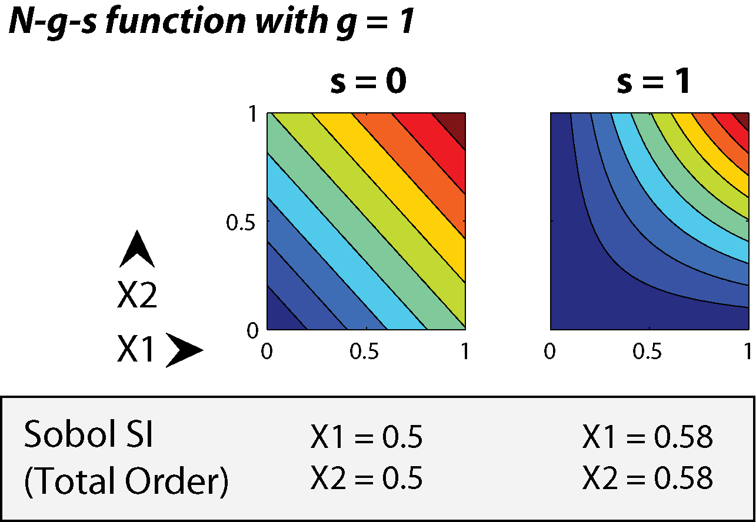
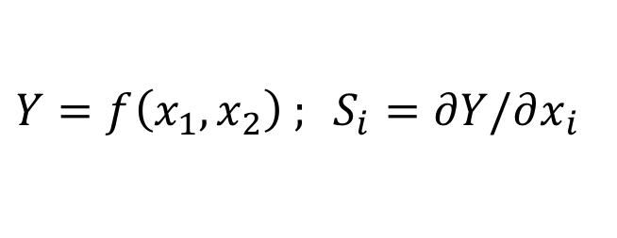
Local SA: Derivatives at a point
$Y=f\left(x_{1},x_{2}\right) ; S_{i}=∂Y/∂x_{i}$
Problem: Which point to use? Misses interactions.

Slide 5

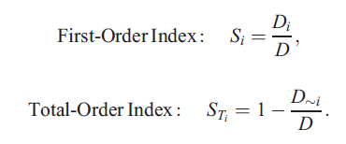
Global SA: Sample throughout the space
Variance Decomposition
These can be estimated with numerical integration of the global sample
→ Saltelli et al. 2008 “Global SA: The Primer”

Slide 6
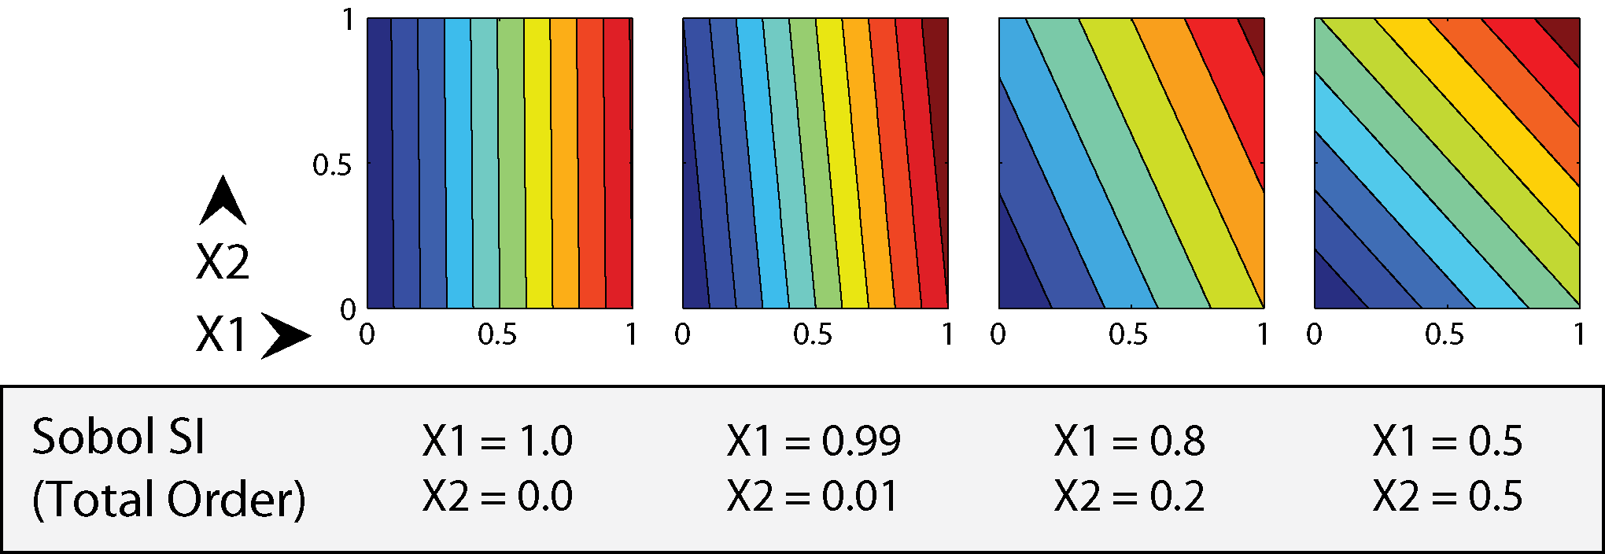
Example Sobol sensitivity indices for linear (separable) functions
No interactions: total-order indices sum to 1

Slide 7
Example Sobol sensitivity indices for separable and non-separable functions
With interactions, sum > 1 because interactions are double-counted

Slide 8
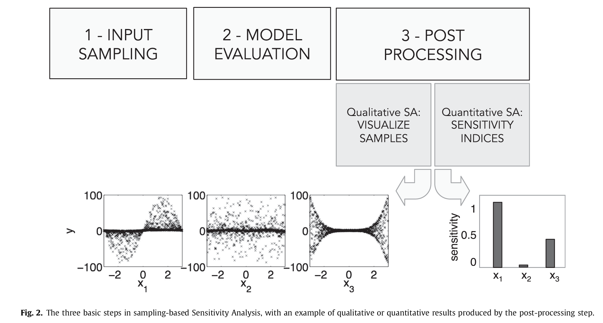
SA: three main steps (Pianosi et al. 2016)

Slide 9
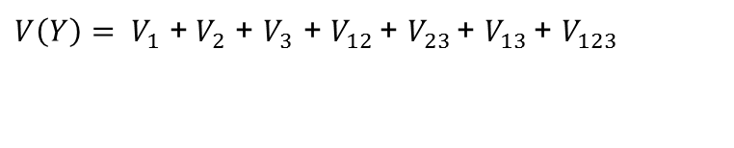
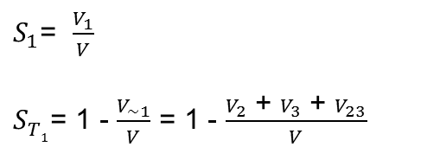
First-order index: the fraction of total variance that a parameter is responsible for by itself
Total-order index: the fraction of total variance that a parameter is responsible for, including interactions with other parameters
For a simple example, with three uncertain parameters:
Total variance:
First order sensitivity index for Parameter 1:
Total order sensitivity index for Parameter 1:

Slide 10
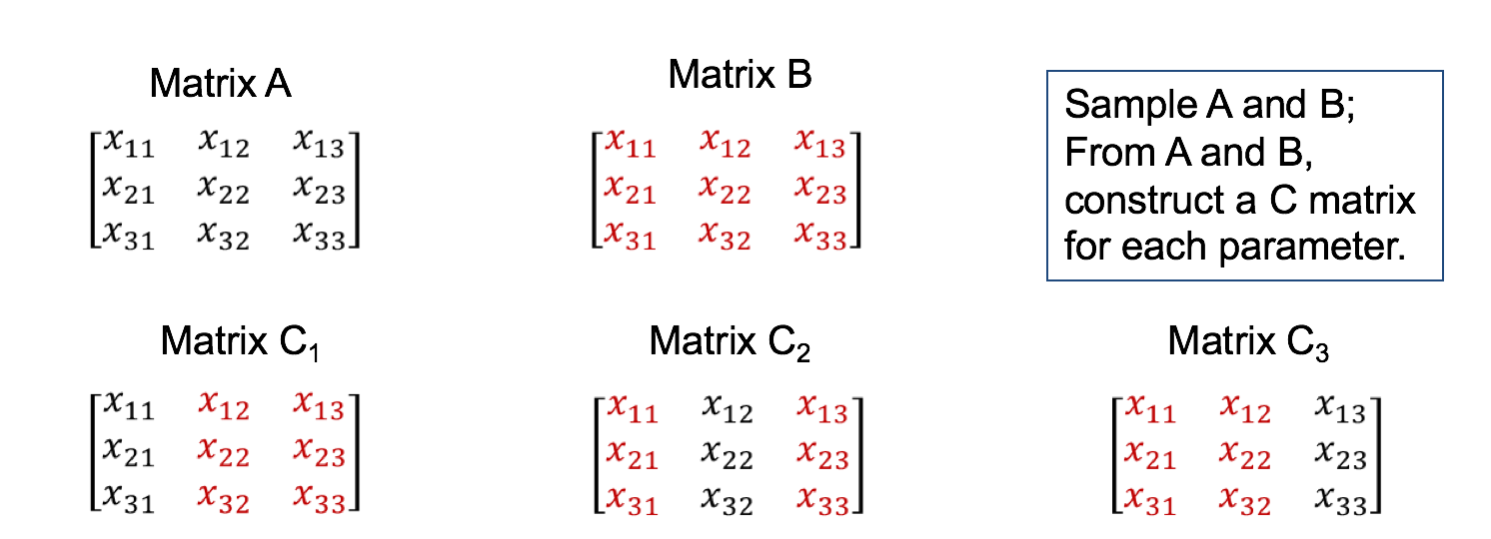
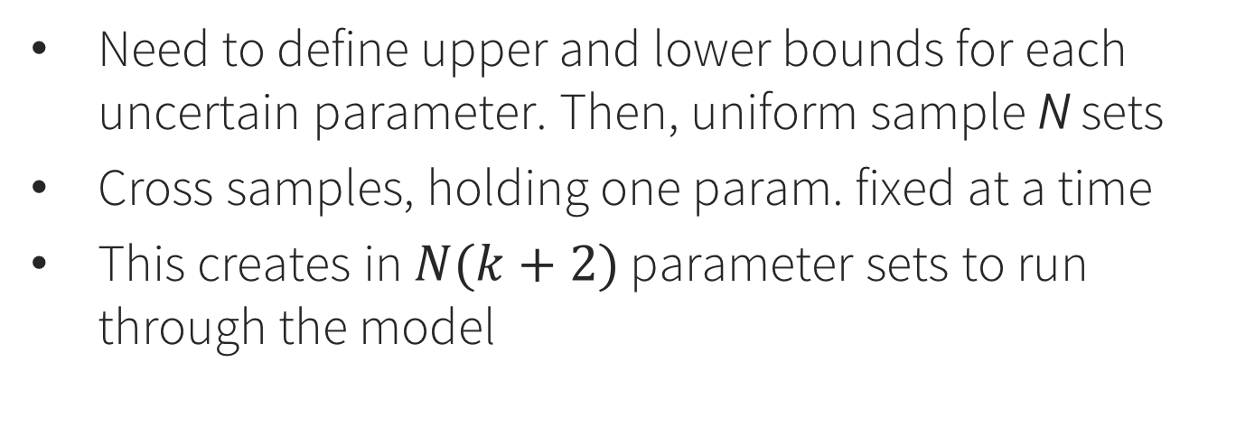
Step 1: Sample parameters (Sobol method)
Need to define upper and lower bounds for each uncertain parameter. Then, uniform sample N sets
Cross samples, holding one param. fixed at a time
This creates in $N(k+2)$ parameter sets to run through the model

Slide 11
Step 2: Run model for all samples in the matrices A, B, and C. Save the output Y.
This step is user-specific and decoupled from everything else. Could even be in a different language.

Slide 12
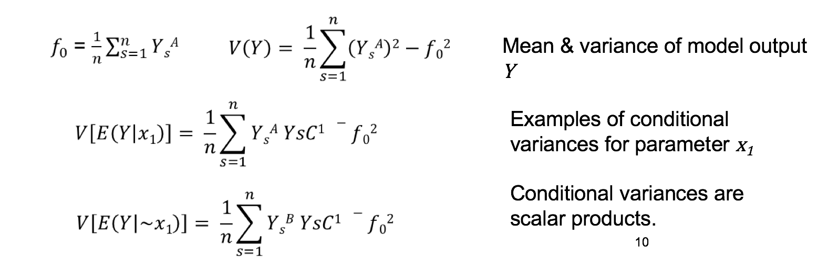
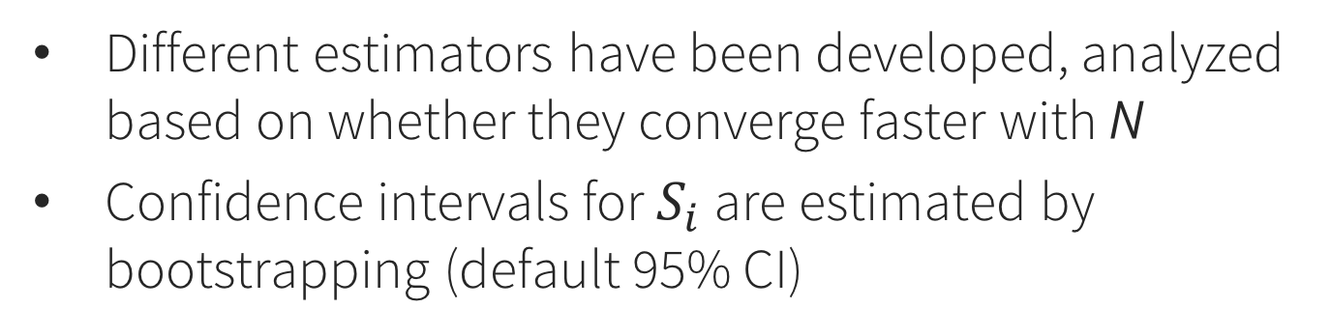
Step 3: Use the model output Y to estimate conditional variances
Different estimators have been developed, analyzed based on whether they converge faster with N
Confidence intervals for $S_{i}$ are estimated by bootstrapping (default 95% CI)

Slide 13

Sensitivity Analysis Library (SALib)
Library: https://github.com/SALib/SALib
Installation: pip install SALib
Tutorial materials: https://github.com/jdherman/DMDU-2018-SALib-Tutorial
Requirements: Python, NumPy, SciPy
https://www.continuum.io/downloads

Slide 14
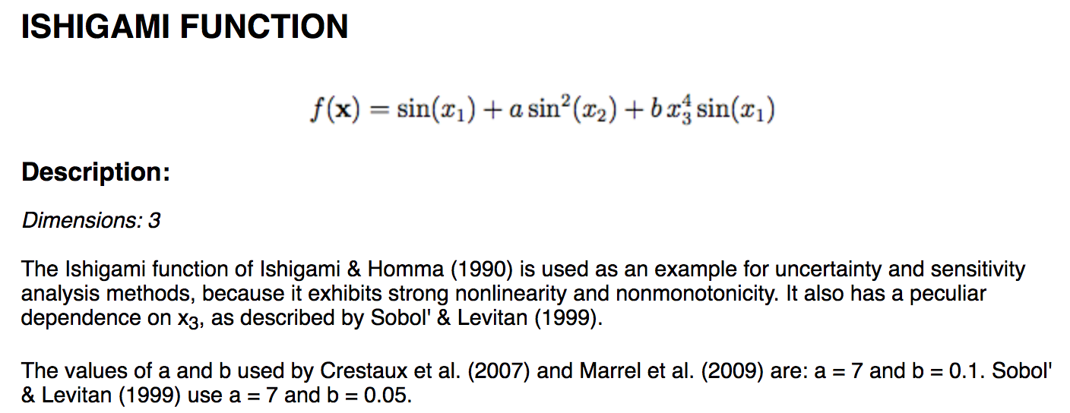
Example: Ishigami function
This is a test function used for SA method benchmarking, because we know what the answer should be.

Slide 15
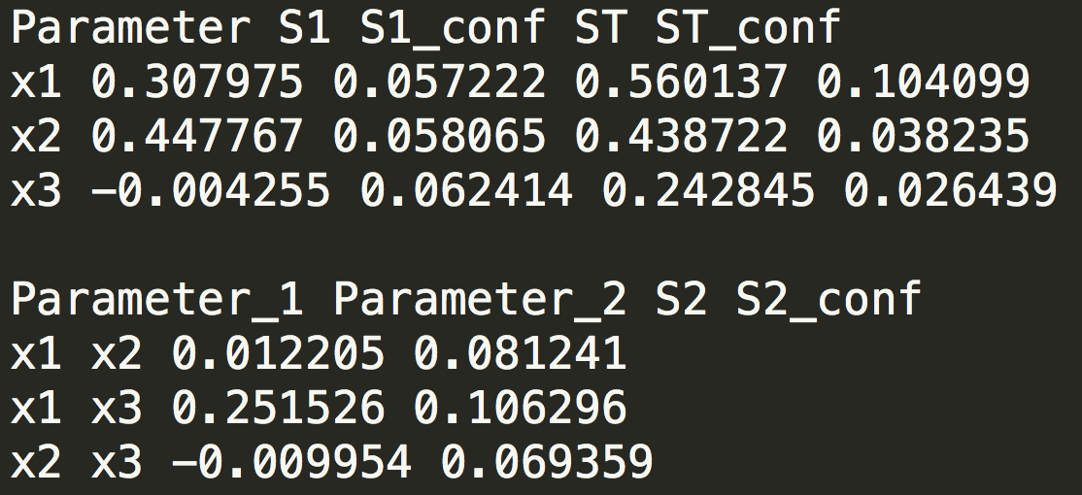
Results: reading the tea leaves
X1 and X3 interact (second-order)
This is reflected in the difference between their respective first- and total-order indices
Confidence intervals should shrink as N increases
Negative values are not possible – they are zero.

Slide 16
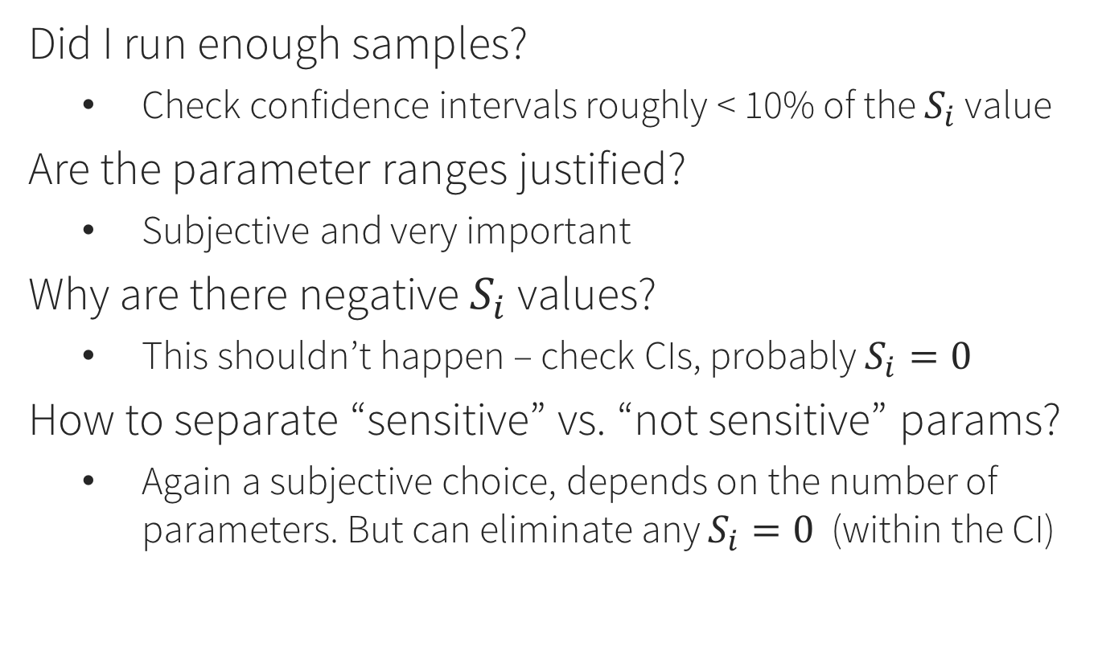
Frequently asked questions
Did I run enough samples?
Check confidence intervals roughly < 10% of the $S_{i}$ value
Are the parameter ranges justified?
Subjective and very important
Why are there negative $S_{i}$ values?
This shouldn’t happen – check CIs, probably $S_{i}=0$
How to separate “sensitive” vs. “not sensitive” params?
Again a subjective choice, depends on the number of parameters. But can eliminate any $S_{i}=0$ (within the CI)

Slide 17
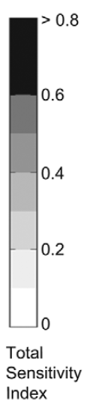
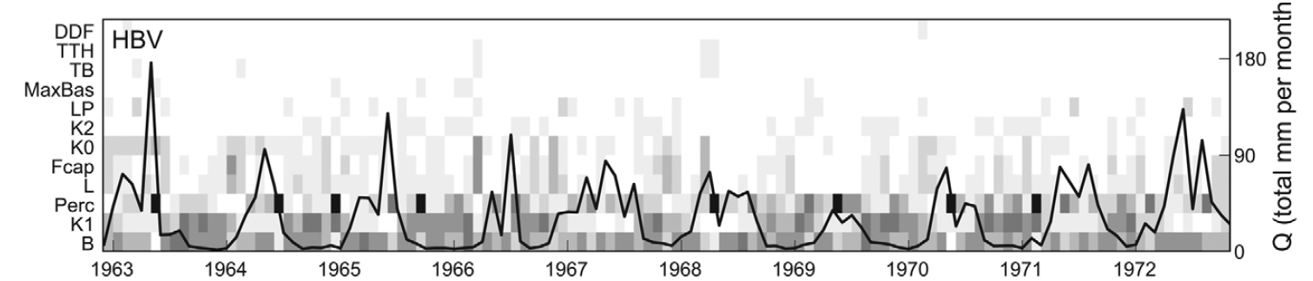
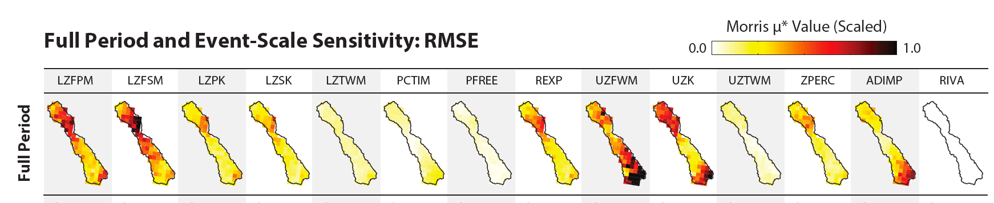
Example results: parameter sensitivity across space/time

Slide 18
Role of SA in decision support
As a model diagnostic: which assumptions need to be refined?
Some inputs are uncertain because they can’t be measured perfectly (e.g. parameters measured within +/- 20%)
Others are uncertain because we simply can’t know them perfectly (e.g. avg.water availability in 50 years)
Relationship to Scenario Discovery methods

