Slide 1
Real time Ai applications
Muhammad Siddiqi
AIMed - AI Department

Slide 2
Good System Design
Clarity & Simplicity
Modularity
Scalability
Maintainability
Flexibility
Reusability
Performance & Efficiency

Slide 3
Communication
Request/Response
Message Queue
Event Streaming/ Event Sourcing
Observer Pattern

Slide 4
Pub/Sub Model
Publish/Subscribe (Pub/Sub) is a messaging pattern where:
Producers (publishers) send messages to a topic.
Consumers (subscribers) listen for messages from that topic.
Publishers and subscribers are decoupled — they don’t know about each other.

Slide 5
Why?
Benefit | Description
🔁 Decoupling | Services don’t need to know each other's logic or location.
📈 Scalability | Multiple subscribers can handle messages in parallel.
⏳ Asynchronous Communication | Services don’t block while waiting for responses.
➕ Extensibility | You can add new subscribers without changing the publisher.
🔍 Maintainability | Easier to isolate and update components independently.

Slide 6
Messaging Systems
Problem | How Messaging Systems Help
❌ Direct dependency between services | ✅ Loosely couples services via topics/queues
❌ Difficult to scale | ✅ Enables horizontal scaling of consumers
❌ Message loss or failure | ✅ Provides durability, retries, and acknowledgements
❌ Tight timing between services | ✅ Supports asynchronous, event-driven workflows
❌ Manual coordination of events | ✅ Automatically routes messages to subscribers

Slide 7
Definitions
Term | Definition
Producer | The component that sends (produces) messages to a messaging system.
Consumer | The component that receives (consumes) messages from the messaging system.
Message | The unit of data sent between producer and consumer, often containing a payload.
Queue | A buffer that stores messages until they are consumed (usually FIFO).
Topic | A named channel to which messages are published (used in publish/subscribe).
Broker | The server that receives, stores, and routes messages (e.g., Kafka, RabbitMQ).
Publish/Subscribe (Pub/Sub) | A messaging model where publishers send messages to topics, and subscribers receive them.
Message Acknowledgement (ACK) | A signal from the consumer to the broker that a message was successfully received.
Dead Letter Queue (DLQ) | A special queue for messages that cannot be processed or delivered.
Retention | How long messages are kept in the system after delivery or consumption.

Slide 8
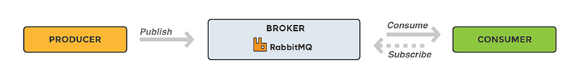
AMQP
Advance Message Queuing Protocol
Enables confirming client applications to communicated with conforming messaging middleware brokers

Slide 9
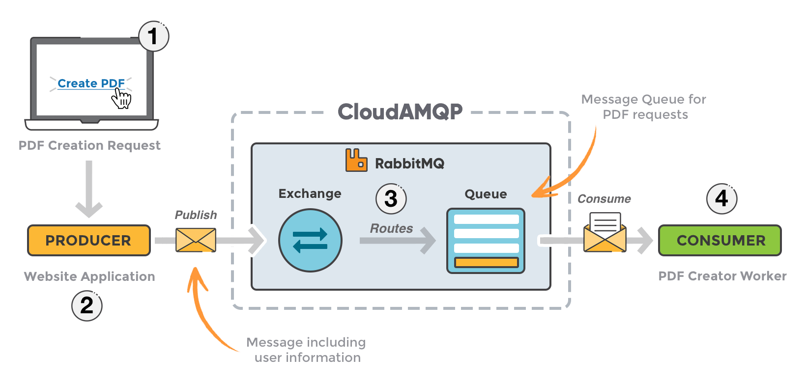

Slide 10
Exchanges
✅ Producers do not send messages directly to queues.
🎯 Messages are sent to an Exchange instead.
🔄 Exchange is responsible for routing messages to appropriate queues.
🔗 Bindings define the relationship between a queue and an exchange.
🗝️ Routing Key is a message attribute used by the exchange to determine routing.
📥 Queues receive messages based on the routing logic configured in the exchange.
🧩 Different exchange types (Direct, Topic, Fanout, Headers) affect routing behavior.

Slide 11
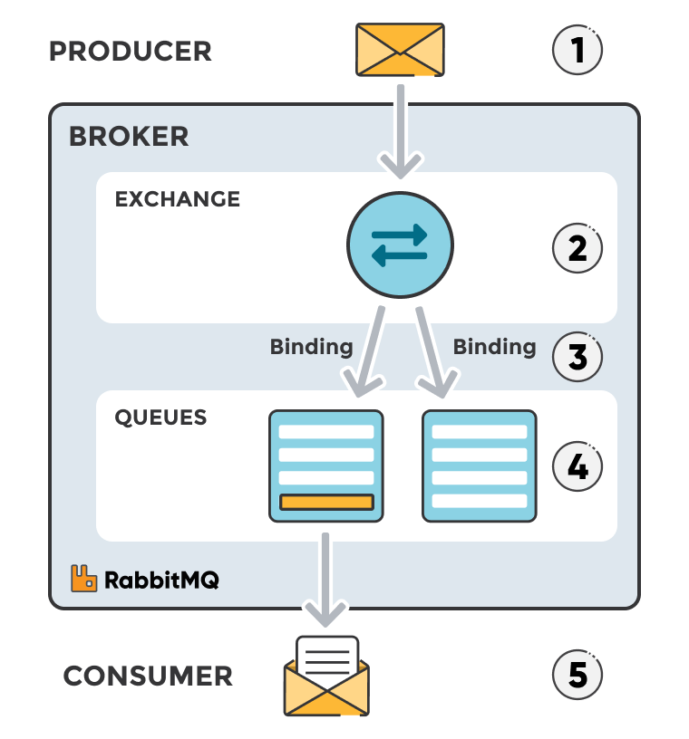
Exchanges

Slide 12
Types of Exchanges
Direct: The message is routed to the queues whose binding key exactly matches the routing key of the message. For example, if the queue is bound to the exchange with the binding key pdfprocess, a message published to the exchange with a routing key pdfprocess is routed to that queue.
Fanout: A fanout exchange routes messages to all of the queues bound to it.
Topic: The topic exchange does a wildcard match between the routing key and the routing pattern specified in the binding.
Headers: Headers exchanges use the message header attributes for routing.

Slide 13
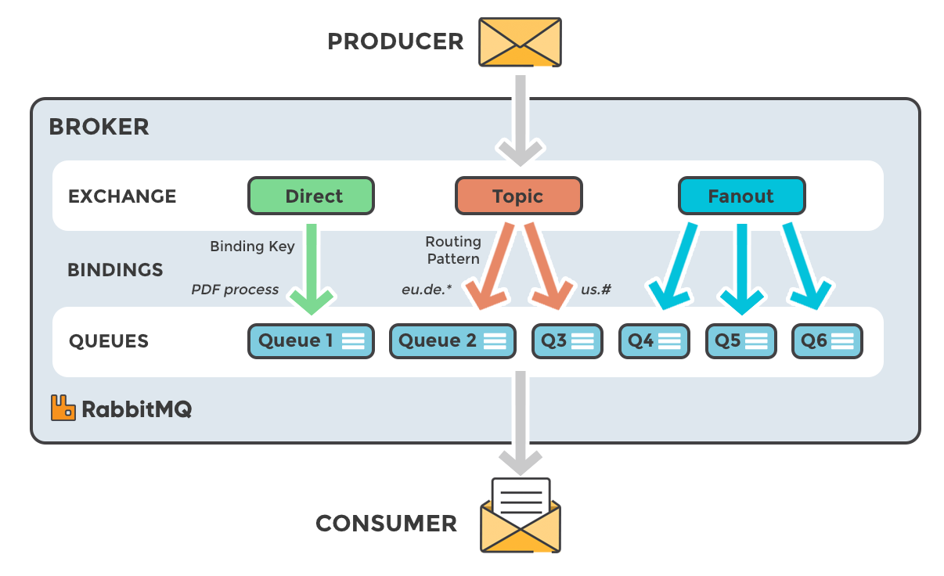
Types of Exchanges

Slide 14
Message Flow
Message Flow – Producer → Exchange → Queue → Consumer
Producer
📨 Sends (publishes) a message
➡️ To: Exchange
Exchange
📦 Receives the message
⚙️ Type is specified on creation (Direct, Fanout, Topic, Headers)
🗝️ Uses message attributes (e.g., routing key)
🔀 Routes message based on:
Exchange type
Routing key
Bindings
3. Bindings
🔗 Connect the exchange to one or more queues
🧭 Direct messages from the exchange to the right queue(s)
4. Queues (2 examples)
🗃️ Store messages until they are consumed
💡 Queues are passive — they don’t pull, they wait for consumers
5. Consumers (1 per queue)
🧑‍💻 Retrieve and process the message
✅ Acknowledge successful handling (ACK)

Slide 15
ACK
By default, when RabbitMQ delivers a message to a consumer, it does not immediately remove it from memory.
Instead, RabbitMQ waits for an acknowledgment (ack) from the consumer.
❓ But what happens if the message goes to a worker and fails to process correctly?
If no ack is received, RabbitMQ assumes the message was not processed and re-queues it for another consumer.
✅ An acknowledgment (ack) is sent from the consumer to RabbitMQ to confirm that:
The message was received and processed successfully.
RabbitMQ can now safely delete the message from memory or disk.

Slide 16
Celery
What is Celery?
A distributed task queue for running background jobs asynchronously.
Written in Python, designed to work with brokers like RabbitMQ or Redis.

Slide 17
Why?
Why Do We Need Celery If We Have RabbitMQ?
RabbitMQ only delivers messages — it doesn't know what to do with them.
Celery adds the logic: it defines tasks, executes them, retries on failure, and stores results.
You focus on writing Python tasks, Celery handles:
📬 Background Task Execution
🔁 Automatic Retries on Failure
🧱 Task Chaining & Workflows
🕒 Periodic Task Scheduling
✅ Result Storage & Tracking
📈 Horizontal Scalability with Multiple Workers

Slide 18
Kafka
Kafka is a distributed event streaming platform.
Used to build real-time data pipelines and streaming applications.
Designed for high-throughput, low-latency, scalable, and fault-tolerant messaging.
Kafka is Used For:
🛰️ Ingesting real-time data (logs, metrics, user activity)
🔁 Decoupling producers and consumers at massive scale
🧩 Building event-driven architectures
📊 Streaming analytics and data pipelines

Slide 19
Kafka Vs RabbitMQ
Feature | Kafka | RabbitMQ
Use Case | High-throughput event streaming | Traditional messaging & task queues
Message Storage | Durable, persisted for long periods | Temporary (until consumed or expired)
Message Retention | Time- or size-based retention | Usually deleted after consumed
Delivery Model | Pull-based | Push-based
Ordering | Per-partition ordering | Per-queue ordering
Built-in Replay | ✅ Yes (via offsets) | ❌ No (unless manually handled)

Slide 20
Fundamentals
Producer: Publishes messages to a Topic
Topic: A category or feed name where messages are stored
Partition: A topic is split into partitions to scale across servers
Consumer: Subscribes to a topic and reads messages
Consumer Group: Enables load-balanced consumption
Broker: A Kafka server that stores and serves data
Offset: A unique, monotonically increasing ID for each message within a partition.

Slide 21
Fundamentals
Kafka Cluster: A group of brokers working together to form a Kafka system.
Replication: Each partition can have replicas across multiple brokers for fault tolerance.
Retention: Kafka retains messages for a configurable time (e.g., 7 days), regardless of whether they've been consumed.
Kafka is a scalable, distributed log system for building real-time streaming data pipelines and event-driven architectures.

Slide 22
Architecture
Consumer
Group A
Kafka Cluster
Consumer 1
Pull Msg
Consumer 2
Producer 1
Broker 1
Push Msg
Broker 2
Consumer 3
Producer 2
Producer 3
Broker 3
Consumer
Group B
Pull Msg
Zookeeper
Consumer 1
Consumer 2

Slide 23
Partitioning in Kafka Topics
Partitions are the unit of parallelism and scalability.
Each partition is an ordered, immutable log of records.
Producers send messages using keys to preserve order per key.
Consumers in a group are assigned unique partitions.
Partitions are replicated across brokers (controlled by replication factor).
One leader handles reads/writes; followers replicate data.
Ensures high availability and fault tolerance via ISR (In-Sync Replica).

Slide 24
Kafka Delivery Guarantees
At Most Once: No retry, may lose messages.
At Least Once: Retries possible, may duplicate.
Exactly Once: Reliable, no duplicates with idempotence & transactions.

Slide 25
Redis
Redis = Remote Dictionary Server
An in-memory, key-value data store
Can be used as a cache, message broker, database, or task queue

Slide 26
Features
🧠 In-memory: Extremely fast reads/writes
🔁 Persistence: Optional disk storage (RDB or AOF)
🧵 Pub/Sub: Native support for messaging patterns
🔐 Atomic operations: Perfect for counters, queues, locks
♻️ Data structures: Strings, Lists, Sets, Hashes, Sorted Sets, Streams

Slide 27
Common Use Cases
⚡ Caching (e.g., session storage, API results)
📬 Message brokering (used by Celery, Resque)
🛠️ Task queues (for async job processing)
📊 Real-time analytics (e.g., leaderboard, counters)
🗝️ Distributed locks and semaphores

Slide 28
Data Structures
Type | Use Case
String | Simple key-value (e.g., user_id → name)
List | Task queues (LPUSH, RPOP)
Set | Unique items (tags, followers)
Hash | Object-like structures
Sorted Set | Leaderboards, ranked data
Stream | Log-like event storage

Slide 29
Example (Inference Request via Kafka)
📥 Client makes a request
🚪 REST API entry point
📤 Sending the request to Kafka
🧠 Worker consuming from Kafka & performing inference
📦 Sending the result back
📬 Client receives the response

Slide 30
Client Sends REST Request
A client (web/mobile) sends an HTTP POST request like:
POST /predict
Content-Type: application/json
{
"input_data": [ ... ]
}

Slide 31
REST API Receives Request
Your REST API:
Parses the input
Serializes the message
Publishes it to a Kafka topic (e.g., inference_requests)
Optionally, generates a unique request ID or correlation ID
kafka_producer.send(
topic='inference_requests',
key=correlation_id,
value=request_payload
)

Slide 32
Kafka Broker Delivers Message
Kafka stores the message in a partition under inference_requests.
Kafka ensures durability and order (within partitions).

Slide 33
Worker Consumes & Performs Inference
A Kafka consumer (worker) reads from inference_requests topic.
It:
Parses the payload
Runs model inference (e.g., loading a PyTorch or TensorFlow model)
Generates the result
result = model.predict(input_data)

Slide 34
Client receives the response
Option A: Synchronous Response (Blocking until inference finishes)
Suitable if inference is fast (e.g., <2 seconds)
After producing to Kafka, the API waits for result on another topic (e.g., inference_responses)
You use correlation ID to match the result to the request

Slide 35
Client receives the response
Option B: Asynchronous Response (Recommended for long inference)
API returns a 202 Accepted immediately with a task_id or correlation_id
{
"status": "processing",
"task_id": "abc123“
}

Slide 36
Client receives the response
Worker publishes result to a different Kafka topic (inference_responses) or saves it in Redis/DB.
GET /predict/abc123
{
"status": “completed",
"task_id": "abc123“,
"results": {…}
}

Slide 37
Client receives the response
Worker publishes result to a different Kafka topic (inference_responses) or saves it in Redis/DB.
GET /predict/abc123
{
"status": “completed",
"task_id": "abc123“,
"results": {…}
}

Slide 38
Reliable AI Systems
Redis: low‑latency cache, ephemeral data, counters, lightweight pub/sub, streams
RabbitMQ: reliable messaging (ack/retry), routing via exchanges, classic work queues
Celery: distributed task execution; uses a broker (RabbitMQ/Redis) + result backend
Kafka: durable event log, high‑throughput streaming, replayability, consumer groups
Rule of thumb: cache → Redis, tasks → Celery, routing → RabbitMQ, streams/events → Kafka

