Slide 1
Suffix Arrays
Sidhant Bansal
Credits: CP-Algorithms, VisuAlgo, Stanford Lecture Notes, MIT ICPC Notebook

Slide 2
Agenda
What is SA?
How to think of it as a blackbox?
How do we construct it?
Applications

Slide 3
What is SA?

Slide 4
What is a Suffix Array data structure?
Let s be a string of length n. The i-th suffix of s is the substring s[i…n−1].
A suffix array will contain integers that represent the starting indexes of the all the suffixes of a given string, after the aforementioned suffixes are sorted.

Slide 5
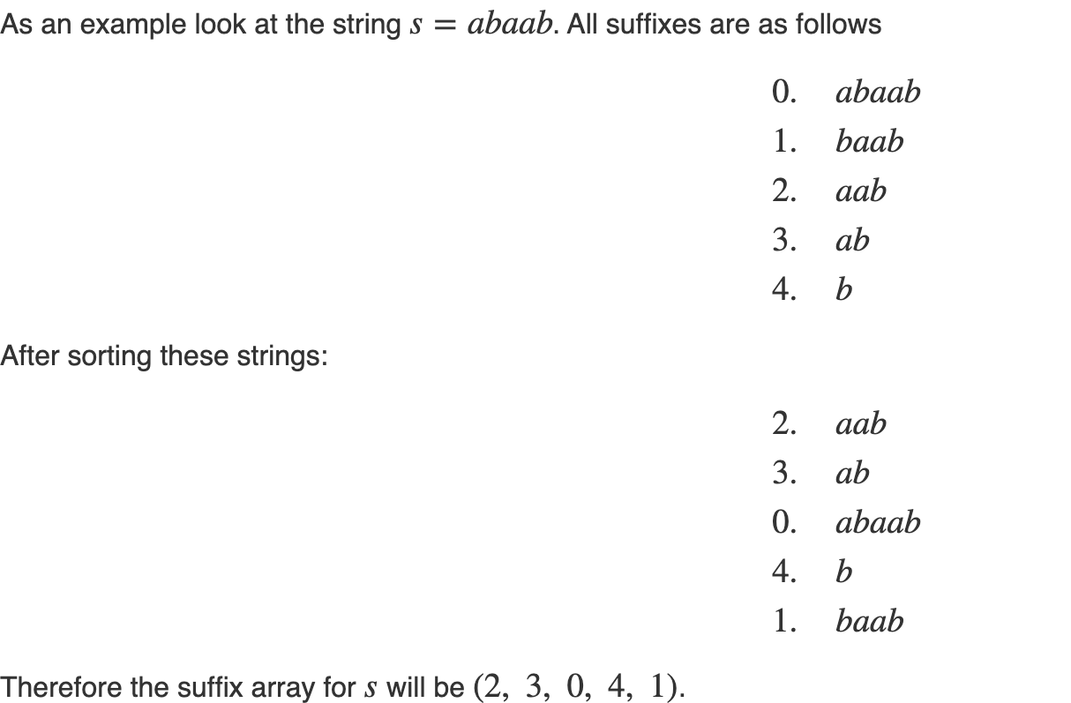
Example:
Credits: CP-Algorithms

Slide 6
Poll Question
Given S = “AGABCTS$”, assume $ < A < B < … < Z
In the suffix array, what will be the 4th entry?
ABCTS$
GABCTS$
CTS$
BCTS$

Slide 7
How to think of it like a black-box?

Slide 8
Pro-tips
Never try to code SA from scratch in a contest/timed environment
Always use book code. CP3 Book Code, MIT ICPC Team Book Code
Understand the high level idea behind it, but when dealing with questions involving SA, best is to think of it like a black-box.

Slide 9
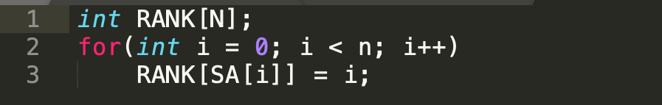
What is the Black-box?
SA[i] denotes the starting index of the suffix which is i^{th} in the sorted suffixes order.
Knowing SA[i] you can also create RANK[i] which denotes where does the suffix of the form S[i...n] go to in the sorted order

Slide 10
LCP Array (LCP = Longest Common Prefix)
For a lot of problems you require to be able to tell the following:
For any two suffixes, you should be able to tell what is the LONGEST COMMON PREFIX between these two suffixes.

Slide 11
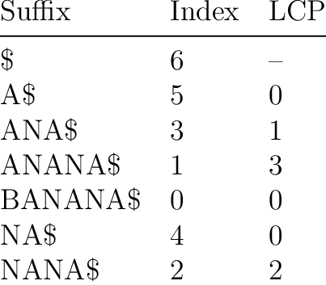
How to make this?
Let LCP[i] denote the LCP between SA[i] and SA[i - 1], i.e the Longest Common Prefix between i^{th} and (i - 1)^{th} suffix when they are put in sorted order.

Slide 12
So what will be LCP(i, j) ?
Let LCP(i, j) = longest common prefix between SA[i] and SA[j].
Then which one will it be:
LCP(i, j) = max(LCP[i + 1], LCP[i + 2], ... , LCP[j])
LCP(i, j) = min(LCP[i + 1], LCP[i + 2], …, LCP[j])
LCP(i, j) = sum(LCP[i + 1], LCP[i + 2], …, LCP[j])
LCP(i, j) = min(LCP[i + 1], LCP[j])

Slide 13
What is the full Black-box?
SA[i] denotes the starting index of the suffix which is i^{th} in the sorted suffixes order.
LCP[i] denotes the longest common prefix between SA[i] and SA[i - 1]
Knowing SA[i] you can also create RANK[i] which denotes where does the suffix of the form S[i...n] go to in the sorted order.
Once you have these two arrays (in O(NlogN) or O(Nlog²N)), then you have ALL that is needed by this data structure for > 90% of SA-related problems.

Slide 14
How do we construct it?

Slide 15
How do we make it?
Slow Method: O(N² log N)
Fast Method: O(N log² N) (We will cover this primarily)
Fastest Method: O(NlogN)

Slide 16
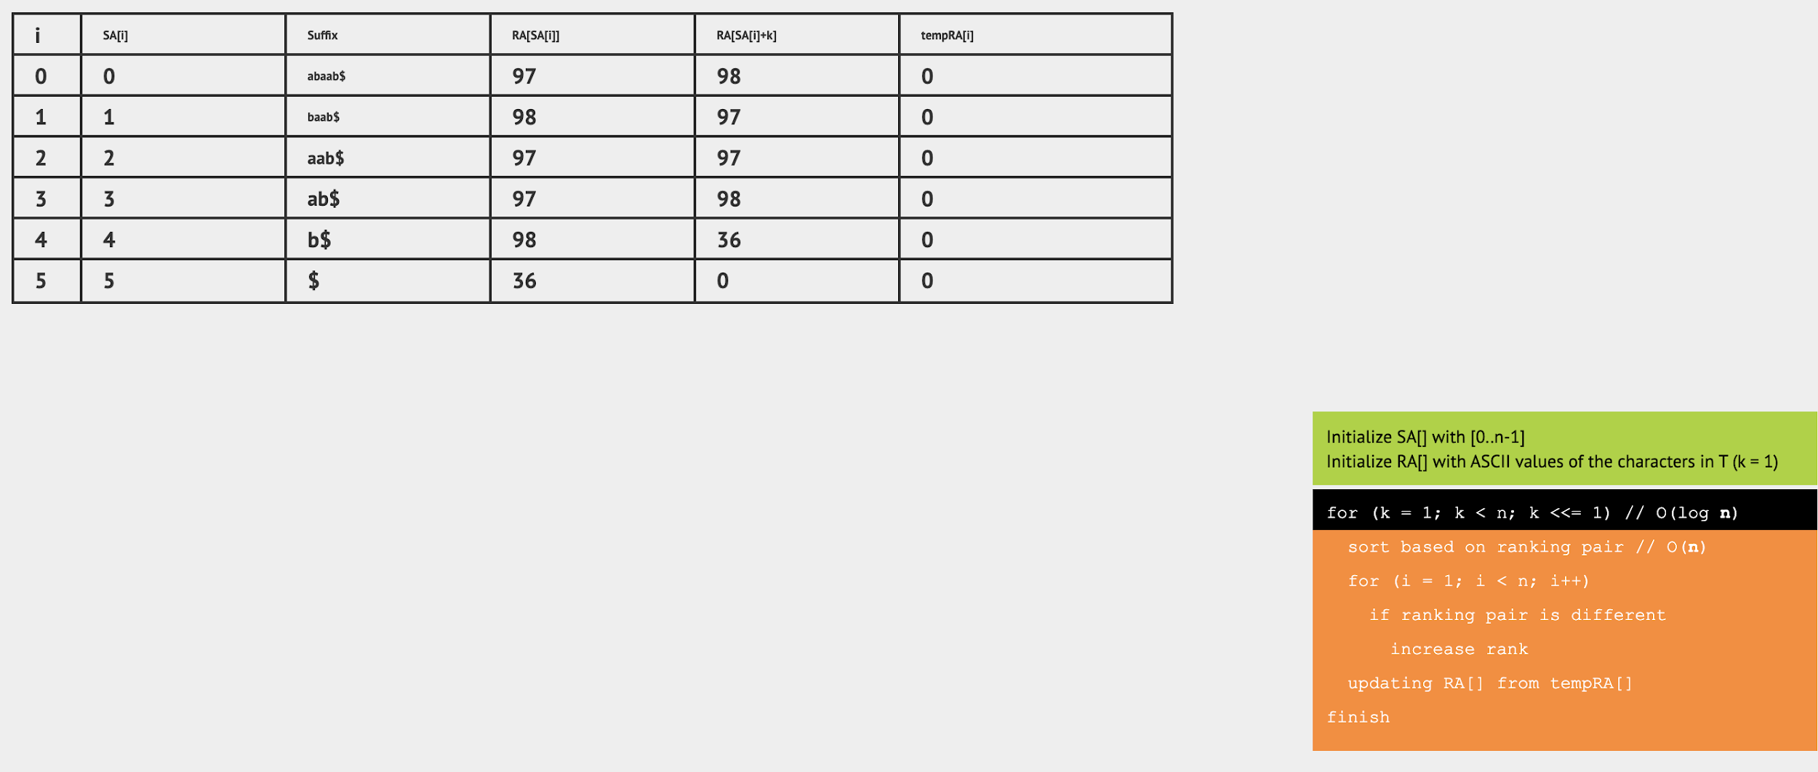
How to construct fast? (Using VisuAlgo to explain)

Slide 17
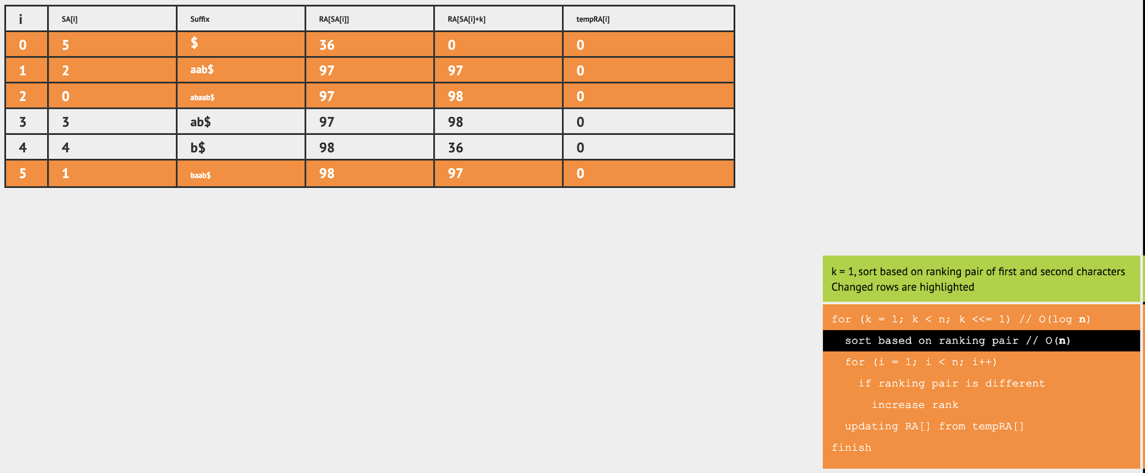

Slide 18
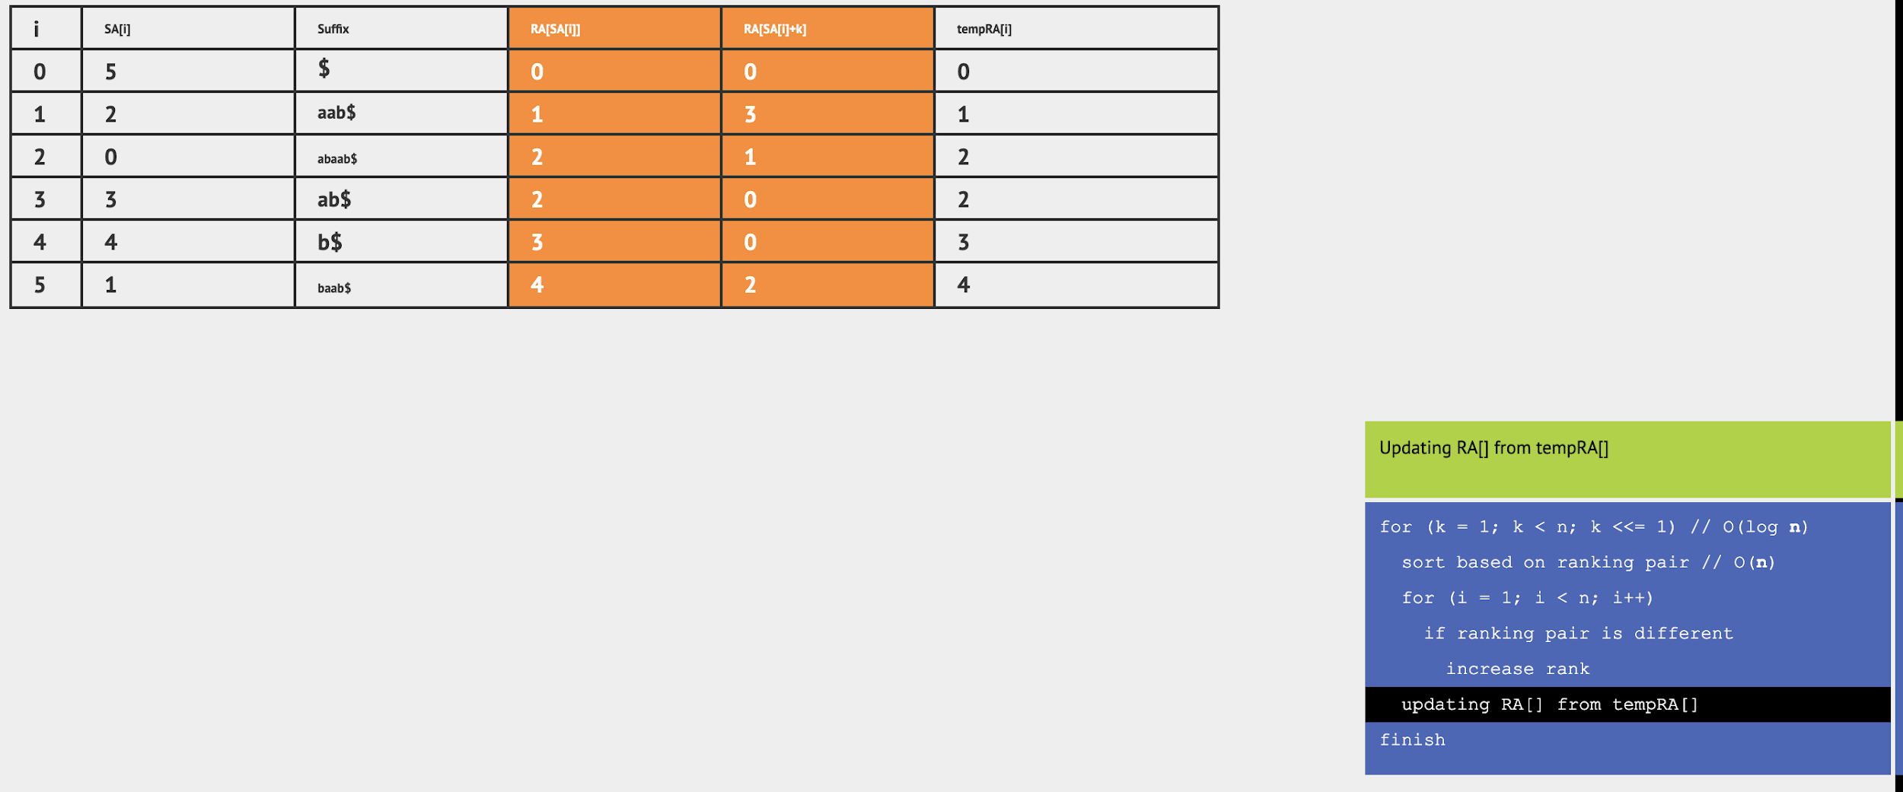

Slide 19
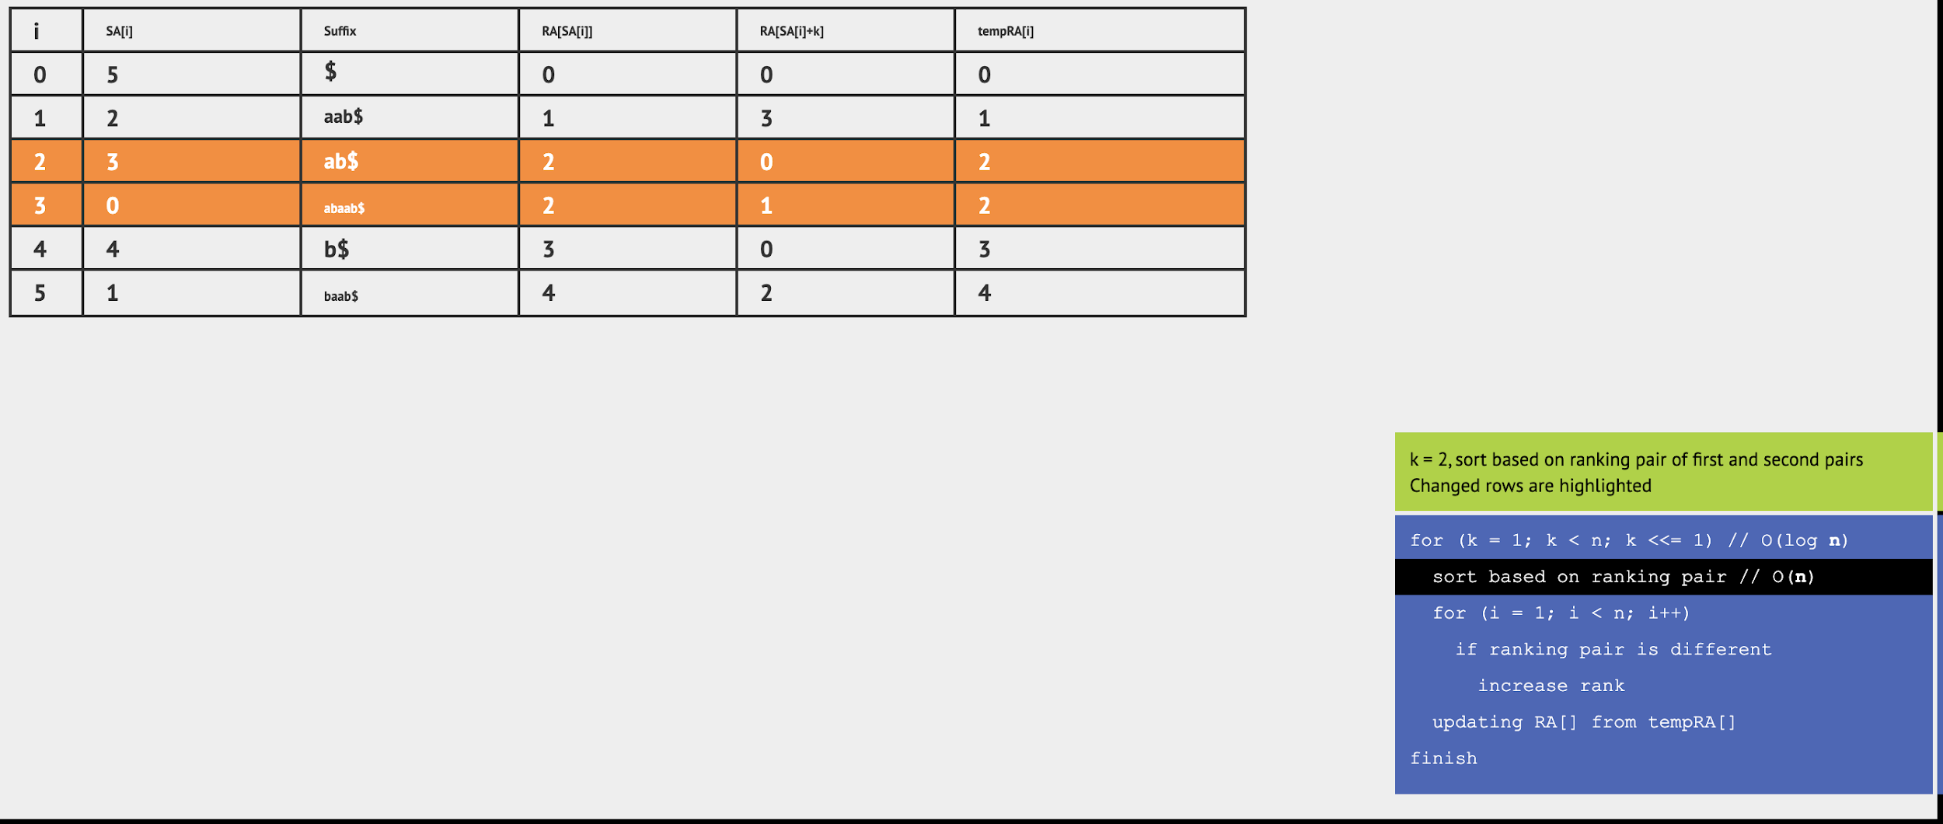

Slide 20
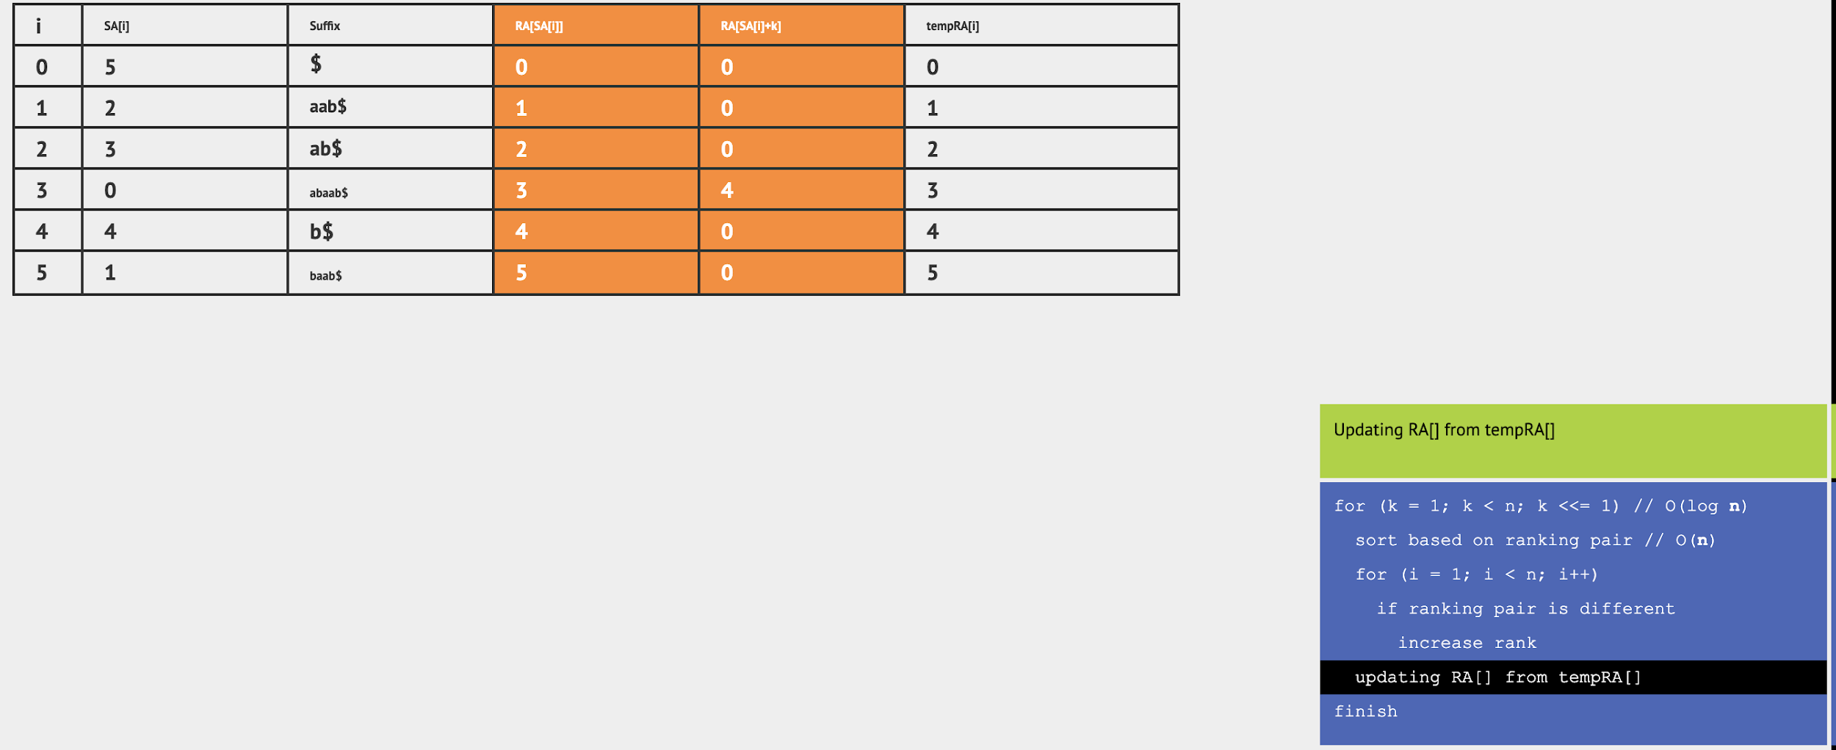

Slide 21
So what is the algo?
For k = 1 to k ≤ n, k *= 2
Sort all pairs of the form (RA[SA[i]], RA[SA[i] + k])
Give ids to all pairs in ascending order (in tempRA[] array)
Set new RA[] array using tempRA[] array

Slide 22
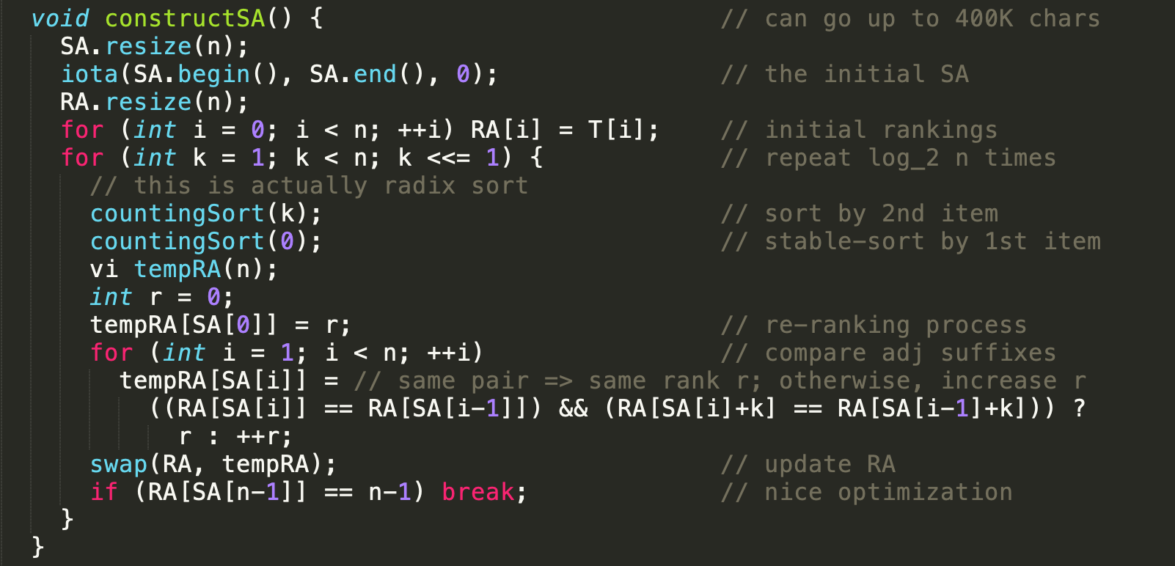
CP3 Book Code

Slide 23
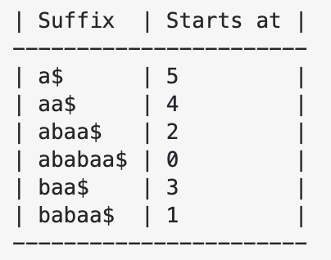
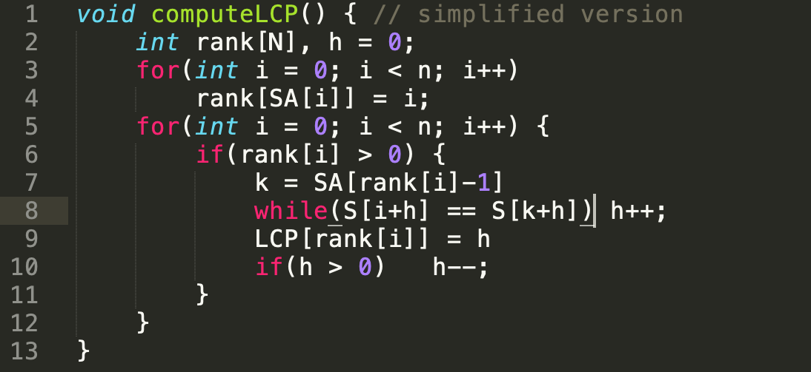
Now how do we make this LCP[] array?
(Algorithm given by Kasai et al.)
Credits: Stackoverflow answer

Slide 24
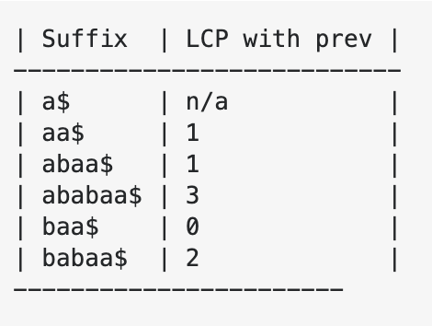
Dry Run

Slide 25
Time complexity
How many times do we decrease h?
Around N² times
At-least NlogN times
At-most N times
At-most N/2 times

Slide 26
So...
If we decrease h at most N times and it still remains positive.
Since LCP[rank[i]] = h (in our code), so our LCP[..] value decreases by at most 1 in each step and then increases.
But we know it always remains ≤ N. So how many times could have h increased/decreased?
~ 2N = O(N) times.

Slide 27
Applications

Slide 28
Finding a substring in a string
Q. Given a string A of length N, and multiple query string of the form B_{i}, such that ∑|B_{i}| ≤ M, then for each query answer “Yes” or “No”, if B_{i} is a substring of A or not?
Aim: O(N log²(N) + Mlog(N))

Slide 29
Finding longest substring that occurs ≥ K times?
Q. Given a string A of length N and an integer K. Find the length of the longest string, that occurs in A at-least K times. (These occurrences are allowed to overlap with one another)
Aim: O(Nlog²N) or O(NlogN)

Slide 30
Find longest palindrome in a given string?
Q. Given a string A of length N find the length of the longest palindrome
Aim: O(Nlog²N) or O(NlogN)

Slide 31
Number of different substrings in a given string?
Q. Given a string A of length N. Count how many “distinct” non-empty substrings are there in A.
Aim: O(Nlog²N) or O(NlogN)

Slide 32
Given some strings find the Longest Common Substring?
Q. Given strings A₁, A₂, …, A_{m} such that ∑|A_{i}| ≤ N. Determine the length of the Longest Common Substring across all A_{i}
Aim: O(Nlog²N + NM(logN + logM))

Slide 33
Further Readings
VisuAlgo
CP-Algorithms
Stanford Lecture Notes
Stackoverflow Answer (Explaining Kasai Algorithm)
Suffix Trees
String Hashing

Slide 34
Thank You
Q&A

