Slide 1
Live Meeting Copilot
Team Lusine
Tackling Real-World Meeting Challenges with Agentic AI
Sambit Mallick Heritage Institute of Technology Kolkata, India
Snigdha Paul Heritage Institute of Technology Kolkata, India

Slide 2
Problem Statement
🧠 Cognitive Overload in Meetings Modern meetings often overwhelm participants with too much information, too fast.
❌ Missed Decisions & ✅ Action Items Key decisions and next steps are frequently lost or forgotten post-meeting.
🔁 Inefficient Follow-Ups Lack of structured documentation and clarity leads to poor meeting outcomes.
🧾 Poor Information Recall Difficulty in retrieving past discussions hampers productivity and continuity.
⚙️ Friction in Collaboration Fast-paced environments expose gaps in how teams conduct and follow up on meetings.

Slide 3




Flowchart
VectorDB
Query Retriever
Code Execution
Google Search
Real Time Transcription
Real Time Voice RAG
Automatic meeting schedule
Critical RAG Tool
RAG Tool Call
External Tool Call
WakeWord/SleepWord Detection
Meeting
Agent
Voice Input
Minutes of Meeting
Action Items
Text Input
Meeting Summary
Accurate Documentation

Slide 4
Key Features
🎤 Real-Time Voice Interaction with AI
🧠 AI Notetaker with Smart Context Understanding
🗂 Transcription & Voice RAG Storage
📺 Live On-Screen Content Explanation
✅ Action Items, Decisions & Minutes Extraction
📝 AI-Generated Meeting Summaries
📅 Calendar Integration & Smart Scheduling
🧾 AI-Generated Images, Diagrams, & Code Snippets

Slide 5
Tech Stack
💻 Programming Language – Python
🤖 Agentic AI – Custom Agentic Framework
🎙 Voice & Text Processing – Gemini AI Studio APIs, Websocket, GROQ API
🔊 Wakeword/Sleepword Detection – Neural Network
🔍 RAG – LLAMAIndex, Gemini Text Embedding, Sentence Transformer
📝 Speech Transcription – Speechmatics API
📅 Calendar Integration – Google Calendar API, OAuth 2.0
🖼️ Frontend – PyQt5 GUI Framework
Risk Analysis
Lag and delay due to simultaneous asynchronous operation
Problem of LLM hallucinations

Slide 6
Why Us❓
Feature | Live Meeting Copilot(Ours) | Otter.ai | Fireflies.ai | Granola
Real Time Voice Interaction | ✅ | ❌ | ❌ | ❌
Live On-Screen Content Explanation | ✅ | ❌ | ❌ | ❌
AI-Generated Images/Code | ✅ | ❌ | ❌ | ❌
Speaker Identification & Voice RAG | ✅ | ✅ | ✅ | ❌
Action Items & Decisions Extraction | ✅ | ✅ | ✅ | ✅
Calendar Integration & Smart Scheduling | ✅ | ✅ | ✅ | ✅

Slide 7
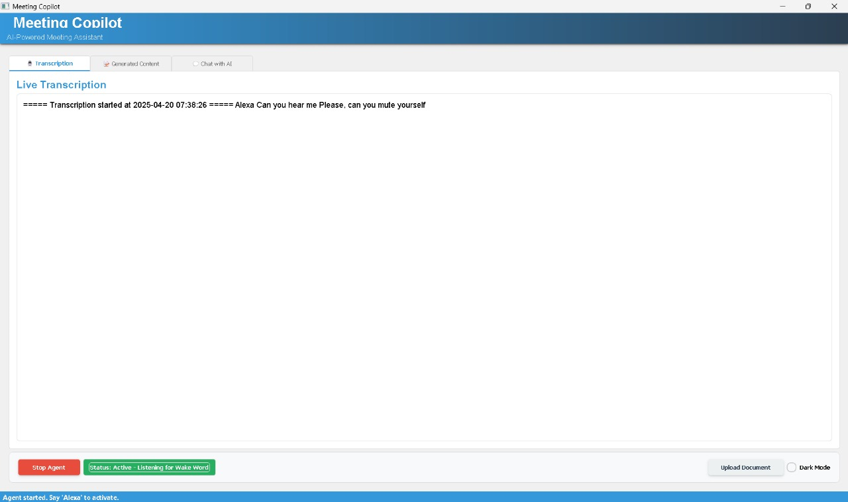
Output Screen

Slide 8
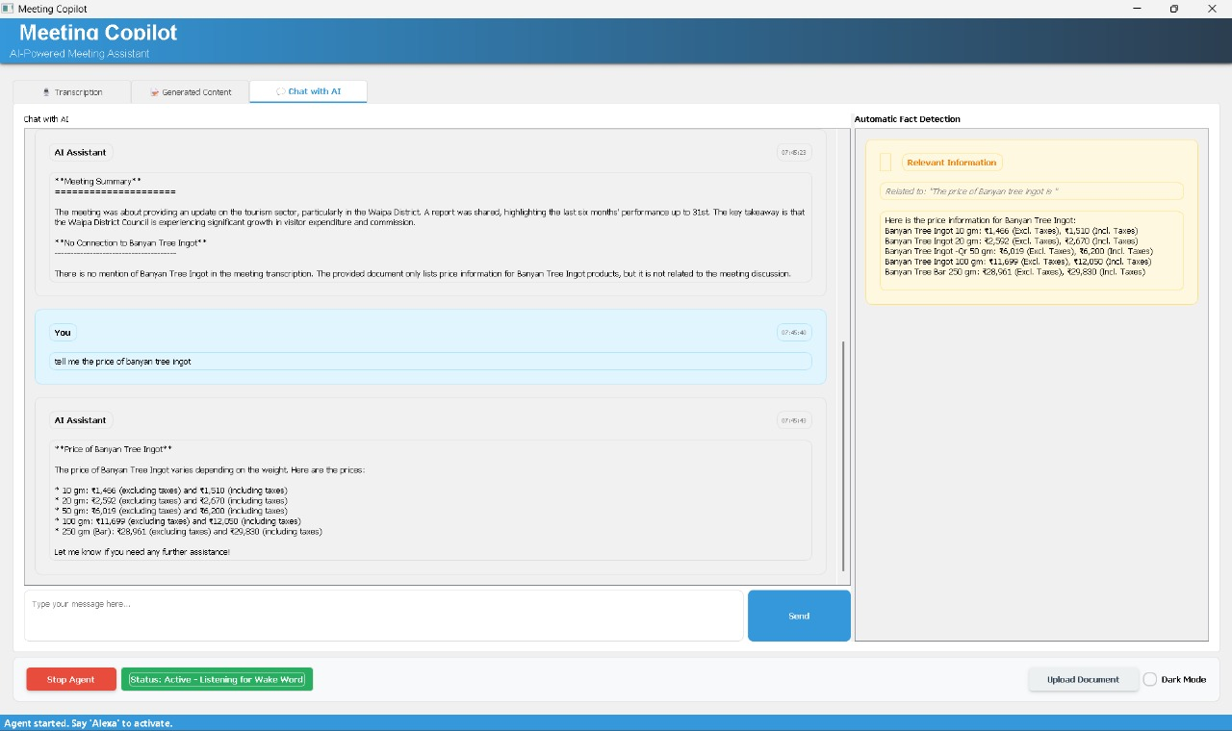
Output Screen ( Critical RAG )

Slide 9
Future Scope
End to End Deployment
Better User Interface
WakeWord Training

