Slide 1
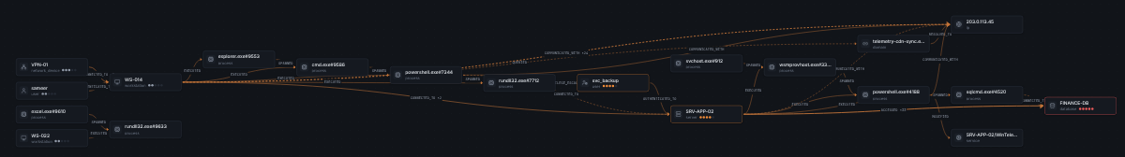
AttackGraph Lens
sameer
WS-014
Which systems did the attacker really reach — in what order — and how do we know?
powershell
SRV-APP-02
hackFront India 2026 · T-2 Cybersecurity · T2.1 GraphOps
Graph engine for security teams: time-correct attack paths, real-time blast radius, one incident picture — with the evidence behind every conclusion.
FINANCE-DB
20:40 → 20:45 → 21:22 → 21:32
Notes:
One question drives the product: which systems did the attacker really reach, in what order, and how do we know? AttackGraph Lens answers it for T2.1 GraphOps — attack paths, real-time blast radius and one incident picture, each tied back to raw evidence. The chain on the right is the real attack in our synthetic dataset: four steps in 52 minutes, from a VPN logon to a 48,211-row read of the finance database.

Slide 2







Alerts arrive in pieces; the attack happens as a chain
01 · THE PROBLEM
JUDGING · PROBLEM ALIGNMENT
Seven feeds, seven partial views
T2.1 GraphOps asks for three things
Identity
Endpoint (EDR)
Map attack paths
who logged on where
what ran, what it touched
1
How did the attacker get from the first foothold to the crown jewels?
Firewall
DNS
who talked to whom
which names resolved
Blast radius — in real time
2
Database audit
SIEM alerts
If this system is compromised, what else is now at risk?
who read which data
what looked bad
Asset inventory
3
One clear incident picture
what matters, IP ↔ host
Turn scattered alerts into one story an analyst can act on.
Each tool sees one slice. The attack is the chain across them — and today an analyst rebuilds that chain by hand.
WHY
Notes:
Every source sees one slice: identity sees logons, EDR sees processes, the firewall sees flows, the database audit sees reads. The attack is the chain across them. T2.1 asks for exactly three things: attack paths, a real-time blast radius and one incident picture. Everything in this deck maps to those three.

Slide 3


Connectivity is not compromise — time and evidence decide
02 · THE INSIGHT
JUDGING · CRITICAL THINKING
Rule 1 · Time
Rule 2 · Evidence
A step can only follow the step that enabled it.
An edge without its source records is a rumour.
sameer
WS-014
BKP-01
edge
powershell.exe#7344 —CONNECTED_TO→ SRV-APP-02
rule
R-NET-01 (EDR network connect) + R-RES-01 (IP → host)
arrive 21:50
last seen 19:30
record
edr:EDR-000399 · edr_events.jsonl, row 270
FINANCE-DB
basis
INFERRED — 10.10.2.12 resolved via asset inventory
Graph says: path exists. Time says: impossible → rejected.
why bad
cited by alert ALR-0006 (high) → suspicion 0.75
Most graph tools stop at “A can reach B”. Analysts need “A did reach B, after X, and here is the record”.
WHY
Notes:
Two rules make an attack graph trustworthy. Rule one, time: a path exists in the graph through the backup server, but the backup server last touched the finance DB at 19:30 and the attacker could only arrive at 21:50 — so we reject it, and show why. Rule two, evidence: every edge carries its source records, the rule that created it, whether it was observed or inferred, and why it is suspicious.

Slide 4
Input → output in six stages, each with one job
03 · END TO END
JUDGING · TECHNICAL IMPLEMENTATION
1
2
3
4
5
6
Ingest
Normalize
Graph
Suspicion
Reason
Explain
7 files · 1,258 rows
hash, validate, reject bad rows
UTC time · one event schema
IP → host via inventory
temporal: 349 entities · 968 edges · 1,625 occurrences
s = max(4 signals)
suspicious if s ≥ 0.5
temporal paths · blast radius
correlation · containment
ranked incident · score breakdown
report + SHA-256 manifest
why
why
why
why
why
why
Bad input must fail loudly, with row and reason
Seven schemas become one comparable language
Keeps every occurrence, not just “A touched B”
Separates attack steps from routine traffic
Answers the three T2.1 questions
Every number traces back to a record
Input: raw logs + alerts + inventory. Output: a ranked, explained incident — and the path, blast radius and fix behind it.
WHY
Notes:
End to end. One: ingest seven files, hash them, reject bad rows with a reason. Two: normalize to UTC and one event schema, and resolve IPs to hosts through the asset inventory. Three: build a temporal graph that keeps every occurrence with its time and source. Four: score each occurrence's suspicion. Five: reason over the graph — paths, blast radius, correlation, containment. Six: explain — every score is broken down and every claim links back to a record.

Slide 5
What is read from each source — and what it becomes
04 · INPUT
JUDGING · TECHNICAL IMPLEMENTATION
Source · file | Fields read | Becomes in the graph
Identity · auth_logs.csv | time, user, src_host, dst_host, logon_type, result | user —AUTHENTICATED_TO→ host
Endpoint · edr_events.jsonl | ts, host, user, image, pid, parent_image, cmdline, dst_ip:port, severity | host —EXECUTED→ process —SPAWNED / CONNECTED_TO→ …
Firewall · firewall.csv | timestamp, src_ip, dst_ip, dst_port, proto, action, bytes_out | host —CONNECTED_TO / COMMUNICATED_WITH→ host | ip
DNS · dns.json | time, client_ip, query, answers | host —QUERIED→ domain —RESOLVED_TO→ ip
Database · db_audit.csv | event_time, db_user, client_host, database, operation, rows_returned | host —ACCESSED→ database (volume = rows)
SIEM · siem_alerts.json | rule, severity, MITRE, entities, evidence_refs | alert —ALERTED_ON→ entity; severity → cited events
Inventory · asset_inventory.csv | name, ip, asset_type, criticality 1–5, owner | IP → host resolution; criticality for risk
Only fields that change a conclusion are read. Formats are auto-detected; uploads are never executed.
WHY
Notes:
This is exactly what we read. Identity gives who logged on where. EDR gives processes, parents, command lines and connections. Firewall and DNS give flows and names. The database audit gives who read which data and how many rows. SIEM alerts give severity, MITRE technique and the records they cite. The inventory resolves IPs to hosts and gives each asset a criticality from 1 to 5.

Slide 6
One raw record → one explained graph edge
05 · WORKED EXAMPLE
JUDGING · PROTOTYPE VALIDATION
RAW · edr_events.jsonl, row 270
NORMALIZE + RESOLVE
GRAPH EDGE + OCCURRENCE
{"id": "EDR-000399",
"ts": "2026-10-27T21:22:00Z",
"host": "WS-014",
"user": "sameer",
"event_type": "network_connect",
"image": "powershell.exe",
"pid": "7344",
"dst_ip": "10.10.2.12",
"dst_port": 5985,
"severity": "medium"}
time
21:22:00 UTC
powershell
#7344
SRV-APP-02
actor
process WS-014/
powershell.exe#7344
CONNECTED_TO (dashed = inferred)
target
10.10.2.12 → SRV-APP-02
(inventory · R-RES-01)
rule
R-NET-01
basis
INFERRED
port
5985 = WinRM
event
edr:EDR-000399
severity
"medium" → 0.50
native
0.50 (medium)
alert
ALR-0006 cites it → 0.75
source
file SHA-256 + row kept
suspicion
0.75 ≥ 0.5 ✓
Click any edge in the app and you land on this exact record — the conclusion and its proof are one click apart.
WHY
Notes:
One real record end to end. EDR-000399 says powershell on WS-014 connected to 10.10.2.12 on port 5985 at 21:22. We normalize the time to UTC, name the process uniquely, and resolve 10.10.2.12 to SRV-APP-02 from the inventory — so the edge is marked inferred, drawn dashed. Its own severity is medium, 0.5. Alert ALR-0006 cites this record, so it inherits 0.75. 0.75 is above the 0.5 threshold, so this hop is suspicious.

Slide 7
Suspicious = the strongest of four signals reaches 0.5
06 · SUSPICION CRITERION
JUDGING · INNOVATION
s(o) = max( s_native , s_alert , 0.8 · s_proximity , s_MD ) suspicious ⇔ s(o) ≥ τ = 0.5
R-SUSP-00
R-SUSP-01
R-SUSP-02
R-SUSP-03
Native severity
Cited by an alert
Alert proximity
MD deviation
The source's own label: info .05 · low .25 · medium .50 · high .75 · critical .95
An alert lists this record in its evidence → inherits the alert severity (unless dismissed benign)
Both endpoints named by one alert, inside its time window → 0.8 × alert severity
Behaviour far from its own baseline → at most 0.45, so it can support but never decide
EDR-000399 (WinRM to SRV-APP-02)
svc_backup → BKP-01 (nightly backup)
max(0.50, 0.75, —, 0) = 0.75 → suspicious
D² = 66 → s_MD = 0.45 < 0.5 → not suspicious
max, not average: one strong independent signal is enough — averaging would dilute a real alert with quiet noise.
WHY
Notes:
This is the exact criterion. Each occurrence gets four signals: its own severity, the severity of any alert that cites it, 0.8 times an alert that names both its endpoints, and a behavioural deviation score. We take the max, and call it suspicious at 0.5. The deviation term is capped at 0.45, deliberately below the threshold: unusual is not the same as malicious. The backup example shows why — very unusual, still correctly not suspicious.

Slide 8
How unusual is this behaviour — against its own history?
07 · BEHAVIOURAL DEVIATION (MD)
JUDGING · INNOVATION
features
x = [sin 2πh/24, cos 2πh/24,
log₁₀(1+volume), novelty]
baseline
same relationship if ≥ 20 samples,
else same type (≥ 30)
robust z
z = (x − median) / (1.4826 · MAD)
shrink
S = 0.8 · cov(z) + 0.2 · I
distance
D² = zᵀ S⁻¹ z
score
s_MD = 0.45 · min(1, (D² − 18.47) / 18.47)
18.47 = 99.9th percentile of χ² with 4 degrees of freedom
Signatures miss new tricks; anomalies alone cry wolf. MD measures how unusual — the cap keeps it from convicting on its own.
WHY
Notes:
The ML part. Each occurrence becomes four features: hour of day as sine and cosine so 23:00 and 01:00 are close, log of volume, and whether this relationship is new. We compare it to its own history using median and MAD, so the baseline is not poisoned by the outliers we are hunting, then compute a Mahalanobis distance. Anything above 18.47, the 99.9 percent chi-square point, starts to score — capped at 0.45. The C2 beacon scores highest. The backup is unusual too, which is exactly why the cap exists.

Slide 9

A path is valid only if every step can follow the previous one
08 · TEMPORAL ATTACK PATHS
JUDGING · CRITICAL THINKING
t(i) − 120 s ≤ t(i+1) ≤ t(i) + 6 h clock skew tolerated · stale links cut
Valid hypothesis #2 · sameer → FINANCE-DB
Rejected · via BKP-01
20:40
sameer —AUTHENTICATED_TO→ WS-014
BKP-01 → FINANCE-DB last occurred 19:30, but the attacker could reach BKP-01 at 21:50 at the earliest. Shown to the analyst with this reason.
off-hours VPN logon
20:45
WS-014 —EXECUTED→ powershell #7344
encoded command
21:22
powershell —CONNECTED_TO→ SRV-APP-02
WinRM, port 5985
8 valid paths
3 rejected
21:32
SRV-APP-02 —ACCESSED→ FINANCE-DB
48,211 rows as svc_backup
138 expansions
2.3 ms query
Static graphs show every route that could exist. Only time-feasible routes can be what actually happened.
WHY
Notes:
The path rule: each step must happen after the one that enabled it, allowing two minutes of clock skew and at most six hours between steps. We propagate the set of possible arrival times along each route with a bounded depth-first search. Hypothesis two is four steps in 52 minutes. The route through the backup server exists structurally but is impossible in time — we reject it and tell the analyst why. Eight valid paths, three rejected, 138 expansions, 2.3 milliseconds.

Slide 10
Every point of the score is visible and explained
09 · RISK SCORE
JUDGING · CRITICAL THINKING
Score = 100 · Σ wₖ · cₖ
.25
criticality
most critical asset reached (1–5)
.35
suspicion
share and strength of suspicious hops
.15
corroboration
independent source systems
.05
evidence quality
observed vs inferred hops
.10
path length
shorter = more direct
.10
recency
half-life 48 h
Critical ≥ 75
High ≥ 55
Moderate ≥ 35
Low
A black-box score gets ignored. A score an analyst can audit — and re-weight in Settings — gets trusted.
WHY
Notes:
Ranking is a weighted sum of six components, each between zero and one. Suspicion carries the most weight at 0.35, criticality 0.25. For hypothesis two: criticality 25 points because FINANCE-DB is 5 of 5, suspicion 28.2, corroboration 15 from four independent sources, and so on — 85.7, Critical. Every weight is visible in the UI and adjustable.

Slide 11
Same reach, different meaning: four evidence tiers
10 · BLAST RADIUS
JUDGING · CRITICAL THINKING
CONFIRMED
Only when an analyst marks it. Never automatic.
SUSPECTED
Reached through an unbroken chain of suspicious steps.
OBSERVED
Direct contact (hop 1), nothing suspicious on it.
POTENTIAL
FINANCE-DB: SUSPECTED from sameer (hop 3) vs POTENTIAL from the admin (hop 2).
Reachable by ordinary activity — exposure, not evidence.
Admins can reach everything. Pure reachability would flag them all — tiers separate “could” from “did, with evidence”.
WHY
Notes:
Blast radius answers: if this account is compromised, what is at risk? Plain reachability is useless — an IT admin reaches more than the attacker does. So we grade every reached entity into four tiers. Suspected requires an unbroken chain of suspicious steps from the source; confirmed is reserved for an analyst. Result: from sameer, FINANCE-DB is suspected at hop 3; from the admin, the same database is only potential exposure.

Slide 12
8 alerts from 6 sources become one incident: INC-0002
11 · ONE INCIDENT PICTURE
JUDGING · PROBLEM ALIGNMENT
20:41
Failed logons → success
T1110.001
21:03
Beacon to new domain
T1071.001
21:24
Service-acct WinRM
T1021.006
21:38
Bulk read FINANCE-DB
T1213
20:46
Encoded PowerShell
T1059.001
21:06
LSASS memory dump
T1003.001
21:29
New remote service
T1543.003
22:11
Large outbound transfer
T1041
R-COR-01
R-COR-02
R-COR-03
Hubs excluded
Shared entity
Graph adjacency
Explicit reference
DC-01, FS-01
two signals touch the same non-hub entity
neighbouring entities within 90 min
alert cites the event as evidence
degree ≥ max(20, 4 × median) can't glue incidents
Union-find over cited rules → INC-0002: Critical 92.6 · 2 identities · 5 assets · 6 independent sources. One story, not 8 tickets.
WHY
Notes:
Eight alerts over 90 minutes, from six source systems, look like eight tickets. We link signals with three published rules — shared entity, graph adjacency within 90 minutes, explicit evidence reference — and merge them with union-find. Hubs like the domain controller are excluded, otherwise everything would glue into one blob. The result is one incident, INC-0002, Critical 92.6, with its timeline and attack-path hypothesis.

Slide 13
Who else saw it? Six independent channels per step
12 · MULTICHANNEL CORROBORATION
JUDGING · INNOVATION
Step | Identity | Endpoint | Network | DNS | Data | Detection
1 · logon 20:40 | primary | corrob. | corrob. | corrob. | — | corrob.
2 · exec 20:45 | corrob. | primary | corrob. | corrob. | — | corrob.
3 · WinRM 21:22 | corrob. | primary | corrob. | — | corrob. | corrob.
4 · DB read 21:32 | corrob. | corrob. | corrob. | — | primary | corrob.
primary
the channel that created the edge
corroborating
independent record, same entities, ±15 min
silent
should have seen it, logged nothing → gap or tampering
100%
4 / 4
0
blind
cannot see this entity type at all
channel agreement
steps seen by ≥ 2 channels
expected-but-silent gaps
One tool can be wrong or blinded. Independent channels are hard to fake — and a silent channel is itself a lead.
WHY
Notes:
Our signature view. For every step we ask: which independent observation channels saw it? Primary is the channel that created the edge; corroborating means another channel recorded the same entities within 15 minutes. On the principal path every step is seen by at least two channels — 100 percent agreement. The useful twist is 'silent': a channel that should have seen a step but logged nothing — a blind spot or possible tampering.

Slide 14
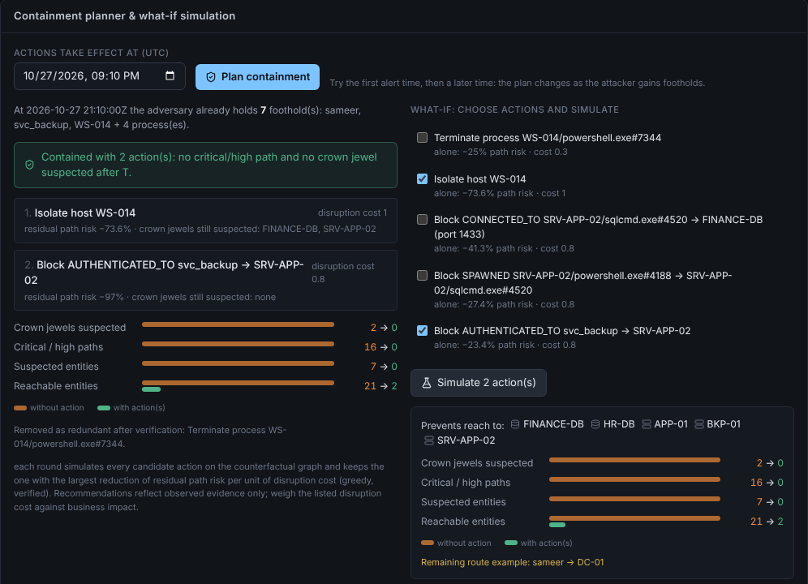
What to cut depends on when you act
13 · CONTAINMENT, BY SIMULATION
JUDGING · INNOVATION
Act at 20:41 · first alert
1 action
Attacker holds: sameer, WS-014
Isolate host WS-014
−98.7 % path risk · paths 57 → 1 · critical 48 → 0
Act at 21:10 · 30 min later
2 actions
LSASS dumped at 21:06 → svc_backup credential stolen · 7 footholds
Isolate WS-014 + block svc_backup → SRV-APP-02
16 → 0 critical/high paths · crown jewels 2 → 0
Counterfactual: delete every occurrence after T that touches the contained entity, re-run paths + blast. Greedy: best risk reduction per unit of disruption cost.
“Isolate everything” is not a plan. Simulating each action against the graph shows the smallest cut that actually stops the attack.
WHY
Notes:
Containment is simulated, not guessed. We replay the graph as if an action had been taken at time T and measure what risk remains. Act at the first alert and isolating one workstation removes 98.7 percent of path risk. Act thirty minutes later and the service account credential is already stolen, so the planner adds a second action — block that account's logon to the app server. Same incident, different time, different plan.

Slide 15
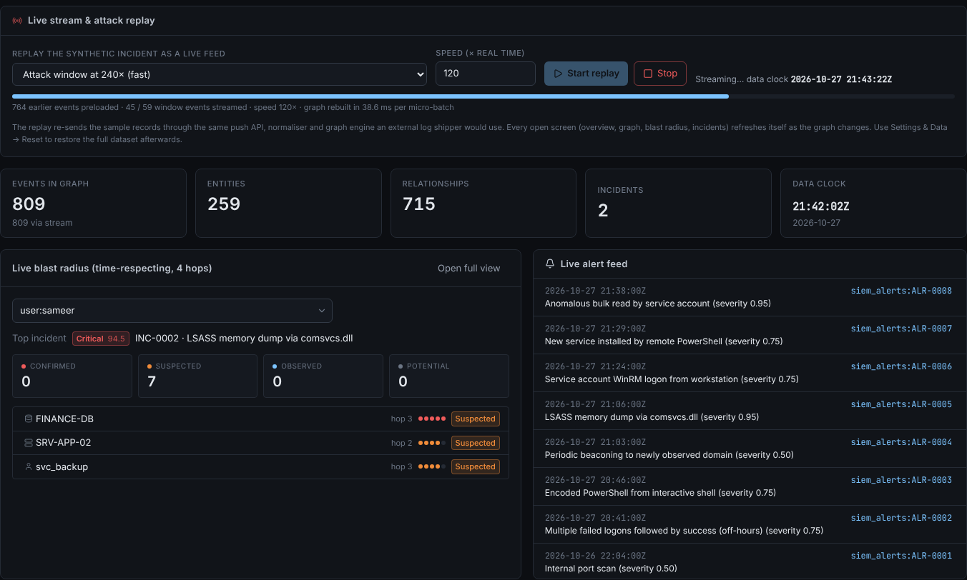
The picture builds while the attack is still happening
14 · REAL TIME
JUDGING · PROBLEM ALIGNMENT
POST /api/stream/events
1
SIEM forwarder or log shipper pushes records
Same validation + normalizer
2
duplicates and bad rows rejected
Micro-batch every 0.4 s
3
graph rebuilt; 38.6 ms per batch in replay
Version++ → Server-Sent Events
4
browser notified, refresh ≤ 1/s
Every view updates
5
blast radius, incidents, paths, graph
Replay of the synthetic intrusion: when the 21:32 read streams in, FINANCE-DB turns SUSPECTED and INC-0002 goes Critical.
T2.1 asks for the blast radius in real time. Live mode uses the same engine as batch — no separate “demo” code path.
WHY
Notes:
T2.1 says real time, so events can be pushed to an API. They pass the same validation and normalizer as file uploads, are micro-batched every 0.4 seconds, and every open view is notified through Server-Sent Events. In the replay you see the alerts arrive one by one; when the 21:32 database read streams in, FINANCE-DB flips to suspected and the incident goes critical.

Slide 16


What we proved — and what we deliberately do not claim
15 · VALIDATION
JUDGING · PROTOTYPE VALIDATION
105
95 %
88 ms
0.4 ms
automated tests passing
(incl. 6 browser end-to-end)
statement coverage
of the backend
ingest 7 files + build graph
(1,191 events)
4-hop temporal
blast radius
Known-answer checks (tests assert these)
Not claimed
Principal path found, 4/4 hops suspicious, starts at 20:40
Backup route rejected as temporally impossible
FINANCE-DB: SUSPECTED for attacker, POTENTIAL for admin
Planted bad rows, duplicate and ID conflict flagged
Report export hash appears in the evidence manifest
No accuracy / precision / recall / F1 — the only labels are synthetic, so a score would be circular
No enterprise-scale latency claim — timings are this dataset only
Neo4j adapter built and unit-tested; not yet validated on live AuraDB
No user study or analyst feedback yet
A security tool that overclaims is a liability. We test what we can prove and state the rest plainly.
WHY
Notes:
Validation: 105 automated tests pass, including six that drive the real UI in a browser, with 95 percent backend coverage. The tests assert known answers on the synthetic dataset — the right path, the rejected route, the attacker versus admin tiers. Just as important is what we don't claim: no accuracy numbers, because our only labels are synthetic; no enterprise-scale latency; and the Neo4j adapter is not yet validated on a live AuraDB instance.

Slide 17





Built to be run, read and trusted
16 · ENGINEERING
JUDGING · TECHNICAL IMPLEMENTATION
Engine
Interface
Graph backend
Python 3.11+ · FastAPI · NetworkX temporal multigraph · NumPy for MD
React 19 · TypeScript strict · React Flow + dagre · 8 screens incl. Live Monitor
In-memory by default; optional Neo4j adapter with parameterised Cypher only
Security
Evidence
Delivery
Uploads size-limited, type-checked, filenames sanitised, never executed; no stack traces; security headers
SHA-256 of every source and export; reports in HTML, Markdown, JSON
One-command run script · Docker · GitHub Actions CI · MIT licence
Built with AI assistance (Anthropic Claude) under the team’s direction — disclosed with all third-party components in the repo.
WHY
Notes:
Engineering choices: Python and FastAPI with a NetworkX temporal multigraph, NumPy for the deviation model; React with strict TypeScript and React Flow for the UI. Neo4j is optional and uses parameterised Cypher only. Uploads are validated and never executed. Every source and export is hashed. It runs with one command, in Docker, with CI. AI assistance and every third-party component are disclosed in the repository.

Slide 18
Where it stops today, and what comes next
17 · LIMITS AND NEXT STEPS
JUDGING · CRITICAL THINKING
Limits today
Next
Synthetic data only
Real connectors
one generated enterprise; real logs are messier
Sysmon, Zeek, Windows events, cloud audit logs
Weights set by reasoning
Calibrate on labelled data
not yet calibrated on labelled incidents
learn weights and τ from analyst verdicts
Pairwise correlation
Scale on Neo4j AuraDB
alert storms need indexing
validate the adapter live; stream at volume
Single user, no auth
Analyst loop
fine for a prototype, not for a SOC
confirm / dismiss feeds back into tiers and scores
Knowing exactly where the model stops is what makes its conclusions usable.
WHY
Notes:
Honest limits: synthetic data only, weights set by reasoning rather than learned, pairwise correlation that would need indexing for alert storms, and no authentication yet. Next: real connectors like Sysmon and Zeek, calibrating weights on labelled incidents, validating the Neo4j adapter at scale on AuraDB, and closing the loop so analyst verdicts feed back into the scores.

Slide 19


T2.1 asked three questions. Each has a traceable answer.
18 · SUMMARY
JUDGING · PROBLEM ALIGNMENT
Map attack paths
Time-feasible paths, ranked by an explained score; impossible routes rejected with the reason.
Blast radius in real time
Four evidence tiers, pushed live; attacker vs admin told apart on the same asset.
One incident picture
8 alerts · 6 sources → INC-0002, with multichannel proof and a time-aware containment plan.
Demo video, source code and docs are in the submission package and repository.
Who was reached, in what order, and how do we know — answered, with the record behind every step.
WHY
Notes:
To close: T2.1 asked three questions. Attack paths — time-correct, ranked, with impossible routes rejected. Blast radius in real time — four evidence tiers, live. One incident picture — eight alerts become one incident with corroboration and a containment plan. And for every answer, we can show the record behind it. Thank you.

