Slide 1
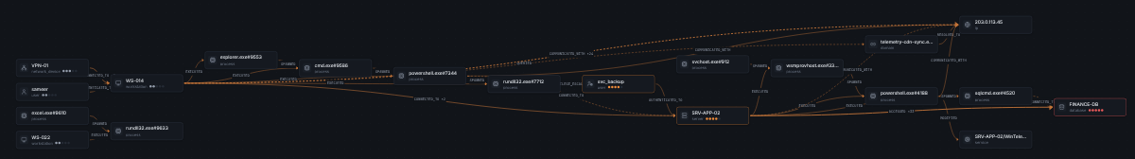
AttackGraph Lens
sameer
WS-014
From fragmented security events to explainable attack paths and blast-radius intelligence.
powershell
SRV-APP-02
hackFront India 2026 | T-2 Cybersecurity | T2.1 GraphOps
FINANCE-DB
Who was reached, in what order, and how do we know?
20:40 → 20:45 → 21:22 → 21:32 UTC
Notes:
AttackGraph Lens answers one question for T2.1 GraphOps: who was reached, in what order, and how do we know? The chain on the right is the attack in our synthetic dataset: four steps in 52 minutes, from a VPN logon to a 48,211-row read of the finance database.

Slide 2







Alerts arrive in pieces; the attack happens as a chain
01 · THE PROBLEM
JUDGING · PROBLEM ALIGNMENT
Seven feeds, seven partial views
T2.1 GraphOps asks for three things
Identity
Endpoint / EDR
Attack-path discovery
who logged on where
what ran, what it touched
1
How did the attacker get from the first foothold to the crown jewels?
Firewall
DNS
who talked to whom
which names resolved
Real-time blast radius
2
Database audit
SIEM alerts
If this system is compromised, what else is now at risk?
who read which data
what looked bad
Asset inventory
3
Unified incident intelligence
what matters, IP ↔ host
Turn scattered alerts into one story an analyst can act on.
Each tool sees one slice. The attack is the chain across them, and today an analyst rebuilds that chain by hand.
WHY
Notes:
Every source sees one slice: identity sees logons, EDR sees processes, the firewall sees flows, the database audit sees reads. The attack is the chain across them. T2.1 asks for three things: attack paths, a real-time blast radius and one incident picture. The rest of the deck maps to those three.

Slide 3


Connectivity is not compromise: time and evidence decide
02 · THE INSIGHT
JUDGING · CRITICAL THINKING
Rule 1 · Temporal feasibility
Rule 2 · Evidence provenance
A step must occur after the event that enables it.
A relationship without source records is not proof.
sameer
WS-014
BKP-01
edge
powershell.exe#7344 → CONNECTED_TO → SRV-APP-02
rule
R-NET-01 (EDR network connect) + R-RES-01 (IP → host)
arrive 21:50
last seen 19:30
record
edr:EDR-000399 · edr_events.jsonl, row 270
FINANCE-DB
basis
INFERRED: 10.10.2.12 resolved via asset inventory
Graph says: route exists. Time says: impossible, rejected ✕
why bad
cited by alert ALR-0006 (high), suspicion 0.75
Most graph views stop at “A can reach B”. Analysts need “A did reach B, after X, and here is the record”.
WHY
Notes:
Two rules make an attack graph trustworthy. Time: a route through the backup server exists in the graph, but the backup server last touched the finance DB at 19:30 and the attacker could only arrive at 21:50, so we reject it and show why. Evidence: every edge carries its source records, the rule that created it, whether it was observed or inferred, and why it is suspicious.

Slide 4
Where AttackGraph Lens goes beyond conventional graph-based security analysis
03 · NOVELTY
JUDGING · INNOVATION
A
B
C
D
E
Temporal feasibility of attack paths
Provenance-native evidence graph
Evidence-tiered blast radius
Multichannel corroboration
Counterfactual, time-aware containment
Keeps every occurrence and timestamp
Enforces order and a maximum gap
Rejects impossible routes, with the reason
Edges keep source-record references
Observed vs inferred kept separate
Conclusion → file, row, rule, event
Confirmed · Suspected · Observed · Potential
Admin reach ≠ compromise
Confirmed only by an analyst
6 channels: identity to detection
Primary, corroborating, silent, blind
Bounded MD deviation as support
Simulate an action at time T
Re-run paths and blast radius
Risk reduction vs disruption cost
Not merely a graph of possible connections: an evidence-backed reconstruction of what could have happened, what likely happened, and why.
AttackGraph Lens integrates temporal feasibility, occurrence-level evidence provenance, graded blast-radius reasoning, multichannel corroboration and time-aware counterfactual containment into one explainable security investigation workflow.
NOVELTY
The building blocks (temporal graphs, graph traversal, Mahalanobis distance, alert correlation, counterfactual analysis) are established techniques. The contribution is their integration.
Notes:
What is new is the combination, not any single algorithm. A: paths must be possible in time, and impossible ones are rejected with a reason. B: every edge keeps the records behind it, and inferred edges stay marked as inferred. C: blast radius is graded into four evidence tiers, so admin reach is not mistaken for compromise. D: six independent channels corroborate each step, with a bounded behavioural score as support. E: containment is simulated at a chosen time and compared by risk reduction and disruption cost. Temporal graphs, Mahalanobis distance and correlation are established techniques; we claim the integrated, explainable workflow.

Slide 5



Built on previous cybersecurity work, designed for explainable investigation
04 · TEAM TRACK RECORD
UniAethel
Design philosophy
AttackGraph Lens
Previous cybersecurity project
What carried over
What is new for T2.1
A cybersecurity tool previously developed by the team
Shortlisted at SUTRAM 2026 by NFSU
Separate project, separate code, different objectives
Evidence-oriented security thinking
Analyst-centric interaction
Clear technical presentation
Focused GraphOps investigation engine
New code, synthetic dataset and methods
No UniAethel code, data or results reused
“Design philosophy inspired by UniAethel, a previous cybersecurity tool shortlisted at SUTRAM 2026 by NFSU.”
The shortlist recognises UniAethel only. It does not validate AttackGraph Lens, and NFSU has not developed, endorsed or reviewed this project.
NOTE
Notes:
Some context on the team. We previously built UniAethel, a separate cybersecurity tool, which was shortlisted at SUTRAM 2026 by NFSU. What carried over is a way of working: evidence first, built for the analyst, explained clearly. AttackGraph Lens is a new, focused GraphOps engine with its own code and synthetic data; nothing from UniAethel's code, data or results is reused. The shortlist is UniAethel's recognition, not a validation of this project.

Slide 6
Six layers around one temporal knowledge graph
05 · SYSTEM ARCHITECTURE
JUDGING · TECHNICAL IMPLEMENTATION
1 · TELEMETRY
2 · VALIDATE + NORMALISE
3 · TEMPORAL GRAPH
4 · ANALYTICAL ENGINES
5 · DECISION + SIMULATION
6 · OUTPUT
Identity
CSV · JSON · JSONL
Schema validation
UTC timestamps
Duplicates + ID conflicts
IP → host resolution
Event provenance
File SHA-256
Temporal knowledge graph
Temporal path discovery
Ranked attack paths
Rejected-path reasons
Blast-radius tiers
Correlated incident
Counterfactual containment
Residual-risk comparison
Attack graph
Endpoint / EDR
Suspicion scoring
Incident view
Entity nodes
Typed relationships
Event occurrences
Observed vs inferred
Time context
Evidence references
Firewall
Mahalanobis (supporting)
Evidence explorer
DNS
Blast radius + evidence tiers
Live monitor
Database audit
Incident correlation
Reports + manifest
SIEM alerts
349 entities
968 relationships
1,625 occurrences
Six-channel corroboration
Asset inventory
Explainable risk score
Advisory containment
Graph storage: NetworkX in-memory (default)
Neo4j adapter: optional, parameterised Cypher, not validated on live AuraDB
LIVE PATH
SIEM / log forwarder
Event-stream API
/api/stream/events
Validate + normalise
Micro-batch graph update
Server-Sent Events
Dashboard refresh
Notes:
The architecture has six layers around one temporal knowledge graph. Telemetry from seven sources is validated and normalised: formats, schema, UTC time, duplicates, conflicts, IP-to-host resolution, provenance and file hashes. The graph keeps entities, typed relationships and every individual occurrence, marked observed or inferred. Seven analytical engines run on it; the Mahalanobis module is drawn dashed because it only supports decisions. The decision layer ranks paths, explains rejections, grades blast radius, builds the incident and simulates containment. The live path reuses the same validation and graph update, then pushes changes to the browser. Storage is in-memory NetworkX by default; Neo4j is optional and not yet validated live.

Slide 7
Input → output in six stages, each with one job
06 · END TO END
JUDGING · TECHNICAL IMPLEMENTATION
1
Ingest
2
Normalise
3
Graph
4
Suspicion
5
Reason
6
Explain
hash, validate, reject
UTC, one schema, IP → host
entities, edges, occurrences
s = max(4 signals) ≥ 0.5
paths, blast, correlate
score, evidence, report
1,258 rows read → 1,251 accepted (5 rejected, 1 duplicate, 1 conflict) → 1,191 events + 60 inventory assets → 349 entities · 968 relationships · 1,625 occurrences
Source · file | Fields read | Becomes in the graph
Identity · auth_logs.csv | user, src_host, dst_host, logon_type, result | user → AUTHENTICATED_TO → host
Endpoint · edr_events.jsonl | host, image, pid, parent, cmdline, dst ip:port | host → EXECUTED → process → SPAWNED / CONNECTED_TO
Firewall · firewall.csv | src_ip, dst_ip, dst_port, action, bytes_out | host → CONNECTED_TO / COMMUNICATED_WITH → host | ip
DNS · dns.json | client_ip, query, answers | host → QUERIED → domain → RESOLVED_TO → ip
Database · db_audit.csv | db_user, client_host, database, rows_returned | host → ACCESSED → database (volume = rows)
SIEM · siem_alerts.json | rule, severity, MITRE, entities, evidence_refs | alert → ALERTED_ON → entity; severity to cited events
Inventory · asset_inventory.csv | name, ip, asset_type, criticality 1 to 5 | IP → host resolution; criticality for risk
Rows, events and occurrences are different counts: inventory rows are reference data, and one event can create several relationships.
WHY
Notes:
End to end in six stages. The counts are deliberately different things: 1,258 rows were read; 1,251 were accepted after 5 rejections, 1 duplicate and 1 ID conflict. Of those, 60 are asset inventory rows used as reference data, leaving 1,191 events. Those events produce 1,625 occurrences on 968 distinct relationships between 349 entities, because one event can create several relationships. The table shows exactly which fields each source contributes and what they become.

Slide 8
One raw record becomes one explainable graph edge
07 · WORKED EXAMPLE
JUDGING · PROTOTYPE VALIDATION
1 · RAW RECORD (edr_events.jsonl, row 270)
2 · NORMALISE + RESOLVE
3 · EVIDENCE-BACKED EDGE
{"id": "EDR-000399",
"ts": "2026-10-27T21:22:00Z",
"host": "WS-014",
"user": "sameer",
"event_type": "network_connect",
"image": "powershell.exe",
"pid": "7344",
"dst_ip": "10.10.2.12",
"dst_port": 5985,
"severity": "medium"}
time
21:22:00 UTC
powershell
#7344
SRV-APP-02
process
WS-014/
powershell.exe#7344
CONNECTED_TO (dashed = inferred)
dest IP
10.10.2.12
rule
R-NET-01
basis
INFERRED
host
SRV-APP-02 (inferred,
inventory · R-RES-01)
event
edr:EDR-000399
severity
"medium" → 0.50
native
0.50 (medium)
alert
ALR-0006 cites it: 0.75
source
file SHA-256 + row 270
suspicion
0.75 ≥ 0.5 ✓
Click any edge in the app and you land on this exact record: the conclusion and its proof are one click apart.
WHY
Notes:
One real record end to end. EDR-000399 says powershell on WS-014 connected to 10.10.2.12 on port 5985 at 21:22. We normalise the time to UTC, name the process uniquely, and resolve 10.10.2.12 to SRV-APP-02 from the inventory, so the edge is marked inferred and drawn dashed. Its own severity is medium, 0.5. Alert ALR-0006 cites this record, so it inherits 0.75, which is above the 0.5 threshold: this hop is suspicious.

Slide 9
Suspicious = the strongest of four signals reaches 0.5
08 · SUSPICION CRITERION
JUDGING · INNOVATION
s(o) = max( s_native , s_alert , 0.8 · s_proximity , s_MD ) suspicious ⇔ s(o) ≥ τ = 0.5
R-SUSP-00
R-SUSP-01
R-SUSP-02
R-SUSP-03
Native severity
Alert reference
Alert proximity
Mahalanobis deviation
The source's own label: info .05 · low .25 · medium .50 · high .75 · critical .95
An alert lists this record as evidence, so it inherits the alert severity (unless dismissed as benign)
Both endpoints named by one alert, inside its time window: 0.8 × alert severity
Behaviour far from its own baseline: at most 0.45, so it can support but never decide
EDR-000399 (WinRM to SRV-APP-02)
svc_backup → BKP-01 (nightly backup)
max(0.50, 0.75, 0, 0) = 0.75 → suspicious
D² = 66 → s_MD = 0.45 < 0.5 → not suspicious
Maximum, not average: one strong independent signal is enough. Averaging would dilute a real alert with quiet noise.
WHY
Notes:
This is the exact criterion. Each occurrence gets four signals: its own severity, the severity of any alert that cites it, 0.8 times an alert that names both its endpoints, and a behavioural deviation score. We take the maximum and call it suspicious at 0.5. The deviation term is capped at 0.45, below the threshold, because unusual is not the same as malicious. The backup example shows why.

Slide 10
How unusual is this behaviour against its own history?
09 · MAHALANOBIS BEHAVIOURAL DEVIATION
JUDGING · INNOVATION
features
x = [sin(2πh/24), cos(2πh/24), log₁₀(1+vol), novelty]
hour wraps round the clock; volume on a log scale
baseline
same pair if n ≥ 20, else same type if n ≥ 30
an entity is compared with its own history first
robust z
z = (x − median) / (1.4826 · MAD)
outliers cannot poison the baseline
shrinkage
S = 0.8 · cov(z) + 0.2 · I
stable inverse even with few samples
distance
D² = zᵀ S⁻¹ z
joint unusualness, correlations accounted for
score
s_MD = 0.45 · min(1, (D² − 18.47) / 18.47)
bounded: supports a decision, never makes it
18.47 = χ² (4 d.f.) 99.9th percentile. The distance is standard; the bounding is ours.
Deviation shows what is unusual for an entity's own history; the bounded contribution stops anomaly detection from convicting an event on its own.
WHY
Notes:
The statistical part. Each occurrence becomes four features: hour of day as sine and cosine so 23:00 and 01:00 are close, log of volume, and whether this relationship is new. It is compared with its own relationship's history when there are at least 20 samples, otherwise with its relationship type. Median and MAD keep outliers from poisoning the baseline; shrinkage keeps the covariance stable. Anything above 18.47, the 99.9 percent chi-square point, starts to score, capped at 0.45. The C2 beacon scores highest. The routine backup is very unusual too, which is exactly why the cap exists.

Slide 11

A path is valid only if every step can follow the previous one
10 · TEMPORAL ATTACK PATHS
JUDGING · CRITICAL THINKING
t(i) − 120 s ≤ t(i+1) ≤ t(i) + 6 h clock skew allowed · stale links cut after 6 h
Valid hypothesis #2 · sameer → FINANCE-DB
Rejected · via BKP-01
20:40
sameer → AUTHENTICATED_TO → WS-014
BKP-01 → FINANCE-DB last occurred 19:30, but the attacker could reach BKP-01 at 21:50 at the earliest. Shown to the analyst with this reason.
off-hours VPN logon
20:45
WS-014 → EXECUTED → powershell #7344
encoded command
21:22
powershell → CONNECTED_TO → SRV-APP-02
WinRM, port 5985
8 valid paths
3 rejected
21:32
SRV-APP-02 → ACCESSED → FINANCE-DB
138 expansions
2.3 ms query
48,211 rows as svc_backup
measured on the synthetic dataset, local machine
A static graph answers whether a route exists. AttackGraph Lens checks whether the sequence is temporally feasible.
WHY
Notes:
The path rule: each step must happen after the one that enabled it, allowing two minutes of clock skew and at most six hours between steps, so stale links are cut. We propagate possible arrival times along each route with a bounded depth-first search. Hypothesis two is four steps in 52 minutes. The route through the backup server exists in the graph but is impossible in time, so we reject it and say why. Eight valid paths, three rejected, 138 expansions, 2.3 milliseconds on our synthetic data.

Slide 12
Every point of the score is visible and explained
11 · EXPLAINABLE RISK SCORE
JUDGING · CRITICAL THINKING
Score = 100 · Σ wₖ · cₖ each cₖ in [0, 1]
.25
criticality
most critical asset reached (1 to 5)
.35
suspicion
share and strength of suspicious hops
.15
corroboration
independent source systems
.05
evidence quality
observed vs inferred hops
.10
path length
shorter = more direct
.10
recency
half-life 48 h
Critical ≥ 75
High ≥ 55
Moderate ≥ 35
Low
This is an explainable prioritisation score, not a calibrated probability of compromise. Every weight is visible and adjustable.
WHY
Notes:
Ranking is a weighted sum of six components, each between zero and one. Suspicion carries the most weight at 0.35, criticality 0.25. For hypothesis two: 25 points for criticality because FINANCE-DB is 5 of 5, 28.2 for suspicion, 15 for four independent sources, and so on, giving 85.7, Critical. It is a prioritisation score, not a probability of compromise, and the weights can be changed in Settings.

Slide 13
Same reach, different meaning: four evidence tiers
12 · BLAST-RADIUS INTELLIGENCE
JUDGING · CRITICAL THINKING
CONFIRMED_COMPROMISE
Only when an analyst marks it. Never automatic.
SUSPECTED_LATERAL_MOVEMENT
Reached through an unbroken chain of suspicious steps.
OBSERVED_CONNECTION
Direct contact (hop 1), nothing suspicious on it.
POTENTIAL_EXPOSURE
FINANCE-DB: SUSPECTED from sameer (hop 3) vs POTENTIAL from the admin (hop 2).
Reachable by ordinary activity: exposure, not evidence.
Simple transitive reachability would flag every asset an admin can touch. Tiers separate “could” from “did, with evidence”.
WHY
Notes:
Blast radius answers: if this account is compromised, what is at risk? Plain reachability misleads, because an IT admin reaches more than the attacker does. So every reached entity is graded into four tiers. Suspected needs an unbroken chain of suspicious steps from the source; confirmed is reserved for an analyst. From sameer, FINANCE-DB is suspected at hop 3; from the admin, the same database is only potential exposure.

Slide 14
8 alerts from 6 sources become one incident: INC-0002
13 · UNIFIED INCIDENT CORRELATION
JUDGING · PROBLEM ALIGNMENT
20:41
Failed logons, then success
T1110.001
21:03
Beacon to new domain
T1071.001
21:24
Service-acct WinRM
T1021.006
21:38
Bulk read FINANCE-DB
T1213
20:46
Encoded PowerShell
T1059.001
21:06
LSASS memory dump
T1003.001
21:29
New remote service
T1543.003
22:11
Large outbound transfer
T1041
R-COR-01
R-COR-02
R-COR-03
Hub exclusion
Shared entity
Graph adjacency
Explicit reference
DC-01, FS-01
two signals touch the same non-hub entity
neighbouring entities within 90 min
an alert cites the event as evidence
degree ≥ max(20, 4 × median) cannot glue incidents
Union-find over cited rules gives INC-0002: Critical 92.6 · 2 identities · 5 assets · 6 independent sources. One story, not 8 tickets.
WHY
Notes:
Eight alerts over 90 minutes, from six source systems, look like eight tickets. We link signals with three published rules (shared entity, graph adjacency within 90 minutes, explicit evidence reference) and merge them with union-find. Hubs like the domain controller are excluded, otherwise everything would glue into one blob. The result is one incident, INC-0002, Critical 92.6, with its timeline and attack-path hypothesis.

Slide 15
Who else saw it? Six independent channels per step
14 · MULTICHANNEL CORROBORATION
JUDGING · INNOVATION
Step | Identity | Endpoint | Network | DNS | Data | Detection
1 · logon 20:40 | ■ primary | ● corrob. | ● corrob. | ● corrob. | none | ● corrob.
2 · exec 20:45 | ● corrob. | ■ primary | ● corrob. | ● corrob. | none | ● corrob.
3 · WinRM 21:22 | ● corrob. | ■ primary | ● corrob. | none | ● corrob. | ● corrob.
4 · DB read 21:32 | ● corrob. | ● corrob. | ● corrob. | none | ■ primary | ● corrob.
■ primary
the channel that created the edge
● corroborating
independent record, same entities, within ±15 min
? silent
expected to see it, logged nothing: an investigative lead, not proof
100%
4 / 4
0
blind
cannot observe this entity type at all
channel agreement
steps seen by ≥ 2 channels
expected-but-silent gaps
One tool can be wrong or blinded. Independent channels are hard to fake, and a silent channel is worth a look.
WHY
Notes:
For every step we ask which independent observation channels saw it. Primary is the channel that created the edge; corroborating means another channel recorded the same entities within 15 minutes. On the principal path every step is seen by at least two channels. Silent means a channel should have seen a step but logged nothing. That is a lead to investigate, such as a blind spot or tampering, not proof of anything.

Slide 16
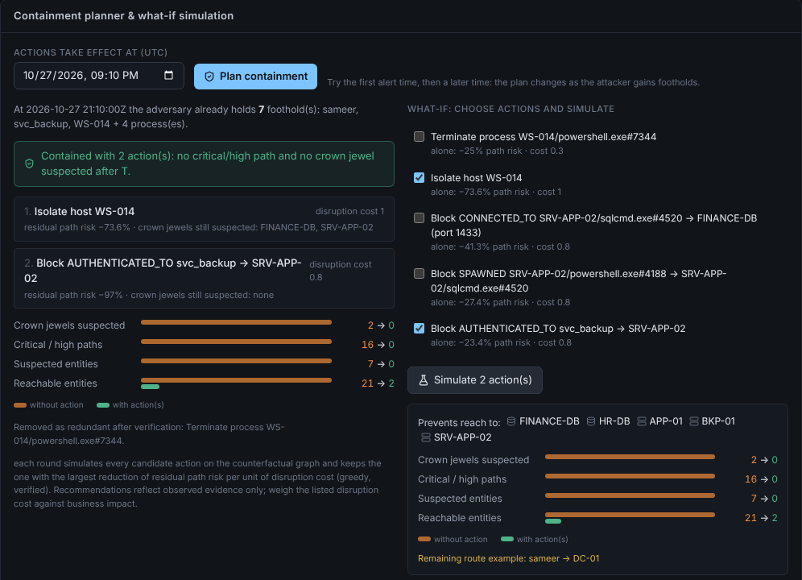
What to cut depends on when you act
15 · COUNTERFACTUAL CONTAINMENT
JUDGING · INNOVATION
Act at 20:41 · first alert
1 action
Attacker holds: sameer, WS-014
Isolate host WS-014
−98.7 % path risk · paths 57 → 1 · critical 48 → 0
Act at 21:10 · 30 min later
2 actions
LSASS dumped at 21:06: svc_backup credential stolen · 7 footholds
Isolate WS-014 + block svc_backup → SRV-APP-02
critical/high paths 16 → 0 · crown jewels 2 → 0
Method: remove every occurrence after T that touches the contained entity, re-run paths and blast radius, then pick the best risk reduction per unit of disruption cost.
Advisory only: the tool simulates and recommends; it never isolates a system. It shows the smallest cut that stops the modelled attack.
WHY
Notes:
Containment is simulated, not performed. We replay the graph as if an action had been taken at time T and measure what risk remains. Act at the first alert and isolating one workstation removes 98.7 percent of path risk. Act thirty minutes later and the service account credential is already stolen, so the planner adds a second action: block that account's logon to the app server. Same incident, different time, different plan. The analyst decides; the tool does not act on systems.

Slide 17
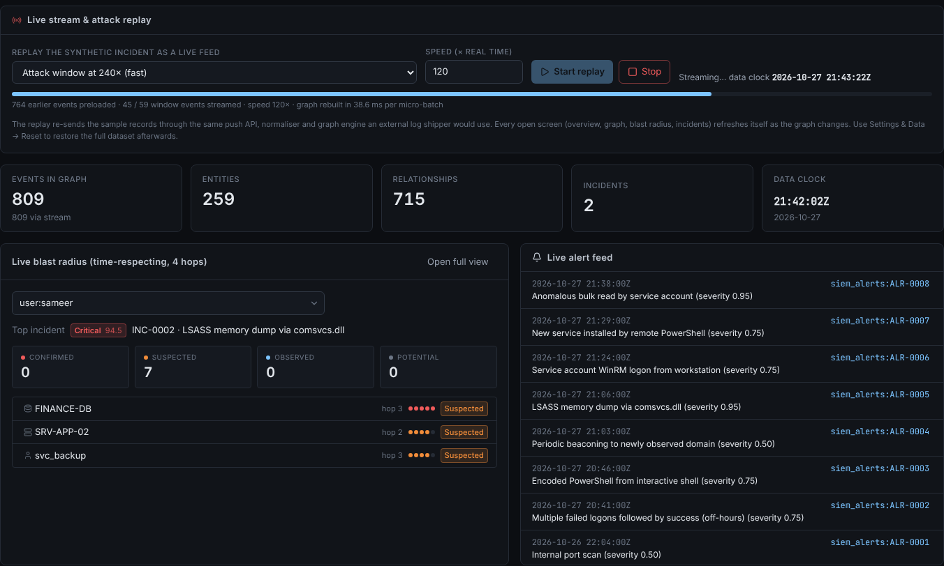
The picture builds while the attack is still happening
16 · REAL-TIME EVENT PROCESSING
JUDGING · PROBLEM ALIGNMENT
POST /api/stream/events
1
SIEM forwarder or log shipper pushes records
Same validation + normaliser
2
duplicates and bad rows rejected
Micro-batch every 0.4 s
3
graph rebuilt; 38.6 ms per batch in replay*
Version + 1 → Server-Sent Events
4
browser notified, refresh at most 1/s
Every view updates
5
blast radius, incidents, paths, graph
*Replay of the synthetic intrusion on a local machine. When the 21:32 read streams in, FINANCE-DB turns SUSPECTED and INC-0002 goes Critical.
T2.1 asks for the blast radius in real time. Live mode uses the same engine as batch analysis; there is no separate demo code path.
WHY
Notes:
Events can be pushed to an API. They pass the same validation and normaliser as file uploads, are micro-batched every 0.4 seconds, and every open view is notified through Server-Sent Events. In the replay the alerts arrive one by one; when the 21:32 database read streams in, FINANCE-DB flips to suspected and the incident goes critical. The 38.6 millisecond rebuild time is from this synthetic replay on one machine.

Slide 18


What we demonstrated, and what we do not claim
17 · PROTOTYPE VALIDATION
JUDGING · PROTOTYPE VALIDATION
105
95 %
88 ms
0.4 ms
automated tests passing
(incl. 6 browser end-to-end)
backend statement
coverage
ingest 7 files + build graph
(1,191 events)*
4-hop temporal
blast radius*
Demonstrated (tests assert these)
Not claimed
Principal path found, 4 of 4 hops suspicious, starts 20:40
Backup route rejected as temporally impossible
FINANCE-DB: SUSPECTED for attacker, POTENTIAL for admin
Bad rows, duplicate and ID conflict flagged
Exported report hash appears in the evidence manifest
No accuracy, precision, recall or F1: the only labels are synthetic, so a score would be circular
No enterprise-scale performance: timings are this dataset only
No live Neo4j / AuraDB validation
No analyst user study yet
*Medians of 5 runs on the synthetic dataset, one local machine. A tool that overclaims is a liability; we state the limits plainly.
WHY
Notes:
Validation: 105 automated tests pass, including six that drive the real UI in a browser, with 95 percent backend coverage. The tests assert known answers on the synthetic dataset: the right path, the rejected route, the attacker versus admin tiers, the flagged bad rows and the evidence hashes. Timings are medians on our synthetic data on one machine. We do not claim accuracy numbers, enterprise-scale performance, live AuraDB validation or analyst feedback.

Slide 19
Built to be run and trusted, with its limits stated
18 · ENGINEERING, LIMITS AND ROADMAP
JUDGING · TECHNICAL IMPLEMENTATION
Engineering
Limits today
Next steps
Engine
Data
Telemetry
Python 3.11+ · FastAPI · NetworkX · NumPy
synthetic dataset only
real connectors: Sysmon, Zeek, cloud audit logs
Interface
Backend
Calibration
React · TypeScript · React Flow · dagre
no live Neo4j / AuraDB validation
learn weights and τ from labelled data
Storage
Scale
Backend
in-memory; Neo4j optional (parameterised Cypher)
no enterprise-scale validation
validate the graph backend live
Controls
Users
Volume
uploads validated, never executed; SHA-256 hashes
no analyst study; no authentication yet
higher-volume streaming
Delivery
Connectors
People
run script · Docker · CI · MIT licence
file + push API only; no native SIEM connectors
analyst feedback loop; multi-user auth
Built with AI assistance (Anthropic Claude) under the team's direction; AI use and all third-party components are disclosed in the repository.
NOTE
Notes:
Engineering: Python and FastAPI with a NetworkX temporal graph and NumPy, a React and TypeScript interface with React Flow, and an optional Neo4j adapter. Uploads are validated and never executed; evidence is hashed. Limits: synthetic data only, no live Neo4j validation, no enterprise-scale or analyst testing, no authentication, and no native SIEM connectors yet. Next: real connectors, calibration on labelled data, live backend validation, higher-volume streaming and an analyst feedback loop with multi-user access control.

Slide 20



T2.1 asked three questions. Each has a traceable answer.
19 · SUMMARY
JUDGING · PROBLEM ALIGNMENT
Map attack paths
Time-feasible paths with evidence-backed explanations; impossible routes rejected with the reason.
Assess blast radius
Four evidence tiers, updated as events arrive; attacker and admin told apart on the same asset.
Build one incident picture
Correlated alerts, independent corroboration and time-aware containment simulation.
Demo video: demo/attackgraph_lens_demo.mp4 · Methods: docs/METHODOLOGY.md · Validation: docs/VALIDATION_REPORT.md (in the submission ZIP and repository)
Who was reached, in what order, and how do we know? AttackGraph Lens answers with the evidence behind every step.
WHY
Notes:
To close: T2.1 asked three questions. Attack paths: time-feasible, ranked, with impossible routes rejected. Blast radius: four evidence tiers, updated live. One incident picture: correlated alerts with independent corroboration and a time-aware containment simulation. For every answer we can show the record behind it. Thank you.

