Slide 1
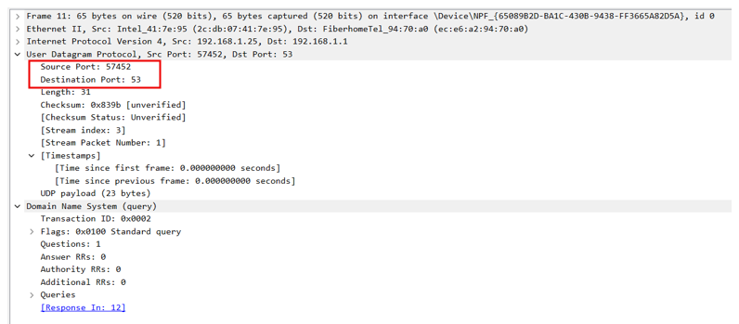
01
TCP vs UDP
Two transport protocols, both seen in one secure website visit
Samina Parveen| C11/26/FCDF/17139
Feature | TCP | UDP
Connection | Handshake first | None, sends at once
Reliability | ACKs + retransmission | No guarantee
Ordering | Sequence numbers | No ordering
Header / PDU | 20+ bytes / segment | 8 bytes / datagram
Speed | Slower, more overhead | Fast, low overhead
In my capture | HTTPS, port 443 | DNS, port 53
UDP: DNS query, source port 57452 to port 53, length 31
58.3%
packets were TCP (HTTPS/TLS)
3.1%
packets were UDP (DNS)
TCP session to 172.66.0.227:443: SYN, SYN-ACK, ACK, then TLS Client Hello (SNI = x.com).
TEAM-08 | TCP IP Communication in Action
01 / 04
Notes:
Good day everyone. I'm [your name], registration number [your reg. number], from TEAM-08. My part covers TCP versus UDP, application examples, one communication failure and the troubleshooting procedure.
TCP and UDP both work at the Transport layer. TCP is connection-oriented: it does a three-way handshake, acknowledges data, retransmits losses and keeps order, so it has a larger header and more overhead. UDP is connectionless with just an eight-byte header and no guarantees, so it is fast and light.
Both appear in my capture of opening x.com. The DNS query went out as one UDP datagram from port 57452 to port 53, length 31 bytes. Then the web session used TCP port 443: SYN, SYN-ACK, ACK and the TLS Client Hello. Wireshark shows about 58 percent of packets were TCP and about 3 percent UDP DNS.

Slide 2
02
Application examples
The right protocol depends on what the application can tolerate
TCP
UDP
Reliability first
Speed first
Secure web (HTTPS, 443) every byte must arrive in order
Email (SMTP, IMAP) messages must not be lost
File transfer (FTP, SFTP) one missing block corrupts the file
Remote access (SSH, RDP) commands must be exact
DNS lookups (53) one small question, one small answer
Video meetings, VoIP a late packet is useless
Live streaming, gaming current data beats retransmission
DHCP, NTP short request and reply
TEAM-08 | TCP IP Communication in Action
02 / 04
Notes:
Choose the protocol by what the application can tolerate. TCP suits reliability-first applications: secure web browsing on port 443, email, file transfer and remote access like SSH, because a lost byte can corrupt a file or a command. UDP suits speed-first applications: DNS lookups on port 53, video meetings and VoIP, live streaming and gaming, plus DHCP and NTP. There, a late packet is useless, so skipping it is better than waiting. Our own website visit used both.

Slide 3
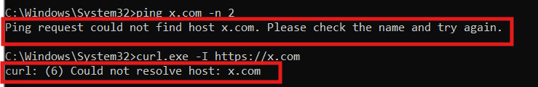
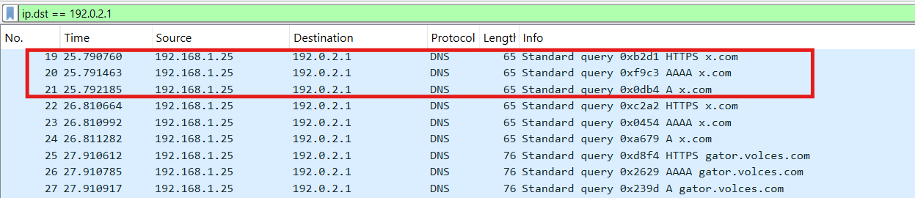
03
Communication failure
DNS not responding: website cannot be opened, network is healthy
Error seen by the user
What happened
Symptom: "Could not resolve host: x.com"
Cause: DNS server set to 192.0.2.1, where nothing answers
Layer: Application (DNS over UDP port 53)
Key clue: ping 8.8.8.8 still works, so IP and routing are fine
Wireshark: repeated DNS queries to 192.0.2.1, no reply
Second test, port 444 blocked: SYN sent and retransmitted 4 times, never answered. A firewall is likely dropping it.
TEAM-08 | TCP IP Communication in Action
03 / 04
Notes:
My failure is a DNS problem. I set the DNS server to 192.0.2.1, an address where nothing answers. The website would not open and the tools reported could not resolve host. In Wireshark the PC keeps repeating DNS queries with no reply. This shows the UDP trade-off: no built-in retransmission, so the application has to retry. The key clue is that pinging 8.8.8.8 still worked, so the network was fine and only name resolution was broken. I also tested port 444: the SYN was retransmitted four times with no answer, which points to a firewall blocking that port.

Slide 4
04
Troubleshooting procedure
Bottom-up: test one layer at a time, then fix and verify
1
Record the symptom
2
ping 8.8.8.8
3
nslookup x.com
Website fails with "Could not resolve host"
Replies: internet and routing work
Fails: name resolution is the fault
4
ipconfig /all
5
Wireshark capture
6
Fix and verify
DNS server is 192.0.2.1, not the router
DNS queries sent, no replies
Reset DNS to 192.168.1.1, flush cache, retest
Verified: gateway ping, 8.8.8.8 ping, nslookup, port 443 test, tracert (8 hops), curl HTTP 200 OK
TEAM-08 | TCP IP Communication in Action
04 / 04
Notes:
My method is bottom-up. One, record the symptom. Two, ping 8.8.8.8: it works, so the internet layer is fine. Three, nslookup fails, so the fault is name resolution. Four, ipconfig shows the wrong DNS server. Five, Wireshark confirms queries with no replies. Six, reset DNS to the router, flush the cache and verify every layer: the gateway, 8.8.8.8, nslookup, port 443, tracert with eight hops, and curl returning HTTP 200 OK.
In summary, TCP gives reliability, UDP gives speed, and a DNS fault can look like a total outage while IP and TCP are healthy. Thank you, I'm happy to take questions.

