Slide 1
Internship Project
By :-
SAMIT D MANVAR
4NM18CS152

Slide 2
Abstract
Vehicle repair service is all about time and quality.
Online Vehicle service is a responsive web application which provides functionality to both customers and the company.
Customers can book for a car service , provide feedbacks , check their service status
The admin can get a tabular view of service details , update services and carry out data analysis.
The web application needs to be responsive ( compatible across all platforms) .
To test the application for responsiveness a application called lambda test is used .
With help of LT Browser a application created by Lambda test helps us to carry out responsive testing

Slide 3
Introduction to the Industry
Exposys Data Labs aims to find solutions to these complicated problems in the coming months as we come up with cutting-edge ideas and apply them to the problematic issues we face today.
Website - http://www.exposysdata.com/
Industry - Software Development
Company size - 11-50 employees
Headquarters - Bengaluru, Karnataka
Founder & CEO - Y Vishnuvardhan

Slide 4










Tech Stack
Front End Back End Additional Libraries and software

Slide 5
Problem Statement
To create a Multi-Page Responsive Website (Web Application)

Slide 6
Objectives
To create a responsive online vehicle service management web application system.
Provide customers to book for a particular vehicle service with available time slots.
Provide the customers a convenient feedback section to express their views so that the company can decide how they can improve.
Allow customer to check the status of their vehicle service.
Provide the admin to get a tabular view of customer and service details.
Provide the admin to update customer’s service status.

Slide 7
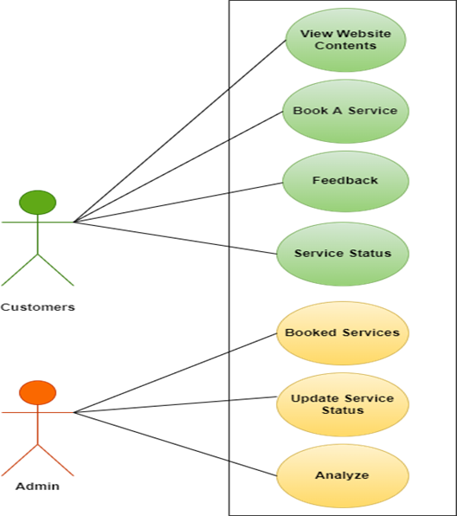
Design (Use Case)
Basic Design of Online Vehicle Service Management System

Slide 8
Details of Training Undergone
Front End UI Design
Designing the home page , navbar and adding contents such as about the company , services the company offers , footer etc.
Designing login page , sign up page
Registration form to book for a service , feedback form
Admin section includes Booked service details ,update service details and data analysis

Slide 9
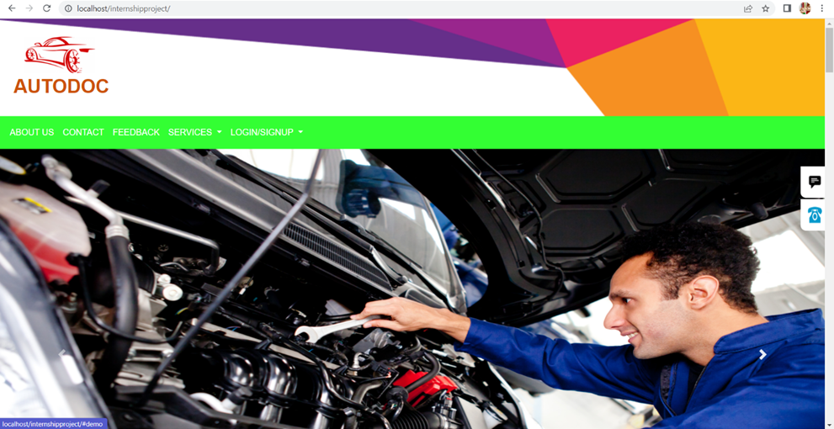
Home Page

Slide 10
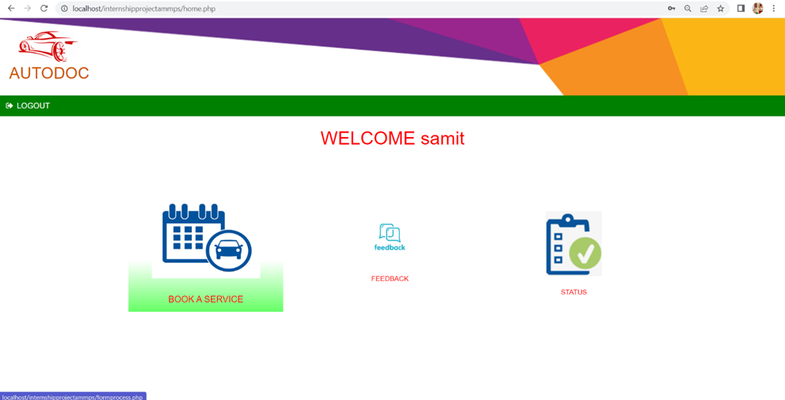
User Home Page

Slide 11
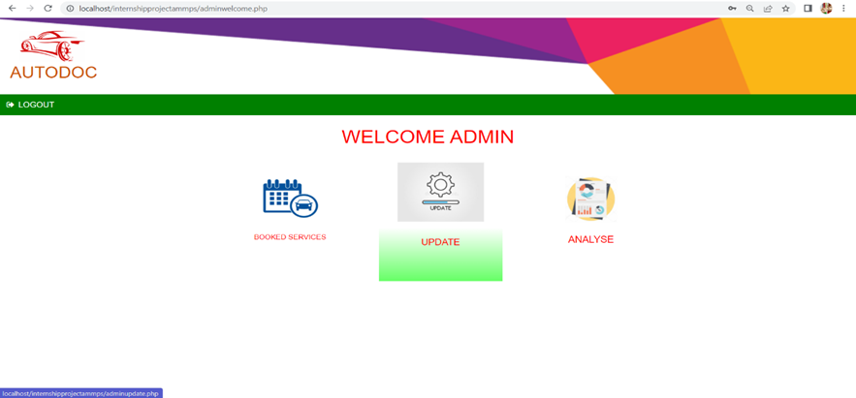
Admin Page

Slide 12
Backend Design
Server side scripting language PHP to process and store (insert) form data , fetch data and display data along with MYSQL
The form data is sent with the HTTP POST method (more secured). mysqli_query () function performs a query against a database.
The web application is made to run in localhost server using ampps/xampp server.

Slide 13
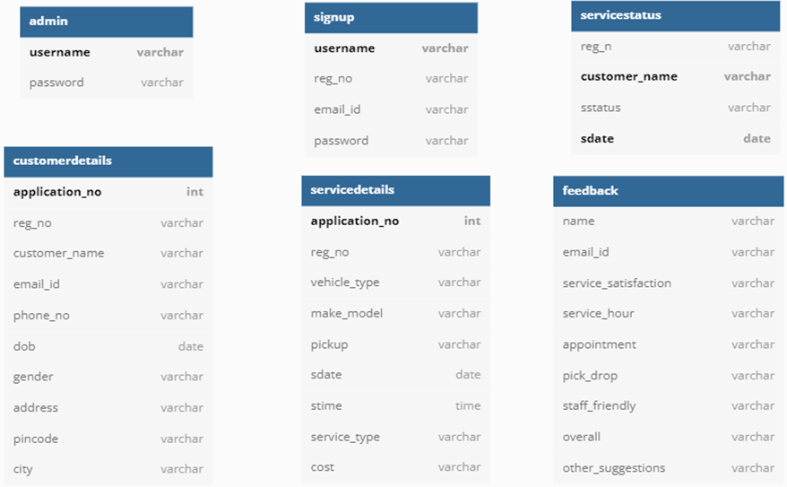
Relations (Tables)

Slide 14
Data Analysis
Graphical representation enables the quick analysis of large amounts of data at one time and can aid in making predictions and informed decision
Data analysis is done with help of google charts that uses data stored in database to carry out analysis such as percentage of services people choose, percentage of type of vehicles serviced (2 or 4 wheelers) etc.

Slide 15
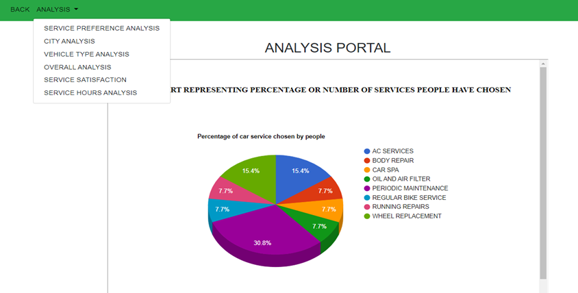
Analysis

Slide 16
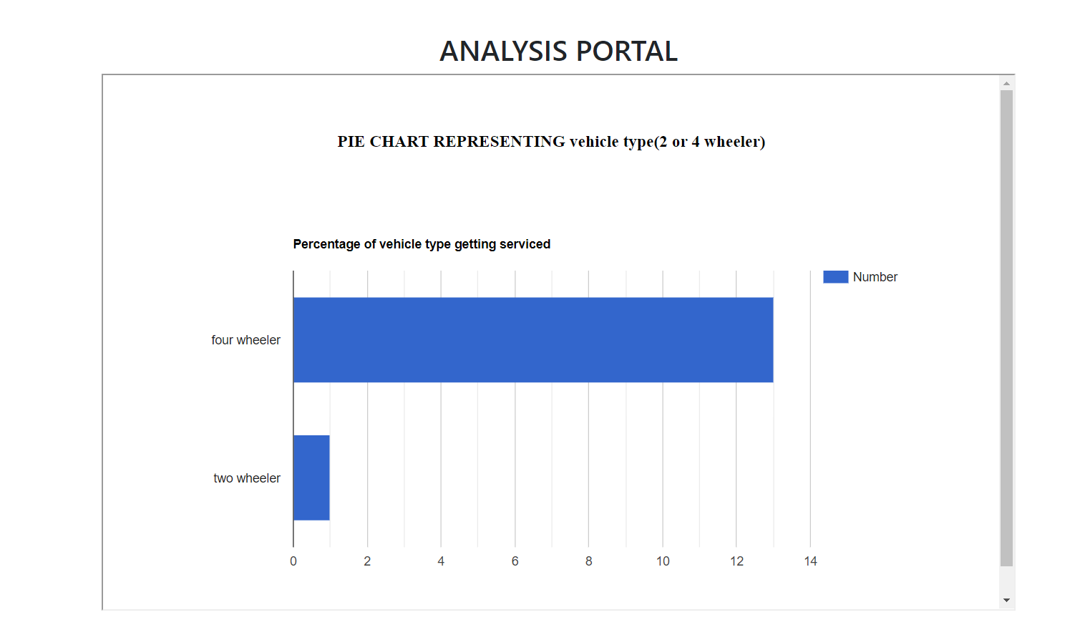
Analysis

Slide 17
Responsive Design and Testing
Responsive design is a way to put together a website so that it automatically scales its content and elements to match the screen size on which it is viewed
Bootstrap is used to create a responsive web application using the core concepts such as container,container-fluid grid systems etc.
LT Browser a software created by Lambda Test to test the application for responsiveness
Can carry out test for all devices such as mobile , tablets , laptop , desktop visually.

Slide 18
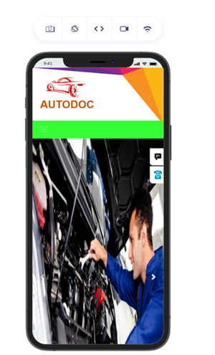
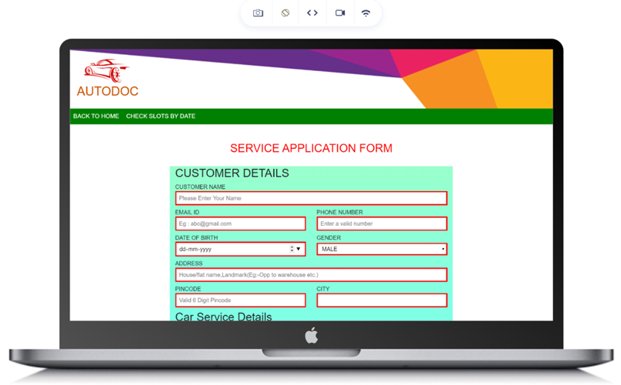
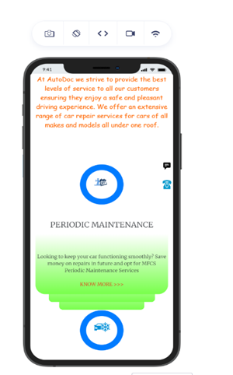
Responsive Testing
FF
T
Responsive Test

Slide 19
Thank You

