Slide 1
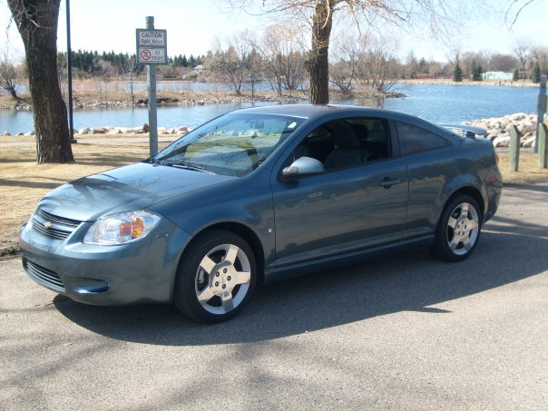
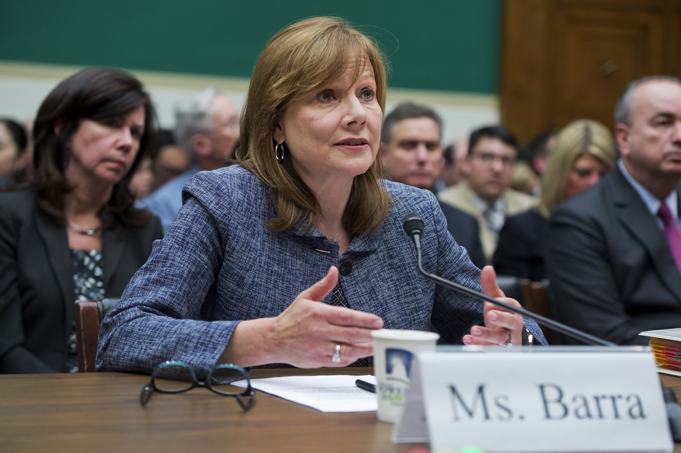
General Motors Ignition Switch Recall Scandal
Chevrolet Cobalt released in 2004.
2.6 million cars recalled in 2014.
At least 97 injuries and deaths related to faulty ignition switches since 2005.
On May 16, 2014, NHTSA fined GM $35 million.
As of May 2015, the company has set aside $550 million to compensate victims.

Slide 2
Ethical and Moral codes broken by General Motors:
Reports suggest that, GM engineers knew about the faulty switches from 2005 but they decided that it was to costly and time consuming to recall and fix these parts.
Many experts said that it wasn’t that costly and each switch fix would have taken less than an hour.
It was a total disregard for public safety from GM and they were more concerned with cutting costs than quality and safety.

Slide 3

Swift actions not taken by National Highway Traffic Safety Administration (NHTSA):
Vision of NHTSA:
National Highway Traffic Safety Administration (NHTSA) is dedicated to achieving the highest standards of excellence in the motor vehicle and highway safety.
National Highway Traffic Safety Administration connected the dots with that first death and the faulty ignition switches in 2007.
Ethical misconduct by NHTSA:
No proper investigation took place on that certain situation back in 2007.
NHTSA went easy on GM.

