Slide 1

ISTANBUL RETAIL · 2021–2023
Istanbul Retail Sales Analysis
Customer and transaction data, 2021–2023
Source: supplied Istanbul retail transaction dataset.

Slide 2

02
METHOD
DATASET
Dataset and calculation
The dataset contains 99,457 transactions from 10 Istanbul shopping malls between 2021 and 2023.
Each transaction has a unique invoice number.
CALCULATIONS
AGE GROUPS
Products sold = sum of quantity
Revenue = sum of quantity × unit price
18–30
31–50
51+
Source: supplied Istanbul retail transaction dataset.

Slide 3
03
RESULTS
EXHIBIT 01
Overall results
99,457
298,712
TL 251,505,794.25
Transactions
Products sold
Total revenue
Source: supplied Istanbul retail transaction dataset.

Slide 4
04
CUSTOMER MIX
EXHIBIT 02
Results by gender
The female group has higher totals in this dataset.
Group | Transactions | Products sold | Revenue | Share of transactions
Female | 59,482 | 178,659 | TL 150,207,136.02 | 59.81%
Male | 39,975 | 120,053 | TL 101,298,658.23 | 40.19%
Source: supplied Istanbul retail transaction dataset.

Slide 5
05
CUSTOMER MIX
EXHIBIT 03
Results by age group
The 31–50 group has the highest totals.
Age group | Transactions | Products sold | Revenue
18–30 | 25,024 | 75,172 | TL 63,047,402.11
31–50 | 38,332 | 115,006 | TL 97,150,259.90
51+ | 36,101 | 108,534 | TL 91,308,132.24
Source: supplied Istanbul retail transaction dataset.

Slide 6
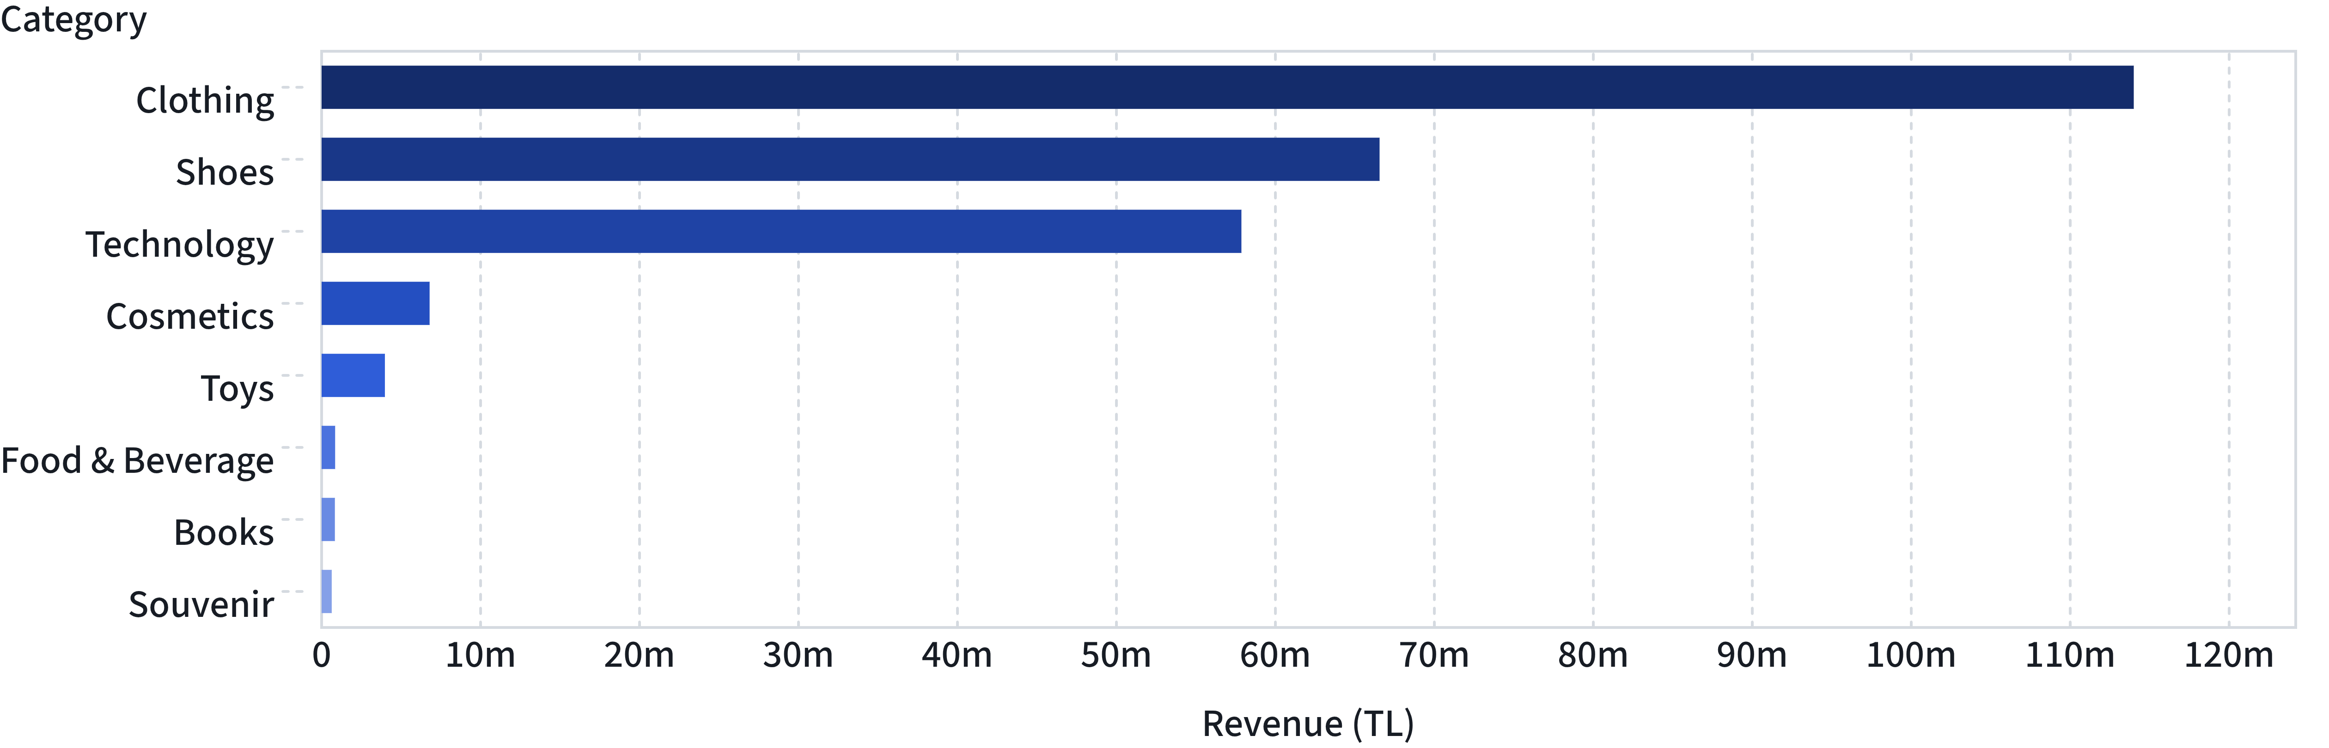
06
PRODUCT MIX
EXHIBIT 04
Revenue by product category
Clothing has the highest revenue, followed by shoes and technology. This is revenue, not profit.
Source: supplied Istanbul retail transaction dataset.

Slide 7
07
PAYMENT
EXHIBIT 05
Payment methods
Cash is used most often. The average transaction values are similar.
Method | Transactions | Share | Revenue | Average transaction value
Cash | 44,447 | 44.69% | TL 112,832,243.02 | TL 2,538.58
Credit Card | 34,931 | 35.12% | TL 88,077,123.77 | TL 2,521.46
Debit Card | 20,079 | 20.19% | TL 50,596,427.46 | TL 2,519.87
Source: supplied Istanbul retail transaction dataset.

Slide 8

CONCLUSION AND LIMITS
Conclusion and limits
The female group has higher transaction, product, and revenue totals.
Ages 31–50 have the highest totals among the age groups.
Clothing has the highest category revenue.
Cash is the most-used payment method.
The dataset has no product cost information, so profit and profit margin cannot be calculated.
This data does not show why customers buy, and it does not show that any action would raise sales.
Source: supplied Istanbul retail transaction dataset.

