Slide 1
Dashboard findings
HR Analytics
Workforce Report
Dashboard findings and recommended next steps.
The dashboard shows workforce size, employee mix, department and state distribution, and hiring records by year.

Slide 2
Key measures
19K
42.03
Active employees
Average age
75.02%
24.98%
HQ share
Remote share
Note: 19K is rounded. The dashboard shows no exact count and no as-of date.

Slide 3

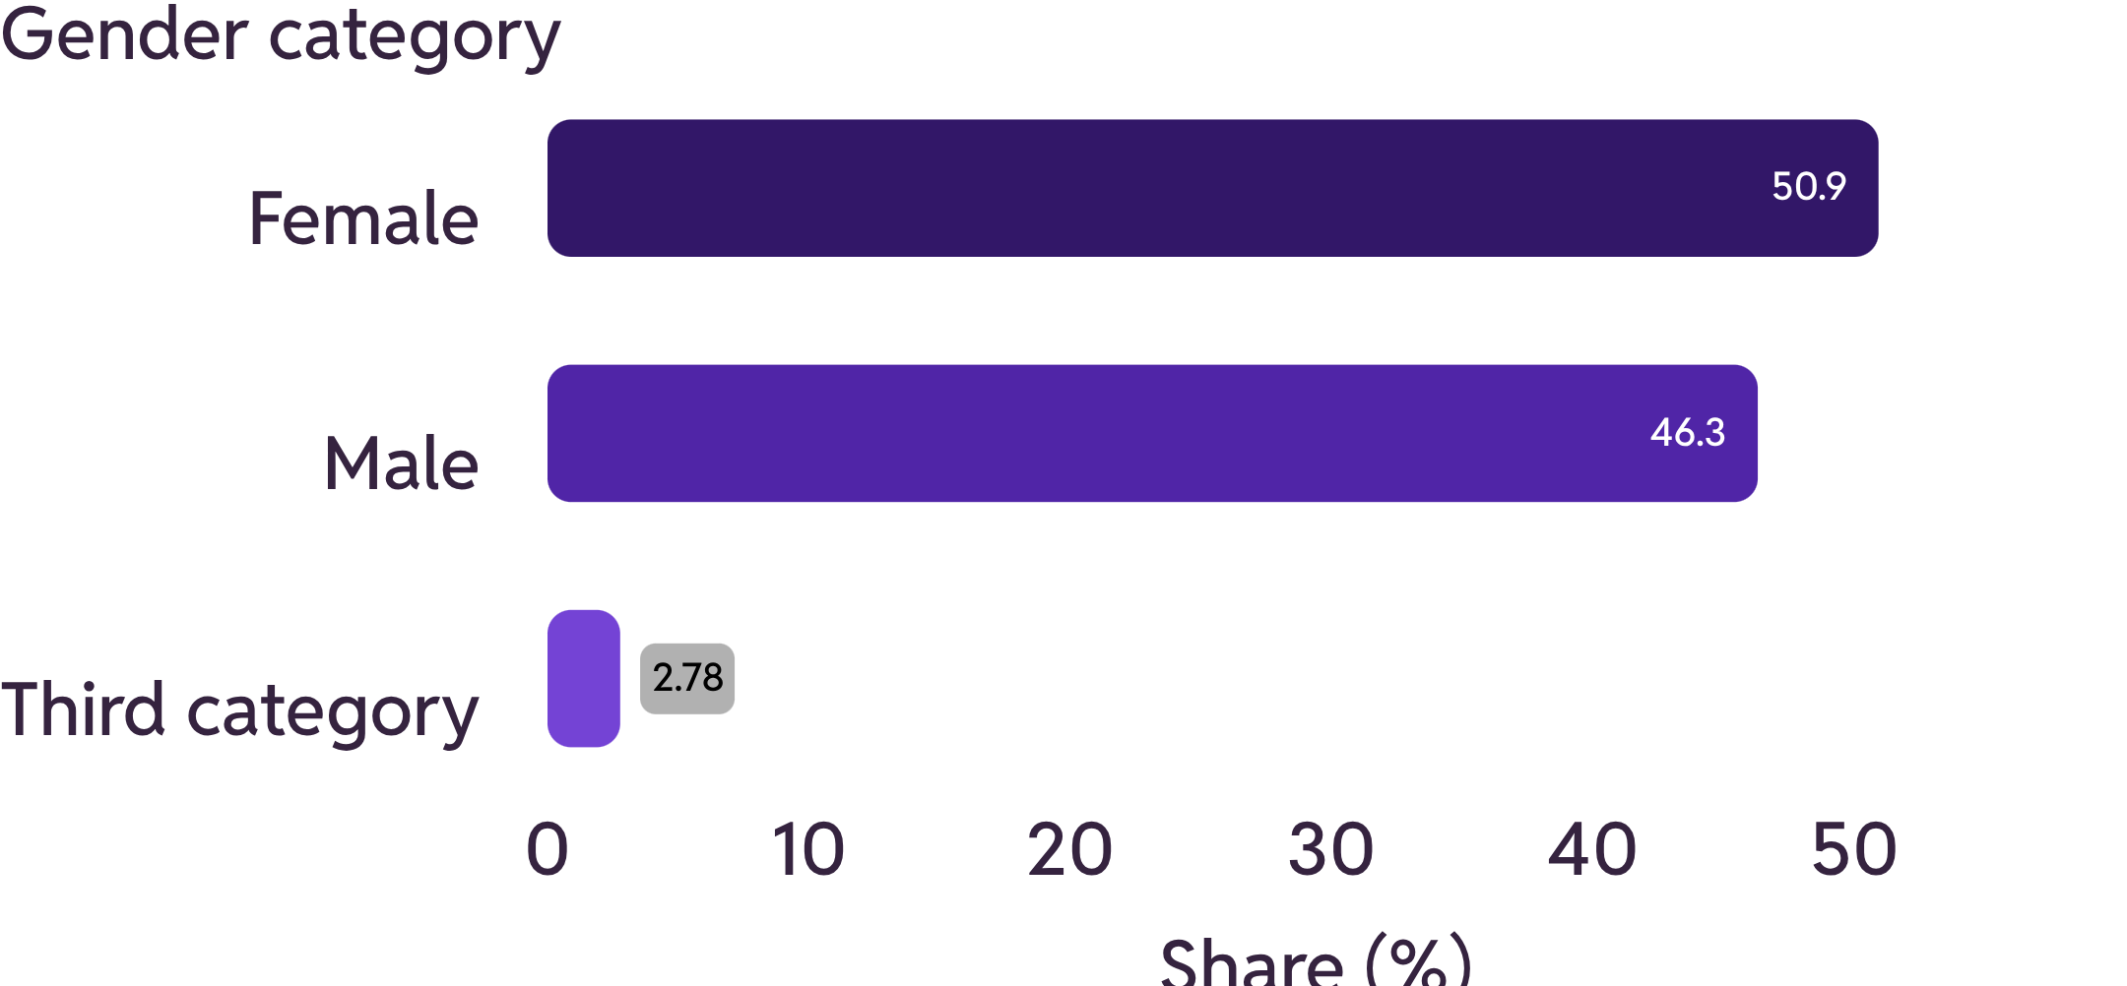
Employee mix
Female: 50.92% · Male: 46.3% · Third category: 2.78%
The third category label is cut off in the screenshot; its full name is not shown.
White is the largest race category displayed. The dashboard gives no exact race counts here.

Slide 4
Department and state distribution
Department
State
Engineering
Ohio
Engineering is the largest department shown. Accounting is next.
Ohio is much larger than the other states shown.
These are patterns on the dashboard. They do not explain why the differences exist.

Slide 5
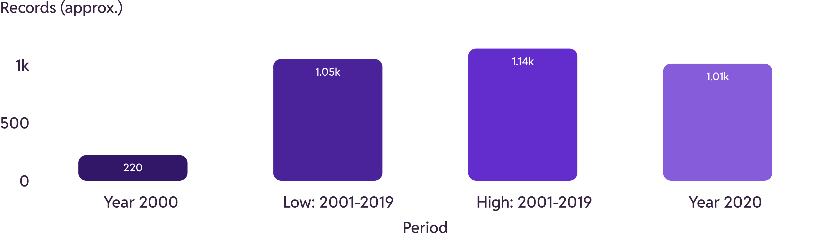
Hiring records by year
Approximate hiring records by year. All values are estimated from the line chart.
2000: about 220 records (approximate). 2001 to 2019: roughly 1.05K to 1.14K per year (approximate). 2020: about 1.01K (approximate).
The middle bars show the low and high estimates for 2001 to 2019, not individual years. The dashboard does not say if 2000 and 2020 are full years.

Slide 6
Recommended checks
01
Confirm the exact active employee count, date, and filters.
02
Check what the HQ and state fields mean.
03
Confirm whether 2000 and 2020 are full years.
04
Show the full gender category name and demographic denominators.
05
Add turnover, exits, tenure, and headcount change for more context.
Note: the hiring chart is labeled "Employee Records by Hire Year." The other distribution charts are labeled "Active Employees." Do not assume they use the same employee population.

