Slide 1
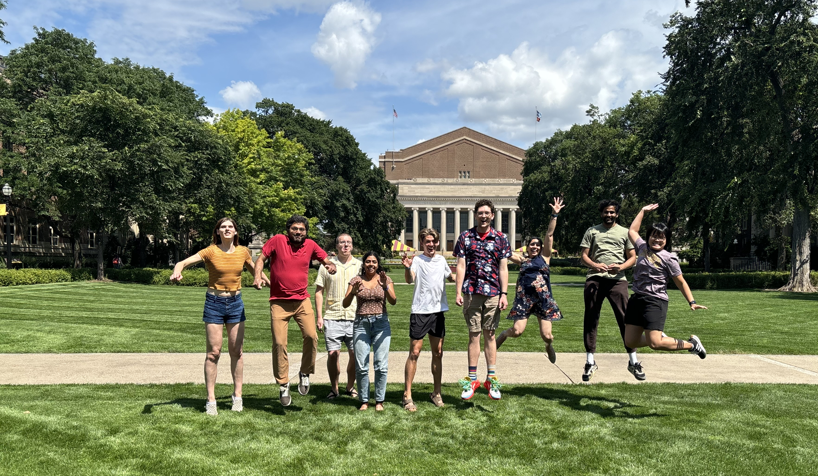
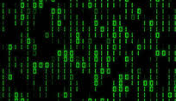

Simulations and Advanced Methods for Probing Energy Landscapes (SAMPEL)
Simulations and Advanced Methods for Probing Energy Landscapes
(SAMPEL)
Molecular engineering of materials to solve societal challenges using computational molecular science
PI: Sapna Sarupria (sarupria@umn.edu)
Molecular dynamics
Advanced sampling
Machine learning
Notes:
Good morning and welcome to the University of Minnesota. I hope you are as excited to be here and start your journey here as we are! In these next 7 mins I will give you a quick overview of our group and the projects we have available for incoming students. I am hoping to recruit two students in the group this Fall.

Slide 2
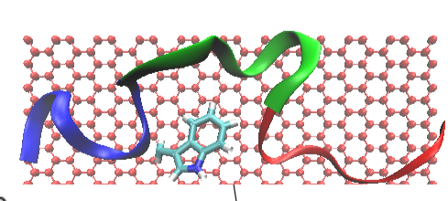
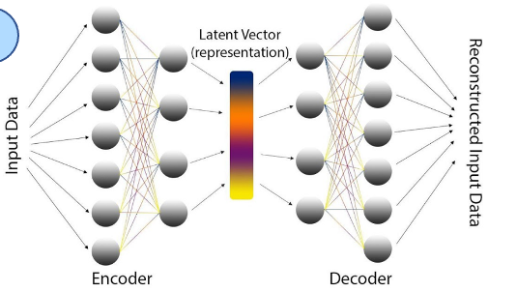
​Simulations and Advanced Methods for Probing Energy Landscape
Discovering novel materials
Anti-icing surfaces
for drug delivery
for vaccine stabilization
for peptide-based sensors
for plastic degradation (enzyme engineering)
for engineering crystallization
Computational collaborators
Enhanced simulation methods
Advanced molecular simulation methods
Molecular dynamics
Machine learning
Experimental collaborators
PI: Sapna Sarupria (sarupria@umn.edu)

Slide 4
​Simulations and Advanced Methods for Probing Energy Landscape
Advancing materials discovery using computational molecular science and data science
1 student
Multiple projects with choice of matching interests with projects
Integration of multiscale modeling, machine learning, simulations
Experimental and computational collaborators

Slide 5
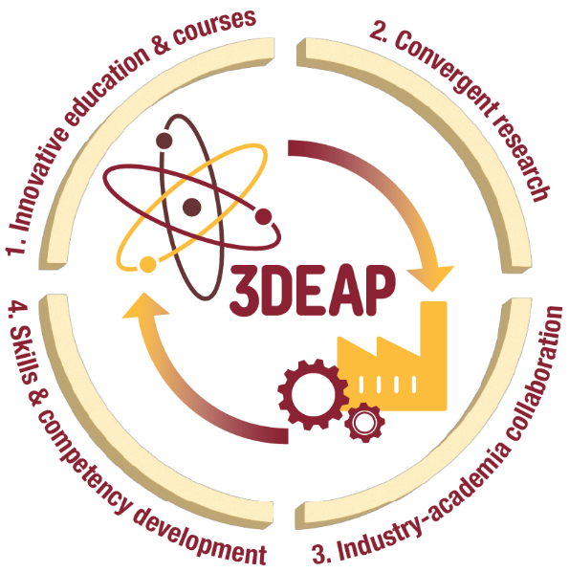
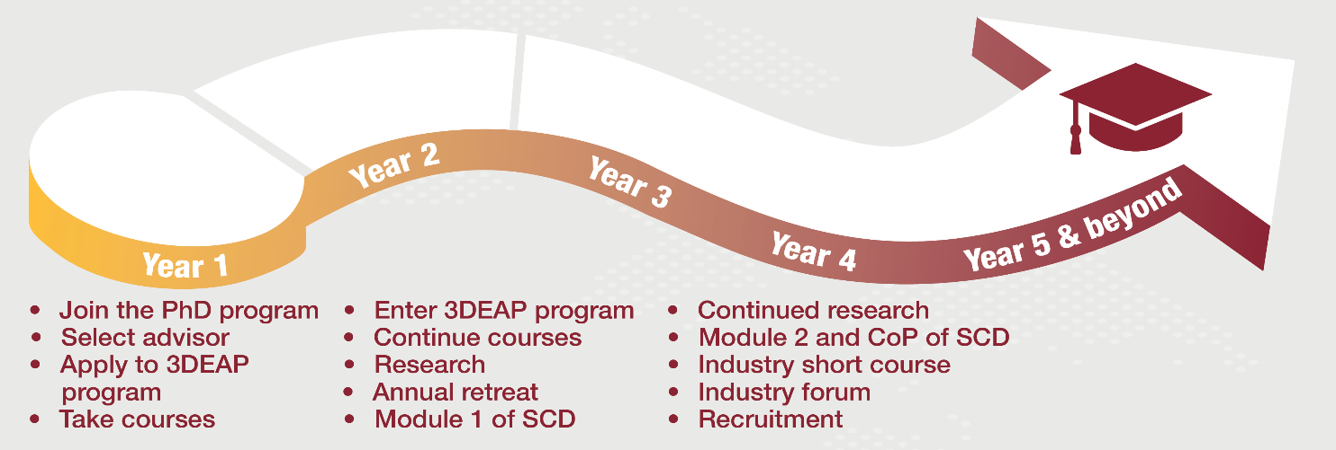
New NSF NRT Program:
Data-Driven Discovery and Engineering from Atoms to Processes (3DEAP)
What is it about? Bridging chemical, biological, and materials engineering with data science and systems engineering
What will we do?
Integrative curriculum leading to a MSDS CEMS
Collaborative research in sustainability, energy, and health, integrating atomic-scale materials discovery with process-scale design and optimization.
Interact and engage with industry leaders.
What will we learn?
Technical skills: domain disciplines, data science and systems engineering.
Professional and soft skills: Cultivate communication, teamwork, and leadership skills; ethics, inclusion and cultural competency; and mental health awareness

Slide 6
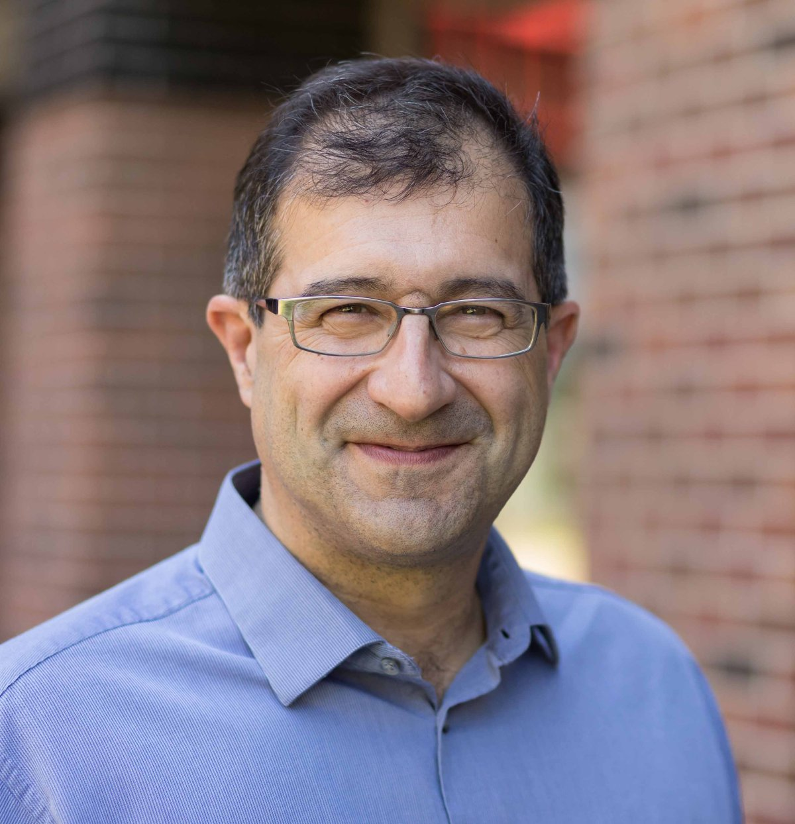
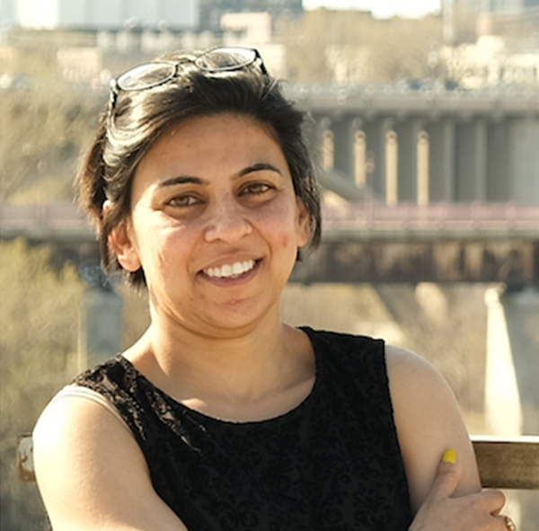
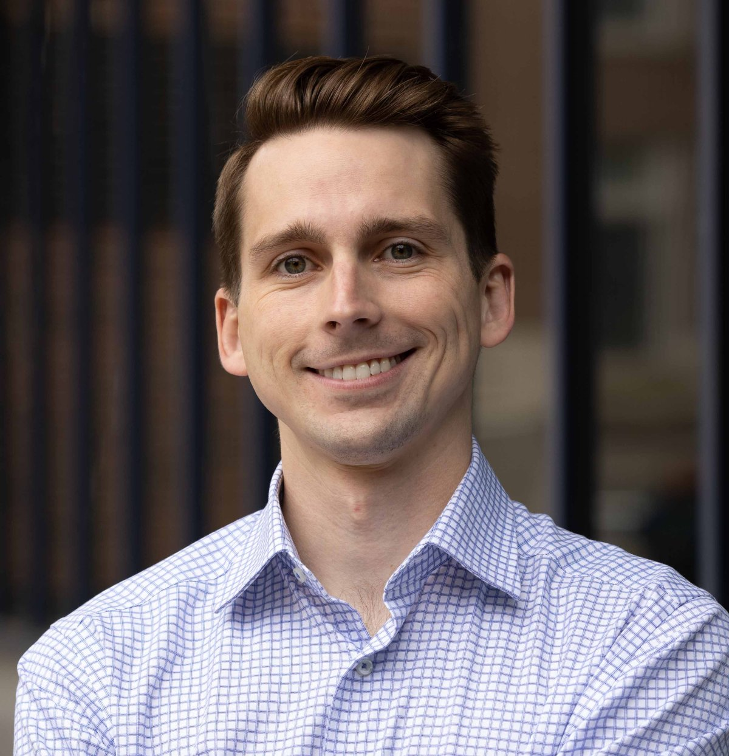
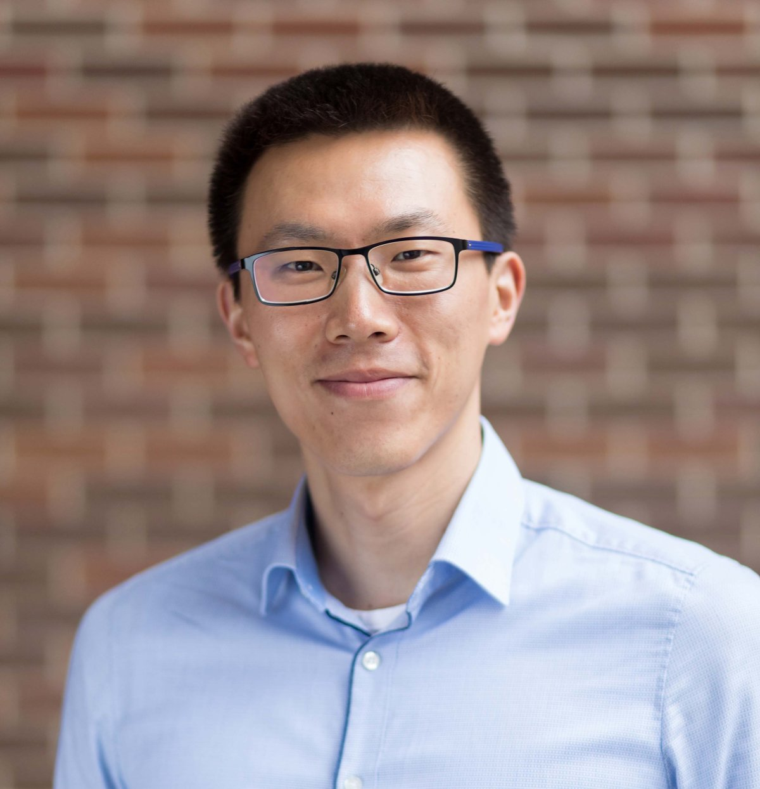
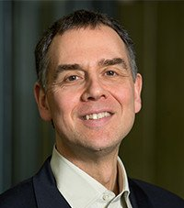
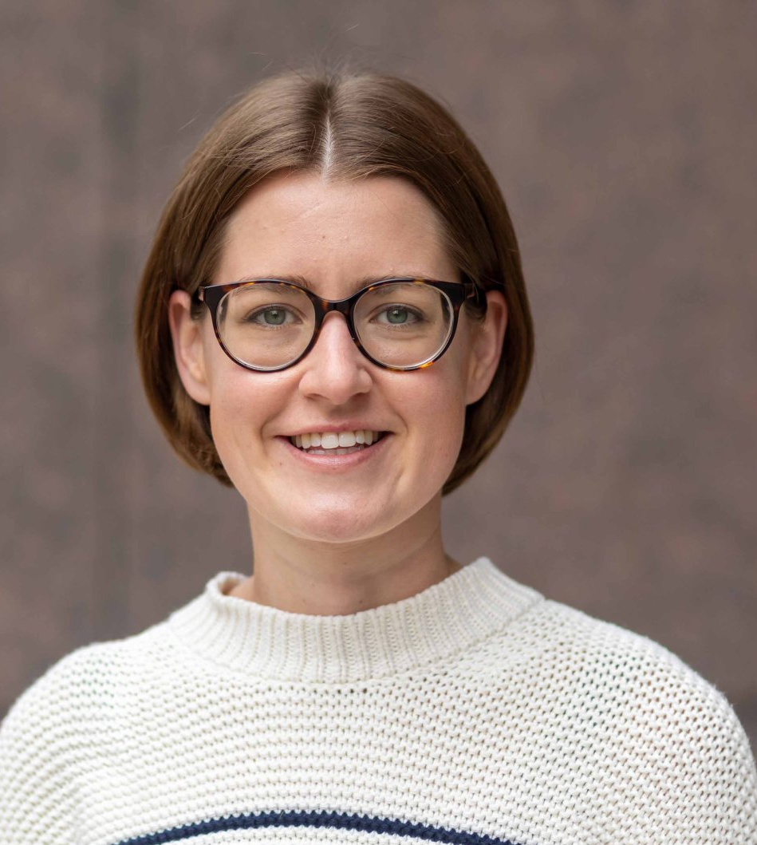
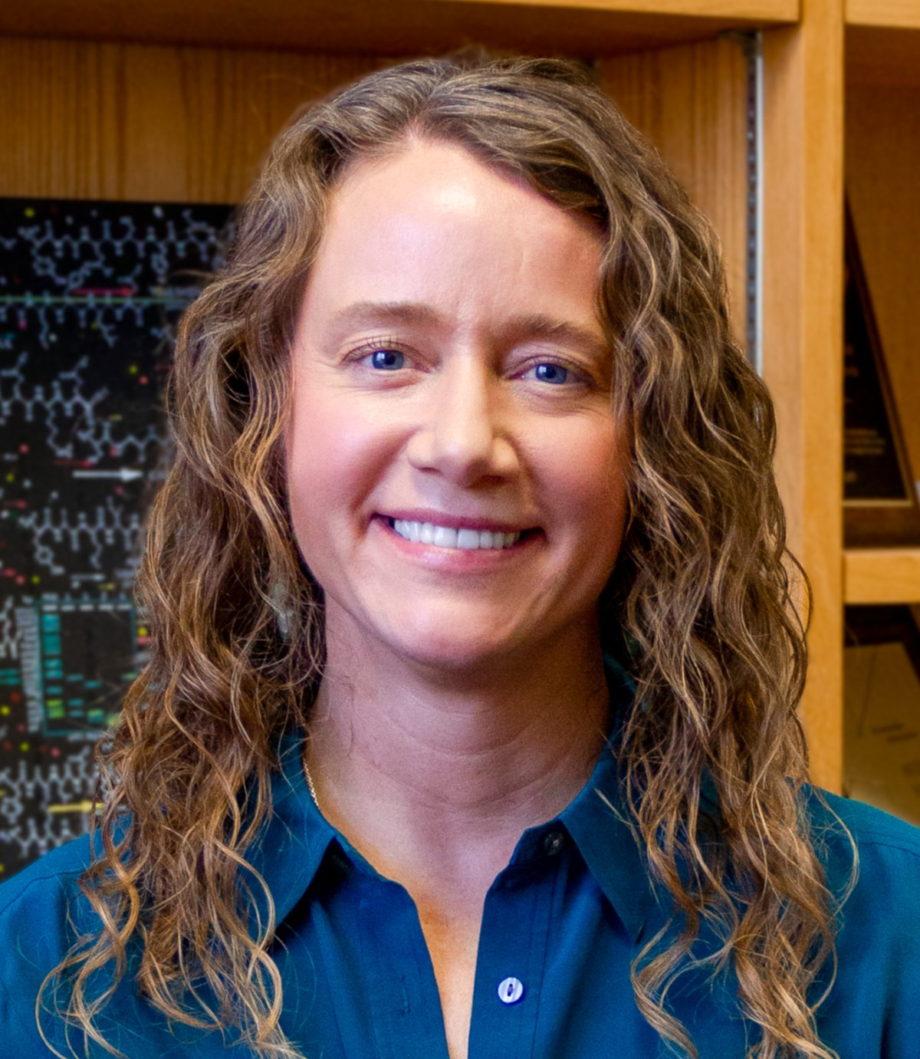
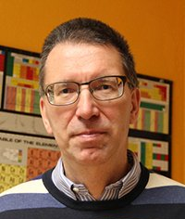
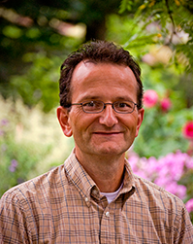
How can you join the New 3DEAP NRT Program?
Projects should be collaborative, co-advised by participating core faculty.
Applications will open in late Fall. Program website is coming soon.
Funding through the NRT program is available only for US citizens, nationals, and permanent residents. International students can participate as non-stipend supported trainees.
Participating Core Faculty
Prodromos Daoutidis
Director (CEMS)
Sapna Sarupria
Co-Director (Chemistry)
Chris Bartel (CEMS)
Qi Zhang (CEMS)
Ellad Tadmor (AEM)
Natalie Boehnke (CEMS)
Theresa Reineke (Chemistry)
Ilja Siepmann (Chemistry)
George Karypis (CS)

Slide 7
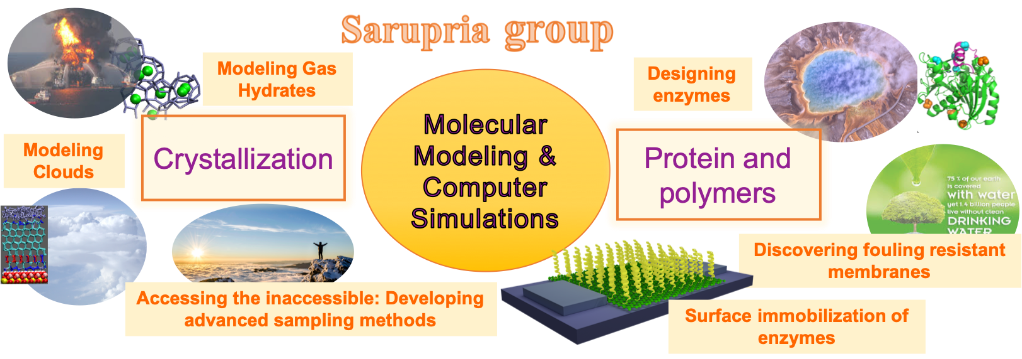
SAMPEL Lab
sampel-group.github.io/
Please reach out: sarupria@umn.edu
Collaborative work is highly encouraged!
No prior computational experience is needed to join the lab. Just need you to be excited about the project and research!

