Slide 1



Molecular Phenomena
in Aqueous Systems
Molecular Simulations
& Machine Learning
Advanced Sampling
Methods & Software

Slide 2
Molecular Simulations
& Machine
Learning
Molecular Phenomena
in Aqueous Systems
Advanced
Sampling
Methods
& Software

Slide 3
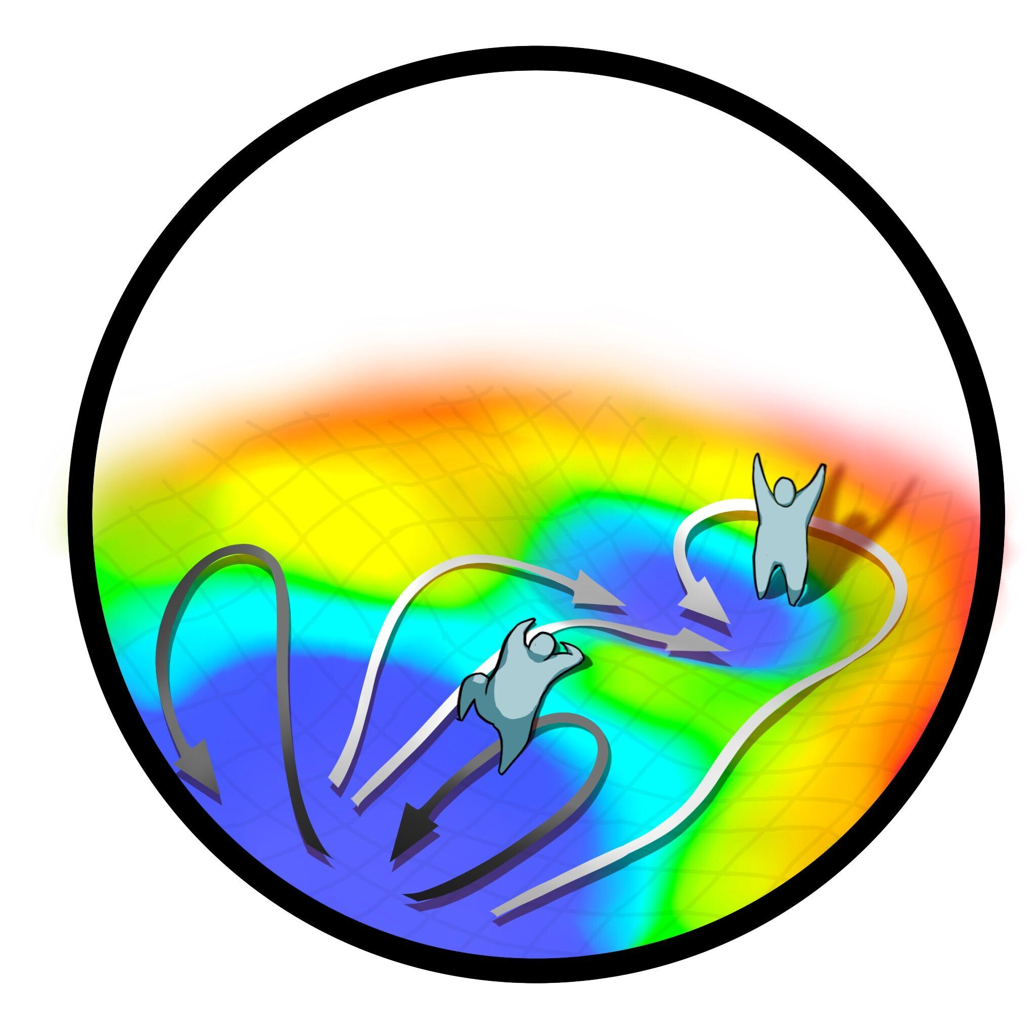
SAMPEL

Slide 4
SAMPEL
sarupriagroup.github.io

Slide 5
Advanced Sampling
Methods & Software
Molecular Simulations
& Machine Learning
Molecular Phenomena
in Aqueous Systems
SAMPEL

Slide 6
Advanced Sampling
Methods & Software
Molecular Simulations
& Machine Learning
Molecular Phenomena
in Aqueous Systems
SAMPEL
sarupriagroup.github.io

Slide 7
Advanced Sampling
Methods & Software
Molecular Simulations
& Machine Learning
Molecular Phenomena
in Aqueous Systems
SAMPEL

