Slide 1



Forest Fire Detection Using Deep learning

Slide 2

Learning Objectives
Understand the need for early forest fire detection.
Learn how to apply Deep Learning (CNN) for image classification.
Implement a model to distinguish between fire and non-fire images.
Evaluate the model’s performance using accuracy and loss metrics.
GOAL
Source :
www.freepik.com/

Slide 3
Tools and Technology used
Programming Language: Python
Libraries:
TensorFlow / Keras
OpenCV
NumPy
Matplotlib
Development Environment: Google Colab
Dataset: Custom image dataset with two classes (fire, no fire)

Slide 4
Methodology
Data Collection: Dataset organized into 1/ (Fire) and 0/ (No Fire) folders.
Preprocessing: Resizing, normalization, label encoding.
Model Architecture:
Conv2D → MaxPooling → Dropout → Dense Layers
Training & Validation: 80/20 split with real-time feedback.
Testing: Upload new images and predict fire presence.

Slide 5
Problem Statement:
Problem: Forest fires are a major threat to ecosystems, often going undetected until it’s too late.
Challenge: Manual detection is slow and inefficient.
Goal: Develop an automated, real-time detection system using deep learning.

Slide 6
Solution:
Built a Convolutional Neural Network (CNN) model.
Trained it on labeled fire and no-fire images.
Used image preprocessing and data augmentation to improve accuracy.
Deployed the model to classify new images and alert if fire is detected.

Slide 7
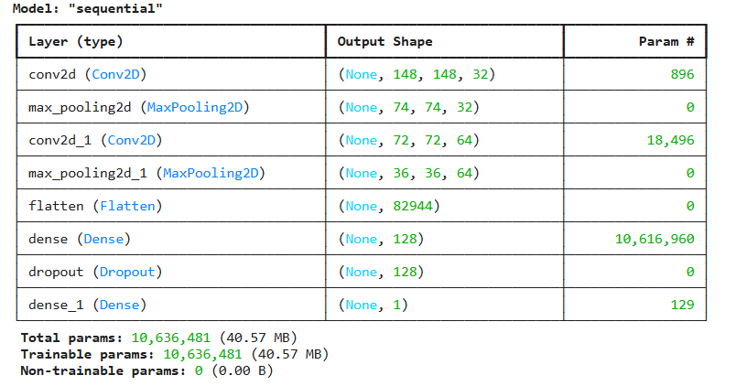
Screenshot of Output:

Slide 8
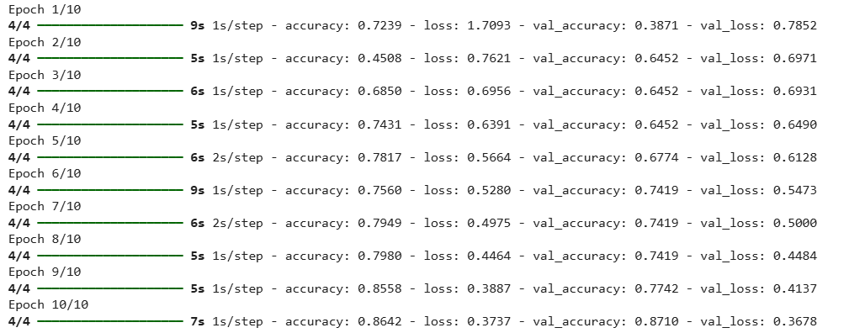
Screenshot of Output:

Slide 9
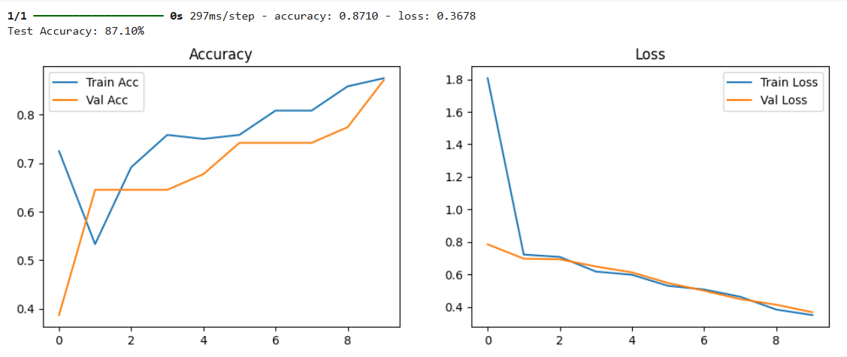
Screenshot of Output:

Slide 10
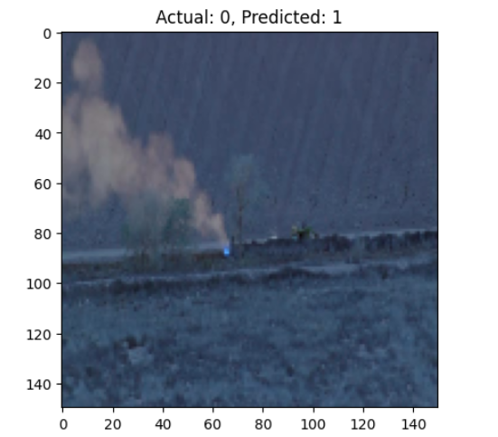
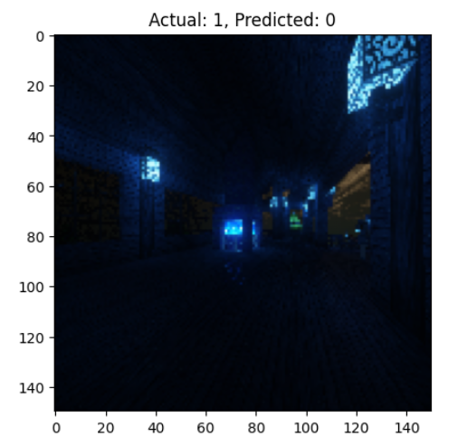
Screenshot of Output:

Slide 11
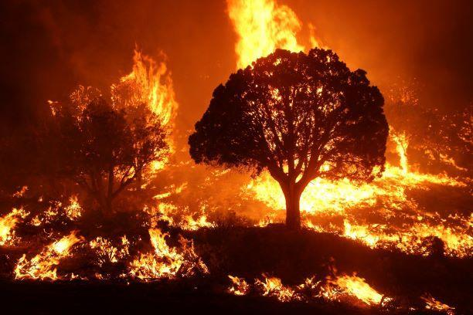
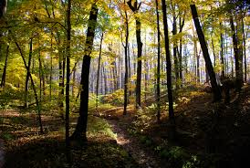
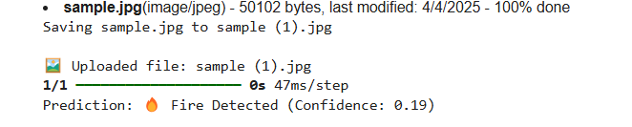
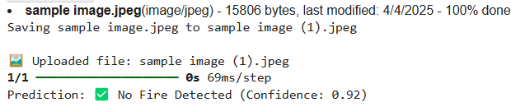
Screenshot of Output:

Slide 12
Conclusion:
Deep Learning effectively detects fire with high accuracy.
Real-time image classification supports early warning systems.
Can be integrated with surveillance drones or CCTV systems.
Future Scope: Add video stream support and integrate with alert systems.

