Slide 1



Introduction to Captcha Recognition
Captchas are security challenges used to verify that a user is human, not a bot. Traditional captchas can be difficult to read, hindering user experience. Automated captcha recognition using convolutional neural networks (CNNs) offers a more efficient and user-friendly solution.
by SAMUDHRA V
Notes:
2

Slide 2

Challenges with Traditional Captchas
1
Readability Issues
2
Ineffective against Bots
Traditional captchas can be distorted and difficult for users to decipher, leading to frustration and abandoned logins.
Sophisticated bots can often bypass traditional captchas, undermining their security purpose.
3
Poor Accessibility
Captchas can pose challenges for users with visual impairments or other disabilities.
Notes:
3

Slide 3
Benefits of CNN-based Captcha Recognition
Improved Accuracy
Enhanced User Experience
Stronger Security
CNNs can accurately identify and decipher captcha elements with a high degree of reliability.
CNN-based captcha recognition is more user-friendly, reducing frustration and abandoned logins.
CNN models are better equipped to distinguish between human users and sophisticated bots.
Notes:
4

Slide 4
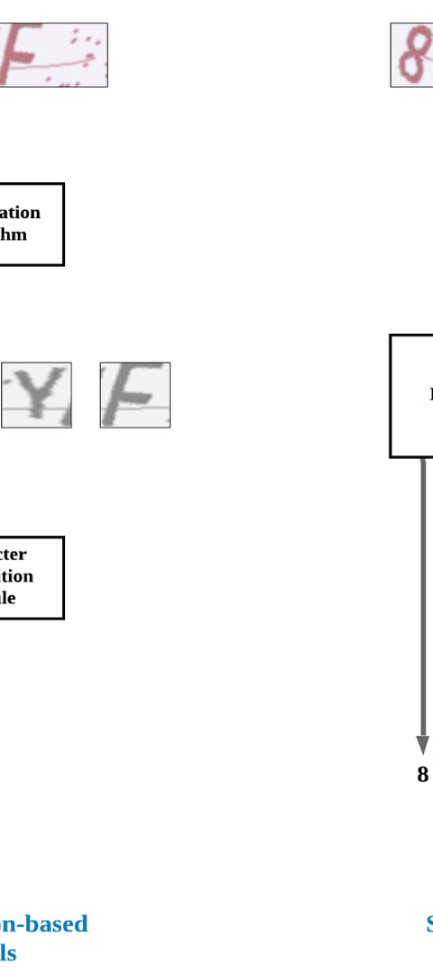
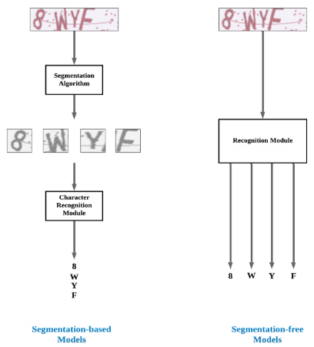
CNN Architecture for Captcha Recognition
1
Input Layer
The CNN model takes a captcha image as input, typically resized to a standard size.
2
Convolutional Layers
These layers extract visual features from the image, such as edges, shapes, and patterns.
3
Pooling Layers
Pooling layers reduce the dimensionality of the feature maps, making the model more efficient.
Notes:
5

Slide 5
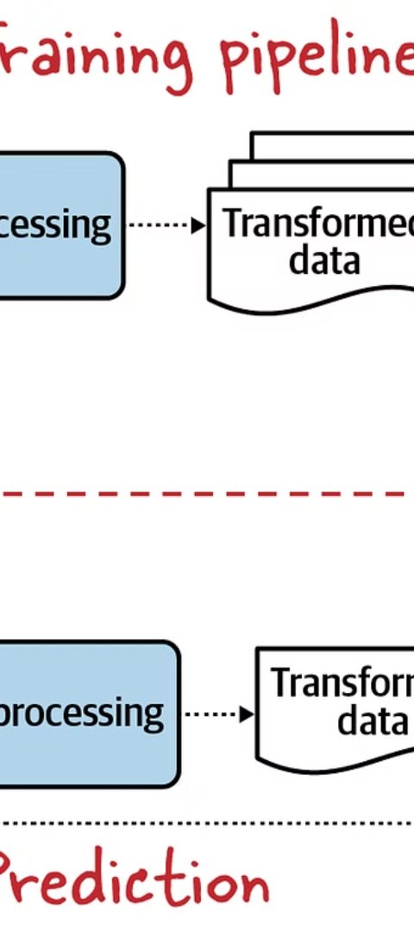
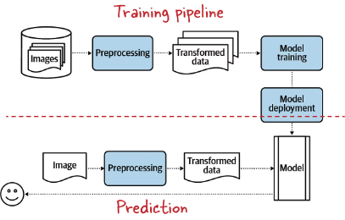
Data Preprocessing and Augmentation
Data Preprocessing
Data Augmentation
Captcha images may need to be normalized, resized, and converted to grayscale to prepare them for the CNN model.
Techniques like rotation, scaling, and noise addition can be used to artificially expand the training dataset and improve model generalization.
Transfer Learning
Pre-trained CNN models can be fine-tuned on captcha data, leveraging their learned features to achieve higher accuracy.
Notes:
7

Slide 6




Model Training and Optimization
Hyperparameter Tuning
Regularization Techniques
Performance Evaluation
Careful selection of hyperparameters, such as learning rate and batch size, can significantly impact the model's performance.
Techniques like dropout and L2 regularization can help prevent overfitting and improve the model's generalization.
The model's accuracy, precision, recall, and F1-score should be evaluated on a held-out test set.
Notes:
8

Slide 7



Deployment and Integration with Login Systems
Server Integration
API Integration
Secure Implementation
The trained CNN model can be deployed on a server to process captcha images in real-time.
The captcha recognition functionality can be exposed as an API, allowing easy integration with login systems.
Measures like input validation and rate limiting should be implemented to ensure the security of the captcha recognition system.
Notes:
9

Slide 8
Conclusion and Future Considerations
Continuous Improvement
Accessibility Enhancements
Ethical Considerations
As captcha techniques evolve, the CNN model should be regularly updated and retrained to maintain its effectiveness.
Integrating accessibility features, such as audio captchas, can improve the inclusivity of the captcha recognition system.
Developers should ensure that the captcha recognition system does not discriminate against users and respects their privacy.
Output Viedo:
https://youtu.be/aaxBWMdpd9g
Notes:
10

