Slide 1
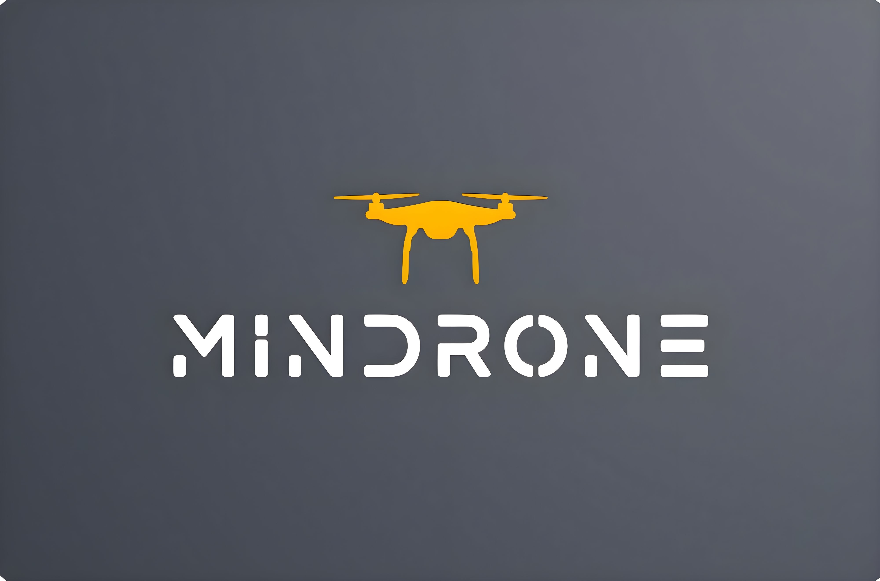

Slide 2
TEAM
We are a group of boys attending the fourth year of secondary school ITIS Mario Delpozzo, Cuneo.
Each of us dealt with a very specific area of the project:
Menardi Samuele, the leader, who takes care of the organisation of the work and coordination of the team in addition to the study, development and programming of the Muse2 sensor.
Giraudo Giacomo and Pellegrino Gabriele, drone managers, development, study, and drone programming.
Leardi Ludovico and Serra Alberto, sensors managers, study, development and programming of the Muse2 sensor.

Slide 3
PROJECT
Our project is thought for people suffering from ALS (Amyotrophic Lateral Sclerosis) or multiple sclerosis and allow them to visit museums directly from their home through a drone called Tello. For people suffering from ASL that, in the advanced states of the disease, can't move any muscle, we developed an automatic flight mode. The user can continue to use the power of the brain concentration. We are able to catch brain waves through a device called Muse2. After receiving a minimum signal of concentration, the drone rises and follows a pre-set path, in which it scans the qr codes and shows the corresponding image of a certain artistic work. While, if users are suffering from multiple sclerosis and they can move neck muscles, they can activate a second mode based on the movements of the neck to manage the direction of the drone in museums. Everything is developed in python.

Slide 4
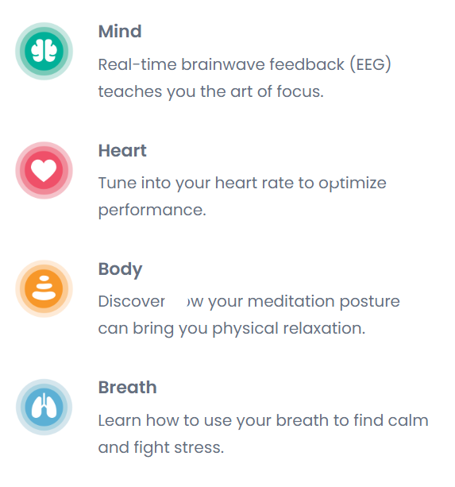
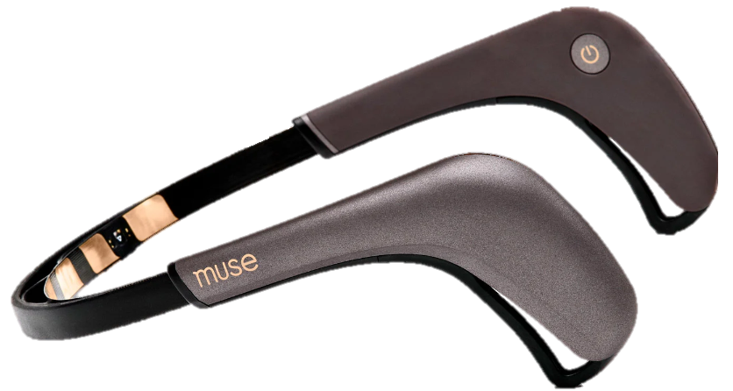
MUSE2
Muse 2 is a multi-sensor meditation device that provides real-time feedback on your brain activity, heart rate, breathing, and body movements to help you build a consistent meditation practice.

Slide 5
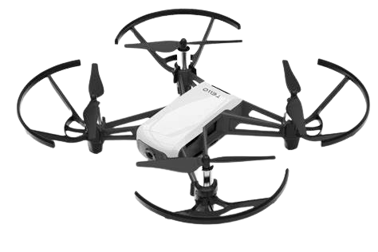
TELLO DRONE
The DJI Tello Drone is made in collaboration with Ryze Tech and developed to be a fun and educational quadcopter drone. The included battery allows 13 minutes of flight with a full charge.
The front of the Tello has a camera that can play 720p video and capture 5 megapixel photos during flight. The intelligent flight processor can coordinate camera movements for a number of custom recording angles. The positioning system uses a downward facing camera to ensure stable movement in motion when needed. In addition to the above battery, the Tello also contains four pairs of propellers and propeller guards.

Slide 6
THANKS FOR YOURS ATTENTION THE END

