Slide 1
Explainable ML Pipeline for AML Fraud Detection & Business Risk Management
Course: 22MDC56 Machine Learning Laboratory | Academic Year 2025–2026
Project Team:
• Sameul D (2403717673721040)
• Mounica K (2403717673722028)
• Naveen raj (2403717673721033)
Notes:
Welcome examiners. Today we present our end-to-end explainable ML AML pipeline connecting detection to business-risk decisions.

Slide 2
EXPLAINABLE AML PIPELINE | 22MDC56
The Real-World AML Crisis & Problem Statement
The Operational & Regulatory Dilemma in Modern Banking:
• Massive Transaction Velocity: Global institutions handle hundreds of millions of daily transactions, with true illicit transfers < 0.1%.
• Severe Alert Fatigue: Traditional static rules generate >95% false alarms, consuming millions in compliance investigator salaries.
• Deterministic Evasion: Criminal syndicates structure amounts under fixed thresholds (smurfing, fan-out/fan-in) bypassing legacy filters.
• Regulatory Transparency Gap: Regulators mandate explainable audit trails (FATF, EU AMLD) that standard black-box deep models cannot satisfy.
• Core Project Objective: Build a zero-leakage, explainable ensemble ML detector with a cost-optimal BI layer that minimizes unrecovered fraud loss.
Notes:
Highlight the extreme 0.1% rarity and explain how traditional rule filters cause 95% false positive rates.

Slide 3
EXPLAINABLE AML PIPELINE | 22MDC56
Comprehensive Literature Survey: Context & Prior Work
• [1] Choi Min-Jae (2026): Machine learning in fraud detection and risk governance. Proved standard accuracy is deceptive in class imbalance and recommended PR-AUC; however, stopped short of modeling transaction dollar loss.
• [2] S. K. Bhowmick et al. (2026): 12-month core banking deployment using hybrid CNN/LSTM/Autoencoder + RF/GB. Reduced FPR from 32% to 2%, but PGD adversarial attack dropped accuracy to 71.2%, exposing acute evasion vulnerability.
• [3] S. Malathy et al. (2026): Multi-layered cybersecurity (SECURE framework) for high-frequency trading achieving 99.8% nominal accuracy; relied on non-temporal splits susceptible to look-ahead leakage.
• [4] S. Papastergiou et al. (2026): Integrated CodeBERT with SHAP and NIST 800-53 controls to map risk scores into cyber insurability underwriting premiums, demonstrating explainability as an actionable business driver.
• [5] R. Aljaafreh et al. (2026): Systematic review showing only 8.6% of modern ML implementations possess real-time integration with Business Intelligence (BI) layers, confirming a pervasive research void.
Notes:
Detail the five peer-reviewed 2026 papers, highlighting Bhowmick's finding that adversarial evasion dropped accuracy to 71.2%.

Slide 4
EXPLAINABLE AML PIPELINE | 22MDC56
Research Gap Analysis & Fundamental Innovations
• Gap 1: Disconnection from Financial Business Losses — Academic models treat a $10 error and a $1,000,000 error identically. Our pipeline integrates an asymmetric cost matrix ($FN = Amount, FP = $50$).
• Gap 2: Look-Ahead Temporal Leakage — Standard k-fold splitting contaminates training with future transactions. We enforce strict chronological partitioning ($max(train) < min(val) < min(test)$).
• Gap 3: Fragility to Adversarial Structuring — Attackers actively tune transaction features to evade detection. We subject models to black-box evasion tests and implement adversarial defense retraining.
• Gap 4: Inactionable Black-Box Outputs — Regulators require legal justifications. We translate local SHAP values into automated top-3 plain-English compliance summaries.
• Gap 5: Absence of Real-Time ML-BI Coupling — We deliver an integrated architecture connecting raw streaming ingestion, FastAPI inference, and Streamlit executive simulation.
Notes:
Explain our five distinct innovations resolving the gaps identified in recent literature.

Slide 5
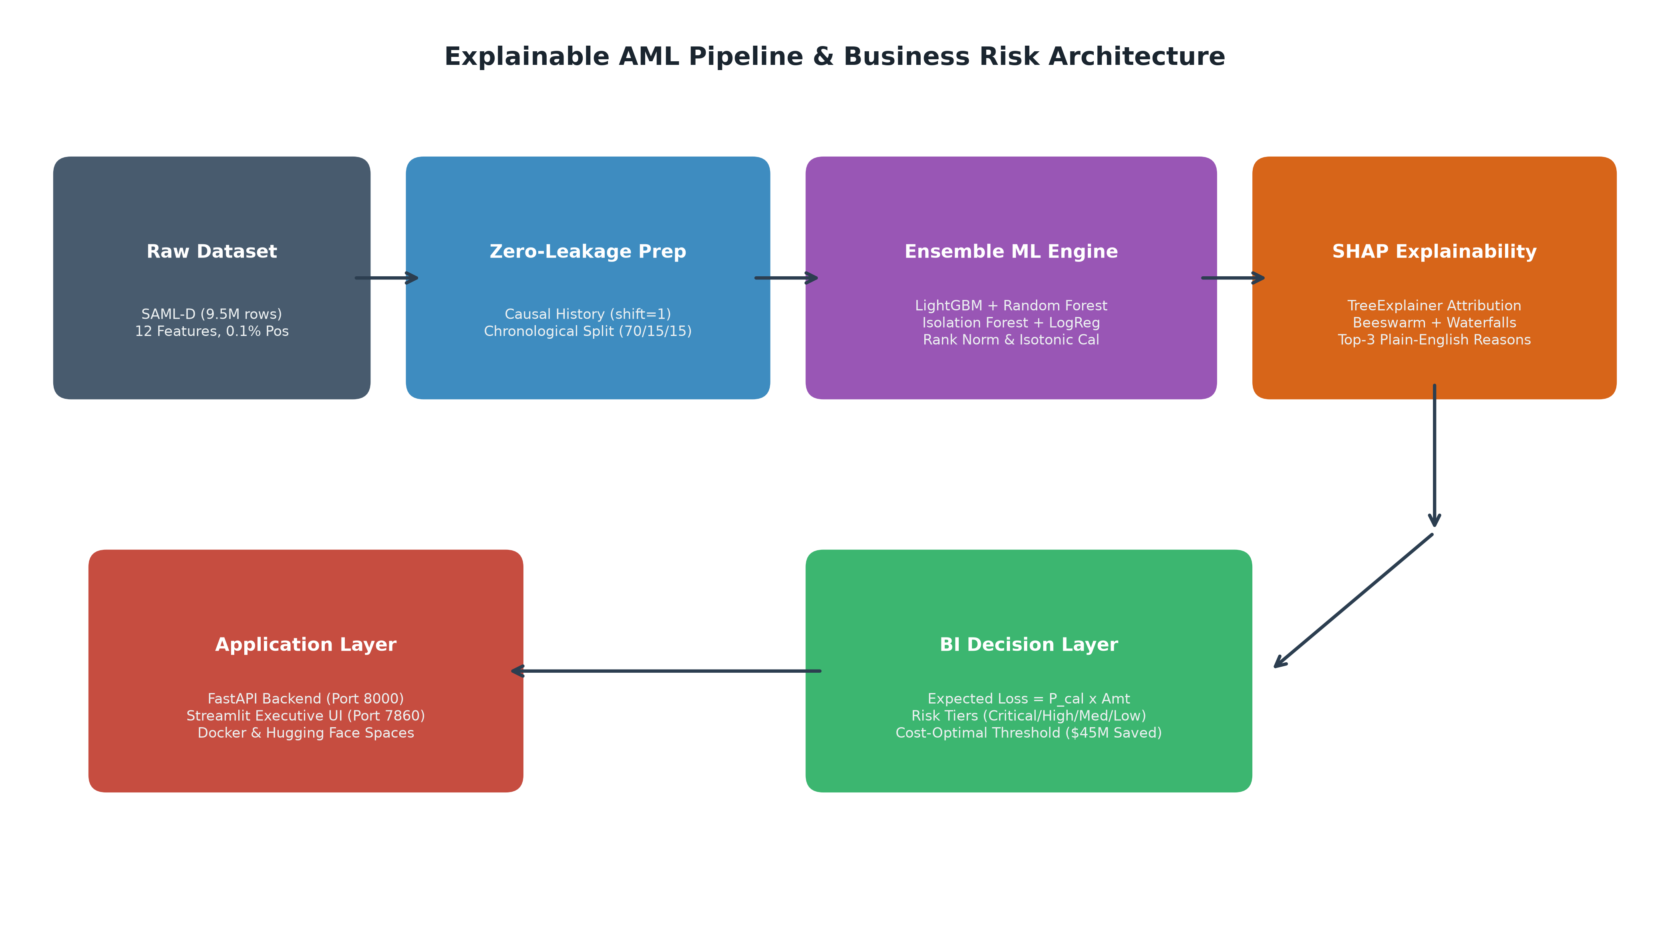
EXPLAINABLE AML PIPELINE | 22MDC56
End-to-End System Architecture & Execution Flow
Notes:
Walk examiners through the modular architecture: raw data, zero-leakage prep, ensemble ML, SHAP transparency, BI layer, and deployed microservices.

Slide 6
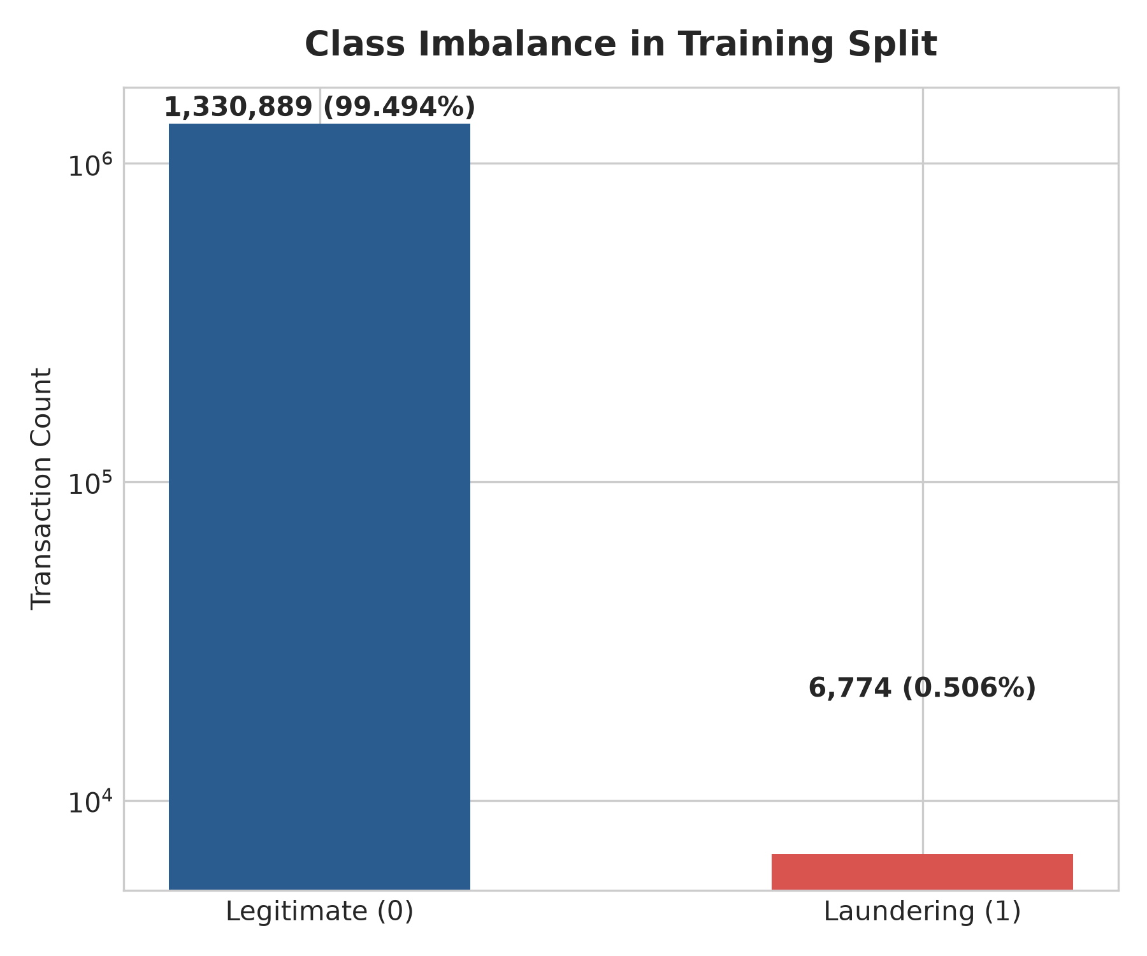
EXPLAINABLE AML PIPELINE | 22MDC56
Dataset: Synthetic Anti-Money-Laundering (SAML-D)
• Benchmark Scale: 9,504,852 total financial records across 321 calendar days (Oct 2022 to Aug 2023).
• Severe Class Rarity: 9,873 confirmed laundering cases (0.104% positive prevalence).
• Key Operational Attributes: Time, Date, Sender_account, Receiver_account, Amount, Currencies, Locations, Payment Rails.
• Leakage Prevention Rule: 'Laundering_type' specifies illicit typology and is purged from features prior to training.
• Account IDs: Excluded from feature vector; leveraged strictly to compute causal behavioral history.
Notes:
Highlight that SAML-D is an institutional-scale dataset of 9.5M rows with 0.104% positives, preserving real banking conditions.

Slide 7
EXPLAINABLE AML PIPELINE | 22MDC56
Rigorous Preprocessing & Zero-Leakage Precautions
• Chronological Partitioning: 70% Train (to May 18, 2023), 15% Validation (May 19 to Jul 5, 2023), 15% Untouched Test (Jul 6 to Aug 23, 2023).
• Verification Assertion: Automated check confirms max(train) < min(val) < min(test) with zero temporal leakage.
• Causal History Engineering (Shift-by-1): All customer transaction features use strictly earlier records only:
• - sender_prior_count: Prior transaction frequency of sender.
• - sender_prior_mean & sender_prior_std: Running historical financial mean and variance.
• - amount_z_score: Dynamic amount deviation relative to customer's personal velocity.
• - time_since_prev_sender_txn: Inter-transaction burst interval.
• - distinct_prior_receivers: Fan-out counterparty proliferation metric.
• Encoders & Risk Jurisdictions: Fit strictly on TRAIN data; unseen values mapped to 'unknown'.
Notes:
Emphasize how shift-by-1 causal features prevent look-ahead bias and explain why correlation checks confirmed no target leakage.

Slide 8
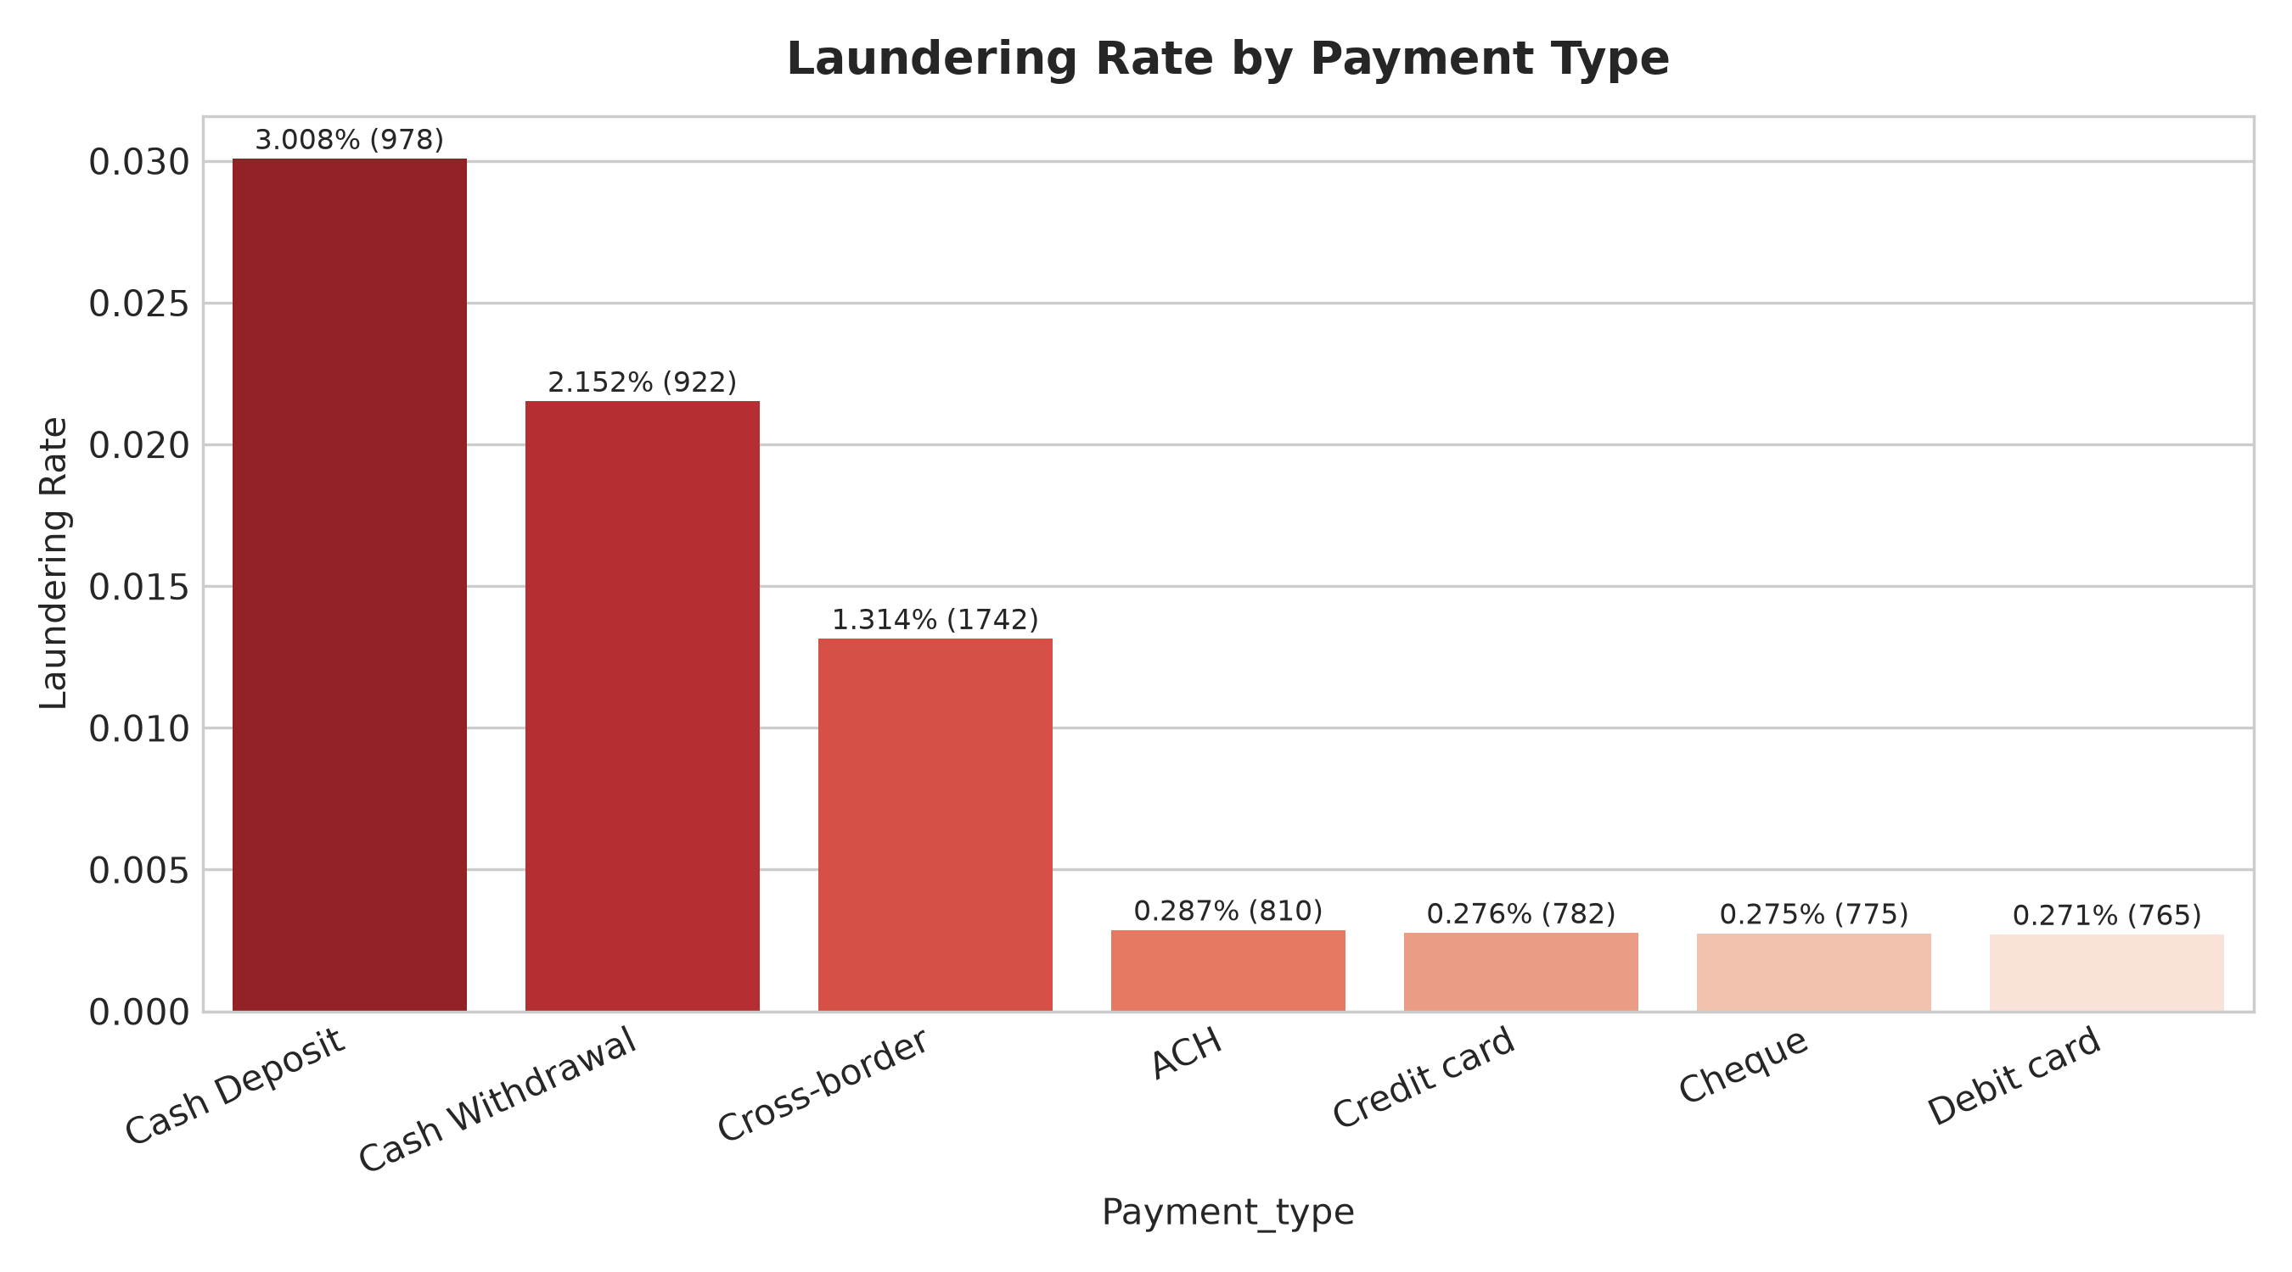
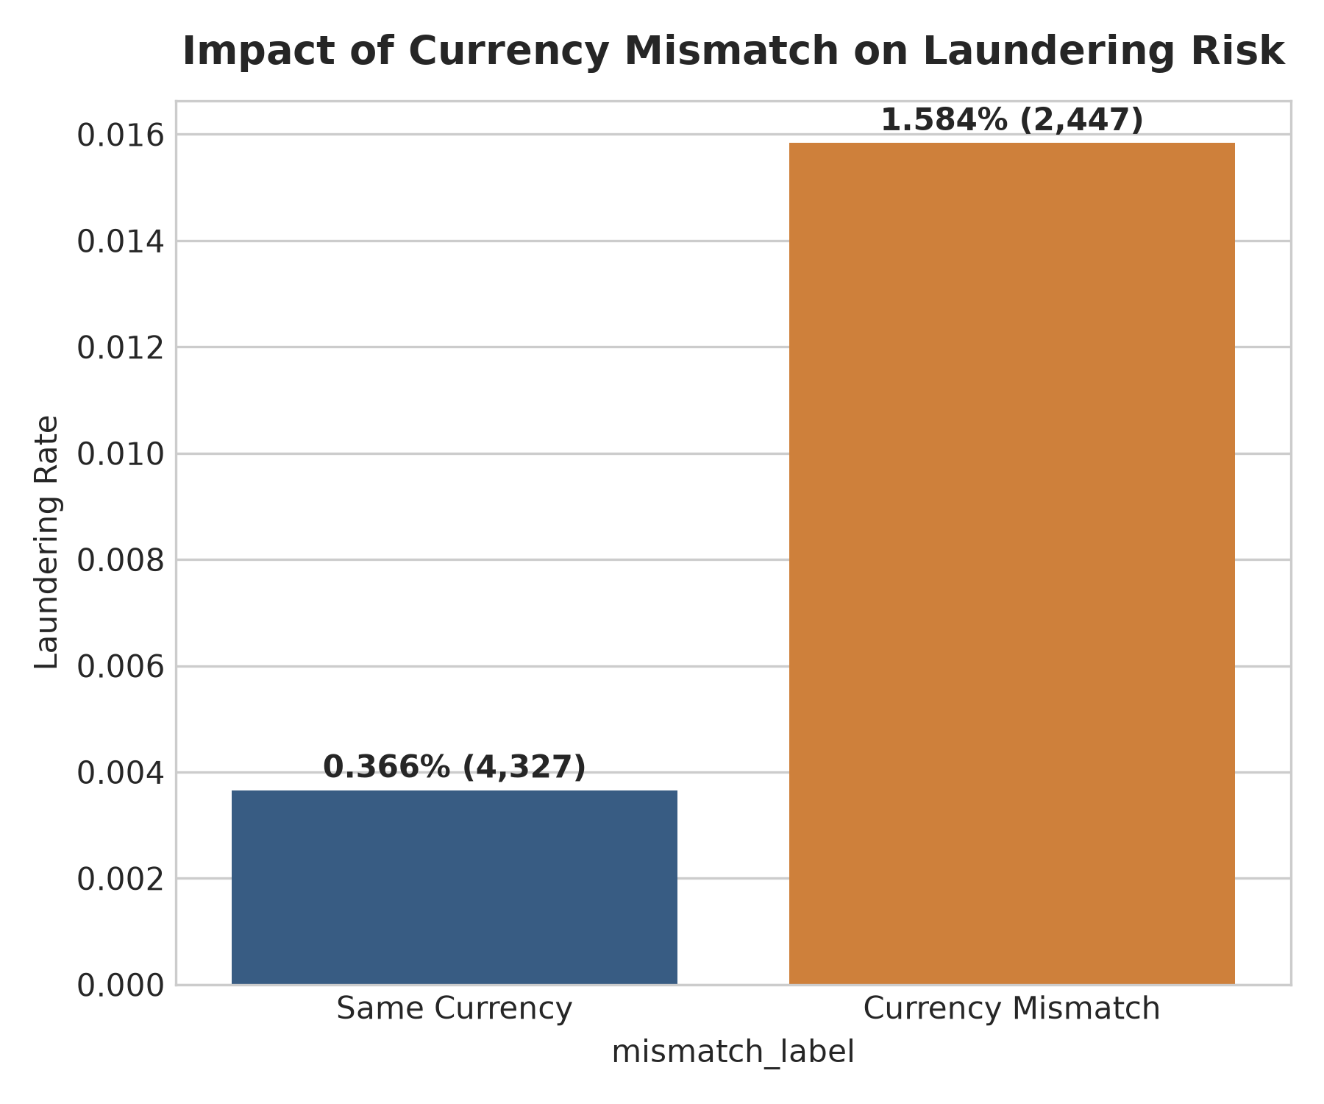
EXPLAINABLE AML PIPELINE | 22MDC56
Exploratory Data Analysis: Risk Channels & Currencies
Notes:
Point out the elevated risk in automated cash/cross-border payment channels and the multi-fold risk spike during currency conversion mismatch.

Slide 9
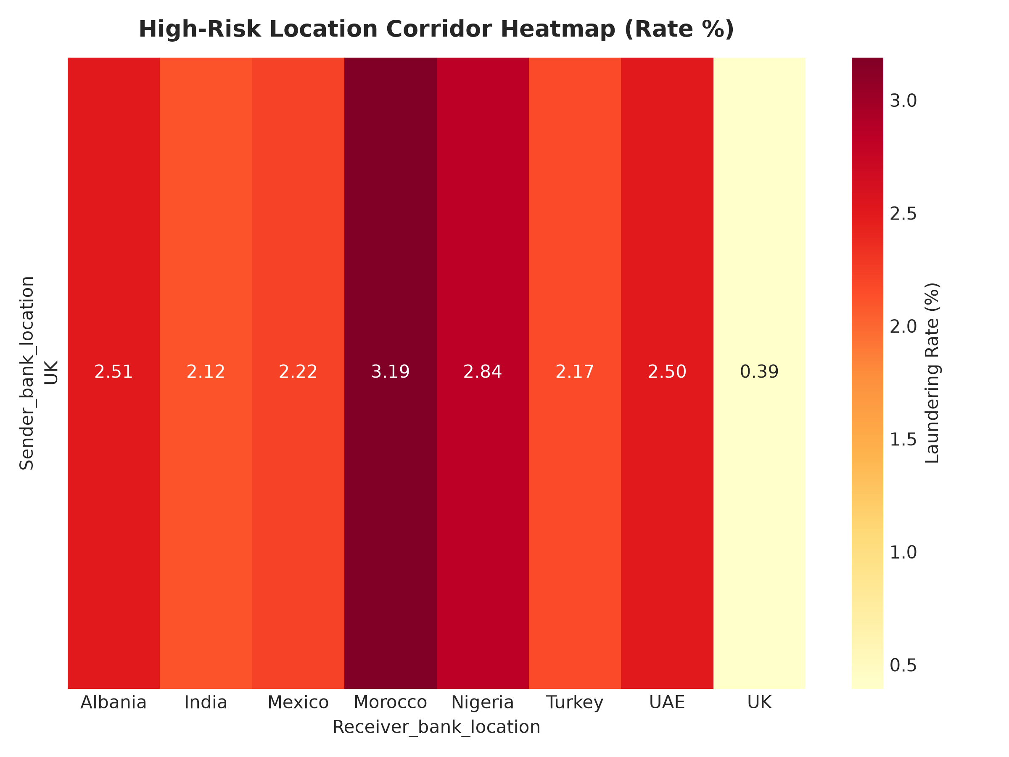
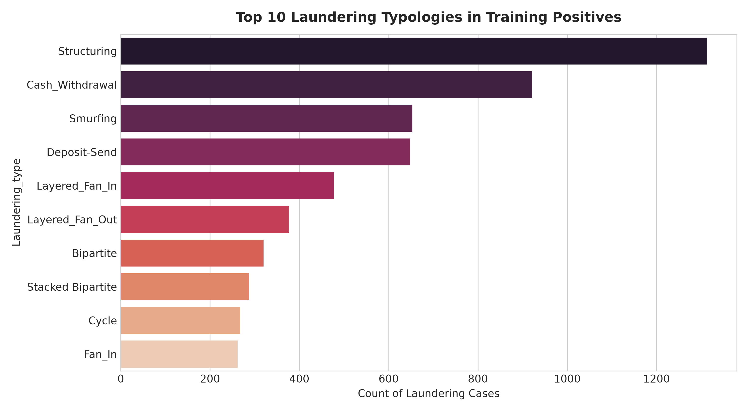
EXPLAINABLE AML PIPELINE | 22MDC56
Exploratory Data Analysis: Geography & Typology Signatures
Notes:
Highlight high-risk jurisdictional transfer corridors and the prevalence of structuring, fan-in, and single-large typologies.

Slide 10
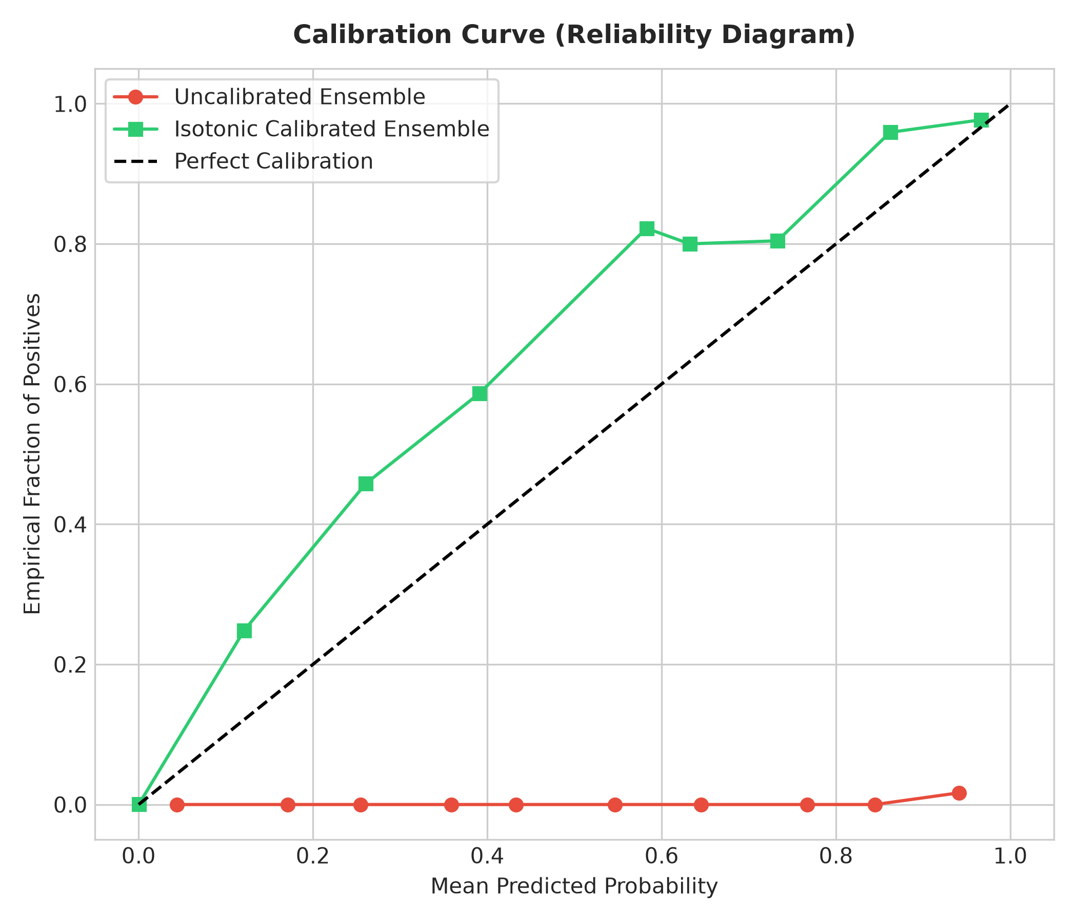
EXPLAINABLE AML PIPELINE | 22MDC56
Model Architecture: Rank-Calibrated Ensemble
• Baseline: Balanced Logistic Regression on standardized causal features (Val PR-AUC: 0.0313).
• M1 LightGBM: Gradient boosting with scale_pos_weight & early stopping (Val PR-AUC: 0.8883, Test PR-AUC: 0.9032).
• M2 Random Forest: Balanced subsampling on 1:10 downsampled training subset (Val PR-AUC: 0.8031).
• M3 Isolation Forest: Unsupervised subspace anomaly depth scoring.
• M4 Rank-Normalized Ensemble: Converts disparate model scores into empirical percentiles, optimized on validation PR-AUC:
• Weights: 0.80 LGB + 0.15 RF + 0.025 IF + 0.025 LR.
• Isotonic Probability Calibration: Calibrates ensemble scores into defensible posterior probabilities.
Notes:
Explain rank normalization for multi-model blending and how Isotonic Regression aligns predictions with empirical risk probabilities.

Slide 11
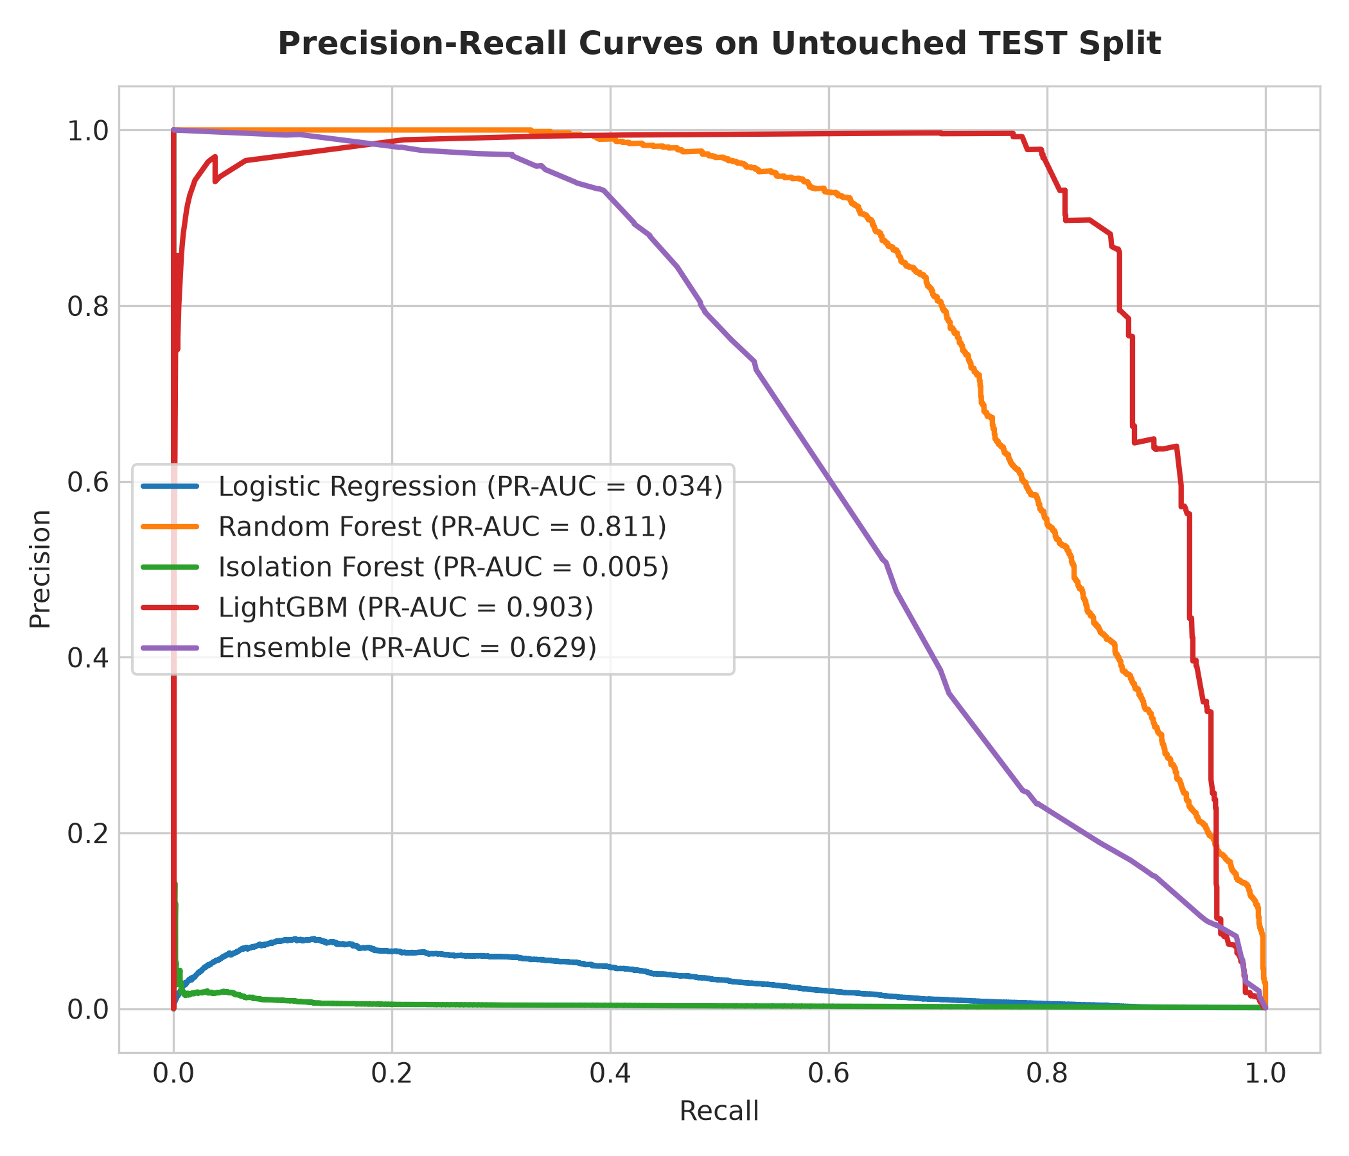
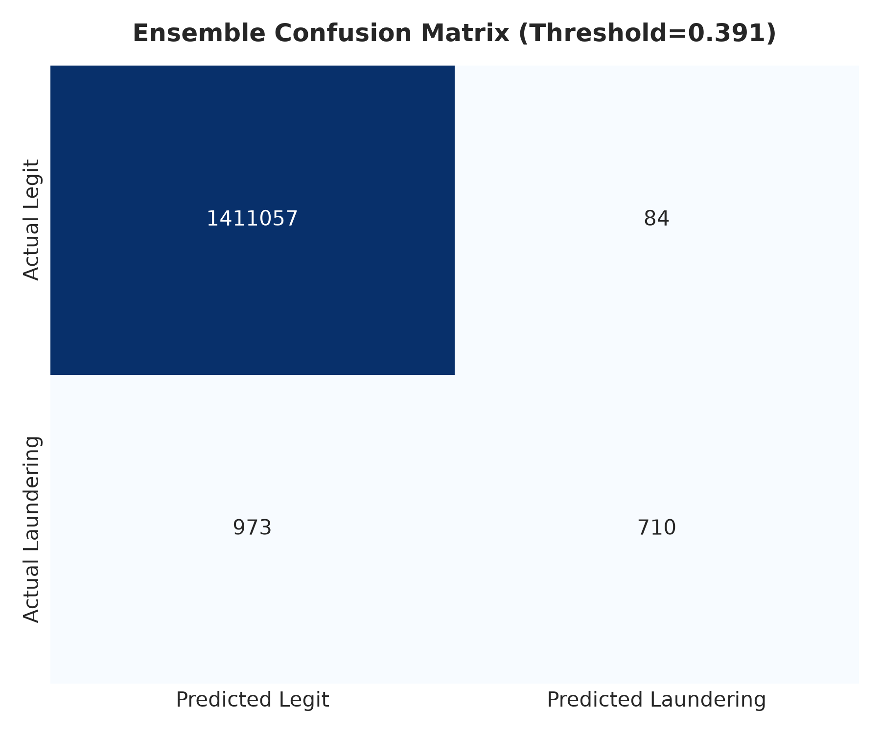
EXPLAINABLE AML PIPELINE | 22MDC56
Results on Untouched TEST Split (PR-AUC: 0.6292)
Notes:
Report test results honestly: LightGBM achieves 0.9032 PR-AUC and ensemble achieves 0.6292. At 1.0% review capacity, Recall@K is 93.58%.

Slide 12
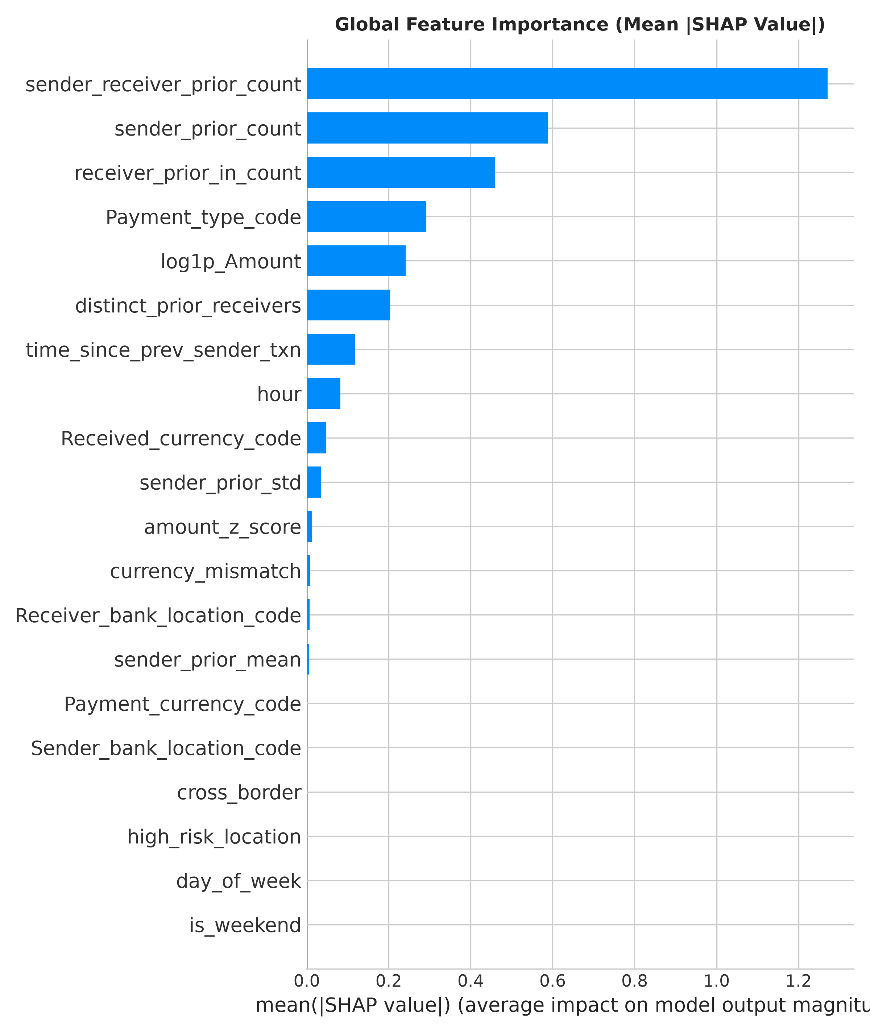
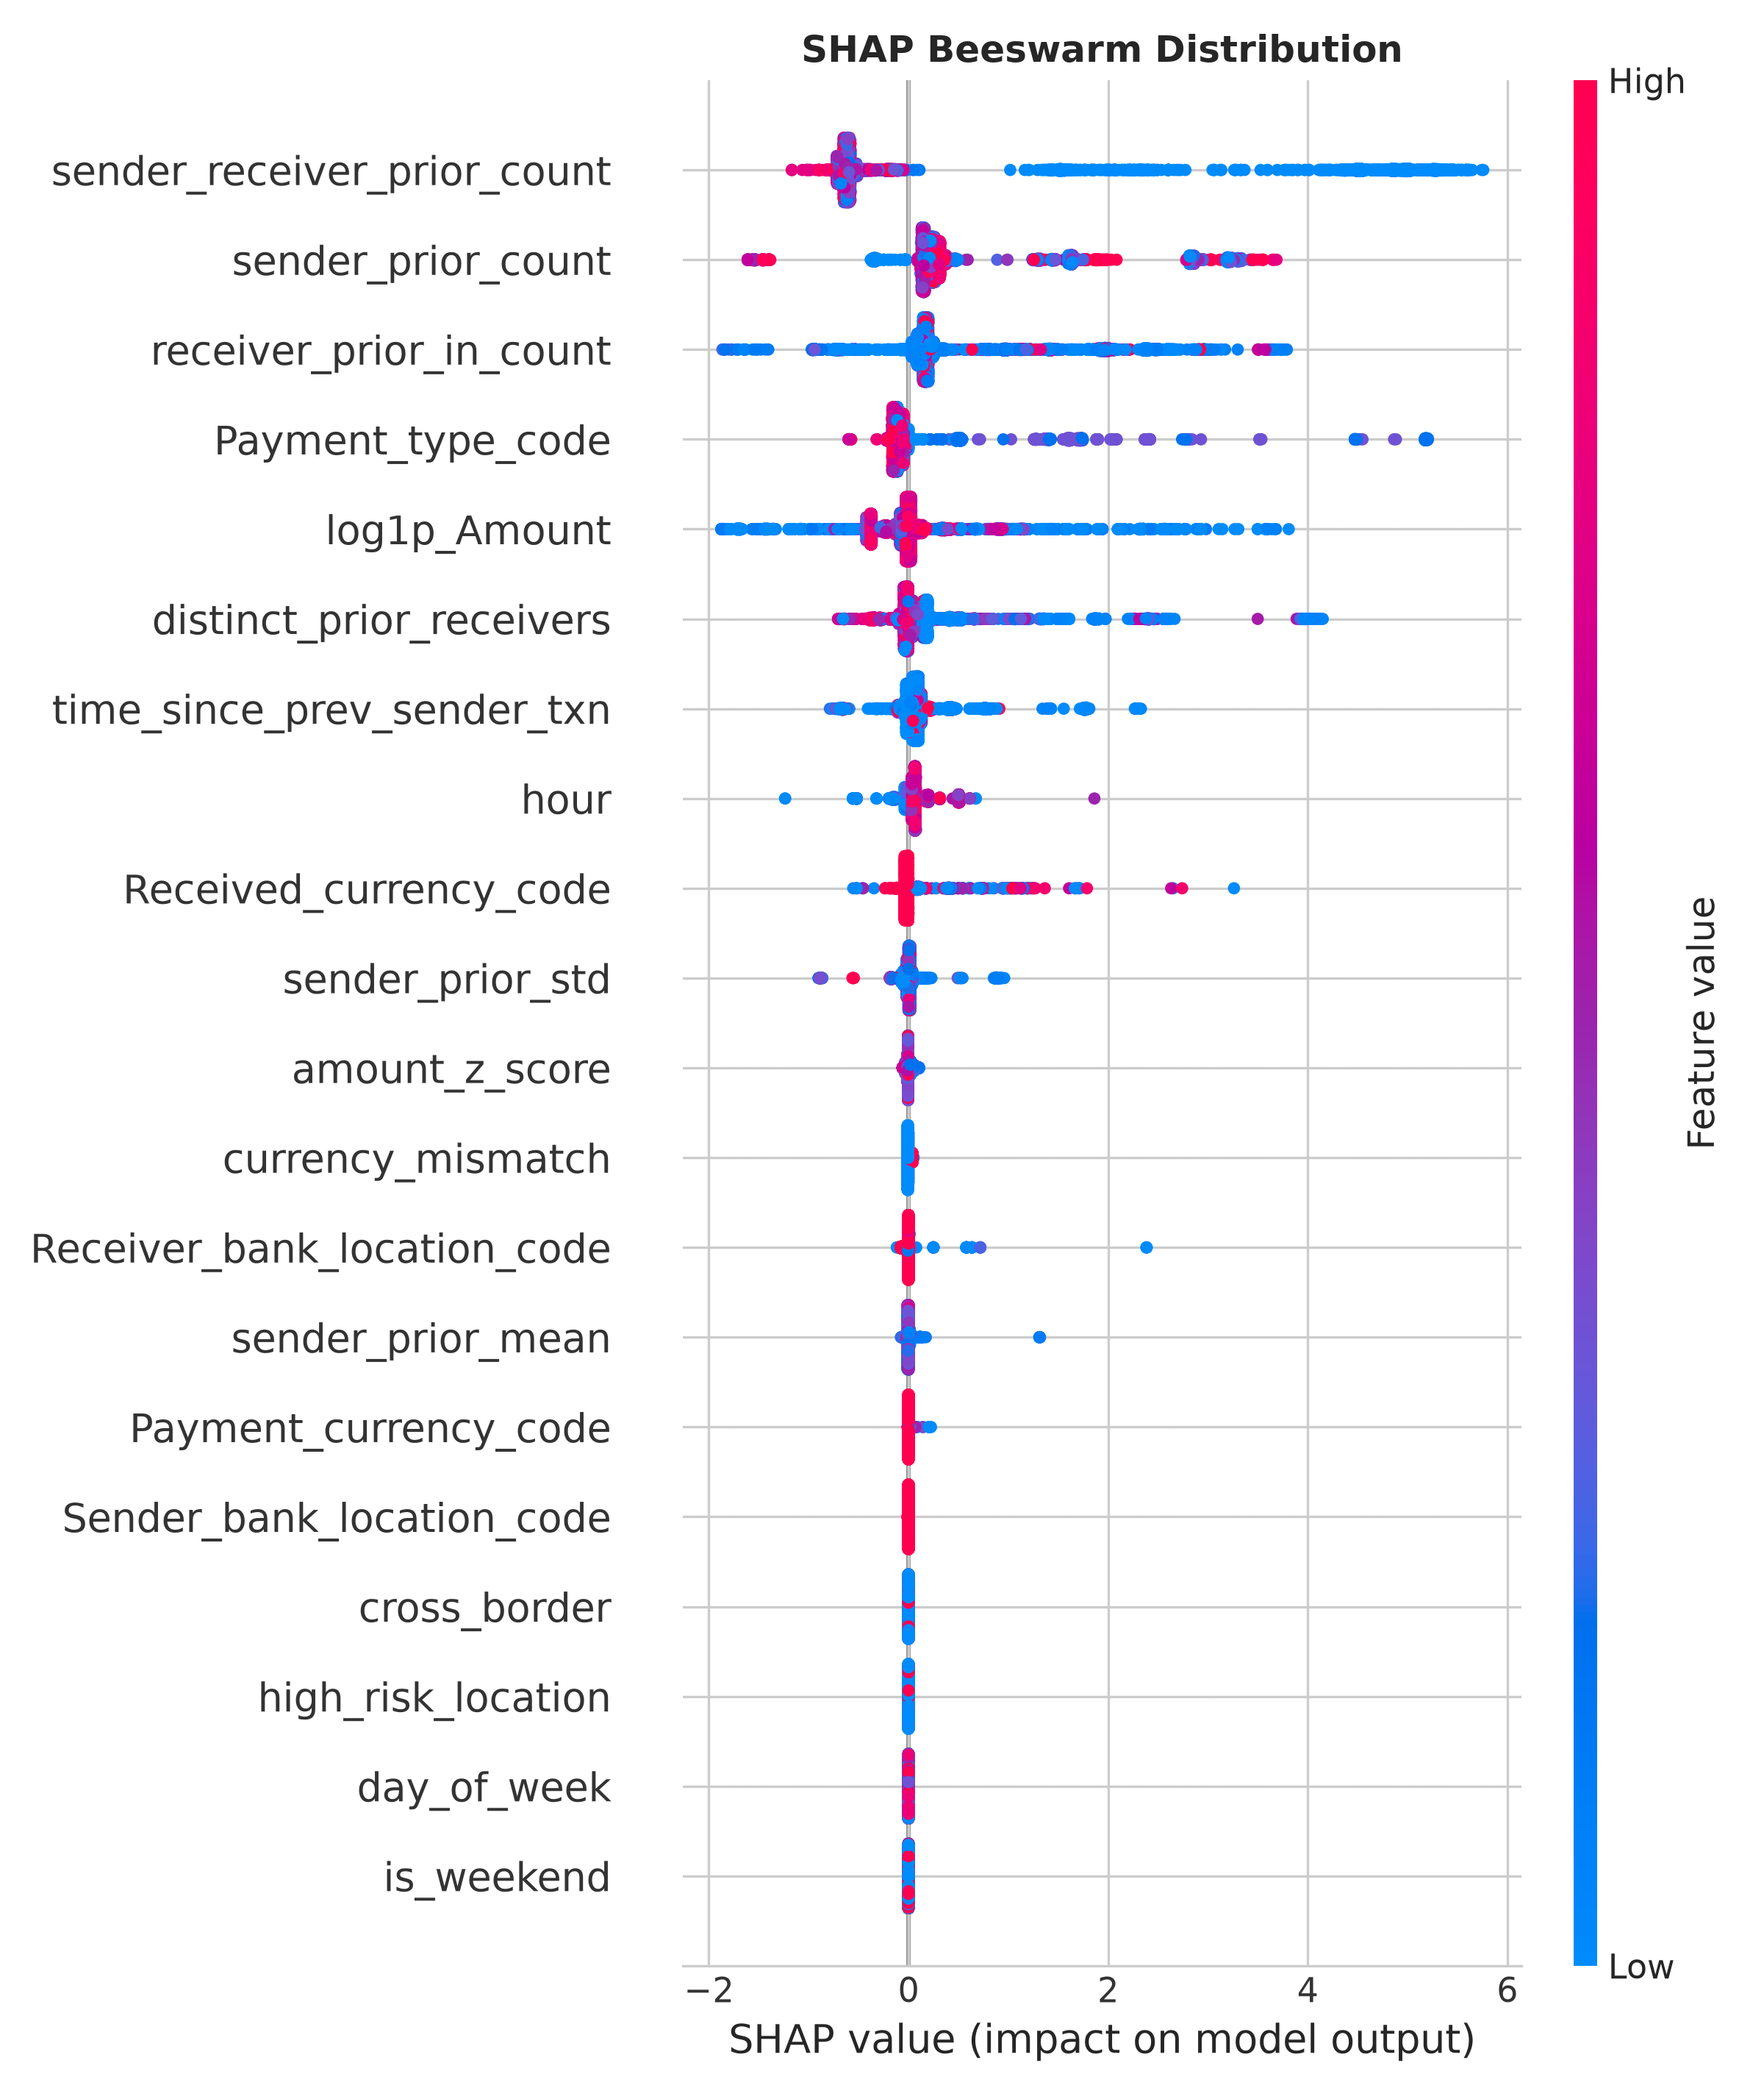
EXPLAINABLE AML PIPELINE | 22MDC56
Explainability: SHAP Attribution & Regulatory Reasons
Notes:
Explain that SHAP TreeExplainer attributes credit to account velocity and transaction amount, generating top-3 plain-English reasons for SAR reports.

Slide 13
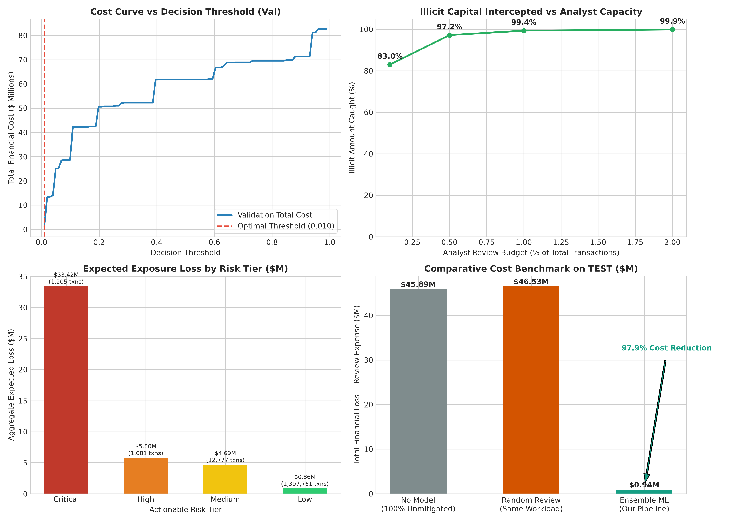
EXPLAINABLE AML PIPELINE | 22MDC56
Business Impact: $44.95M Saved (97.94% Cost Reduction)
Notes:
Highlight the financial bottom line: our cost-optimal threshold reduces total loss from $45.89M to $0.94M, saving $44.95M.

Slide 14
EXPLAINABLE AML PIPELINE | 22MDC56
Robustness, Deployment & Future Research Directions
• Imbalance Robustness: Sustained high ROC-AUC (0.9948) and PR-AUC across extreme negative-to-positive ratio variations (1:1 to 1000:1).
• Adversarial Defense: Evasion attacks degraded naive recall, but adversarial retraining recovered detection to 0.9881 with 0.9824 clean PR-AUC.
• Production Deployment: Containerized FastAPI (Port 8000) and Streamlit (Port 7860) live microservices compatible with Hugging Face Spaces.
• Future Work: (1) Graph Neural Networks for multi-hop layering graphs, (2) Federated Learning across inter-bank consortiums, (3) Real-time Kafka/Flink streaming.
• Conclusion: A fully realized, reproducible ML-BI AML system achieving 93.58% Recall@1%, 97.94% cost reduction, and defensible audit explanations.
Notes:
Conclude with our stress-test results, deployment architecture, and key avenues for future research.

