Slide 1


| Tech Management, SRI-B
CLAWS
CLASH OF THE
M S Ramaiah_Clover
MACHA – Message-Driven Academic Content Harmonization Agent
Kartik Katwe
Mohammed Fouzan Anwar
Amisha
Amani Masood

Slide 2
Problem Statement
Idea
What problem are we solving?
Almost all students in india recieve their material and announcements through wahtsapp.
A student gets a PDF from a classmate on WhatsApp, screenshots notes from someone else's phone, gets a forwarded message about an assignment deadline, and downloads slides from their college portal. By end of semester they have 4 different folders, 3 different drives, notes in their gallery, and absolutely no idea where anything is.
Then exam week hits and they spend more time finding their notes than actually studying.
MACHA is a single place that a student can throw everything at in the most natural way possible, which is just forwarding it on WhatsApp, and it organises everything automatically and reminds them of deadlines they didn't even explicitly set.
Why this theme?
Productivity because this is genuinely a productivity problem disguised as a storage problem. The issue was never "I don't have enough space for my notes." It was "I have notes everywhere and I can never find anything when I actually need it." MACHA fixes the retrieval problem, not just the storage problem.
Who Faces it?
Any student.
Why is it important?
Because exam stress in Indian engineering colleges is real and a lot of it comes from chaos, not from the student not knowing the material. When you can't find your notes two days before an exam, you panic. When you miss a submission deadline because a professor sent the date in a long paragraph and it got buried under 200 other messages, your internal assessment marks drop and that affects your final grade.
MACHA doesn't make anyone smarter. It just removes the chaos so the student can actually focus on studying.
Most AI study tools assume the student is already organised. They give you better search, better summarisation, better flashcards. MACHA assumes the student is completely disorganised and works backwards from there. That's the actual gap nobody is solving for.

Slide 3
Idea
Current Solution & Gaps
Existing tools like Notion, Google Drive, and college LMS platforms rely too much on students manually organizing notes, folders, and reminders. In reality, most academic communication happens informally through WhatsApp messages, forwarded notices, screenshots, and class announcements, making important deadlines easy to miss.
MACHA solves this by turning WhatsApp into an AI powered academic assistant. It automatically organizes study materials, extracts deadlines from messages, creates reminders, and helps students retrieve information instantly. Instead of asking students to change their habits, MACHA works within the platform they already use every day.
Current reminder and productivity apps also fail because they require structured input. Students rarely stop to manually create tasks while reading long professor messages. Existing systems cannot understand context like “OS quiz tomorrow at 1:45 PM” and automatically act on it the way a human would.

Slide 4
Idea
Our solution
What We Built
MACHA is a WhatsApp AI assistant that automatically organises a student's notes and never lets them miss a deadline. You forward it stuff, it handles the rest.
Core Ideas
One inbox for everything academic. No new app, no new habit. Just WhatsApp.
The agent reads everything, including messy professor forwards and blurry notice board photos, and figures out what to do without being explicitly told.
Files are stored and retrieved by subject and unit automatically. The student never thinks about folder structure.
Key Features
Smart Storage Forward any file, image, link, or message. MACHA classifies it by subject and unit on its own and saves it cleanly.
Automatic Deadline Detection Reads every incoming message for hidden deadlines. No manual entry needed. If a professor buries a quiz date in a long paragraph, MACHA catches it.
Intelligent Reminders 3 days out, 1 day out, 2 hours before. Automatically. Adjusts if the event gets postponed or cancelled.
Daily Morning Digest Every day at 8AM, MACHA tells the student everything due in the next 5 days.
Instant Retrieval Ask for your DBMS Unit 2 notes and you get them. No searching, no scrolling, no folder diving.
Semester Archiving “End of sem”, one message, everything gets archived cleanly and a new session starts.

Slide 5
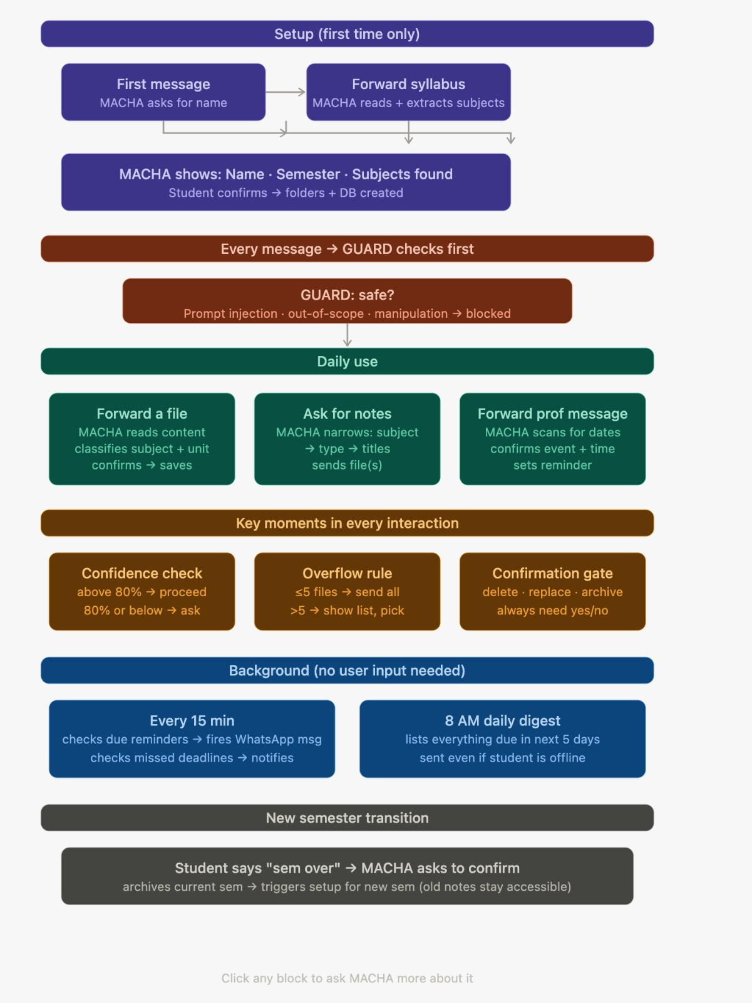
Idea
Demo/Product Walkthrough
Screen
There is only one screen. WhatsApp. That is the entire interface. No dashboard, no portal, no login page.
Flow & User Interaction
First Time
Student messages MACHA for the first time. MACHA asks for their name, their syllabus, and their semester. Student forwards the syllabus PDF. MACHA reads it, lists out all detected subjects, confirms with the student, and sets everything up. Done in under 2 minutes.
Day to Day
Professor forwards a message in the college WhatsApp group. Student forwards it to MACHA. MACHA saves whatever file is in it, detects any deadline buried in the text, sets reminders and confirms back in one line.
Student forwards notes to MACHA. MACHA identifies the subject and topic, confirms the details, and automatically organizes and saves the resource. Student types "send me CN unit 3 notes." MACHA sends the file.
Reminder Moment
Student gets a WhatsApp message from MACHA at 8AM listing everything due that week. Later that day another message 2 hours before a submission deadline.
End of Semester
Student sends "sem over." MACHA asks for confirmation, archives everything, and immediately starts setup for the next semester.

Slide 6
Idea
Demo/Product Walkthrough
Key Moments
The Forward Student forwards a messy professor message. MACHA pulls out a deadline they didn't even notice was in there and sets a reminder without being asked. This is the moment that makes the student trust MACHA.
The Retrieval Night before exam, student asks for their notes. MACHA sends the right file in seconds. No scrolling through gallery, no digging through Drive.
The 8AM Digest Student wakes up and already knows exactly what their week looks like academically. No surprises.
The Miss Prevention MACHA catches a rescheduled exam in a forwarded notice and updates the reminder automatically. Student never even knew the date changed.

Slide 7
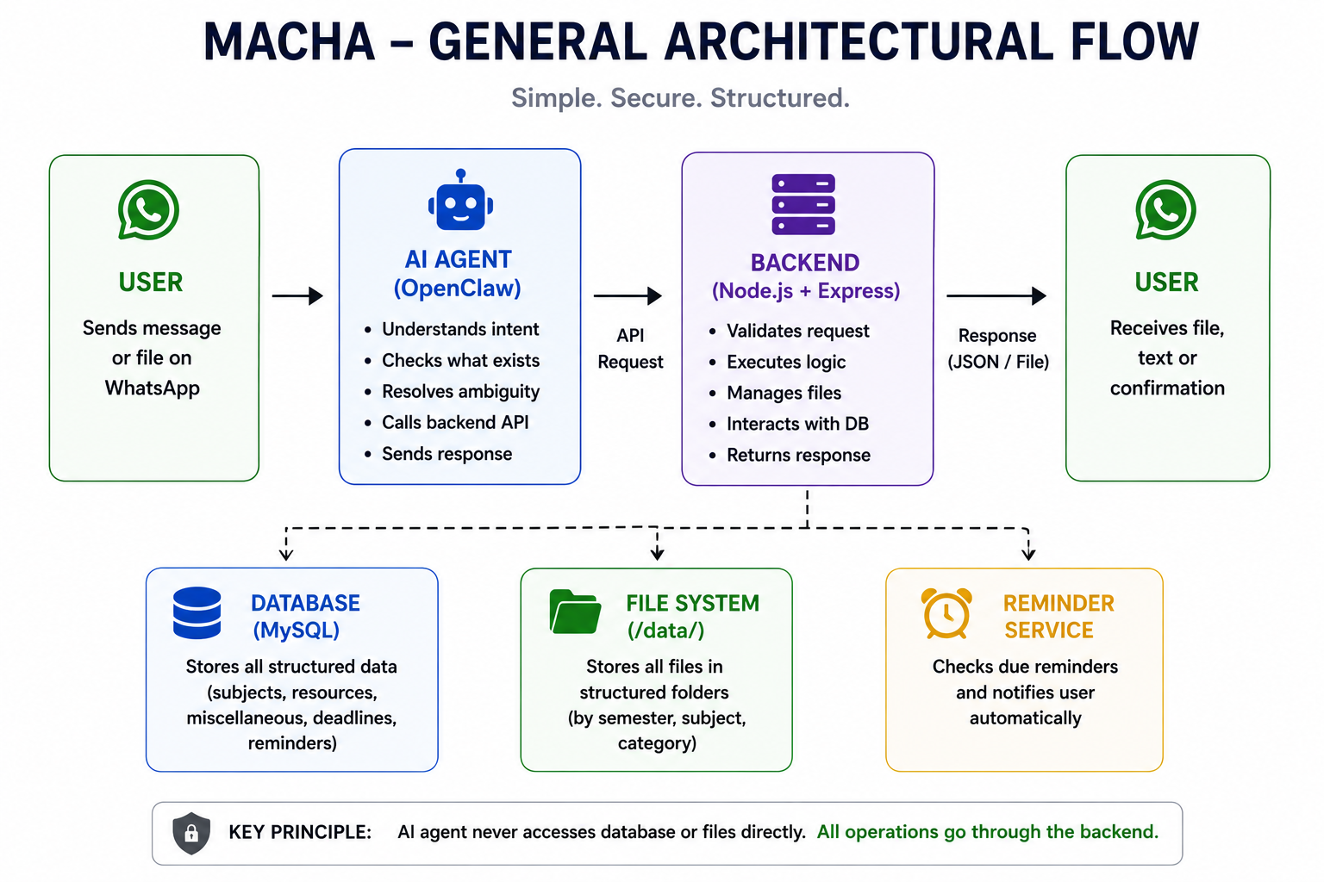
Tech & Architecture
Idea

Slide 8
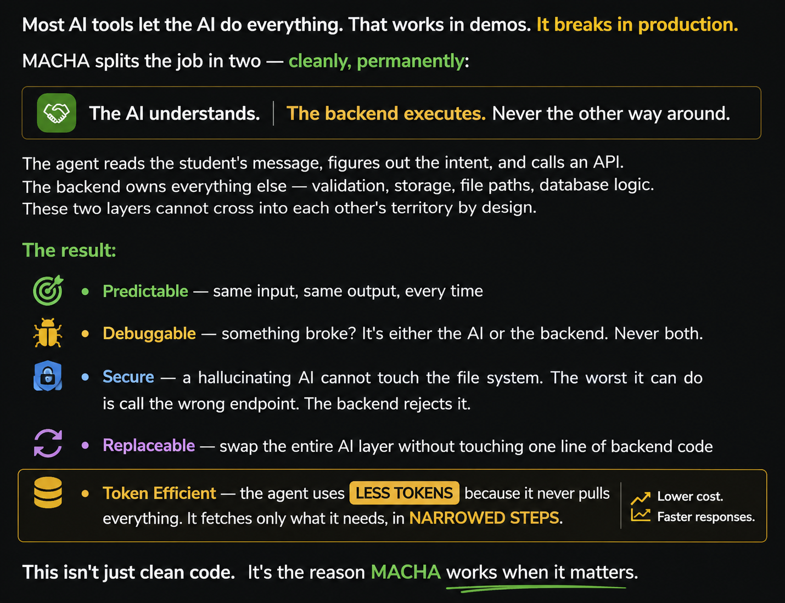
WHY DID WE CHOOSE THIS APPROACH?

Slide 9
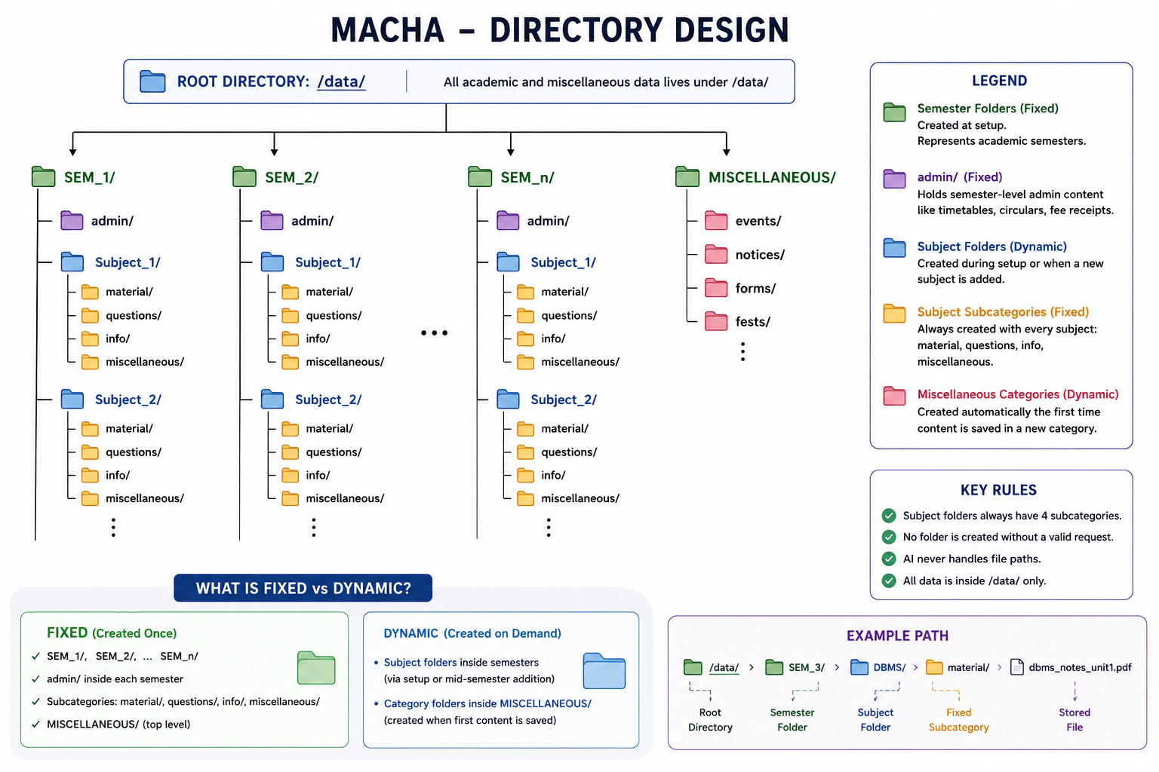
Data Storage Design

Slide 10
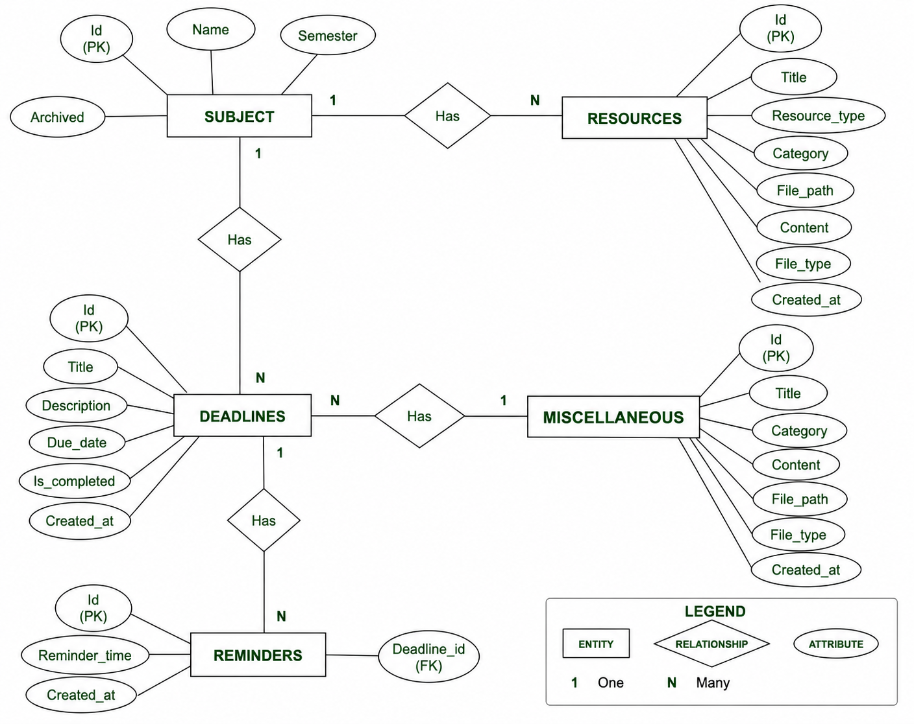
Entity-Relationship Diagram for MySQL Database

Slide 11
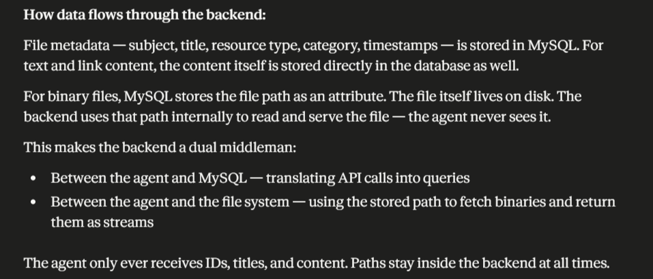

Slide 12
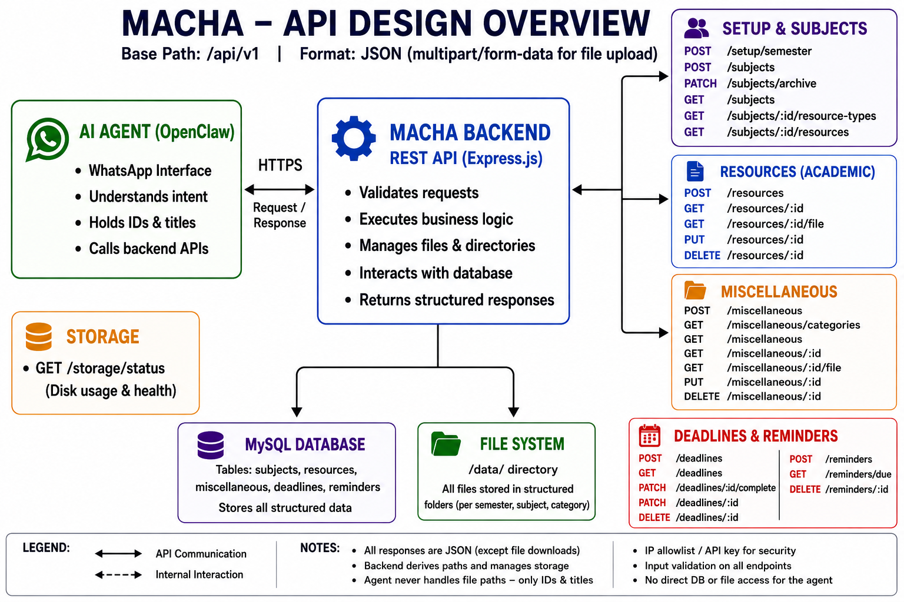

Slide 13
API endpoint list
Setup
- POST /api/v1/setup/semester
- POST /api/v1/subjects
- PATCH /api/v1/subjects/archive
Academic Resources
- GET /api/v1/subjects
- GET /api/v1/subjects/:id/resource-types
- GET /api/v1/subjects/:id/resources
- POST /api/v1/resources
- GET /api/v1/resources/:id
- GET /api/v1/resources/:id/file
- PUT /api/v1/resources/:id
- DELETE /api/v1/resources/:id
Miscellaneous
- POST /api/v1/miscellaneous
- GET /api/v1/miscellaneous/categories
- GET /api/v1/miscellaneous
- GET /api/v1/miscellaneous/:id
- GET /api/v1/miscell

Slide 14
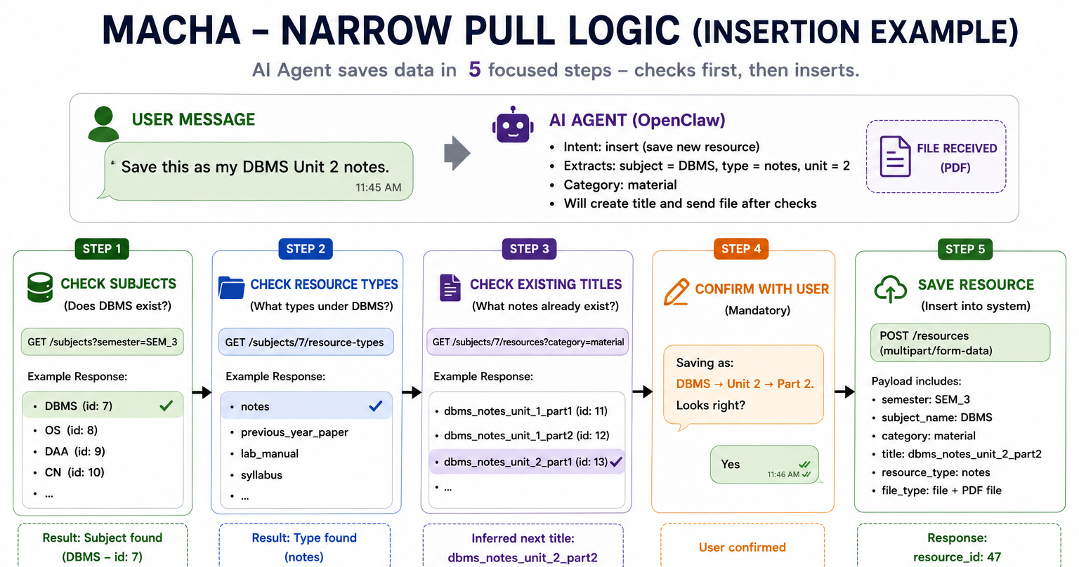

Slide 15
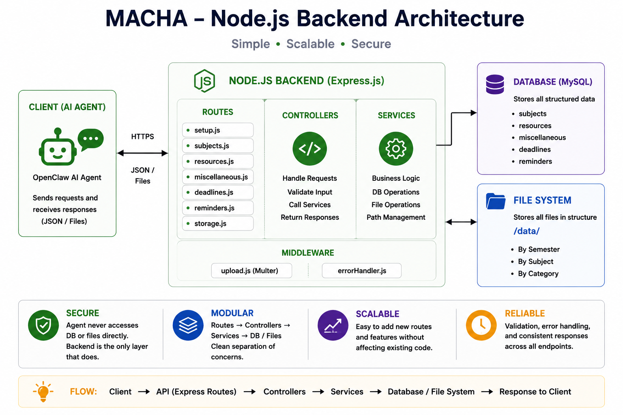

Slide 16
Idea
Impact & Use cases
Real Life Scenarios
In one scenario, a professor sends a WhatsApp message saying, “OS quiz at 1:45 PM in Lab 4 tomorrow.” The student simply forwards the message to MACHA. MACHA reads the text, identifies the subject, event type, time, and venue, then automatically schedules reminders and alerts the student before the quiz.
In another scenario, a student receives DBMS notes from a classmate and forwards them to MACHA. The system analyzes the content, identifies the subject and topic, and automatically organizes and stores the resource in the correct academic category for future access.
MACHA also helps during exam preparation. A student can ask, “Send me Unit 3 DBMS notes,” and MACHA instantly retrieves the correct material using semantic search without the student manually searching through chats or folders. Students can also request summaries of uploaded notes, allowing MACHA to generate concise revision points and key concepts for faster learning and preparation.
Scale Potential
MACHA has the potential to scale far beyond a basic student productivity assistant. The platform can support multiple students, colleges, and educational institutions while integrating additional features such as timetable management, attendance tracking, collaborative resource sharing, multilingual academic support, and AI driven study planning.
Since the system is built around WhatsApp, a platform already used daily by billions of users, MACHA removes the need for students to adopt a completely new application or workflow. This creates strong scalability potential across schools, colleges, coaching centers, and universities globally.

Slide 17
Idea
Differentiation
Why Our Solution Stands Out
Most productivity tools expect students to already be organized. They assume people will sit down, create folders, type reminders, maintain dashboards, and keep everything updated consistently. In reality, that almost never happens. Academic life is messy, fast paced, and usually spread across WhatsApp groups, forwarded messages, PDFs, screenshots, and random notes from classmates. MACHA stands out because it works with that chaos instead of fighting it.
What makes MACHA different is that it fits naturally into the way students already function. Students do not have to learn a new app or completely change their habits. They can simply forward messages, upload notes, or ask questions in plain language through WhatsApp, and the system handles the organization, reminders, and retrieval automatically. It feels less like using software and more like having an academic assistant that actually understands what is going on.
Strong MOAT
The biggest strength of MACHA is its ability to understand academic context from informal communication. A normal reminder app sees a message as just text. MACHA understands that “OS quiz tomorrow at 1:45 PM in Lab 4” is something important that needs a reminder, context, and prioritization. That layer of academic intelligence is difficult to replicate because it is built around real student communication patterns.
Another major advantage is that MACHA lives inside WhatsApp, where students already spend most of their time. Instead of trying to pull users into another productivity platform, MACHA becomes part of their existing workflow. That lowers friction massively and makes adoption much more natural compared to traditional apps that depend on students consistently staying organized on their own.

Slide 18
Idea
Demo Link
GitHub Repo - https://github.com/SAMURAI-75/MACHA
VIdeo demo Link –Existing in the github repository

