Slide 1
موضوع: کاهش مصرف انرژی (ابر سبز) در مراکز داده های ابری با کمک الگوریتم های فرا ابتکاری و تنظیم کاهش مهاجرت ماشین مجازی
نام و نام خانوادگی: سیدعلی محترمی
شماره دانشجویی:980199610
استاد درس سمینار: دکتر سید علی رضوی ابراهیمی
بهمن –اسفند 1399

Slide 2
WHAT IS THE CLOUD?
Many people think of the cloud as a collection of technologies.
• But
• The cloud is actually a service or group of services.
• Or
• Computing facilities are being made available as services offered by reputed vendors.

Slide 3
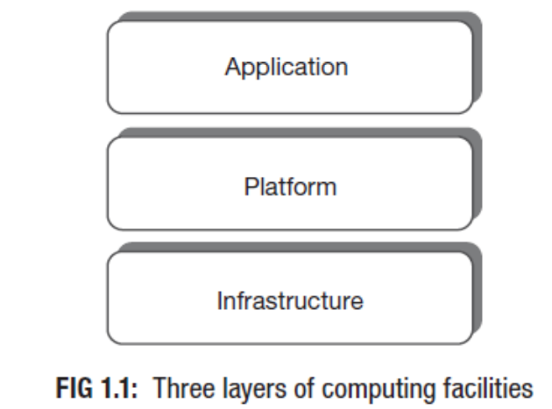
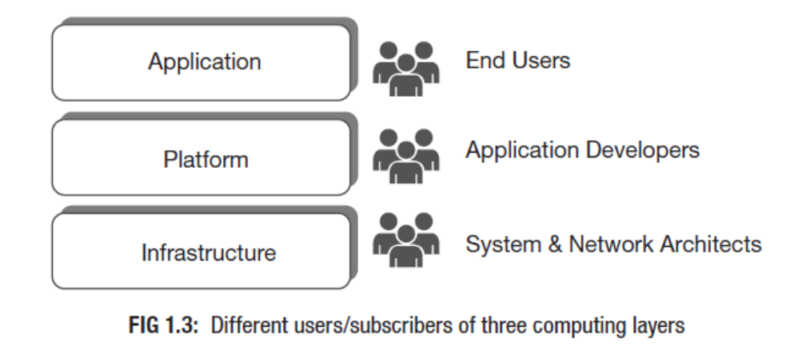
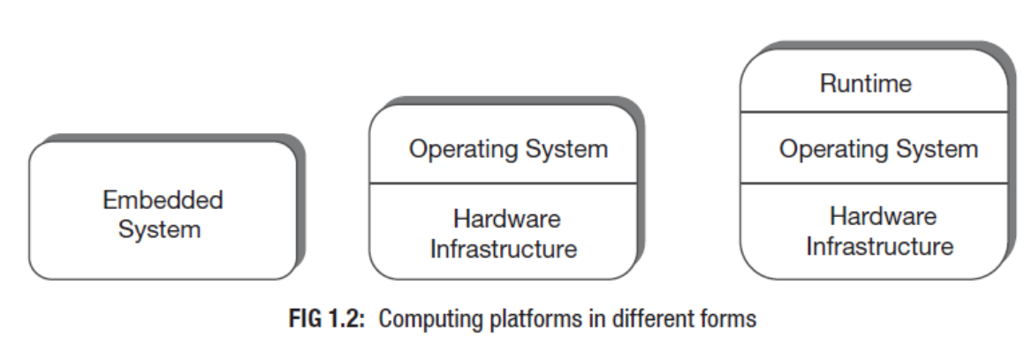
Three layers of computing

Slide 4
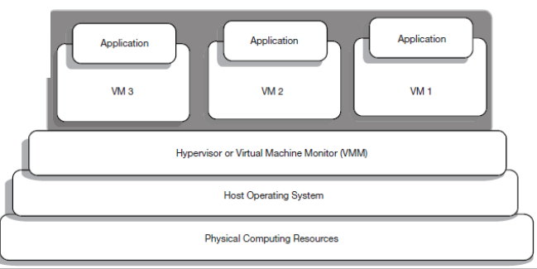
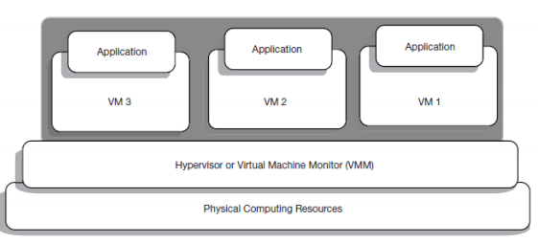
VIRTUALIZATION
Bare Metal Approach: Removal of the Host OS ) Type 1 hypervisor(
or
Native Hypervisor – Hosted Approach) Type 2 hypervisor(

Slide 5
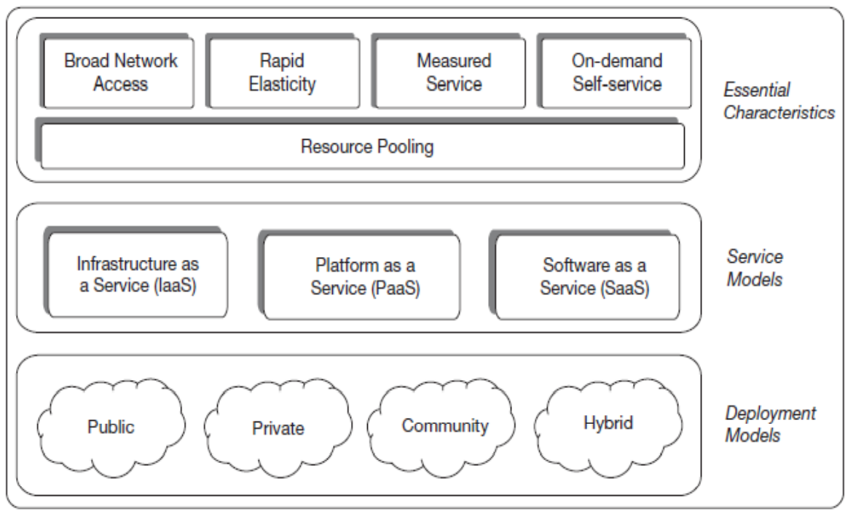
Any technology needs a standard model for the conveniences of understanding uniformity.
• NIST: National Institute of Standards and Technology
– Cloud computing is a model and not a technology.
– Cloud computing enables the users’ access pools of computing resources via network.
– The resources are shared among users and made available ondemand.
– The prime benefit is the ease of use with very little management tensions for the users.

Slide 6
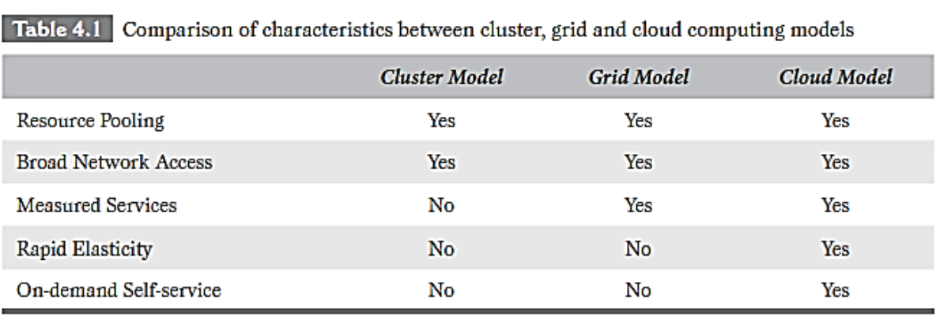
Cluster and Grid Computing Revisited

Slide 7
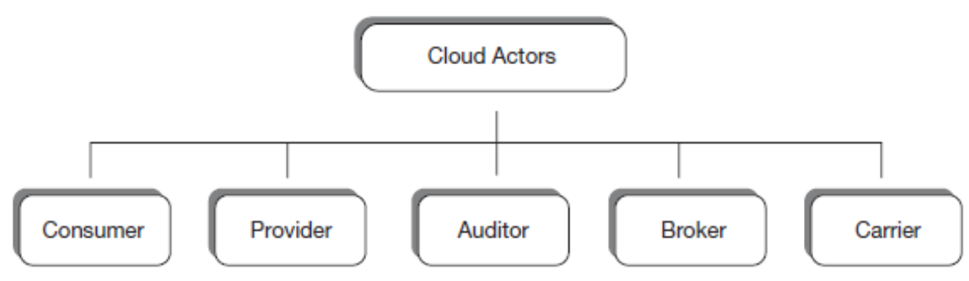
The Actors and Their Roles

Slide 8
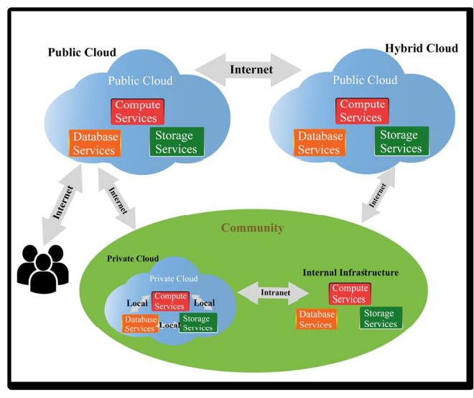
• Public Clouds
• Private Clouds
• Community Clouds
• Hybrid Clouds

Slide 9
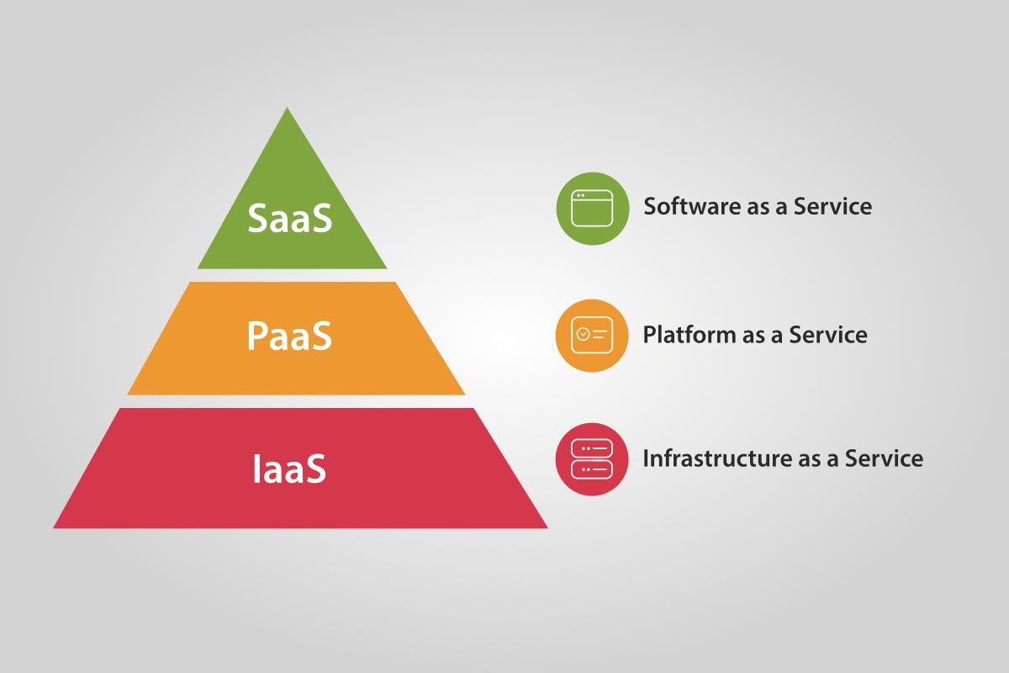
Cloud computing service models arranged as layers in a stack

Slide 10
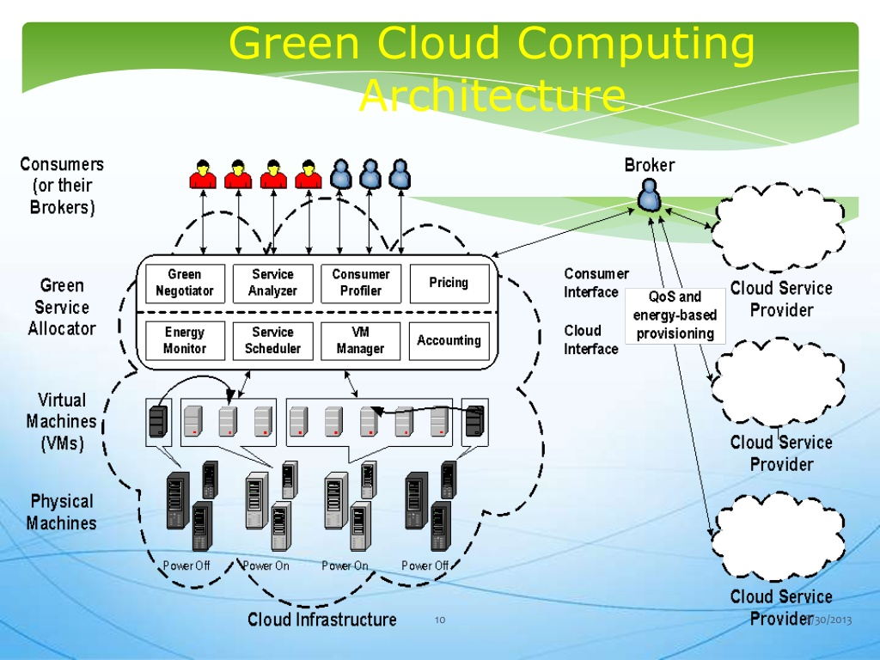

Slide 11
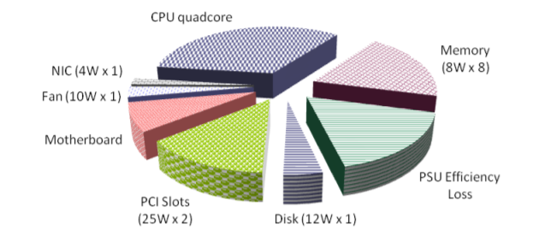
Energy consumption in one node

Slide 12
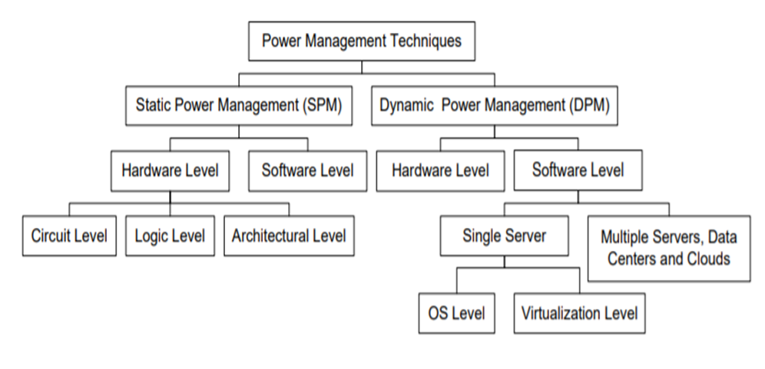

Slide 13
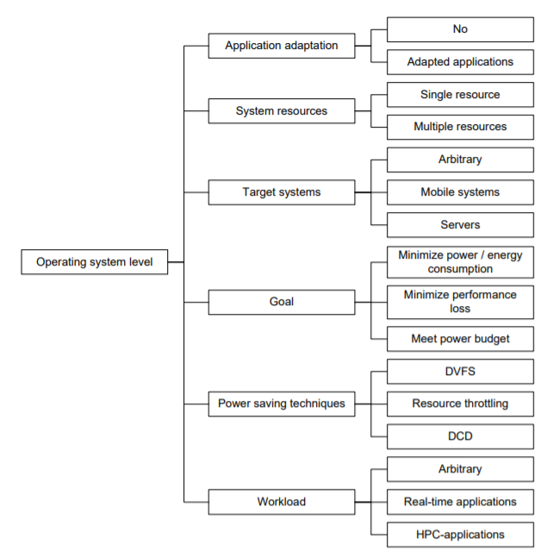
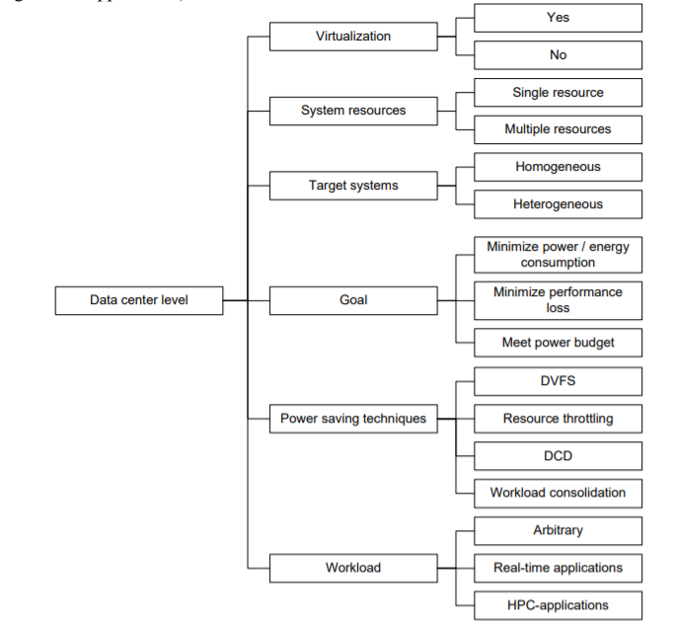

Slide 14
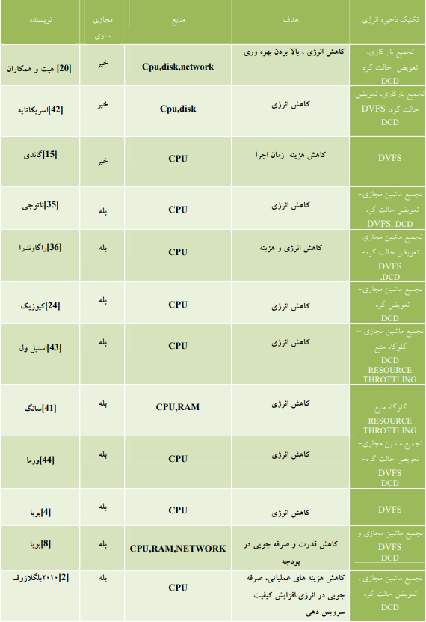
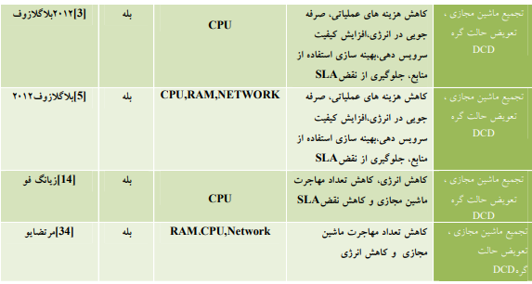

Slide 15
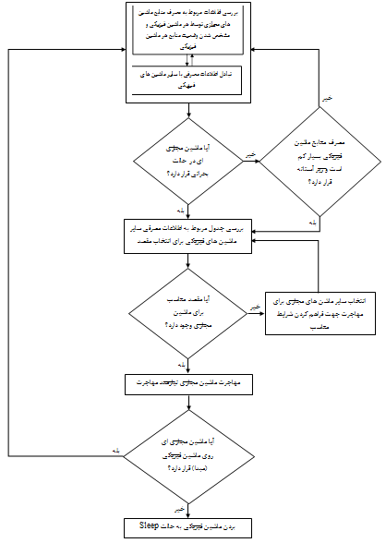

Slide 16
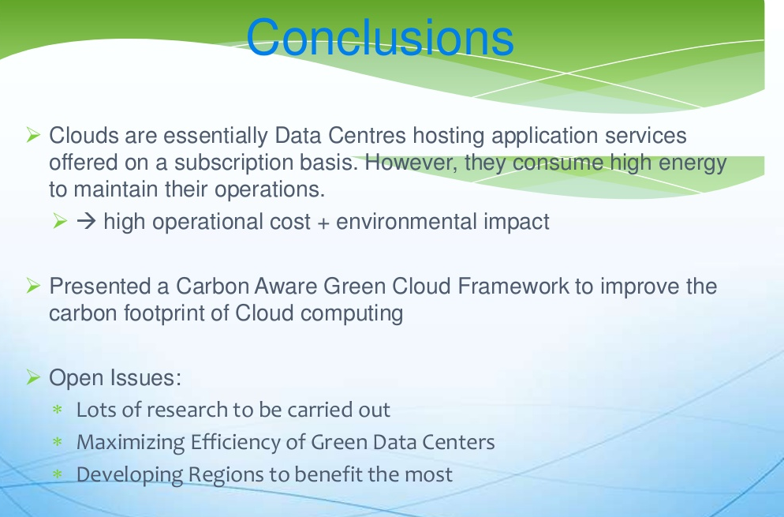

Slide 17


