Slide 1
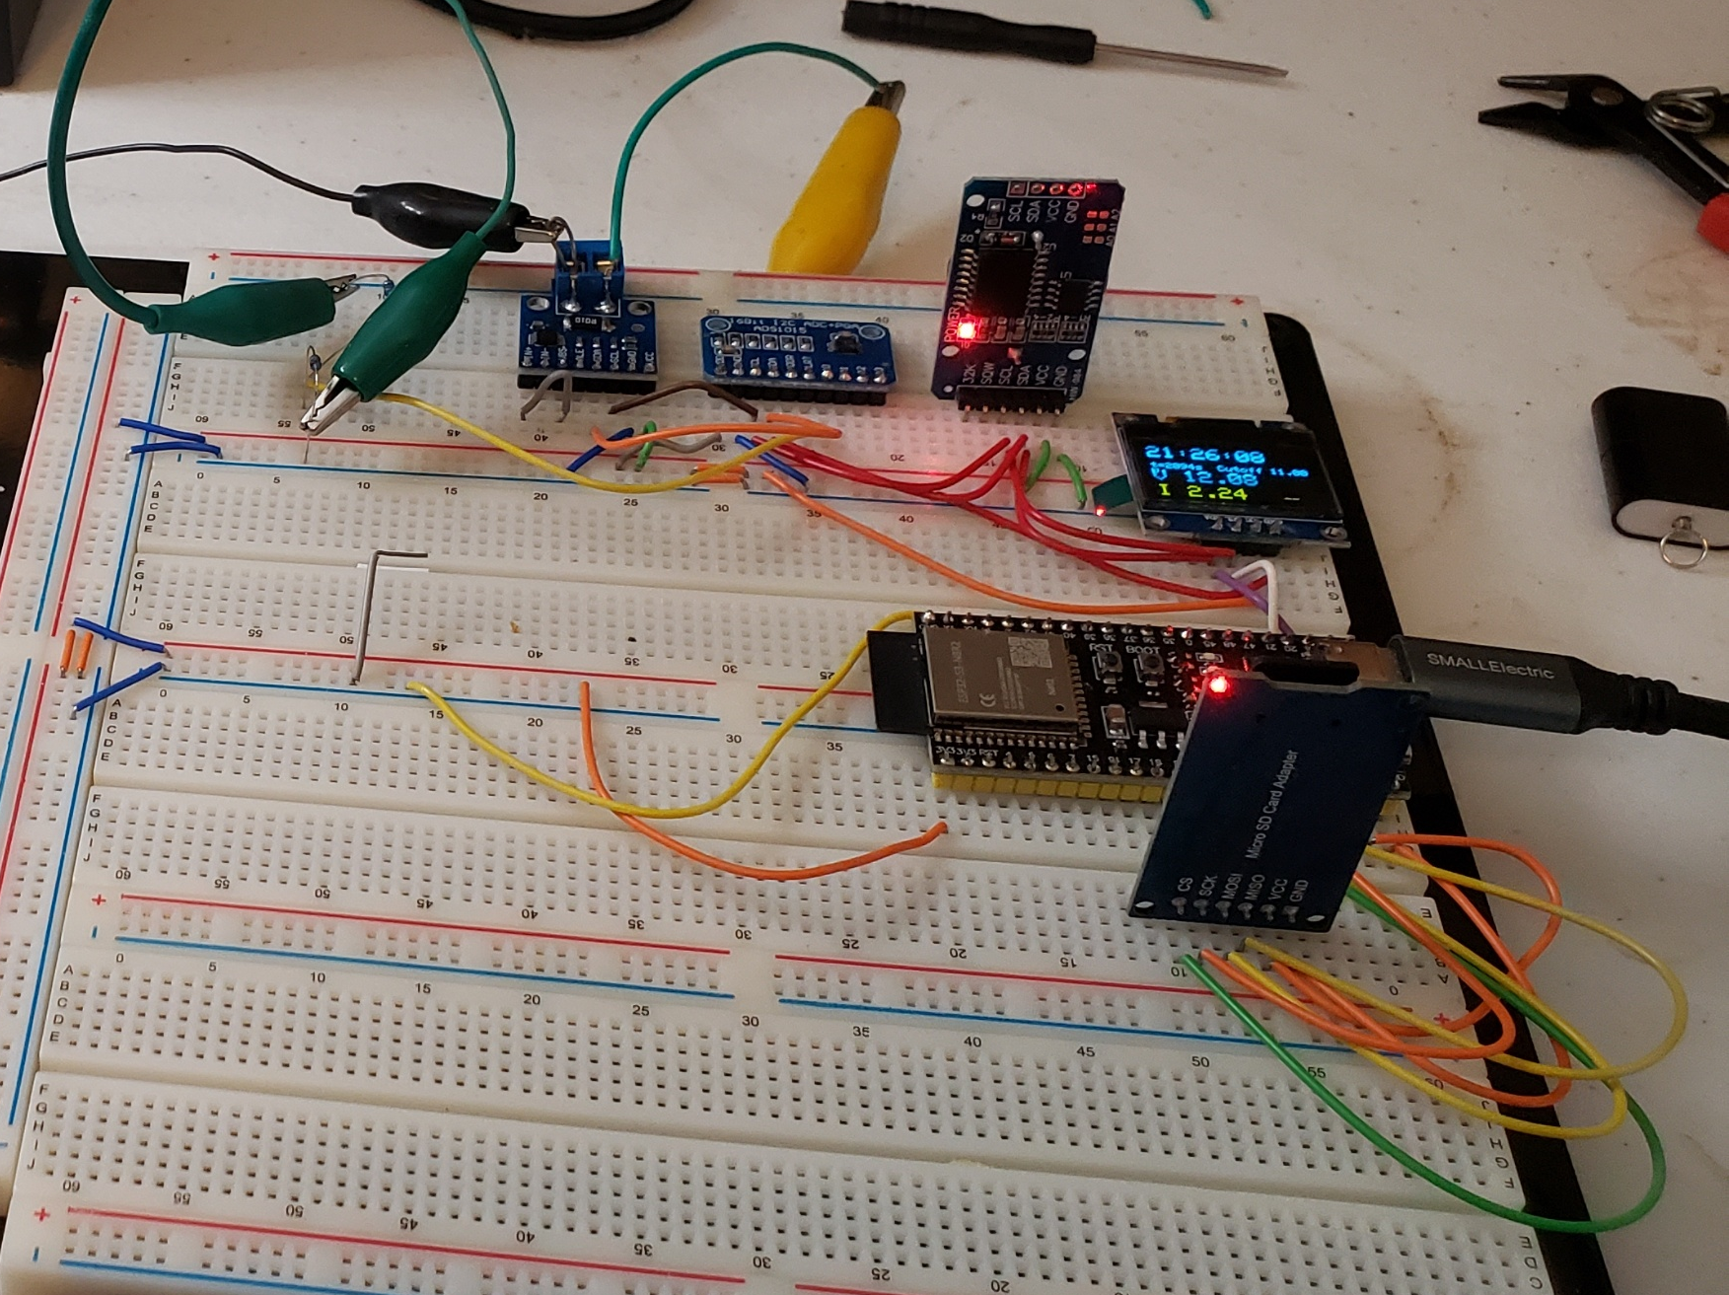
ADS1115 16-bit I²C ADC
DS3231 RTC module
SSD1306 128×64 I²C OLED
INA226 I²C module
ESP32-S3-DevKitC
SPI microSD breakout

