Slide 1


Website: www.tronbsc.io
Email: admin@tronbsc.io
A TRX Based 100%
Decentralized System
Time to Build Your Future With TronBSC

Slide 2


Decentralized
TRONBSC is a Tron Base plan which is 100% Decentralized.
This system works on Blockchain Technology.
It’s global plan run by crowd funding.
It’s 100% secure and no one can hack it.
All transactions are done peer to peer (No middlemen).
TronBSC can also be checked on Tron Scanner.
Being Decentralized TRONBSC has no owner.
*The Blockchain is an immutable record of transactions and information, which is cryptographically protected from any subsequent manipulation using thousands of independent computers worldwide.

Slide 3
Slots
TRON BSC X2
1. 50
2. 100
3. 200
4. 400
5. 800
6. 1600
7. 3200
8. 6400
9. 12800
10. 25600
11. 51200
12. 102400
TRON BSC X3
1. 50
2. 100
3. 200
4. 400
5. 800
6. 1600
7. 3200
8. 6400
9. 12800
10. 25600
11. 51200
12. 102400
12 Slots of working (TRONBSC X2) and 12 slots non working (TRONBSC X3)

Slide 4
Registration
ACTIVATION @100TRX

Slide 5
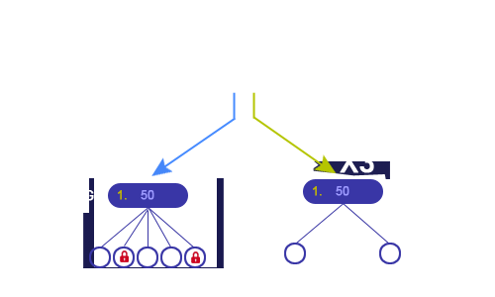
Activation
Your 100 TRX Will be equally distributed 50 in X2 and 50 in X3

Slide 6
How TRONBSC System Works
TRONBSC X2
TRONBSC X3
50
50
At the time of Joining , we get fitst slots automatically in X2 and X3 ,
X2 is a 5 matrix plan, while X3 is a pipeline based system.

Slide 7
How TRONBSC X2 Works
X2
1. 50
2. 100
3. 200
4. 400
5. 800
6. 1600
7. 3200
8. 6400
9. 12800
10. 25600
11. 51200
12. 102400
After joining TRONBSC, All X2 slots can be purchased in sequence.

Slide 8
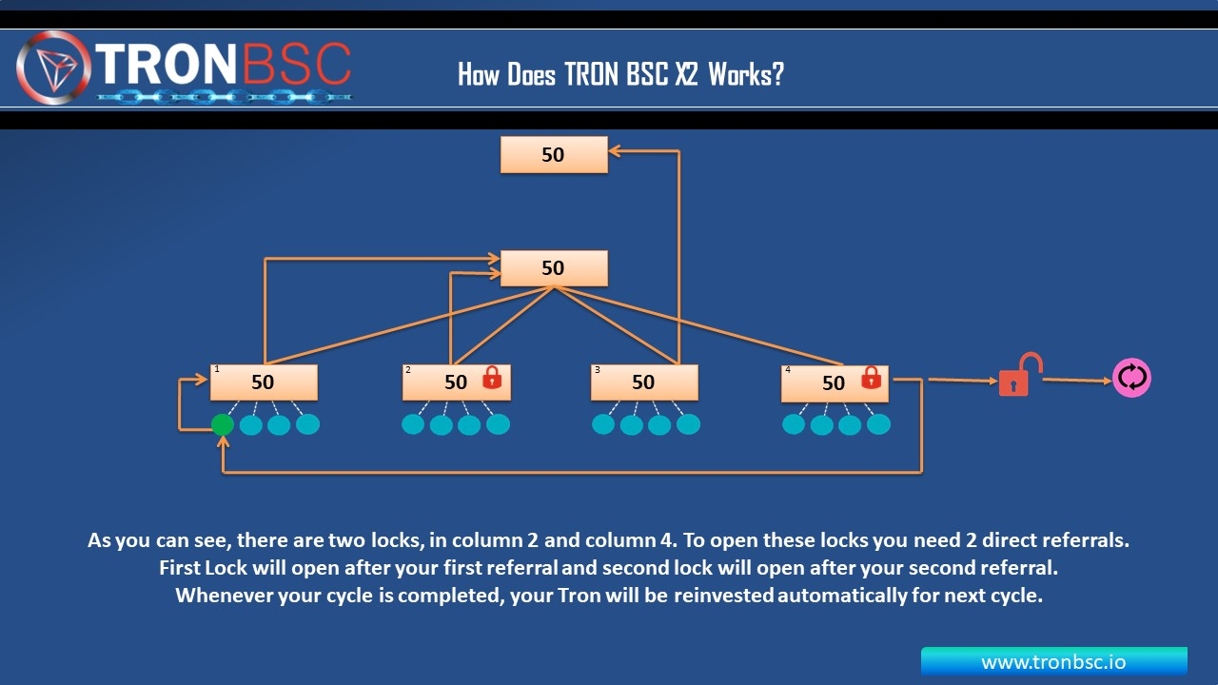



How TRONBSC X2 Works
50
50
Pipe Line Club Income
Old Member
Pipe Line Enter
New Member
Pipe Line Enter
1. 50
2. 50
3. 50
4. 50
5. 50
TRX
As you can see, there are two locks, in colum 2 and column 5, To open these locks you need 2 direct referrals First lock will after your first referal and second lock will open after your second referal whenever your cycle is completed , your Tron will be reinvested automatically for next cycle,

Slide 9


How TRONBSC X2 Works
ID
Pipe Line Club Income
New Member
Pipe Line Enter
Old Member
Pipe Line Enter
1
2
3
4
50 TRX
Member in 100 TRX to 5 Member Director Referral In Entry Pipe Line Club .
You can take Club Income Life Time .
All partners in your slots of the X2 PROGRAM are your personally referral partners. When you invite pertners, they take places under you.

Slide 10

How TRONBSC X2 Works
1
2
3
4
5
Pipe Line Club Income
Old Member
Pipe Line Enter
New Member
Pipe Line Enter
ID
1
2
3
4
TRX
1
2
3
4
5
The distribution of payments when filling out the matrix automatically occurs as follow:
The first referral partner takes a place under you 100% payout goes to your TRON wallet.
The Second referral partner takes second place below you. Payment is also instantly credited to your wallet.
The third partner takes third place below you. It will be given to your upline 100% on his wallet.
The fourth referral partner place below you. The income will credited 100% in your downline team.
The five partner place below you it will be given to your pipe line club Income 100% on his Club Income achiever wallet .
The first number slot of X2 is 50 TRX, under which rule is working, from the next 2 number slots to 12 number slots will work in their own place on the same rule.

Slide 11


How TRONBSC X3 Works
X3
1. 50
2. 100
3. 200
4. 400
5. 800
6. 1600
7. 3200
8. 6400
9. 12800
10. 25600
11. 51200
12. 102400
As you can see now, there are 2 more locks in X3. but don’t be confused. These two locks Will automatically open, Once you refer 2 direct in your X2. .
Once your 2 locks are open in X3. All you remaining X3 slots can be purchased in sequence.

Slide 12

TRONBSC X3 Works
ID
50 +50 = 100
50 +50 = 100
50 +50 = 100
This is first ever unique global pipeline.
All ids TRONBSC have to pass thru this pipeline.
When you enter in this pipeline. Next 1stID which will enter after you, there income will come to you and the income of second will go to the ID just after you.
Your ID automatically are invested and you will complete one cycle.
All other slots will work in same way as your first cycle.
Thru this pipeline all member will supported by each other.
The first number slot of X3 is 50 TRX, under which rule is working, from the next 2 number slots to 12 number slots will work in their own place on the same rule.

Slide 13

Club and Superclub Achiever
Total 5 Joining
2 direct referrals
3 new
joining
YOU WILL
CLUB ACHIEVER
Get Club Income Lifetime.
If you make 2 direct referrals and 3 new joining, you will be eligible for Club Achiever.
5 direct referrals
15 new
joining
Total 20 Joining
YOU WILL
SUPER CLUB ACHIEVER
5
15
Get Super Club Income Lifetime.
f you make 5 direct referrals and 15 new joining, you will be eligible for Super Club Achiever.
The more people you join by your direct referral in TRONBSC platform, the more you will have TRON income and you can join the unlimited people through your direct referral in this platform.
For the income of Super Club Achiever, after deducting 10% on every payment of all members of TRON BSC, Super Club Achiever will be immediately given in their wallet.

Slide 14


How TRONBSC System Works
Gift from superior
With Reference
Gift From Downline
Gift From Crossline
No Expiration date of the slot
Unlimited Automatic Reinvests
TRONBSC is a closed system, without deadlines for slots, with a limited number of reinvests. In the matrix, the referral link is fixed the person who invited you. You always follow your superoir partner to wach of the slots activated.
In the Tron X2 Program below you is three places in one line in the TRON X3.
Program below you are two lines - 2 places in the first line and places in the second . When you register
In TRONBSC you can open both programs simultaneusly.

Slide 15
Upgrade
Slots can be purchased on this platform of TRON BSC respectively.
In this platform of TRON BSC, the work done by you or by your team or by your cross line or cross line team can be availed only when you buy that slot.
In this platform of TRON BSC, if the slot purchased by your down line is equal to the price of the slot, you will have to buy the slot before buying your down line. Then you will benefit from the slot purchased by your down line. If you did not buy a slot equal to the slot purchased by your down line, before that your down
TRX 50
TRX 100

Slide 16
THANK YOU!
Website: www.tronbsc.io

