Slide 1
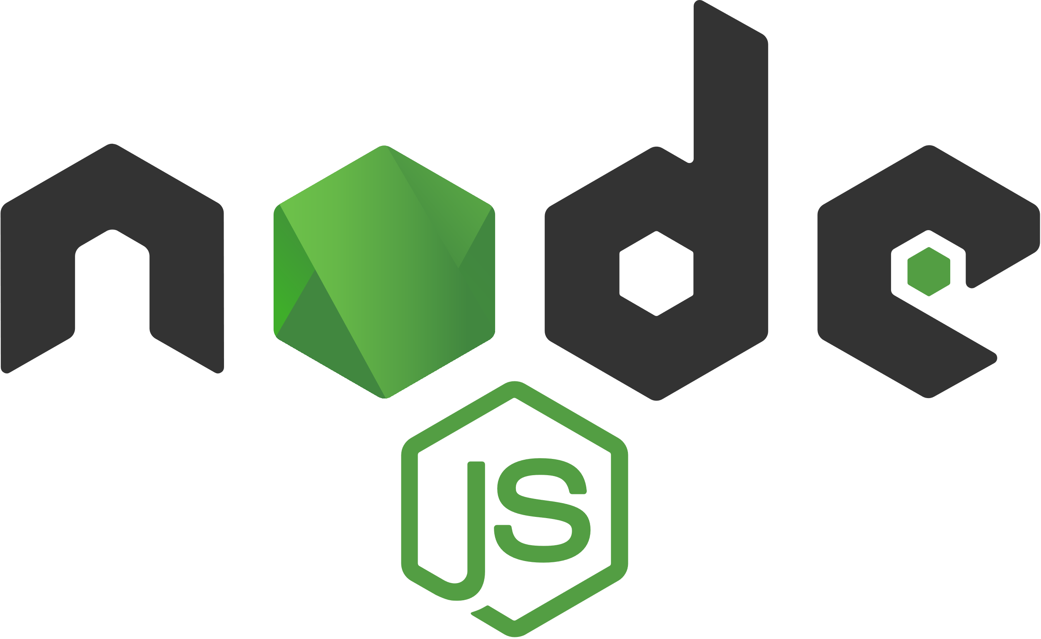
CPNT-262 Node.js

Slide 2
Course Information
Important information about this course. Please refer back to these slides as needed.

Slide 3
Grading
Task | Percentage of Overall Grade
Daily JavaScript Exercises | 15%
JavaScript Final Project | 35%
Daily Node.js Exercises | 15%
Node.js Final Project | 35%
Total Grade for CPNT-262 | 100%

Slide 4
Introduction to Node.js

Slide 5
What is Node.js?
Not a programming language
An environment that lets you use JavaScript outside of the browser
Uses Chrome’s V8 JavaScript engine
With Node.js, you can build anything from small command line tools to HTTP servers that power dynamic websites. Simply put, it’s server-side JavaScript.

Slide 6
Background
Reading and writing of data to and from the network and hard drive (input/output aka I/O) can be a difficult or slow task
JavaScript does not have a built-in way to do input and output (unlike Python, for example)
Moving data around takes time and scheduling it well makes your program faster

Slide 7
Node.js to the rescue
Designed to help you write JS programs that talk to networks, file systems or other I/O sources.
I/O sources like:
Databases
APIs
HTTP/WebSocket connections
Files

Slide 8
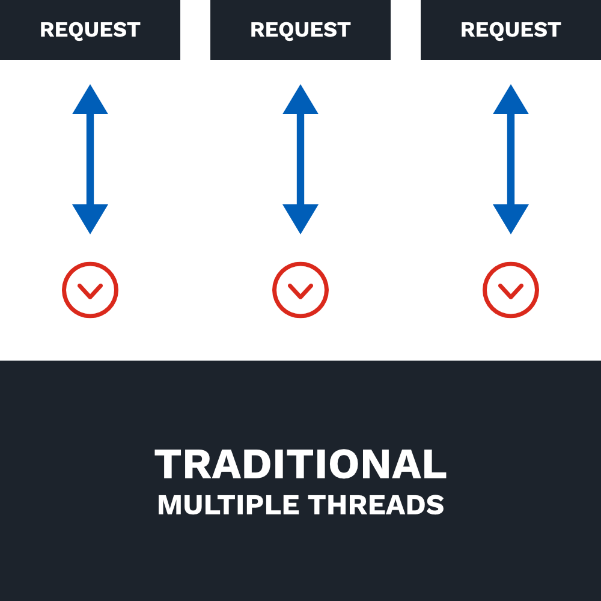
Traditional Web-Serving Techniques
Uses the thread model. 1 thread for each request.
In an I/O operation (downloading a file, for example), the request spends most of the time waiting for it to complete.
A lot of I/O operations can mean having a large amount of unused resources (like memory) linked to these threads.
1 thread per request (multiple threads) doesn’t scale well

Slide 9
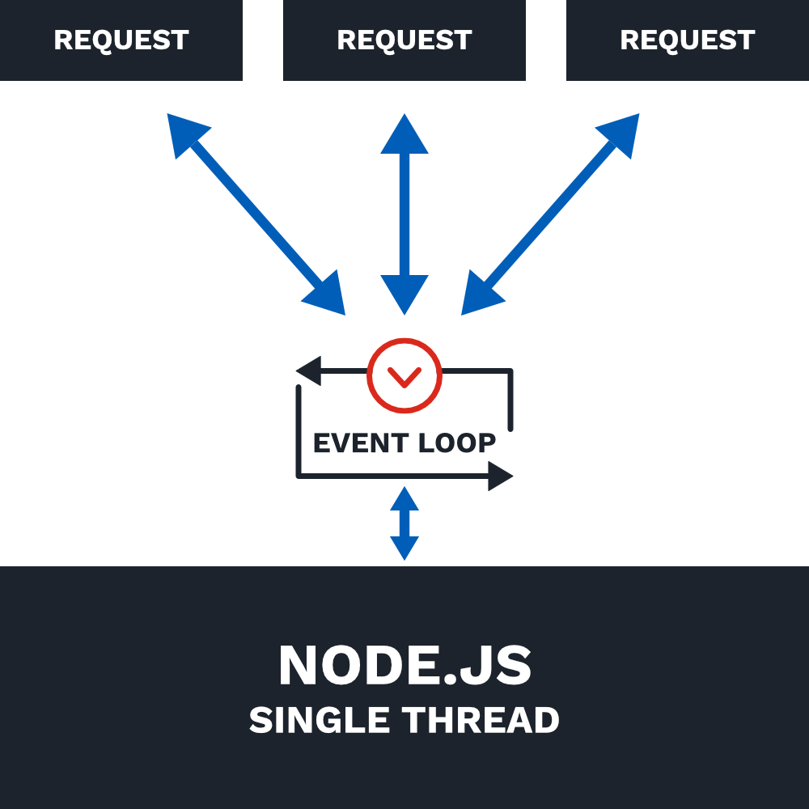
Node.js uses a single thread
Ryan Dahl, the creator of Node.js, argued that software should be able to multi-task and proposed eliminating time spent waiting for I/O results to come back.
Instead of the traditional thread model, Node uses a single thread.
and…

Slide 10
Node.js is... Asynchronous
Synchronous execution refers to code executing in sequence. The program is executed line by line, one line at a time. The program execution waits until a function returns before continuing to the next line of code.
Asynchronous execution refers to execution that doesn’t run in the sequence it appears in the code. The program doesn’t wait for the task to complete and can move on to the next task.
Remember using the Fetch API to fetch resources asynchronously? When the resource was ready, then we could do something with it.

Slide 11
Node.js is... Non-blocking
In a blocking I/O model, operations block other operations from happening while they wait for the operation to be finished.
In a non-blocking I/O model, operations don’t block other operations. If the program is waiting for something to happen, it can move on to another task instead of blocking all other tasks from happening. The program could come back and check again later or just do something later when it finally gets a response.

Slide 12
Node.js is... Event-driven
Node uses events heavily. Think of when you click on a button and a function is called. Or when a program is listening for a completed file download or an error.
In Node, there is a main event loop that listens for events and then triggers a callback function when one of those events is detected.

Slide 13
Node.js Example
Instead of writing code that goes through steps in order:
Read File
Print File Contents
Query Database
Filter Database Query Results
We break up tasks like this:
Read File and then Print File Contents
Query Database and then Filter Database Query Results

Slide 14
Node.js Example
Read File and then Print File Contents
Query Database and then Filter Database Query Results
Node will start at the top and begin reading the file, but reading a file takes some time. So while it’s reading the file and waiting on the results, Node can go to the next task and query the database.
If the program finishes reading the file first, then it will print the file contents. But if it finishes querying the database first, it will then filter the database query results.
Notes:
We don’t have to wait for each step in the program to finish before moving on to the next one. Similar to adding an event listener on a button click, but instead we’re listening for things like network requests and database queries.

Slide 15
Node.js Analogy – Fast Food
In a traditional model, you:
order your food
pay for your food
wait for your food, blocking all other customers from ordering
receive food and leave
In Node.js, you:
order your food
pay for your food
step over to the side and wait for your food. While you’re waiting, the cashier continues to take orders from other customers.
When your order is ready, the cashier lets you know. You receive your food and leave.
You need a lot more cashiers (threads) in the traditional model in order to handle all the customers!
Notes:
We don’t have to wait for each step in the program to finish before moving on to the next one. Similar to adding an event listener on a button click, but instead we’re listening for things like network requests and database queries.

Slide 16
History of Node.js
2009 – Designed by Ryan Dahl (and later sponsored by Joyent). Created out of a sense of frustration with Apache HTTP server’s ability to handle many concurrent connections and the common way of writing code where code blocked the entire process or multiple threads were needed
2010 – Introduced package manager; npm, created by Isaac Schlueter
2011 – Supported on Windows (instead of just Linux and Mac OS X)
2012 – Dahl stepped aside. Schlueter took over.
2014 – Timothy J. Fontaine took over.
2014 – A fork of Node.js (io.js, created by Fedor Indutny) created due to internal conflict over Joyent’s governance.
2015 – Node.js and io.js communities voted to work together under the Node.js Foundation. Node.js v0.12 and io.js v3.3 merged back together into Node v4.0. Yay ES6 features and more!
Current versions of Node.js are 10.16.3 LTS (long-term support) and 12.10.0 Current (latest features).

Slide 17
Set Up Node.js

Slide 18
Obligatory Hello World
Yeah, it’s overdone. But it’s traditional so let’s go for it anyway!

Slide 19
Prerequisites
Node.js and npm installed
Internet Access/Browser
Text Editor

Slide 20
Activity: Install Node.js
Download the Node.js installer (LTS version): https://nodejs.org/en/download/
Run the installer (default options are good).
Verify installation. Open a terminal and type in
node -v
If Node.js is installed correctly, it will display the version number.
Notes:
Check to make sure everyone has installed correctly and has a current version.

Slide 21
Activity: Hello World
Create a project folder on your Desktop named sait-node.
Open your text editor and create a new file named hello.js. Save it to your sait-node folder.
Inside your hello.js file, write the following code:
Save the file and run it by typing node hello.js in the terminal. (you’ll need to navigate to the correct folder first)
console.log("Hello World!");
Notes:
Check to make sure everyone has installed correctly and has a current version.

Slide 22
Built-in Node.js Modules

Slide 23
Modular Design
When creating an application, you often reach a point where putting all your code in a single file becomes unwieldy.
Node modules bundle up code for reuse, and they don’t alter the global scope.
Node modules allow you to select which functions and variables from the included file are exposed to your app.
You can use built-in Node modules, 3rd-party modules, or even build your own.
Notes:
Use modules to organize all related code into a single file. Modules can be small and can serve a very specific purpose.

Slide 24
Built-in Node Modules
Node.js has several built-in modules that you can use in your app.
HTTP module – make Node.js act as an HTTP server
File System module – Handle the file system
URL module – Parse URL strings
To see a list of built-in modules, you can run the following code:
const builtin = require("module").builtinModules;
console.log(builtin);

Slide 25
Creating a Web Server

Slide 26
Web Servers and HTTP Requests
Web browsers communicate with web servers using HyperTextTransfer Protocol (HTTP).
When you click a link on a page, submit a form, or run a search, the browser sends an HTTP Request to the server.
URL identifying the target server and resource
Method that defines the required action (get a file, update data, etc.)
Any additional information (search parameters, form data, etc.)

Slide 27
Web Servers and HTTP Response
Web servers wait for request messages, process them, and reply with an HTTP Response message
HTTP Response contains:
Status code (“200 OK”, “404 Not Found”, “403 Forbidden”)
A successful response to a GET request would also contain the requested resource
https://developer.mozilla.org/en-US/docs/Learn/Server-side/First_steps/Client-Server_overview

Slide 28
HTTP Module
In the previous activity, we Hello World shows up in the terminal. But wouldn’t it be nice if we could display it in our browser instead?
To make this happen, we need to build a web server!
The HTTP module will allow us to send requests and get responses.

Slide 29
Activity: HTTP Module
Create a new file named app.js. Save it to your sait-node folder.
Notes:
Go over to your editor and walk through how to create a web server.

Slide 30
Step 1: Load HTTP module
The HTTP module is a module in Node.js that provides useful functions and classes to build an HTTP server.
In order to tell our program that we’re going to use this module, we must “require” it.
// Load HTTP module
const http = require("http");
Notes:
https://nodejs.org/api/http.html

Slide 31
Step 2: Create the HTTP server
Next, we need to create the server and pass in a function that will handle the server configuration and what to do with the response
We will also listen on a port of our choosing for requests (port 8000)
// Load HTTP module
const http = require("http");
// Create HTTP server and listen on port 8000 for requests
http.createServer((request, response) => {
}).listen(8000);
Notes:
https://nodejs.org/api/http.html

Slide 32
Step 3: Set response HTTP header
Use response.writeHead() method to pass in the status code (200 means all is OK) and the response headers.
const http = require("http");
http.createServer((request, response) => {
// Set the response HTTP header with HTTP status and Content
response.writeHead(200, { "Content-Type": "text/html" });
}).listen(8000);
Notes:
If the response from the HTTP server is supposed to display as HTML, make sure to include an HTTP header with the correct content type.

Slide 33
Step 4: Send the response body
const http = require("http");
http.createServer((request, response) => {
response.writeHead(200, { "Content-Type": "text/html" });
// Send the response body "Hello World"
response.end("<h1>Hello World!</h1>");
}).listen(8000);
Notes:
After the page has been written, the response.end() method is called. The server should consider this message complete now.
We can also pass in data here. In this case, we passed in the text Hello World! wrapped in an h1 tag.
If we pass in data to response.end() it will assume it needs to response.write() that content before ending.

Slide 34
Step 4a: Send the response body
const http = require("http");
http.createServer((request, response) => {
response.writeHead(200, { "Content-Type": "text/html" });
// Use response.write() instead of response.end(). response.write("<h1>Hello World!</h1>");
response.end();
}).listen(8000);
Notes:
Alternatively, we can just use response.write() to write that content to the page. We still need to tell the server to end the response when we’re done.

Slide 35
Activity: HTTP Module
Save the file and run it by typing node app.js in the terminal.
In your browser, navigate to localhost:8000. You should see “Hello World!” on the page.
You can hit ctrl-C in your terminal to stop the server.

Slide 36
Step 5: Log a message when the server starts up.
const http = require("http");
http.createServer((request, response) => {
response.writeHead(200, { "Content-Type": "text/html" });
response.end("<h1>Hello World!</h1>");
// Pass in a function as the 2nd argument to listen() so that we log a message to the console when the server is running.
}).listen(8000, () => {
console.log(`Server running on port 8000`);
});
Notes:
You can also show them how to add a console.log message to show when the server is running. Just to make the experience a bit more obvious.

Slide 37
Read the Query String
const http = require("http");
http.createServer((request, response) => {
response.writeHead(200, { "Content-Type": "text/html" });
// Write the URL to the page
response.write(request.url);
response.end();
}).listen(8000);
The function we pass to http.createServer() has a request argument that represents the request from the client. This request object has a property called url that holds part of the URL.

Slide 38
Activity: Query String
Save the file again and run it by typing node app.js in the terminal.
In your browser, navigate to localhost:8000/sait. You should see “/sait” on the page.
Try navigating to other subfolders.
You can hit ctrl-C in your terminal to stop the server.

Slide 39
File System

Slide 40
File System Module
The Node.js file system module allows you to work with the file system on your computer.
With this module, we can:
Read files
Create files
Update files
Delete files
Rename files

Slide 41
Activity: FS Module
Import the FS module at the top of your app.js file.
const http = require("http");
// Load FS module at the top of the page. Just add it under previously loaded modules.
const fs = require("fs");

Slide 42
Activity: Read Files
Create a new file named demo.html.
Add some basic HTML code.
<!DOCTYPE html>
<html lang="en">
<head>
<title>Document</title>
</head>
<body>
<h1>Best Headline Ever</h1>
<p>What a great paragraph!</p>
</body>
</html>

Slide 43
Activity: Read Files
Back in app.js, let’s edit the createServer() code to read a file.
http.createServer((request, response) => {
fs.readFile("demo.html", (err, data) => {
response.writeHead(200, { "Content-Type": "text/html" });
// Write the data that we read from "demo.html".
response.write(data);
response.end();
});
}).listen(8000);

Slide 44
Creating and Updating Files
We can also create files using the FS module.
Several methods exist for creating new files:
fs.appendFile()
fs.open()
fs.writeFile()

Slide 45
Append Files
fs.appendFile() appends content to the end of a file.
If the file doesn’t exist, the file will be created.

Slide 46
Activity: Append File
Create a new file named file-system.js. In this file, add the following code and run it.
Try changing the content and running the file again.
const fs = require("fs");
fs.appendFile("newFile.txt", "Hello World! (again)", err => {
if (err) throw err;
console.log("File saved.");
});
https://nodejs.org/api/fs.html#fs_fs_writefile_file_data_options_callback

Slide 47
Open Files
fs.open() takes a “flag” as the 2nd argument.
Flags tell what mode to open the file as:
‘a’ – Open for appending. File is created if it doesn’t exist.
‘r’ – Opens file for reading. Exception occurs if file doesn’t exist. You can’t write to this file.
‘w’ – Opens file for writing. File is created if it doesn’t exist. If it does exist, you write over whatever was already in the file.
There are a ton more flags that you can use! https://nodejs.org/api/fs.html#fs_file_system_flags

Slide 48
Activity: Open File
Let’s create a new, empty file using the fs.open() method.
In file-system.js, add the following code:
fs.open('newFile2.txt', 'w', (err, file) => {
if (err) throw err;
console.log('File saved.');
});
https://nodejs.org/api/fs.html#fs_fs_open_path_flags_mode_callback

Slide 49
Write to Files
fs.writeFile() replaces the chosen file and content if it exists.
If the file does not exist, creates a new file containing the chosen content.

Slide 50
Activity: writeFile()
Let’s create a new file using the fs.writeFile() method.
In file-system.js, add the following code:
Try changing the content and running the code again. What happens to the file?
fs.writeFile("newfile3.txt", "Hello world!", err => {
if (err) throw err;
console.log("File saved.");
});
https://nodejs.org/api/fs.html#fs_fs_open_path_flags_mode_callback

Slide 51
Updating Files
We can also update files using the FS module (which we did in the last few activities).
Remember!
fs.appendFile() – Adds to the end of the file.
fs.writeFile() – Replaces the content in the file.

Slide 52
Deleting Files
We can also delete files using the FS module.
fs.unlink() – Deletes a specified file.

Slide 53
Activity: unlink()
Let’s delete a file using the fs.unlink() method.
In file-system.js, add the following code:
Check your folder. Where did newfile2.txt go?
fs.unlink("newfile2.txt", err => {
if (err) throw err;
console.log("File deleted.");
});
https://nodejs.org/api/fs.html#fs_fs_unlink_path_callback

Slide 54
Renaming Files
We can rename files using the FS module.
fs.rename() – Renames a specified file.

Slide 55
Activity: rename()
Let’s delete a file using the fs.rename() method.
In file-system.js, add the following code:
Check your folder. Where did newfile.txt go?
fs.rename("newfile.txt", "renamedFile.txt", err => {
if (err) throw err;
console.log("File renamed.");
});
https://nodejs.org/api/fs.html#fs_fs_rename_oldpath_newpath_callback

Slide 56
Parsing URLs

Slide 57
URL Module
The Node.js URL module splits up a web address into readable parts.
We can use url.parse() to return each part of the web address as separate properties.

Slide 58
Activity: URL Module
Go back to app.js and add (then run) the following code:
const url = require("url");
let address = "http://localhost:8000/demo.html?year=2019&month=october";
let parsedAddress = url.parse(address, true);
console.log(parsedAddress);
Notes:
Import the URL module
Save a URL with query strings to variable address.
Use url.parse() to parse the address and save this information to variable parsedAddress.
console.log(parsedAddress) to see what information you get back

Slide 59
Activity: URL Module
Log out the following:
host
search
pathname
year
month
Notes:
console.log(parsedAddress.host)
console.log(parsedAddress.search)
console.log(parsedAddress.pathname)
console.log(parsedAddress.query.year)
console.log(parsedAddress.query.month)

Slide 60
URL Module + Web Server
Now that we can parse query strings, let’s add some code to our web server.
We’re going to serve specific files requested by the client.

Slide 61
URL Module + Web Server: The Code
const http = require("http");
const fs = require("fs");
const url = require("url");
// Create HTTP server and listen on port 8000 for requests
http.createServer((request, response) => {
let parsedAddress = url.parse(request.url, true);
let file = "." + parsedAddress.pathname;
fs.readFile(file, (err, data) => {
response.writeHead(200, { "Content-Type": "text/html" });
response.write(data);
return response.end();
});
}).listen(8000);
Notes:
Demo transforming the previous code into this code.
Replacing “demo.html” with file variable. Parsing the address to create the file variable.
Return response.end() to exit the function (this will come in handy later when we handle errors)

Slide 62
Activity: Serve Specific Files
Create 2 new HTML files (similar to demo.html).
about.html – Put some content about you in this file.
contact.html – Add some information about how people can contact you here (just your email address is fine).
Modify your app.js createServer() code to serve specific files.
Visit localhost:8000/about.html and localhost:8000/contact.html.
Try visiting localhost:8000 and check your terminal for an error.

Slide 63
404 Page
If the filename doesn’t exist, then we can’t serve it!
Let’s write some code to handle what happens when there’s an error.

Slide 64
Activity: 404 Page
Add the following code to your createServer() code.
Visit pages that don’t exist. What happens?
if (err) {
response.writeHead(404, { "Content-Type": "text/html" });
response.write("<h1>404: Page Not Found</h1>");
return response.end();
}
Notes:
Returning response.end() is important or else we’ll continue trying to serve the particular filename that doesn’t exist.

Slide 65
Activity: Homepage
Can you think of a way to add a homepage to your code? Try to make it work!
Notes:
if (file === "./") {
file = "./homepage.html";
}
Students may come up with other ways of doing this. As long as it works, it’s fine. We’ll be using Express later.

Slide 66
Understanding Callbacks

Slide 67
Callbacks
Nearly everything in Node uses callbacks. You’ve seen them before as they are part of the JavaScript language.
Callbacks are functions that are executed asynchronously, or at a later time.
Notes:
https://stackoverflow.com/a/28757703

Slide 68
Callbacks Example
const fs = require("fs");
let file = fs.readFile("number.txt", "utf8");
console.log(file); // throws error because it runs before the file is read
Linear code isn’t how Node works. Here, readFile() will take a while to complete. Logging the file won’t work until it’s been read.

Slide 69
Callbacks Example
const fs = require("fs"); // fs is the built-in file system module
let file = fs.readFile("number.txt", "utf8", logFile);
function logFile(err, data) {
console.log(data);
}
We need to show that logging the file depends on readFile() finishing. That’s what callbacks are for. readFile() expects a function that is executed when it finishes reading the file. It expects a callback.
Notes:
Here, we’re creating a separate function named logfile(), but in previous examples, we just passed the entire function in rather than naming it.

Slide 70
Callbacks – Errors
const fs = require("fs");
let file = fs.readFile("number1.txt", "utf8", logFile);
function logFile(err, data) {
if (err) throw err;
console.log(data);
}
Most Node built-in modules use callbacks with 2 arguments: 1) the error (if one occurs) and 2) the results.
Notes:
You can check documentation to see what arguments a callback function requires.

Slide 71
Local Modules

Slide 72
Node Modules
In the previous activities, we used built-in modules to add additional functionality to our app.js file.
You can also create your own modules to organize your code.
Organize all related code into a single file.
Keep modules small and specific.
Modules can be published to the npm registry and shared with the community.

Slide 73

Creating Modules
Modules can be either single files or directories containing one or more files.
If a module is a directory, the file in the module directory should be named index.js. You can change this in package.json

Slide 74
Activity: Currency Module
In your sait-node folder, create a new file named currency.js. This is your new module.
Add the following code to currency.js.
const canadianDollar = 0.76;
function roundTwo(amount) {
return Math.round(amount * 100) / 100;
}
exports.canadianToUS = canadian => roundTwo(canadian * canadianDollar);
exports.USToCanadian = us => roundTwo(us / canadianDollar);

Slide 75
module.exports
exports.canadianToUS = canadian => roundTwo(canadian * canadianDollar);
exports.USToCanadian = us => roundTwo(us / canadianDollar);
module.exports lets us set things for export
exports is a shorthand alias for module.exports (avoid using exports as a variable name or you’ll destroy this link)
Here, we’re exporting a function called canadianToUS so that other modules can use it.

Slide 76
Activity: Import Currency Module
In your sait-node folder, create a new file named test-currency.js.
Add the following code to test-currency.js.
Run the code in the terminal with node test-currency.js
// Load currency module
const currency = require("./currency");
// Use functions from currency module
console.log(`50 Canadian dollars equals ${currency.canadianToUS(50)} US dollars.`);
console.log(`50 US dollars equals ${currency.USToCanadian(50)} Canadian dollars.`);
Notes:
Here, we’re importing the currency module using the require module.

Slide 77
require
const currency = require("./currency");
require lets us specify modules to be imported into a current module
the .js extension is assumed, so you don’t need it
use relative paths

Slide 78
Activity: More Currencies
Create and export new functions to convert between Canadian dollars and British pounds.
You can Google the exchange rate.
Notes:
Here, we’re importing the currency module using the require module.

Slide 79
Node Package Manager (npm)

Slide 80
What is npm?
Package manager for Node.js packages (modules)
https://www.npmjs.com/ (discover and install public packages – free to use in your projects)
Installed automatically when you install Node.js

Slide 81
package.json
package.json is the configuration file used by the program npm, the Node Package Manager
You will be installing a lot of different things for your project (dependencies), and package.json keeps a list of things you installed. This helps you share the project with others.
package.json is also the configuration file for automating tasks and publishing your project

Slide 82
Creating a Node Project
So far, we’ve just been writing code, but it’s time for us to officially make this a real Node.js project

Slide 83
Activity: Start Node Project
Navigate to the sait-node folder in the terminal and then run npm init.
The npm command will ask you a few questions. You can hit enter to keep the default with the following changes:
Entry point should be app.js
Change the author name to your name!
In your sait-node folder, you should now see a package.json file.

Slide 84
Packages
Now that our project is official, we have a package.json file that allows us to store information about the project.
Now, we can install 3rd-party modules and save them to our project.

Slide 85
Installing Packages
Global – all global packages are placed in a single place on your system
npm install package-name –g
install packages globally when it provides an executable command that you run from the terminal, and it is reused across packages
Local – installed in the directory where you run the command; placed inside the node_modules folder within the directory
npm install package-name
installed as dependency for your project
npm install package-name --save-dev
installed as development dependency for your project
unneeded for production, but needed for your development workflow
Notes:
There are different ways to install packages, depending on what your project needs.

Slide 86
Nodemon
Let’s update our workflow. So far, we’ve had to restart the server every time we make a change. /yaaaaawwwn
Let’s use nodemon to automatically restart the server whenever changes are made.
Since nodemon gives us an executable command that we can run from the terminal (nodemon app.js instead of node app.js), we can install it globally!

Slide 87
Activity: Install a Global Package
In the terminal, run the following command.
npm install nodemon -g
Start up your server one more time, but this time use nodemon!
nodemon app.js

Slide 88
Nodemon, part 2
There is a growing concern that installing development packages globally means that it’s harder for others to quickly get up and running with your projects.
Installing packages like Nodemon as a local development dependency means that other people can just npm install to set up the project and everything you used.
Installing locally instead of globally also means that you have more control over the version of the package and that you don’t run into potential conflicts down the road.

Slide 89
Uninstalling Packages
Global
npm uninstall -g nodemon
Local (navigate to the root folder first)
npm uninstall nodemon
Local dev dependency (navigate to the root folder first)
npm uninstall --save-dev nodemon

Slide 90
Activity: Uninstall a global package
Uninstall Nodemon as a global package (you can always reinstall it later).

Slide 91
Activity: Install a Dev Dependency
In the terminal, navigate to your sait-node folder.
Install nodemon as a development dependency (we need it for our development workflow, but not for the project itself).
npm install nodemon --save-dev
nodemon app.js no longer works. We’ll need to edit our package.json file. Within “scripts”, add this after the test property
"start": "nodemon app.js"
Start up your server one more time, but this time using nodemon as a local package!
npm run start
Notes:
npm run start will check our package.json file for a script called start and run whatever is listed there. In this case, it will automatically run nodemon app.js for us.

Slide 92
Activity: Install a Package for Production
Install Moment.js (https://momentjs.com/docs)
Format the time as Month Day, Year (October 1st, 2019) - https://momentjs.com/docs/#/displaying/
Log the time to the console.
Notes:
npm run start will check our package.json file for a script called start and run whatever is listed there. In this case, it will automatically run nodemon app.js for us.

Slide 93
Express Framework

Slide 94
Express
Popular Node web framework
a light layer on top of the Node.js web server
helps to cut down on all the code needed to make things happen
add functionality
minimalist – probably doesn’t do everything you need, but won’t add a lot of stuff you don’t need either

Slide 95
Activity: Install Express
Create a new folder named sait-express.
Navigate to this folder in your terminal and initiate a new Node project (index.js is fine).
Install nodemon as a dev dependency and set up a script to npm run start
Install Express as a dependency. npm install express

Slide 96
Activity: Require Express
Require and then initialize the server. This will create an Express application that we can work with.
const express = require("express");
const app = express();

Slide 97
Listening for Requests
Once we initialize the Express app, we can start listening for requests.
We need to set a port for our server to listen to. We do this using the listen() method.
app.listen(8000, () => {
console.log("Server is listening on port 8000. Ready to accept requests.");
});

Slide 98
Activity: Listen for Requests
In your app, listen for requests on port 8000
Run your app in the terminal

Slide 99
Communicating with the Server
We’ve built the server and we’re listening for requests, and now we can communicate with it.
We can control the server with handler functions.

Slide 100
What is a handler function?
When a request reaches the server, we need a way of responding to it. This is where the handler function comes in.
A handler function is a function which receives requests and handles them.
Takes a request and response object, sends the response back to the client along with any information you choose.

Slide 101
Express handler function
The get() method is used to define a handler function in Express.
Takes 2 arguments:
the endpoint (the part of the URL that comes after /) at which to trigger an action
the handler function that tells it what to do
app.get("/", (req, res) => {
res.send("Hello World!");
});

Slide 102
Activity: Create a handler function
In your app, create a custom handler function
You can choose to send any content that you want
When you’re done, check localhost:8000 to see what happens.

Slide 103
Routing
Right now, we’re only working with the “/” endpoint.
If you go to localhost:8000/about, all you see is “Cannot GET /about”
So let’s make some new endpoints and make the server send different responses for different requests.
app.get("/about", (req, res) => {
res.send("I'm awesome!");
});

Slide 104
Activity: Add new endpoints
Send different content for the following endpoints:
/about
/contact

Slide 105
Routing – 404 Page
In Express, you can render a 404 page by adding middleware after all the other routes. This way, if a page isn’t found, you’re handling it with a specific 404 page.
app.use((req, res, next) => {
res.status(404).send("Sorry can't find that!");
});

Slide 106
Activity: Add 404 middleware
If the page doesn’t exist, send 404 information.
Test to see if your code works!

Slide 107
Serve Static Files
We’re sending back simple messages when we connect to specific endpoints, but it’s much better if we can send back an entire HTML page!
HTML files, images, etc. are static assets
For static files, we can’t use res.send(). Instead, we need to use a special built-in middleware function that comes with Express.

Slide 108
Middleware
What is middleware and how do we use it?

Slide 109
Middleware
A plain JS function that Express will call for you between the time it receives a network request and the time it fires off a response.
A function that sits in the middle.
We use middleware for:
checking to see if a user is logged in and has permission to view whatever they’re requesting
sending static files if the user requests one
Functions are called in the order you specify every time there’s a request.

Slide 110
Middleware
You can write your own middleware functions. Takes 3 arguments:
req
res
next
When someone visits your website, the web browser sends a request to your server. Express takes that request and passes it through all the middleware functions that you’re using.
next is a function that we call at the end of the middleware function – tells Express to move to the next middleware in the stack.

Slide 111
Middleware Example
app.use((req, res, next) => {
// Code goes here
next();
});
app.use() is how we load the middleware function into Express.
When we use built-in or 3rd-party middleware functions, it looks like this:
app.use(functionName);

Slide 112
Back to Express
We can use middleware to serve static files.

Slide 113
express.static()
special built-in middleware function that comes with Express
allows us to serve all the static assets in a particular folder
app.use(express.static("views"));

Slide 114
Activity: Serve static files
In sait-node, create a new folder named views.
In the views folder, add an index.html file for your homepage. Duplicate the about.html and contact.html files you made before and add them to the views folder or create new ones.
Delete all your app.get() endpoint functions and replace them with the express.static() function on the slide before this one.
Refresh your app. What do you see now?
Notes:
With the code above, you can visit localhost:8000, localhost:8000/about.html, and localhost:8000/contact.html

Slide 115
CSS and JS files
We also use express.static to add static files like our CSS and JavaScript files.
We can use the public folder to store CSS, JS files, images, etc.
Once we tell Express to use this folder, we can then refer to these resources in our views files.
app.use(express.static("public"));
<link rel="stylesheet" href="/style.css">

Slide 116
Activity: Serve CSS files
In sait-node, create a new folder named public.
In the public folder, add an style.css file for your CSS.
Add some basic CSS. Change the background color, for example.
Use express.static() to serve all the static assets in the public folder. Add a link to your style.css in your index.html page.
Refresh your app. What do you see now?

Slide 117
.html extension
Want to get rid of those unsightly .html extensions? We can pass in some options to the express.static() function.
This tells Express that .html is a default file extension to use when searching for the static files.
app.use(express.static("views", {
extensions: ["html"]
}));

Slide 118
Forms

Slide 119
Sending Data
So far, we’ve been requesting data from the server, but we can also send data to the server.
HTTP Request Methods
GET – app.get – deals with requests that use the GET HTTP method
POST – used to send data to the server
Let’s post some data!

Slide 120
Activity: Create a form
In a new create-post.html file, add the following form code:
Add at least one other form field. Maybe the blog post title?
The action attribute is the endpoint that the form data will be sent to.
<form action="/create-post" method="POST">
<textarea name="blogpost" rows="5" placeholder="Write a new blog post!"></textarea>
<button type="submit">Publish</button>
</form>

Slide 121
Streams
Data comes to the server in streams.
With a pure Node server, we’d have to write code to collect the stream of data properly. But Express handles that for us.
To make this work for us, we need to define a route to deal with requests that come through on the /create-post endpoint.

Slide 122
Post Data
To post data, we’ll use app.post() instead of app.get()
app.post("/endpoint", (req, res) => {
});

Slide 123
Activity: Post data
Use app.post with the “/create-post” endpoint to send form data to the server
Inside your app.post function, console.log request.body. You should see undefined. We’ll have to do something else in order to access the form data.
Notes:
With the code above, you can visit localhost:8000, localhost:8000/about.html, and localhost:8000/contact.html

Slide 124
express.urlencoded()
When data is posted to the server as FormData, we can’t extract it from the req.body like we normally could.
Let’s use some Express middleware (express.urlencoded()) to help us out with this.
recognizes the incoming request object as strings or arrays
extended: true is the default and allows you to parse more types of Request Object
app.use(express.urlencoded({ extended: true }));

Slide 125
Activity: Parse Incoming Requests
Use express.urlencoded() between your app.use statement and your app.post statement. (in the middle!)
(Add it above all of your routes as you’ll need it for other app.post statements later).
Now log req.body to the console inside your app.post statement.
What do you see in the terminal now?

Slide 126
Activity: End the Request
We need to end the response to the client.
We can use res.end() OR we can redirect to another page (which also calls res.end() for us).
Create a thank-you page and redirect to it at the end of your app.post statement or you can redirect back to the same /create-post page.
res.redirect("/thank-you");

Slide 127
Template Engines

Slide 128
What is a template engine?
Template engines allow us to add data to a view and generate HTML dynamically.
Express uses Pug by default, but there are a ton of choices:
Pug
Handlebars
Mustache
EJS
Notes:
So how do we do this?

Slide 129
Pug
For this course, we’re going to use Pug (but feel free to check out alternatives).
First, you must install pug as a dependency
Then, we need to tell Express where to look for the .pug files and that we’re using Pug as our engine of choice. We can place this at the top of our file under our import statements.
const path = require("path"); // require path - utilities for working with file and directory paths
app.set("views", path.join(__dirname, "views"));
app.set("view engine", "pug");
Notes:
At the top of our index.js file, we should require path along with the other modules.
Under const app, we should then set the views folder and the view engine. This tells Express where to find the views folder and also that we’ll be using pug files.

Slide 130
From Static to Dynamic
Now that we’re using dynamic templates instead of static templates, we need to update our index.js file to reflect this change.
Instead of using:
We need to create separate routes for each page.
app.use(express.static("views"));

Slide 131
Activity: Create Routes
For each page you’ve created, write an app.get statement to render the appropriate file.
// create routes
app.get("/", (req, res) => {
res.render("index");
});

Slide 132
From Static to Dynamic
If we try to refresh the app in the browser now, we’ll get an error:
Failed to lookup view "index" in views directory
That’s because our app is looking for pug files now.
So let’s create them!

Slide 133
Learning Pug Syntax
Converting HTML to Pug is all well and good, but let’s actually learn how to right Pug syntax
doctype html
head
meta(charset='UTF-8')
meta(name='viewport' content='width=device-width, initial-scale=1.0')
meta(http-equiv='X-UA-Compatible' content='ie=edge')
title Document
h1 Welcome
Notes:
Pug takes the tag name as the first thing in the line, and the rest of the content goes inside that line.
You get rid of all the angle brackets <> and the code looks much cleaner.
Indentation is incredibly important. To show that tags are nested in other tags, you must indent.

Slide 134
Learning Pug Syntax
Set the doctype
Id and class attributes
doctype html
h1#title Welcome
h2.subtitle All About Pug Syntax

Slide 135
Learning Pug Syntax
Nested elements
Attributes
nav
ul
li
a(href='/about') About
li
a(href='/create-post') Create Post
a.nav-link(href='/create-post' title="Create Post") Create Post

Slide 136
Learning Pug Syntax
There’s a lot more to Pug syntax (though what we’ve covered will get you started).
For more information: https://flaviocopes.com/pug/

Slide 137
Activity: Convert to Pug
Save your .html files as .pug files.
Convert your HTML into Pug syntax.
Now, you should be able to load your app like before, except now you’re using Pug instead of HTML!
Note: You can also use this handy html to pug converter to change your HTML into a Pug template file. (https://html-to-pug.com/). Before you use this, try to convert at least one .html file on your own!

Slide 138
Pug – 404
You can change your 404 middleware to render a specific 404 page.

Slide 139
Activity: Add 404 Page
Create a 404 page using pug.
Rewrite your 404 middleware in index.js to render the 404 page instead of sending a message.
Check to make sure your code works.

Slide 140
Interpolating Variables
Passing in data to our templates.

Slide 141
Interpolating Variables
Sometimes you want to pass data into the templates
index.js
index.pug
app.get("/", (req, res) => {
res.render("index", { greeting: "Hello there!" });
});
h1 #{greeting}
Notes:
Demo what this looks like on the homepage when you refresh in the browser.

Slide 142
Iterating over variables
index.js
index.pug
app.get("/", (req, res) => {
res.render("index", { greetings: ["Hello", "Bonjour", "Hola", "Ciao"] });
});
each greeting in greetings
h1= greeting
Notes:
Demo what this looks like on the homepage when you refresh in the browser.

Slide 143
Layouts

Slide 144
Layouts
You can create layouts that all of your pug files can use.
To do this, create a template or layout.pug file.
Use the block keyword to specify default content that can be overwritten in other .pug files.
main#main
block content
Notes:
Demo what this looks like on the homepage when you refresh in the browser.

Slide 145
Layouts
In the other .pug files, you can specify that you’re extending the particular layout.pug file.
Use the block keyword followed by a unique name to specify what block you’re creating or overwriting.
extends layout.pug
block content
h1 This headline will overwrite any default content in the content block.

Slide 146
Activity: Use Layouts
Refactor your .pug files to use 1 main layout.pug file.
This file should include:
doctype html
head
block title with default information
body
header
block content with default information
footer

Slide 147
Activity: Use Layouts
Edit the rest of your .pug files to extend this layout.pug file.
Use block title and block content to overwrite the page titles and main content.
When testing, you should see the same header and footer across all pages, but the rest of the content should change.

Slide 148
Databases
Notes:
We’ve spent time reading and sending files, but wouldn’t it be nice to save and display those blog posts we’re writing?

Slide 149
Databases
There are generally 2 types of databases
SQL – MySQL
NoSQL - MongoDB

Slide 150
SQL
SQL databases allow you to add and retrieve data using SQL (structured query language)
Existed since 1986
relational database
all of your data must follow the same structure
Table-based
a lot of up-front preparation (you can’t just add a new column dynamically)
SELECT * FROM pets
INSERT INTO pets VALUES ('Spot', 8)

Slide 151
NoSQL
Document-based (objects) database storage
Create documents without having to define the structure first
Each document can have its own unique structure
Syntax can vary between databases
Add fields as you go
Stored in a format similar to JSON (but enhanced) – great for JavaScript developers

Slide 152
MongoDB
A popular NoSQL database
exposes a JavaScript API we can use to create databases and collections of objects (documents)
To work with MongoDB, we need to set up the database!

Slide 153
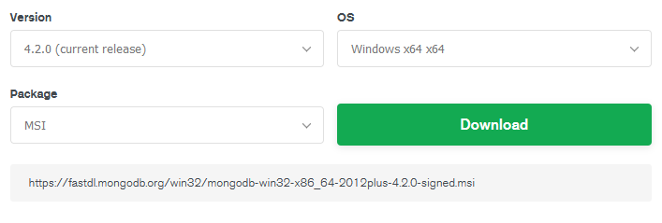
Activity: Install MongoDB Locally
Go to the MongoDB Download Center: https://www.mongodb.com/download-center/community
Choose Current Release, Windows, and MSI
Run the installer, but uncheck Install MongoD as a Service
Go ahead and install Compass as part of the installation process

Slide 154
Local Installation
For now, we’re working locally so we don’t have to rely on an internet connection.
Later, we’ll go over how to use MongoDB Atlas

Slide 155
Activity: Start the MongoDB Server
In order to actually work with databases, we have to start the database server!
Create the database directory (you only have to do this the first time).
cd C:\
md "\data\db"
Start the database.
cd C:\Program Files\MongoDB\Server\4.2\bin
mongod
You should see the database running in your terminal now.

Slide 156
MongoDB Compass
Compass is a nice GUI for MongoDB. It allows you to visually explore your data and physically see how everything is set up.
Let’s go ahead and connect to it.

Slide 157
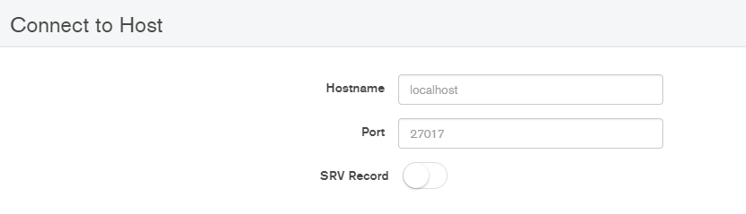
Activity: Start Compass
Open MongoDB Compass
Connect to Host – For localhost, you can use all the defaults. Just press Connect.
Soon, we’ll add a new database and data!

Slide 158
Installing MongoDB in Your Project
Now that we have MongoDB installed locally, we need to install the package that allows us to work with it in our project.
npm install mongodb
Require the mongodb package and get the MongoClient from it.
const mongo = require("mongodb").MongoClient;
Create a URL to the MongoDB server. For a local installation:
const url = "mongodb://localhost:27017";

Slide 159
Installing MongoDB in Your Project
Then, we can use the mongo.connect() method to get the reference to the MongoDB instance client:
mongo.connect(url, {
useNewUrlParser: true,
useUnifiedTopology: true
},
(err, client) => {
if (err) {throw err;}
//...
}
);

Slide 160
Installing MongoDB in Your Project
In the mongo.connect() method, you can select a database using the client.db() method.
(err, client) => {
if (err) {
throw err;
}
const db = client.db("db");
}
Notes:
Here, we are selecting a database named “blog”. If this database doesn’t exist, it will be created.

Slide 161
Installing MongoDB in Your Project
After selecting a database, we can create and get a collection. If the collection doesn’t exist, it’s created.
(err, client) => {
//... const db = client.db("db");
const collection = db.collection("names");
}

Slide 162
Insert data into a collection
Add one object
Add multiple objects
collection.insertOne({ name: "Joe Smith" }, (err, result) => {
// code goes here
});
collection.insertOne({ name: "Joe Smith" }, (err, result) => {
// code goes here
});
Notes:
Once we open a connection and choose a database and collection, we can start adding, updating, and removing data!
Demo each of these methods under the code from the last slide – Use MongoDB Compass to show off the data and changes. Don’t forget to refresh in the Compass app

Slide 163
Find data in a collection
Find all documents
Find a specific document using a filter
collection.find().toArray((err, items) => {
// code goes here
});
collection.find({ name: "John Smith" }).toArray((err, items) => {
console.log(items);
});
Notes:
Demo each of these methods under the code from the last slide – Use MongoDB Compass to show off the data and changes. Don’t forget to refresh in the Compass app

Slide 164
Find data in a collection
Find One Document
If you only need one item, you don’t need to convert the information into an array.
Instead, you can use findOne() to just get one item.
collection.findOne({ name: "John Smith" }).toArray((err, item) => {
console.log(item);
});
Notes:
Demo each of these methods under the code from the last slide – Use MongoDB Compass to show off the data and changes. Don’t forget to refresh in the Compass app

Slide 165
Update data in a collection
Update An Item in the Document
updateOne() finds the first item that matches and updates it.
Use $set to only update/add the specified data. Otherwise, you’ll change the whole object completely.
collection.updateOne({name: "John Smith"}, {'$set': {'name': 'John Smith II'}}, (err, item) => {
console.log(item)
})
Notes:
Demo each of these methods under the code from the last slide – Use MongoDB Compass to show off the data and changes. Don’t forget to refresh in the Compass app

Slide 166
Update data in a collection
Update Many Documents
updateMany() updates every match
collection.updateMany({name: /^John/}, {'$set': {'name': 'Mr. Smith'}}, (err, item) => {
console.log(item)
})
Notes:
Demo each of these methods under the code from the last slide – Use MongoDB Compass to show off the data and changes. Don’t forget to refresh in the Compass app

Slide 167
Delete data in a collection
Delete a Document
collection.deleteOne({ name: "John Smith" }).toArray((err, item) => {
console.log(item);
});
Notes:
Demo each of these methods under the code from the last slide – Use MongoDB Compass to show off the data and changes. Don’t forget to refresh in the Compass app

Slide 168
Activity: Database
Change your code to create a new database named “Test”.
CRUD – Create, Read, Update, and Delete
Practice different MongoDB operations in order to:
Create Documents
Read Documents
Update Documents
Delete Documents

Slide 169
MVC
Model - View - Controller
Notes:
Before we get too much further, let’s take a hard look at our app so far and reorganize it!

Slide 170
MVC
Model-View-Controller is a popular architecture for applications.
Model – part of the application that deals with the database or database-related functionality
View – everything the user will see. In our example app, this is all of our .pug files.
Controller – The logic of the app, and the connector between the models and views. The controller calls the models to get data, and then sends that data to the views so that the user can see the information.

Slide 171
MVC Example – Basic CMS
Users can create posts and view all the blog posts that everyone has written.
We need a model for our blog posts that would define how posts are stored in the database. This model might specify that blog posts should be objects that have a title, an author, a post, a URL, and a creation date.
We would need 3 views: the main page where every post can be seen, the author’s page where you can see every post written by the author, and a single post page where you can see just the single post.
Our controller would be called by Express in an app.get() statement. It would use the details of the request to determine which view should be shown and which post should be shown.

Slide 172
Activity: Restructure Your App
You have your views folder, but now you need to add:
models
controllers
We’re going to start breaking out different code into different sections using the MVC pattern.

Slide 173
Back to Databases
Notes:
Before we get too much further, let’s take a hard look at our app so far and reorganize it!

Slide 174
Mongoose
To really create an app based on MVC pattern, we should use Mongoose.
Mongoose allows us to define and create models for our data using the Schema interface.
The Schema allows us to define the fields stored in each document (object) along with validation requirements and default values.

Slide 175
Setting Up Mongoose
npm install mongoose
// Require the mongoose module
var mongoose = require('mongoose');
// Set up a mongoose connection
var mongoDB = 'mongodb://127.0.0.1/blog';
mongoose.connect(mongoDB, { useNewUrlParser: true });
// Get the connection
var db = mongoose.connection;
// Bind connection to error event (to get notification of connection errors)
db.on('error', console.error.bind(console, 'MongoDB connection error:'));
Notes:
Demonstrate replacing mongo.connect code with Mongoose code in index.js

Slide 176
Create a Post Model
Create a new file named Post.js and save it in the models folder.
This is where we’ll define the model for our posts.
First, we need to require mongoose since we’ll be using it.
var mongoose = require('mongoose');
Notes:
Demonstrate replacing mongo.connect code with Mongoose code in index.js

Slide 177
Create a Post Model
Now, let’s define a simple Schema for our blog posts.
We need to use the mongoose.Schema constructor to create a new Schema instance and define the fields inside it.
const postSchema = new mongoose.Schema({
post: {
type: String,
required: true,
trim: true
},
// more fields defined below
});
Notes:
Here, we’ve defined a post as a String. We specify that it should be required and that we’ll trim any extra white space from the post.

Slide 178
Activity: Add a title field to your Post model
Now that we’ve defined the post itself, you should also define the title and URL slug for the post.
If you want to add extra form fields to your blog post creator, go ahead and define those in your postSchema too!
Notes:
title: {
type: String,
required: true,
trim: true
},
url: {
type: String,
required: true,
trim: true,
unique: true //
},

Slide 179
Adding Logic
Now that we’ve created a model for our blog posts, we can add some logic in a controller to save and display these posts in our database.
Notes:
Demonstrate replacing mongo.connect code with Mongoose code in index.js

Slide 180
Activity: Create a postController
In the controllers folder, create postController.js
In this file, require your Post model. Make sure to use a relative path.

Slide 181
postController
In our controller is where we put the logic of the app. Here, we’ll connect our database to our view.
We’re going to create a function to create our posts and another function to display our posts.

Slide 182
postController – Create Posts
We create a function called createPost that accepts the request and response objects.
Define an instance of the Post model. Pass in the data that you want to save (in this case, we’re saving the request body.
Take this post and call .save() on it.
Once the post is saved, redirect to the blog page.
exports.createPost = (req, res) => {
const post = new Post(req.body);
post.save(err => {
if (err) throw err;
res.redirect("/blog");
});
};

Slide 183
Updating your app.post statement
In your app.post statement for the create-post page, you can replace the function there with postController.createPost.
app.post("/create-post", postController.createPost);

Slide 184
Activity: Test it!
Update your postController and make sure that you’re requiring it in your index.js file.
Update your app.post statement and then test that your blog posts are being saved to your database (refresh Compass and look for a post).

Slide 185
Displaying Errors
exports.createPost = (req, res) => {
const post = new Post(req.body);
post.save(err => {
if (err) throw err;
res.redirect("/blog");
});
};
We need to update our code a bit so that we can display errors on the create-post page.

Slide 186
Displaying Errors
// in post.save()
if (err) {
const errorArray = [];
const errorKeys = Object.keys(err.errors);
errorKeys.forEach(key => errorArray.push(err.errors[key].message));
return res.render("create-post", {
errors: errorArray
});
}
Notes:
Demo this.
We can create an errorArray to hold our error messages. We’ll need to loop through our error Object to get all the different error messages.
Once we have our array of error messages, we can pass this into the render() method. We’ll add some code to our create-post.pug file to display these error messages in a bit.
We use the return keyword here because we don’t want the function to move on to redirecting to the blog page if there are errors.

Slide 187
Displaying Errors – Pug File
if errors
ul
each error in errors
li= error
Notes:
Demo this.
In our .pug file we can add this above our form to display all of the error messages.

Slide 188
Activity: Display Error Message
Update postController.js and create-post.pug to loop through and display the errors at the top of the page
Test the page to make sure it works.
Try to add the correct error message below each field instead.
In your Post.js model, change required: true to required: "Error message goes here" in order to display custom messages.

Slide 189
Displaying Errors – Unique Slugs
Right now, we don’t get a nice error if we add the same slug name. So let’s add a package that will help us with this.
npm install mongoose-unique-validator
const uniqueValidator = require("mongoose-unique-validator");
const postSchema = new mongoose.Schema({
// fields defined here
});
postSchema.plugin(uniqueValidator);
Notes:
In our Post.js model, we need to add this code. This will give us handy error messages when an item isn’t unique.

Slide 190
Activity: Unique
Add the uniqueValidator plugin.
Test the create-post page to make sure it works.
In your Post.js model, change unique: true to unique: "Error message goes here" in order to display custom messages.

Slide 191
Displaying Errors – Custom Validation
Currently, our slug field accepts any input. But there should be rules!
No hyphens at the beginning or ending
No question marks, etc
We can use regex to test the slug against a particular pattern and display an error message if it doesn’t fit our criteria.
validate: {
validator: function(v) {
return /^[a-z0-9]+(?:-[a-z0-9]+)*$/.test(v);
},
message: props => `${props.value} is not a valid URL slug.`
}
Notes:
This is a common regex pattern for testing slugs. - https://digitalfortress.tech/tricks/top-15-commonly-used-regex/

Slide 192
Activity: Custom Validation
Try adding some custom validation.
Test the create-post page to make sure it works.

Slide 193
Sanitize Input ??????
We also want to sanitize the input to remove or replace characters in the data that might be used to send malicious content to the server.
To do this, we can install a package to help us out (mongo-sanitize). Once installed, we can sanitize our inputs like this:
validate: {
validator: function(v) {
return /^[a-z0-9]+(?:-[a-z0-9]+)*$/.test(v);
},
message: props => `${props.value} is not a valid URL slug.`
}
Notes:
This is a common regex pattern for testing slugs. - https://digitalfortress.tech/tricks/top-15-commonly-used-regex/

Slide 194
postController – Display Posts
We create a function called displayPosts that accepts the request and response objects.
Use the .find() method on your Post model to find all posts.
Once the post are founds, render the blog page and pass in the posts in an object so you can use it in your blog.pug file.
exports.displayPosts = (req, res) => {
Post.find((err, posts) => {
res.render("blog", { blogPosts: posts });
});
};

Slide 195
Displaying Posts in blog.pug
In your .pug file, check to see if blogPosts exist (this is the object we passed in).
Loop through each blog post and display the title and post. (these are the names we gave to the title and post fields in /create-post)
if blogPosts
each post in blogPosts
a(href="/blog/" + post.slug)
h1= post.title
div= post.post

Slide 196
Activity: Test it!
Go to your /blog page and make sure you can see posts there!
Go to your /create-post page and add a new blog post.

Slide 197
Displaying Single Pages
Right now, we have a link that takes us to /blog/post-slug but that page doesn’t actually exist yet!
We need to add some code to our routes and to our controller so that we can actually pull in that information.

Slide 198
Displaying Single Pages – Route
In our index.js page, we need to add a new route.
Now we need to create the controller function to display the single post.
app.get("/blog/:slug", postController.displaySinglePost);

Slide 199
Displaying Single Pages – Controller
In our postController.js, we need to render a single post page.
exports.displaySinglePost = (req, res) => {
Post.findOne({ slug: req.params.slug }, (err, post) => {
console.log(post);
res.render("blog-single", { post: post });
});
};
Notes:
In this code, instead of finding all posts, we’re finding the one post that has a particular slug. This slug information is pass through req.params.slug since we used :slug as the parameter in our route.

Slide 200
Displaying Single Pages – View
We need to create a blog-single.pug file that renders our single posts.
doctype html
head
meta(charset='UTF-8')
meta(name='viewport' content='width=device-width, initial-scale=1.0')
meta(http-equiv='X-UA-Compatible' content='ie=edge')
title Blog
if post
h1= post.title
div= post.post
Notes:
We don’t need the link around the title anymore. And we’re no longer checking for an array of blogPosts and looping through it.

Slide 201
Activity: Test your single post page!
Go to your /blog page and click on a post to go to the single page view!

Slide 202
Authentication

Slide 203
Authentication
We’ve created a basic CMS that will allow you to:
create blog posts
view all blog posts
view single posts
But anyone that goes to this app could create a new blog post. Maybe we should add user login and some more features.

Slide 204
Authentication
Creating users and allowing them to log in and log out is important. Hiding pages from people who aren’t allowed to view them is pretty big too!
We’re going to use passportJS to help us out and handle our authentication and sessions for us.
What do we need?
Views – register, login, log out
Models – User model
Controller - userController

Slide 205
Install Passport and more
We need to install a few things to get set up.
passport – to handle authentication
passport-local – authenticate with username and password (there are other strategies you can use instead)
express-session – handles cookies so we can tell if a user is logged in or out
npm install passport passport-local express-session
Notes:
We can install multiple packages at once.

Slide 206
Require New Packages
Make sure to require the packages we just installed in your index.js file.
const session = require("express-session");
const passport = require("passport");
const LocalStrategy = require("passport-local").Strategy;

Slide 207
Express-Session
Allows us to assign every user of the app a unique session, which allows us to store user state (are they logged in?)
secret is a required parameter and is used to sign the session ID cookie – should be a random unique string
app.use(session({
secret: "super secret",
resave: false,
saveUninitialized: true
}));
Notes:
resave and saveuninitialized are related to how the session object is saved in the session store. For now, we’re using some defaults so deprecation notices don’t show up in the terminal, but you can read more about this and decide what your app needs later.
Here, I’m using “super secret” as the secret. Later, we’ll learn where to store secrets properly and use a random unique string instead.
Passport uses express-session as a dependency so we’ve done all we need to do for now.
Add this under app.set(“view engine”, “pug”);

Slide 208
User Model
Before we continue configuring passport, let’s create a model for our users.
For our User Model, we’re going to need a new Schema with the following information:
username
password
Later, we can add more information, but these are pretty standard.

Slide 209
Activity: Create a User Model
Create a file named User.js in your models folder.
Create a new userSchema that has details for:
username – make this unique
password – for now, we’re just going to save this as plain text…but don’t do this on a real project
Use lowercase: true to convert username input into lowercase.

Slide 210
Creating a Sign-Up Page
doctype html
head
meta(charset='UTF-8')
meta(name='viewport' content='width=device-width, initial-scale=1.0')
meta(http-equiv='X-UA-Compatible' content='ie=edge')
title Document
h1 Sign Up
form(method='POST' action="/sign-up")
label(for="username") Username
input(name="username" placeholder="Username" type="text")
label(for="username") Email
input(name="email" placeholder="Email Address" type="email")
label(for="password") Password
input(name="password" type="password")
button(type="submit") Register
Notes:
Now that we have a User Model, we need a sign-up page so that people can actually register as new users!
Demo building this

Slide 211
Create userController.js
In userController.js, you’ll need to create some logic so that the new users are saved in the database.
exports.createUser = (req, res, next) => {
const user = new User({
username: req.body.username,
password: req.body.password
}).save(err => {
if (err) return next(err);
res.redirect("/");
});
};
Notes:
We create a newUser and pass in the username and password that we can get from the request body.
Then, we save this data in the database and redirect to the homepage.
Make sure to require the User model.

Slide 212
Create Routes
In index.js, we can create routes for our sign-up page now.
Make sure to require userController.js in your index.js file.
app.get("/sign-up", (req, res) => res.render("sign-up-form"));
app.post("/sign-up", userController.createUser);
Notes:
We create a newUser and pass in the username and password that we can get from the request body.
Then, we save this data in the database and redirect to the homepage.

Slide 213
Activity: Test User Registration
Make sure you have:
Created a sign-up page
Built out the logic in userController.js (require the User model)
Created GET and POST routes for /sign-up in index.js (require the userController)
Test your sign-up workflow. Check MongoDB Compass to make sure it’s getting new sign-ups!

Slide 214
Configuring Passport for Logging In
Now we can tell Passport that we want to use the LocalStrategy to check usernames and passports when people log in. Takes a username and password
Tries to find the user in the database
Checks to see if the user’s password matches the password entered into the login form
If the user exists and the passwords match, it authenticates the user and moves on
We pass in the correct information to done() and passport handles everything for us
For more information: http://www.passportjs.org/docs/configure/
Notes:
Code on the next page – demo building this out

Slide 215
passport.use(
new LocalStrategy((username, password, done) => {
User.findOne({ username: username }, (err, user) => {
if (err) return done(err);
if (!user) {
return done(null, false, { msg: "Incorrect username" });
}
if (user.password !== password) {
return done(null, false, { msg: "Incorrect password" });
}
return done(null, user);
});
})
);
Notes:
Add this code after the sessions code and before all the routes, etc.

Slide 216
Allow Users to Stay Logged In
We want to allow users to stay logged in once they log in. We don’t want them to have to keep logging in as they browse around the website.
Passport provides us some functions we can use to do this:
passport.serializeUser(function(user, done) {
done(null, user.id);
});
passport.deserializeUser(function(id, done) {
User.findById(id, function(err, user) {
done(err, user);
});
});
Notes:
serializeUser saves the user.id in the session
deserializeUser takes the id we passed into serializeUser and makes a request from our database to find the full profile information for the user. It attaches that information to req.user so that we can use it in our app.
Add this after passport.use (LocalStrategy) function

Slide 217
More Middleware
Because we’re using Express, we need to call passport.initialize() in order to initialize Passport.
Because the app uses persistent login sessions, we need to call passport.session().
Add this under your serialize and deserialize functions.
app.use(passport.initialize());
app.use(passport.session());

Slide 218
Create a Login Form
Let’s go ahead and edit index.pug to add a login form directly to the homepage.
h1 Please Log In
form(action="/log-in" method="POST")
label(for="username") Username
input(name="username" placeholder="Username" type="text")
label(for="password") Password
input(name="password" type="password")
button Log In

Slide 219
Add the Login POST Route
Over in index.js, we should add a login route that runs code when the login form is submitted. We can add this directly under our app.get("/") route.
app.post(
"/log-in",
passport.authenticate("local", {
successRedirect: "/",
failureRedirect: "/"
})
);
Notes:
This will use Passport to authenticate the login details with the LocalStrategy we set up earlier. If it’s a success or a failure, we’ll redirect back to the homepage.

Slide 220
One More Thing
We can create middleware to save req.user to res.locals.currentUser so that we can use this information throughout the rest of our app.
We insert this code after initializing passport and before we render our views.
app.use((req, res, next) => {
res.locals.currentUser = req.user;
next();
});

Slide 221
Logged in or Logged out?
Now that we can use currentUser data to check and see if the user is logged in or out, we can edit our index.pug file to hide the login form and show a welcome message when they’re logged in!
if currentUser
h1 Welcome Back #{currentUser.username}
a(href="/log-out") Log Out
else
// Login Form goes here
Notes:
Notice that we’ve created a log out link. Let’s hook it up in our routes so that it actually works.

Slide 222
Log out
In index.js we need to create a route that will log out of the app when someone clicks on the log out link.
We need to call the logout() function provided to us by Passport, and then redirect back to the homepage so we can see the login form again.
app.get("/log-out", (req, res) => {
req.logout();
res.redirect("/");
});

Slide 223
Activity: Test Logging In and Out
Make sure you have:
Configured Passport
Created a log-in form
Created a POST route for /log-in in index.js
Added middleware to store user information in res.locals.currentUser
Edited the homepage to show a welcome message OR a log-in form
Added a GET route for logging out
Test your login workflow.

Slide 224
Securing Passwords

Slide 225
Securing Passwords
We’re currently storing passwords as plain text in our database which is a HUGE no no.
We need to go back and edit our code so that we securely store passwords instead.
To do this, we’re going to:
install bcryptjs
require it in our files in the appropriate places
use it where we save passwords
use it where we compare passwords inside the LocalStrategy

Slide 226
bcryptjs
A library to help you hash passwords. JS version of C++ bcrypt.
Protects against attacks.
npm install bcryptjs
https://codahale.com/how-to-safely-store-a-password/

Slide 227
Activity: Store Hashed Passwords
Require bcryptjs and assign it to bcrypt.
Take everything that was inside the exports.createUser function and wrap it in the bcrypt.hash function.
Change req.body.email out with hashedPassword
Test that the database now gets hashed passwords
exports.createUser = (req, res, next) => {
bcrypt.hash("somePassword", 10, (err, hashedPassword) => {
// if err, throw err
// create new User with hashedPassword and store it in the database
});
};

Slide 228
const bcrypt = require("bcryptjs");
exports.createUser = (req, res, next) => {
bcrypt.hash(req.body.password, 10, (err, hashedPassword) => {
const user = new User({
username: req.body.username,
email: req.body.email,
password: hashedPassword
});
user.save(err => {
if (err) {
return next(err);
}
res.redirect("/");
});
});
};

Slide 229
Compare passwords
Now that we’re storing hashed passwords, a direct comparison between the password a user inputs and the password stored in our database isn’t going to work.
In index.js, we need to update our LocalStrategy code.
if (user.password !== password) {
return done(null, false, { msg: "Incorrect password" });
}
return done(null, user);

Slide 230
Compare passwords
Since we’re using bcrypt, we can use the .compare() method to compare passwords.
bcrypt.compare(password, user.password, (err, res) => {
if (res) {
// passwords match! log user in
return done(null, user);
} else {
// passwords do not match!
return done(null, false, { msg: "Incorrect password" });
}
});
Notes:
We can replace the old password comparison code with this code. This basically takes what we had before but wraps it in the .compare() method. We pass in the password provided in the login form as well as the password from the database, check to see if they match or not.
If they don’t match, we provide a message that we can use to notify the user.

Slide 231
Activity: New Workflow
Now that we’ve setup bcryptjs, our old user information in the database will no longer work. Remove any users with unhashed passwords.
Add a few more users and test the workflow to make sure everything still works.

Slide 232
Linking Collections

Slide 233
Linking Collections
Now that we have our app set up with both a users and posts collection, we may find that we want to link the two together.
For example, let’s show an author page with all of the posts from a particular author.
To do this, we need to:
update our User and Post models
add a blog-author.pug file
create a route for "/author/:username"
create a displayPostsByUser function in postController.js

Slide 234
Update Post.js
You can create references from one document/model instance to another using the ObjectId schema field.
The field stores the ide of the related model.
In Post.js, we can add a user property with the value of of the user object id. This allows us to associate a particular user/author with each post.
user: { type: mongoose.Schema.Types.ObjectId, ref: "User" }

Slide 235
postController.js
In postController.js, we’ll need to update our controller functions so we can get author information when we save a post..
exports.createPost = (req, res) => {
const post = new Post(req.body);
post.user = res.locals.currentUser._id;
// the rest of the createPost code
Notes:
This automatically saves the current user information when they save a blog post.

Slide 236
postController.js
In postController.js, we’ll need to update our controller functions so we can get author information.
exports.displayPosts = (req, res) => {
Post.find()
.populate("user") //This populates the user id with actual user information!
.exec(function(err, posts) {
if (err) throw err;
res.render("blog", { blogPosts: posts });
});
};
Notes:
In Mongoose, we can use the exec keyword to run a function once we’re done chaining together queries.
First, we get all the posts with Post.find(), then we populate the user information (without doing this, it’s just a reference to the user by id). Once we’re doing with our queries, we use exec to run the last function.
We’re still rendering the blog page with the blog post information, but now we have access to the user information for each blog post.

Slide 237
Activity: New Blog Posts
The old blog posts you’ve created don’t have a user associated with them. We’ll need to start over!
In your MongoDB database, delete the posts collection.
Login to your app using the info of one of the users you’ve already created.
Create a new post.

Slide 238
Update blog.pug
In blog.pug, we can pull in information about the author/user to display.
We can now access user.username in our blog.pug file. We can set up a link to a page that will eventually display all author pots.
p by
a(href=`/author/${post.user.username}`)= post.user.username

Slide 239
Create a route for author pages
In index.js, we can create a new route for author pages.
Similar to how we set up the single post pages, we can use a parameter to automatically send information about which author we’re viewing.
Now we need to create a function that will display all of the posts from a particular author.
app.get("/author/:username", postController.displayPostsByUser);

Slide 240
displayPostsByUser
In postController.js, we’ll need to import the User.js model so that we can find posts by a particular author.
exports.displayPostsByUser = (req, res) => {
User.findOne({ username: req.params.username }, (err, author) => {
Post.find({ user: author._id }, (err, posts) => {
if (err) return handleError(err);
res.render("blog-author", { user: author.username, blogPosts: posts });
});
});
};
Notes:
This will allow us to:
find a particular user using the username parameter in the URL.
Get the ._id information from that particular user.
Find all posts with that user id.
Render a page with the blogPosts information as well as a new user property that we’ll use to add some additional content to the page.

Slide 241
blog-author.pug
Copy the blog.pug file into a new file called blog-author.pug.
Add a title to the page that lets us know which author we’re viewing.
user is the information that we passed in the displayPostsByUser function
h1 Posts by #{user}

Slide 242
Activity: Test the New Author Page
Go to your blog page and click on a username. Do you see all posts from a particular user?

Slide 243
Storing Sensitive Information

Slide 244
Storing Sensitive Information
Now that we are using authentication, sessions, cookies, and user passwords, we need to make sure that nothing that would compromise our system can be leaked.
Important info that should stay hidden includes:
express.sessions secret
mongoDB URL
API keys
You don’t want to commit this information to your git repositories or publish this information in any way.

Slide 245
dotenv
In order to hide our secrets, we’re going to use the package dotenv.
Dotenv is a zero-dependency module that loads environment variables from a .env file into process.env.
This allows us to store configuration information separate from our code, but still allow our code to access the information as needed.
npm install dotenv

Slide 246
Setting up dotenv
As early as possible in the app, we need to require and configure dotenv.
const dotenv = require('dotenv’).config();
Now we can create a new file and save it as “.env”. This is where we can add our secrets and environment-specific variables.
PORT=8000
DB_CONN="mongodb://127.0.0.1/blog"
SECRET="super secret goes here – try randomly generating from password generator"

Slide 247
Setting up dotenv
In our code, we can now replace our environment details and secrets with the variables.
app.listen(process.env.PORT, function() {
console.log(
`Server is listening on port ${process.env.PORT}. Ready to accept requests.`
);
});

Slide 248
Activity: Replace sensitive information
Go through your code and replace sensitive or environment-specific information with process.env variables.
port (PORT)
mongoDB url (DB_CONN)
session secret (SECRET)
Make sure everything still works!

Slide 249
Migrate Database to MongoDB Atlas
Preparing to Deploy

Slide 250
Migrating to MongoDB Atlas
MongoDB is a cloud MongoDB service. This is how we can store our data without having to maintain the database on a server of our own.
Go to https://www.mongodb.com/cloud/atlas and sign up for an account. I recommend using a non-SAIT email since you’ll lose that one eventually.
Notes:
Walk the students through these steps.

Slide 251
Create a Starter Cluster
If MongoDB Atlas asks: “What do you plan to use MongoDB Atlas for?” you can choose Learning MongoDB. This will set up a bunch of defaults for you.
Choose a Free Tier Cluster – AWS is fine
Cluster Tier = M0 Sandbox
Additional Settings = MongoDB 4.0, No Backup
Choose a cluster name – you can name this sait-cms or whatever you prefer
Click Create Cluster

Slide 252
Whitelist Connections
Atlas only allows client connections to the cluster from entries in the project’s whitelist.
To do this, navigate to Clusters and then click Connect.
You’ll be given the option to Setup connection security.
Add 0.0.0.0/0 as the IP address to whitelist. This will whitelist all connections and is needed for deploying to Zeit Now (which we’ll be doing later). This ensures that any IP can access the MongoDB database. (Valid credentials will still be required).

Slide 253
Create a MongoDB User
Under Connect and Setup connection security, you’ll also be given the opportunity to Create a MongoDB User.
Add a username and password and remember these as you’ll need them again soon.

Slide 254
Choose a Connection Method
Now click Choose a Connection Method.
From here, we’re going to first Connect with MongoDB Compass.
Click Connect with MongoDB Compass. Click I have Compass. Click Copy to copy your connection string.
Open Compass. If Compass is already opened, go to Connect > Connect to…
This will automatically load in the information if you copied the string in the last step.
Add the password that you created earlier.
Press Connect.

Slide 255
Export MongoDB Data as JSON
You should also connect to your Local MongDB if you haven’t already.
From there, navigate to Blog > Posts and click Collection in the menu and then Export Collection.
Toggle on Export Full Collection
Select JSON as the Output File Type
Browse and save the file as posts.json. Click Export.
Do this again for your users collection.

Slide 256
Import Data
In MongoDB Compass, move back to your MongoDB Atlas Connection.
Now we’re going to import your data.
Create a new collection in blog database. Name it posts.
Click Collection > Import Data. Choose the posts.json file and then click Import.
Do the same for the users collection

Slide 257
Connect Your Application
Back in MongoDB Atlas website, click Connect and then Connect Your Application.
Copy the Connection String Only.
In your .env file, replace the old MongoDB URL with this string.
Replace test with the name of your database (blog).
Replace <password> with your password.
Replace special characters in your password with %Hex using this chart: https://ascii.cl/
$ would be %24
Notes:
We’re going to hook the MongoDB Atlas database to your app so that you’re no longer using the local database.
https://docs.atlas.mongodb.com/troubleshoot-connection/#special-characters-in-connection-string-password

Slide 258
Activity: Test your application
Now that your app is hooked up to the cloud database, make sure everything still works!
Can you see new data added to your Atlas database?

Slide 259
Deploy Your App

Slide 260
Deploying Your App
We’ve been working in a development environment, but now we can deploy our app to production.
You can use a ton of different services for hosting, but we’re going to use ZEIT Now – a cloud platform for static sites and serverless apps. We can host our app on it!
ZEIT Now:
integrates with GitHub and GitLab
works with different web frameworks
has free automatic SSL

Slide 261
Preparing Your App
In order to deploy to Now, we have to set up a few things!
Create ZEIT Now Account
Add a now.json file to provide configuration for deployment
Add secrets using Now CLI
Deploy to dev to test
Deploy to production!

Slide 262
Create a ZEIT Now Account
Go to https://zeit.co/ and sign up for an account if you haven’t already.
Install the Now CLI - https://zeit.co/download
Add your secrets to Now using Now CLI (you may need to login first: now login)
now secrets add port 8000
now secrets add DB_CONN "mongodb string"
now secrets add secret "secret string"
Notes:
- Secret names are automatically lowercased before being stored.

Slide 263
Create a now.json file
The now.json file allows you to configure your app for deployment.
Specify the:
name
ZEIT Now version (version 2 is the current one and allows Node deployments)
builds
routes
env secrets and variables

Slide 264
{
"name": "sait-cms",
"version": 2,
"builds": [
{
"src": "index.js",
"use": "@now/node"
}
],
"routes": [{ "src": "/.*", "dest": "/" }],
"env": {
"PORT": "@port",
"DB_CONN": "@db_conn",
"SECRET": "@secret"
}
}
Notes:
Name your app anything you prefer.
Specify that you’re using version 2 of ZEIT Now.
Create a build for the index.js file. @now/node builder is recommended for Node apps.
Specify the routes. src can take a regular expression that matches each incoming pathname (excluding the querystring). dest is the destination pathname or full URL including the querystring.
env will store all of the secrets. If you’ve deployed to ZEIT Now, it will use the secrets stored using the Now CLI. If you’re testing locally (like with now dev), it will use the values found in the .env file.

Slide 265
Deploy to dev and production
You can use now dev to deploy to development. This will allow you to open the app using localhost.
You can use now to deploy to production. This will create a link that you can use to share your web app.

Slide 266
Activity: Deploy Your App
Set up your application and deploy it to ZEIT Now.
Test your app locally and on the production site.

