Slide 1


INTRODUCTION TO
UNIX-LINUX –
QUALITY CONTROL
Klebsiella Workshop
Sep 2024

Slide 2
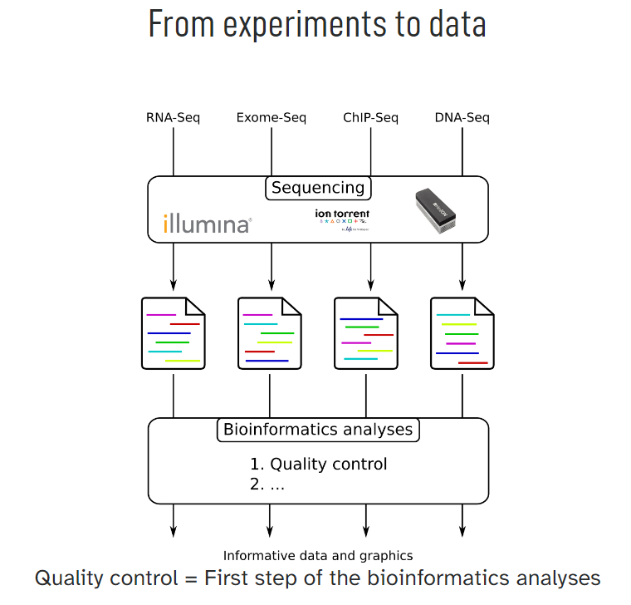
Quality control
(raw reads)
we are here
Trimming (adapters/low quality reads)
Alignment /mapping
(QC)
Variant calling
(QC)
Tree Building
(QC/caveats)

Slide 3
Different Quality Control tools
Quality control
we are here
Adaptor / Trimming
Illumina
FastQC (most widely used)
MultiQC (compresses dataset)
Fastp (all-in-one)
DeNovo
Metaplan
BLAST
Alignment /mapping
Variant calling
Tree Building

Slide 4
Quality control
Quality Control: FastQC
we are here
Adaptor / Trimming
A quality control tool for high throughput sequence data.
FastQC aims to provide a simple way to do some quality control checks on raw sequence data coming from high throughput sequencing pipelines. It provides a modular set of analyses which you can use to give a quick impression of whether your data has any problems of which you should be aware before doing any further analysis.
The main functions of FastQC are:
Import of data from BAM, SAM or FastQ files (any variant)
Providing a quick overview to tell you in which areas there may be problems
Summary graphs and tables to quickly assess your data
Export of results to an HTML based permanent report
Offline operation to allow automated generation of reports without running the interactive application
Alignment /mapping
Variant calling
Tree Building

Slide 5
Installation & Usage: FastQC
Quality control
we are here
Adaptor / Trimming
Installation:
Wget https://github.com/s-andrews/FastQC/archive/refs/tags/v0.12.1.zip
Usage:
Run either interactive graphical application in which you can dynamically load FastQ files and view their results OR
In a non-interactive mode where you specify the files you want to process on the command line and FastQC will generate an HTML report for each file without launching a user interface.
Alignment / mapping
Variant calling
Tree Building

Slide 6
Quality control
Installation of fastQC using conda
we are here
Adaptor / Trimming
conda install bioconda::fastqc conda install bioconda/label/broken::fastqc conda install bioconda/label/cf201901::fastqc
Alignment /mapping
Variant calling
Tree Building

Slide 7
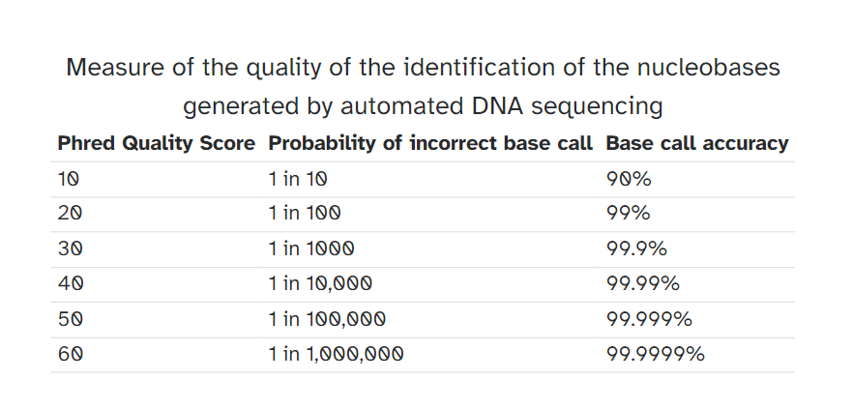
Quality control
Quality Scoring
we are here
Adaptor / Trimming
Alignment /mapping
Variant calling
Tree Building

Slide 8
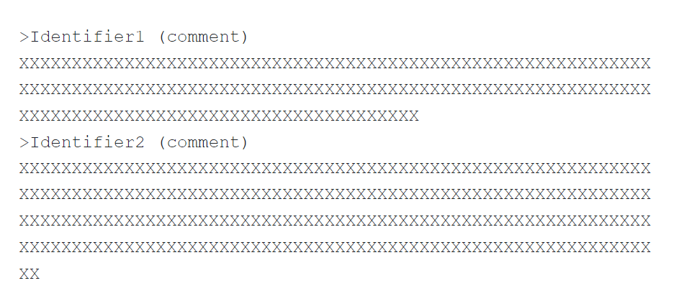
Quality control
Sequence: FASTA
we are here
Adaptor / Trimming
Alignment / mapping
Variant calling
Tree Building

Slide 9
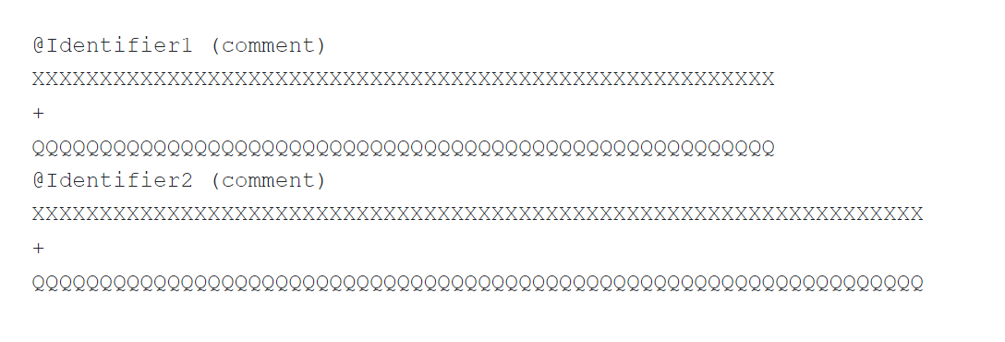
Quality control
Sequence: FASTQ
we are here
Adaptor / Trimming
Alignment / mapping
Variant calling
Tree Building

Slide 10
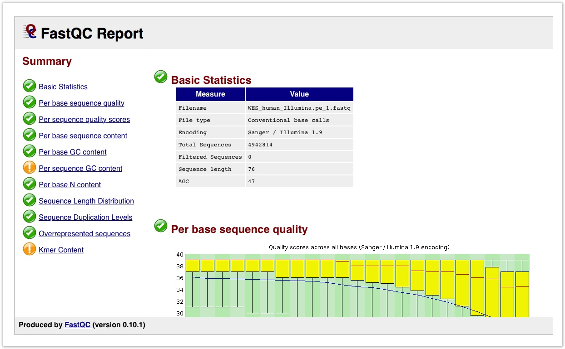
Quality control
we are here
Adaptor / Trimming
Alignment / mapping
Variant calling
Tree Building

Slide 11
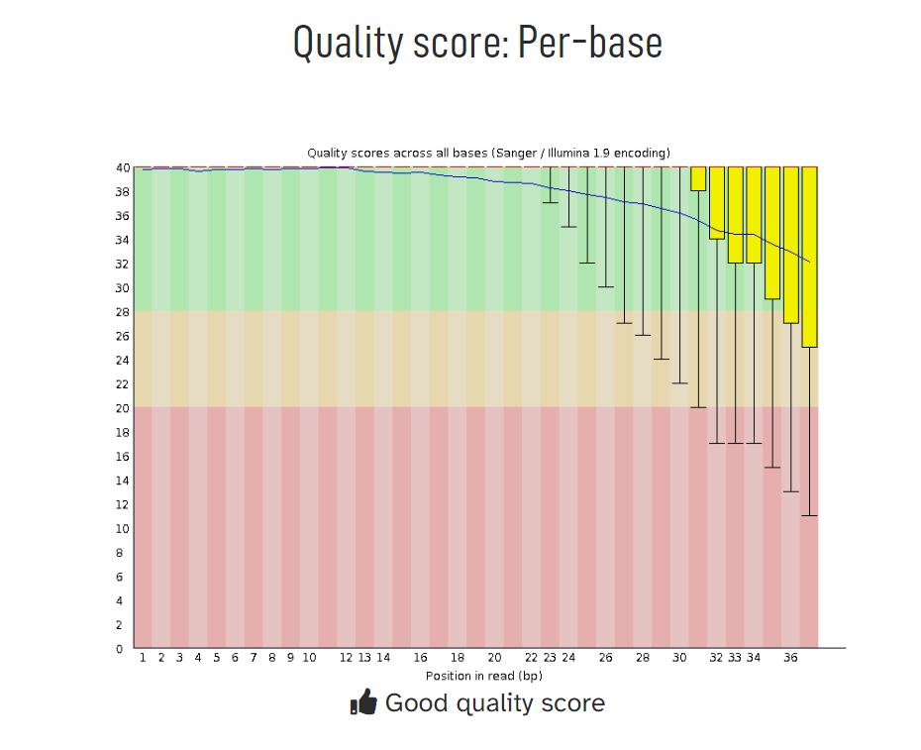
Quality control
we are here
Adaptor / Trimming
Alignment / mapping
Variant calling
Tree Building

Slide 12
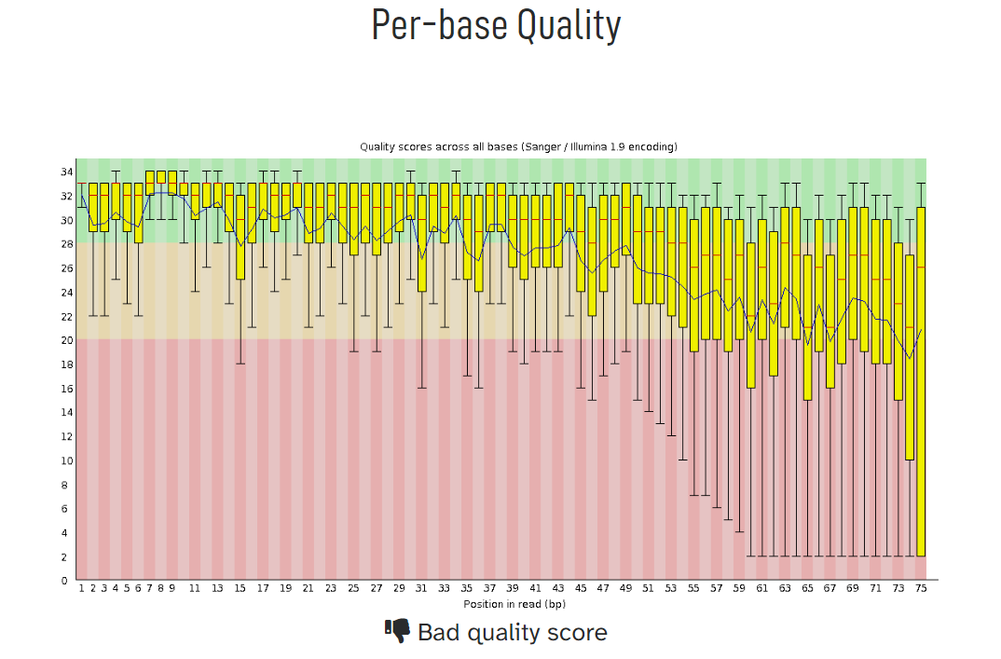
Quality control
we are here
Adaptor / Trimming
Alignment / mapping
Variant calling
Tree Building

Slide 13
Improving Quality
Quality control
we are here
Adaptor / Trimming
Filtering of sequences
with small mean quality score
too short
with too many N bases
based on their GC content
Cutting/Trimming sequences
from low quality score parts
tails
Alignment / mapping
Variant calling
Tree Building

Slide 14
Quality control
Different trimming tools
Adaptor / Trimming
Illumina – ref data
Trimmomatic
CutaDapt
Fastp
Flexar
Trimgalore
we are here
DeNovo – no ref
Kraken
Blobology
BLAST
Alignment / mapping
Variant calling
Tree Building

Slide 15
Trimmomatic
Quality control
Adaptor / Trimming
Trimmomatic performs a variety of useful trimming tasks for Illumina paired-end and single ended data. The selection of trimming steps and their associated parameters are supplied on the command line.
Requires Java installation check: run java –version
Inputs - Single-end or Paired-end FASTQ or FASTQ.gz reads
https://github.com/usadellab/Trimmomatic?tab=readme-ov-file
we are here
Alignment / mapping
Variant calling
Tree Building

Slide 16
Installation & Usage: Trimmomatic
Quality control
Adaptor / Trimming
we are here
Installation:
wget https://github.com/usadellab/Trimmomatic.git
Usage:
java -jar trimmomatic-0.39.jar PE input_forward.fq.gz input_reverse.fq.gz output_forward_paired.fq.gz output_forward_unpaired.fq.gz output_reverse_paired.fq.gz output_reverse_unpaired.fq.gz ILLUMINACLIP:TruSeq3-PE.fa:2:30:10:2:True LEADING:3 TRAILING:3 MINLEN:36
The above code is for reference only
Alignment / mapping
Variant calling
Tree Building

Slide 17
Fastp
Quality control
Adaptor / Trimming
fastp is a tool designed to provide fast all-in-one preprocessing for FASTQ files. This tool is developed in C++ with multithreading supported to afford high performance.
Inputs - Single-end or Paired-end FASTQ or FASTQ.GZ reads
https://github.com/OpenGene/fastp?tab=readme-ov-file#features
we are here
Alignment / mapping
Variant calling
Tree Building

Slide 18
Installation & Usage: Fastp
Quality control
Adaptor / Trimming
Installation:
wget http://opengene.org/fastp/fastp
chmod a+x ./fastp
Usage:
SE code: fastp -i in.fq -o out.fq
PE code: fastp -i in.R1.fq.gz -I in.R2.fq.gz -o out.R1.fq.gz -O out.R2.fq.gz
The above code is for reference only
we are here
Alignment / mapping
Variant calling
Tree Building

