Slide 1
Manipulating Genomic Data
Analysis Module

Slide 2
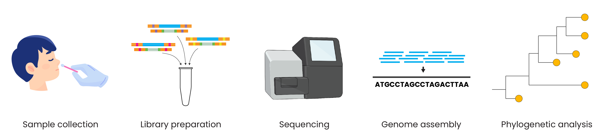
Genomic epidemiology workflow
BioRender.com
Pixel True https://www.pixeltrue.com/about, CC BY-SA 4.0, via Wikimedia Commons
Notes:
Feedback:
- I’ll provide an overview figure to add here!

Slide 3
Genomic epidemiology workflow
1
Build a background dataset
Multiple sequence alignment
Run phylogenetic analysis
2
3
BioRender.com
Pixel True https://www.pixeltrue.com/about, CC BY-SA 4.0, via Wikimedia Commons

Slide 4
Genomic epidemiology workflow
1
Build a background dataset
Multiple sequence alignment
Run phylogenetic analysis
2
3
BioRender.com
Pixel True https://www.pixeltrue.com/about, CC BY-SA 4.0, via Wikimedia Commons

Slide 5
Outline
Viewing FASTA files
Concatenating consensus genomes
Downloading publicly available genomes
The importance of multiple sequence alignment

Slide 6
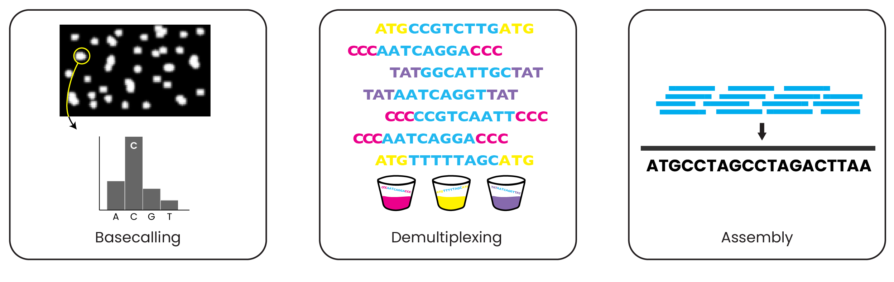

How to view files
Call nucleotides from raw signal data
Divide reads by sample barcode
Assemble reads into a complete genome
Raw data
FASTQ
FASTQ
These are your consensus genomes
?
?
?

Slide 7
How to view FASTA files
Call nucleotides from raw signal data
Divide reads by sample barcode
Assemble reads into a complete genome
Raw data
FASTQ
FASTQ
These are your consensus genomes
FASTQ
1 FASTQ per sample
FASTA

Slide 8
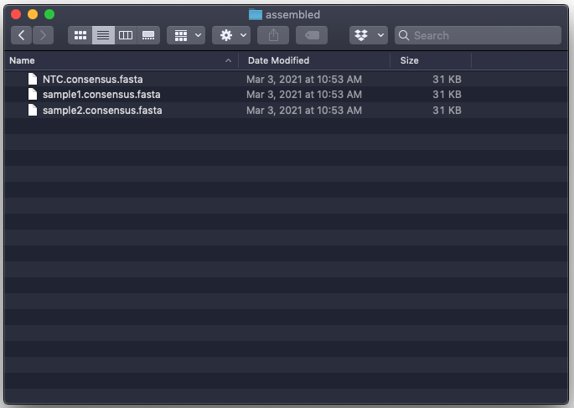
How to view FASTA files

Slide 9
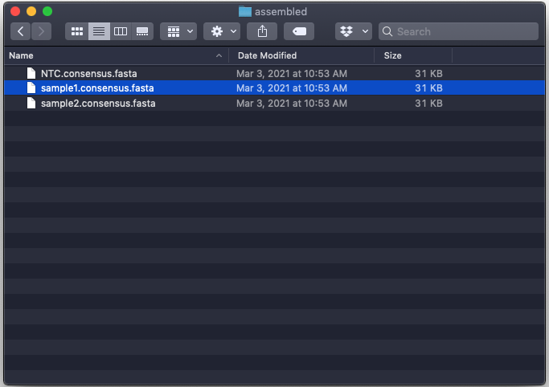
How to view FASTA files

Slide 10
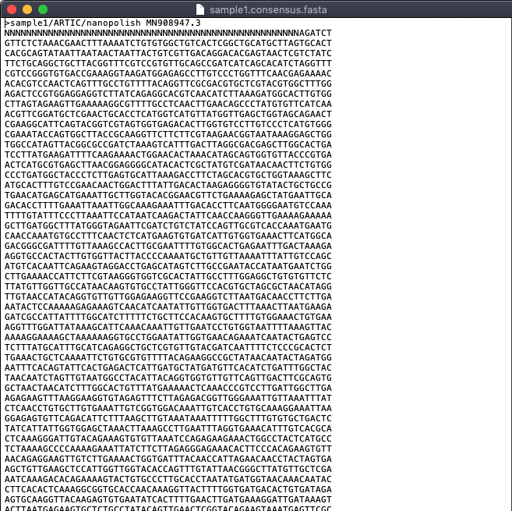
How to view FASTA files
Open in your favorite text editor:
TextEdit (Mac)
Notepad++ (Windows)
gedit (Ubuntu)

Slide 11
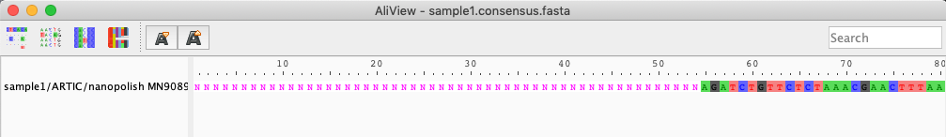
How to view FASTA files
You can also open FASTA files in specialized software for working with genomic data
e.g., AliView: https://ormbunkar.se/aliview/ (free software)
e.g., Geneious or other software
Or view directly on command line using less

Slide 12
Outline
Viewing FASTA files
Concatenating consensus genomes
Downloading publicly available genomes
The importance of multiple sequence alignment

Slide 13
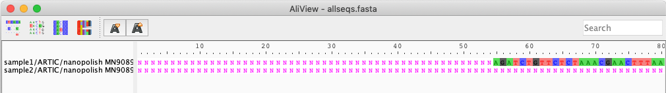
Concatenating consensus genomes
Two methods for concatenating sequences:
Command line using cat
Copying and pasting in a text editor

Slide 14
Concatenating consensus genomes
username@computername:~/sequencing/output/myproject/genomes$ cat *.fasta > allseqs.fasta

Slide 15
Concatenating consensus genomes
username@computername:~/sequencing/output/myproject/genomes$ cat *.fasta > allseqs.fasta

Slide 16
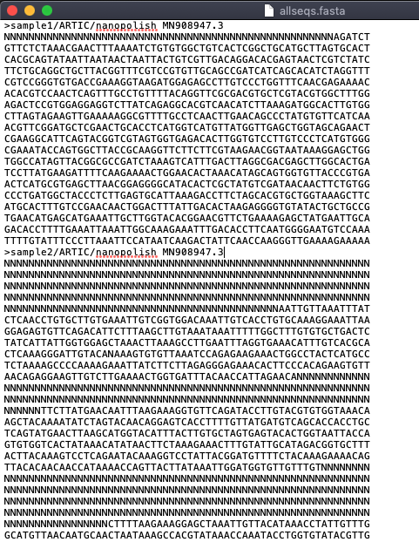
Concatenating consensus genomes
Both methods produce a multi-fasta
A file containing multiple sequences, each starting on a new line with the “>” symbol
Still FASTA file format (.fa, .fas, .fasta), sometimes .mfa is used to indicate multi-fasta
Useful for analyses you want to perform on more than one genome at a time

Slide 17
Outline
Viewing FASTA files
Concatenating consensus genomes
Downloading publicly available genomes
The importance of multiple sequence alignment

Slide 18
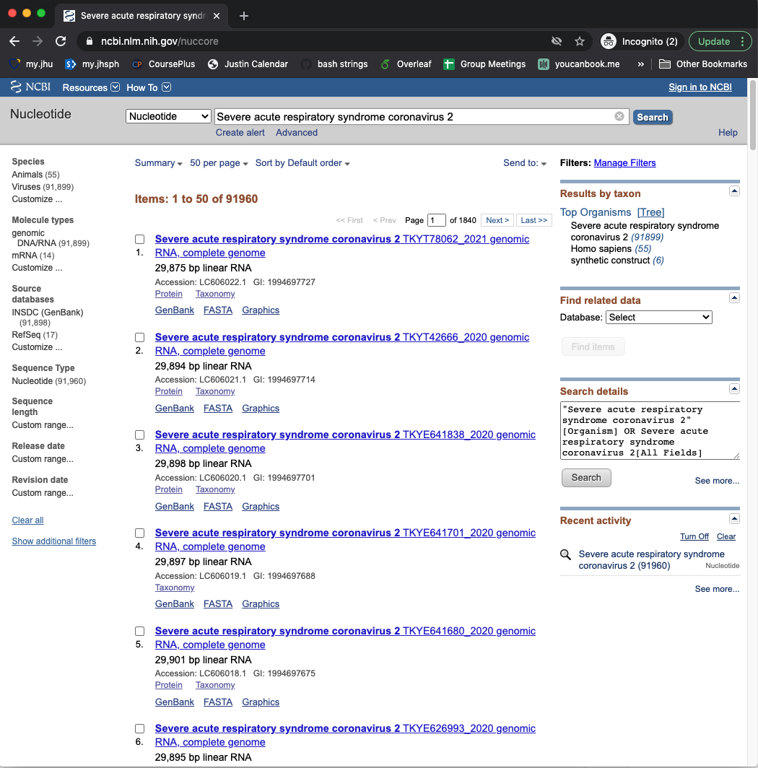
Downloading publicly available genomes

Slide 19
Downloading publicly available genomes

Slide 20
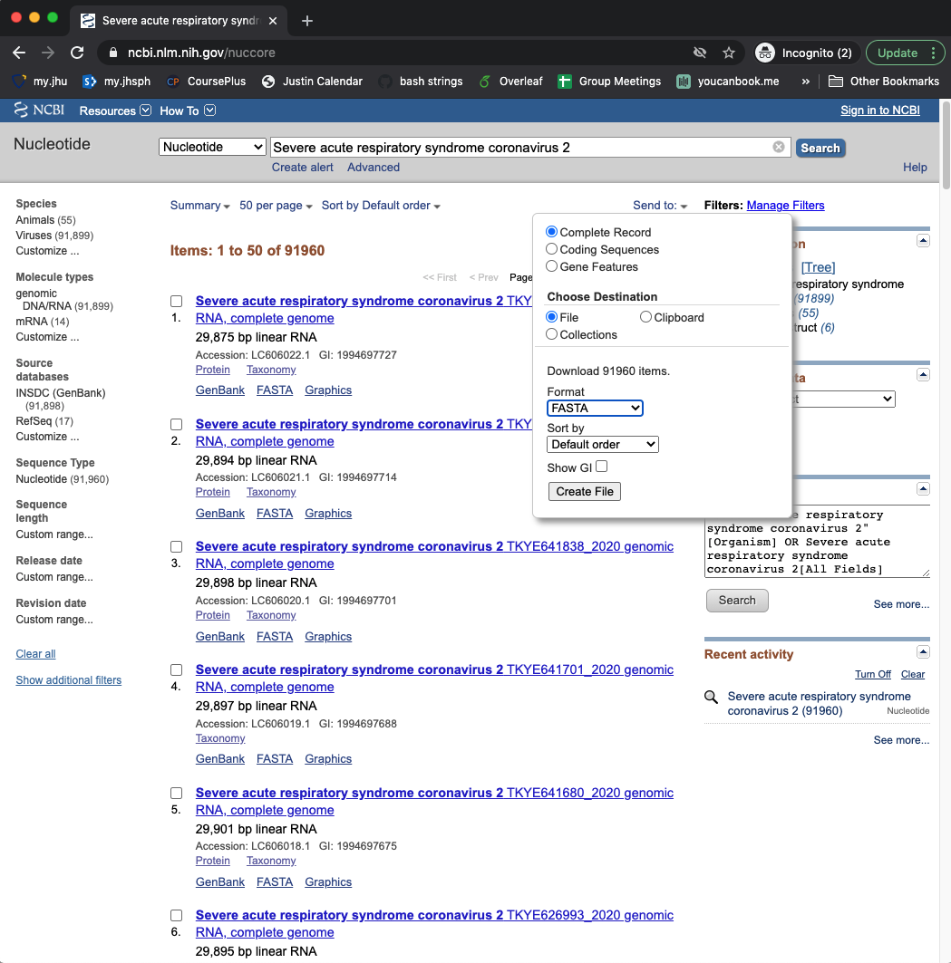
Downloading publicly available genomes

Slide 21
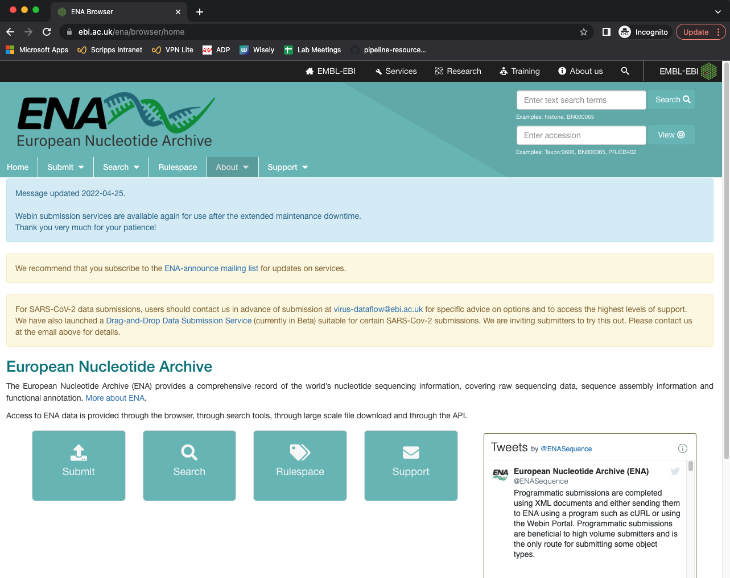
Downloading publicly available genomes

Slide 22
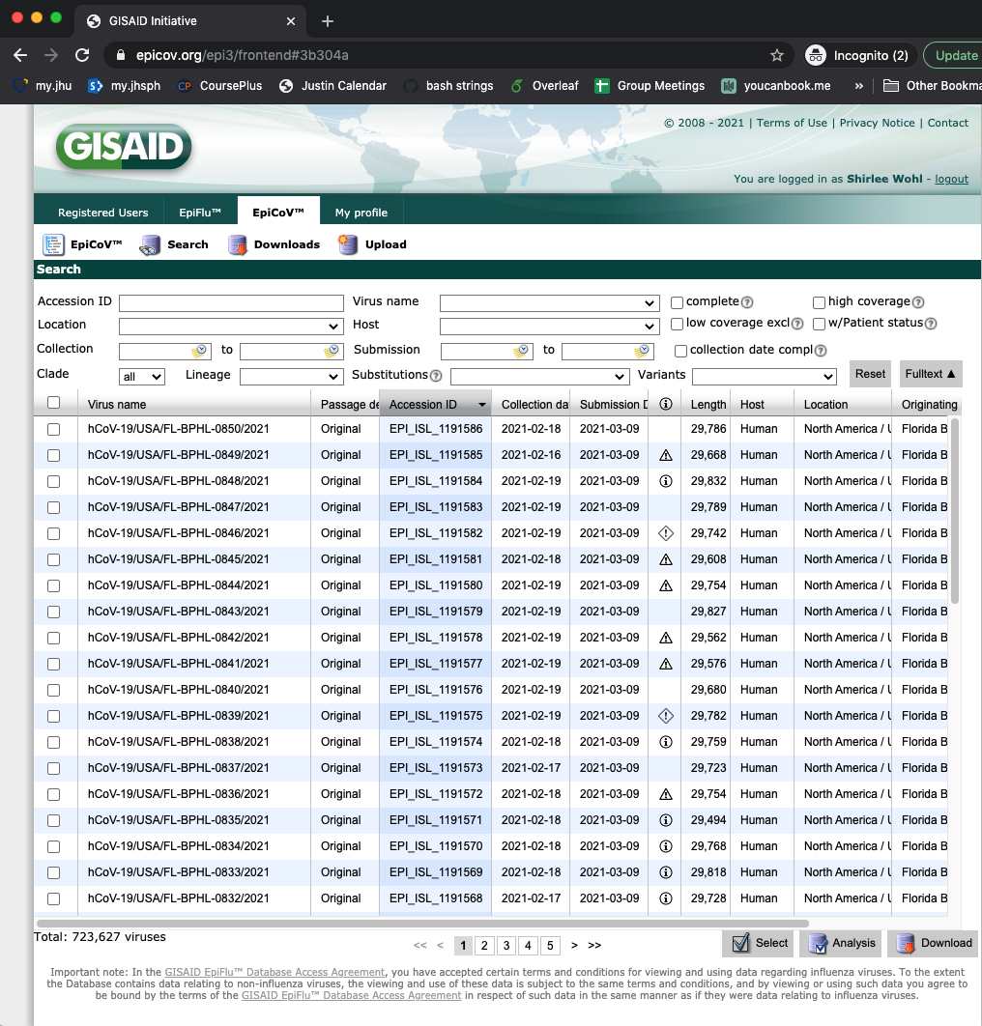
Downloading publicly available genomes

Slide 23
Downloading publicly available genomes

Slide 24
Downloading publicly available genomes

Slide 25
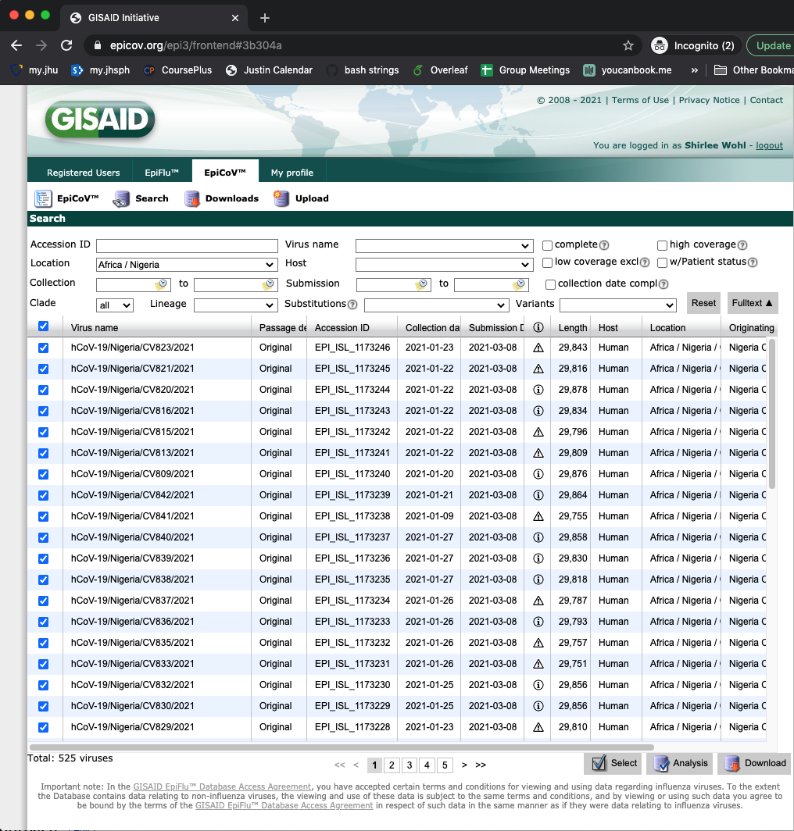
Downloading publicly available genomes

Slide 26
Downloading publicly available genomes

Slide 27
Downloading publicly available genomes

Slide 28
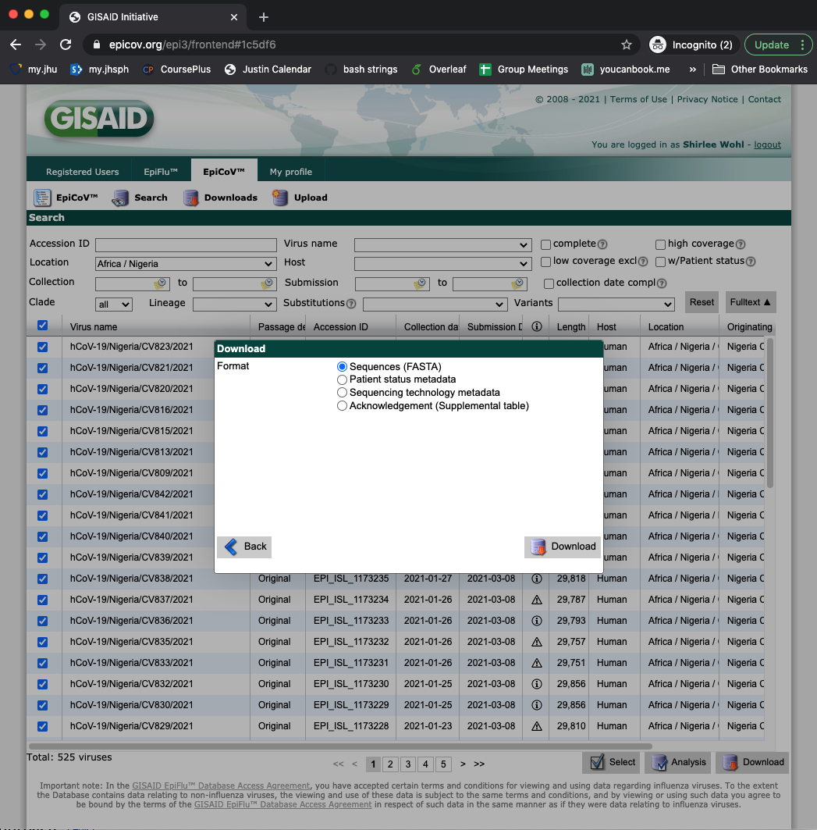
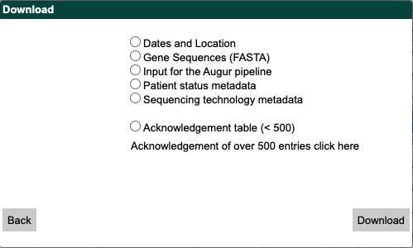
Downloading publicly available genomes

Slide 29
Downloading publicly available genomes
Most SARS-CoV-2 genomes are available on GISAID
Acknowledge authors of original sequences, per GISAID rules
Concatenate background sequences to consensus genomes

Slide 30
Downloading publicly available genomes
Most SARS-CoV-2 genomes are available on GISAID
Acknowledge authors of original sequences, per GISAID rules
Concatenate background sequences to consensus genomes
username@computername:~/sequencing/output/myproject/genomes$ cat *.fasta gisaid_hcov.fasta > allseqs_with_background.fasta

Slide 31
Downloading publicly available genomes
Most SARS-CoV-2 genomes are available on GISAID
Acknowledge authors of original sequences, per GISAID rules
Concatenate background sequences to consensus genomes
username@computername:~/sequencing/output/myproject/genomes$ cat *.fasta gisaid_hcov.fasta > allseqs_with_background.fasta
How to select an appropriate background dataset for phylogenetic analysis?

Slide 32
Selecting background data for phylogenetics
For pathogens with limited data, use all available sequences
Selecting background data is not a trivial task
Considerations include:
Geography
Time period
Hosts / sample source
Subsampling of highly similar sequences
There is a lack of broadly useful sampling guidance for phylogenetics

Slide 33
Outline
Viewing FASTA files
Concatenating consensus genomes
Downloading publicly available genomes
The importance of multiple sequence alignment

Slide 34
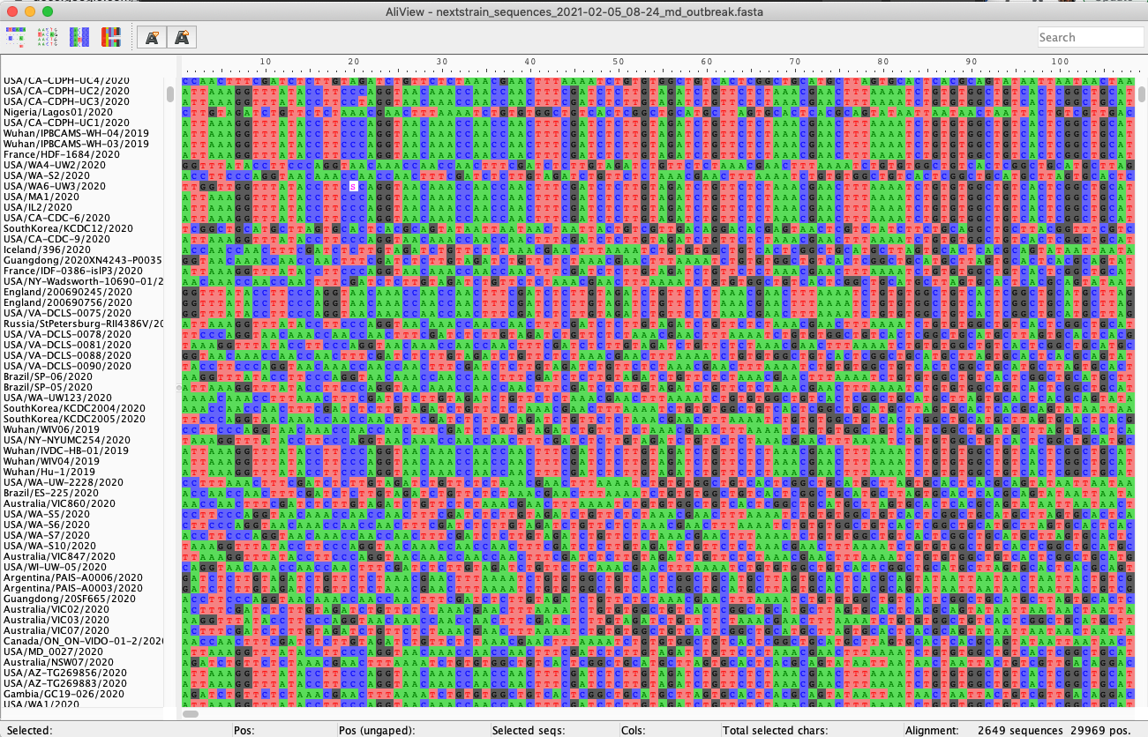
Multiple sequence alignment

Slide 35
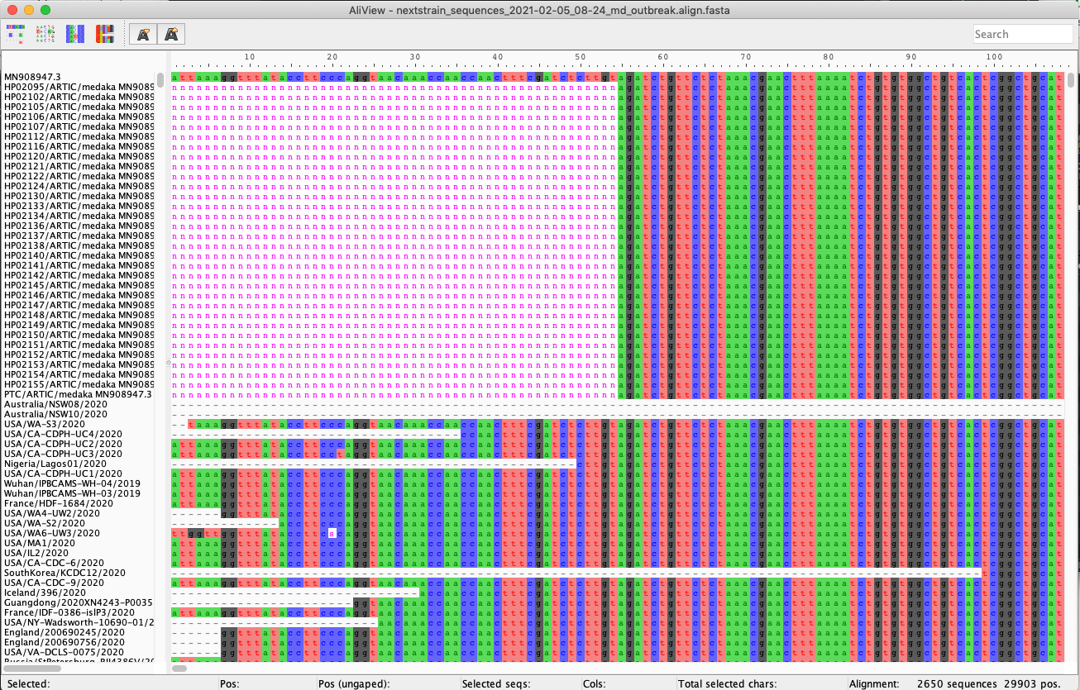
Multiple sequence alignment

Slide 36
Multiple sequence alignment
Multiple sequence alignment = lining up consensus genomes
Don’t confuse with reference-based assembly = lining up sequencing reads to a reference
Multiple sequence alignment is required before phylogenetic analysis

Slide 37
Summary
Build a background dataset
Multiple sequence alignment
Run phylogenetic analysis
1
2
3

