Slide 1
Visualizing Phylogenetic Trees
Analysis Module

Slide 2
Outline
Topic 1
Topic 2
Topic 3
Etc.
Notes:
*Only use outline slide if useful for screen demos, at minimum title slide and summary slide will be included in the video, additional slides should be included if helpful / will enhance understanding
Feedback:
Briefly list the topics to be covered
If possible/as needed, make it clear when you are switching from one topic to another (outline slide can be repeated if helpful)

Slide 3
Placeholder
Analysis-6 Visualizing Phylogenetic Trees (not pathogen specific)
Video format: on-screen walkthrough
Visualizing and annotating trees using FigTree and ITOL
Focus on questions you might be trying to answer
Be careful about interpretation and discuss this during the lecture
Come back to some slides from genomic epidemiology theory modules

Slide 4
Open a toy tree in Figtree
Points to be made:
NOTE: what is a newick file format
OPEN IT IN FIGTREE
Topology the structure of evolutionary relationships
The branches show us lineages evolving over time
The branch lengths are the amount of evolutionary change (or time)
E.g. the number xx (whatever is the scale) indicates the branch length of xx
The branch lengths unit is average number of nucleotide substitutions per site
This is calculated as the number of substitutions (genetic changes) divided by the length of the sequence
Sometime this is calculate as the percentage change aka the number of changes per 100 nucleotide sites

Slide 5
Open a toy tree in Figtree
Points to be made:
The vertical axis means nothing and is just to connect the branches

Slide 6
Open a toy tree in Figtree
Points to be made:
There are two types of nodes:
External aka tips representing sequences that were sampled and sequences
Internal nodes representing the hypothetical common ancestor
A clade is a monophyletic group of sequences
Monophyletic: common ancestor and all descendants
Paraphyletic: common ancestor but not all descendants
Sister clade
Notes:
This may be good info to show in a slide with visual reference(s) prior to the screen demo or at the beginning of the demo

Slide 7
Open a toy tree in Figtree
Points to be made:
Rotating internal nodes doesn’t change phylogenetic inference

Slide 8
Open a toy tree in Figtree
Points to be made:
Remember: tips only represent the taxa sampled and sequenced
We usually know things about these sequences like place and time of sampling we can use to contextualize the tree
If we’re working with pathogens, tips are our sampled sequences
Common ancestors represent an infected host sometime in the past that produced transmission chains that resulted in the sampled viruses
Phylogenies are not transmission trees

Slide 9
Open a toy tree in Figtree
Points to be made:
The root is the “common ancestor” of the entire sampled tree
Usually unknown
Rooting is important as it gives us the directionality of events in the tree aka branching order
Ancestor (internal node) xx exist before yy and gg.
Many phylogenetic reconstructive methods don’t explicitly estimate the root
Returns an arbitrary root.
Need extra information to inform root

Slide 10
Open a toy tree in Figtree
Points to be made:
Time “flows” approximately from left to right
We’ve already discussed the molecular clock, the clock-like accumulation of mutations over time as the pathogen spreads
So if we use that relationship between time and genetic change, we can convert branch lengths in genetic distance to time units
We won’t focus on this but we can use this to root the tree

Slide 11
Open a toy tree in Figtree
Points to be made:
Other rooting strategies
Outgroup rooting
Taxa closely related to ingroup, but not part of ingroup
Large evolutionary distances to its closest potential outgroup virus risks the introduction of rooting artefacts
Midpoint
Assumes all branches evolve approximately at the same rate
unreliable if internal branches are short
Notes:
This may be good info to show in a slide, possibly with visual reference(s)

Slide 12
Open a toy tree in Figtree
Points to be made:
We’ve discussed how these values are calculated
Bootstraps give us bifurcation (node) supports
Ranging from 0 – 1 (100)
These values are the percentage of trees in the replicates sets that contain the grouping of sequences to the exclusion of others
High value is good
What is ”robust”

Slide 13
Open a toy tree in Figtree
Polytomies
Not enough phylogenetic signal to resolve relationships
Zero branch lengths tells us sequences are identical
E.g. outbreak investigations
Not enough data to infer directionality or “who-infected-who” without additional epidemiological data

Slide 14
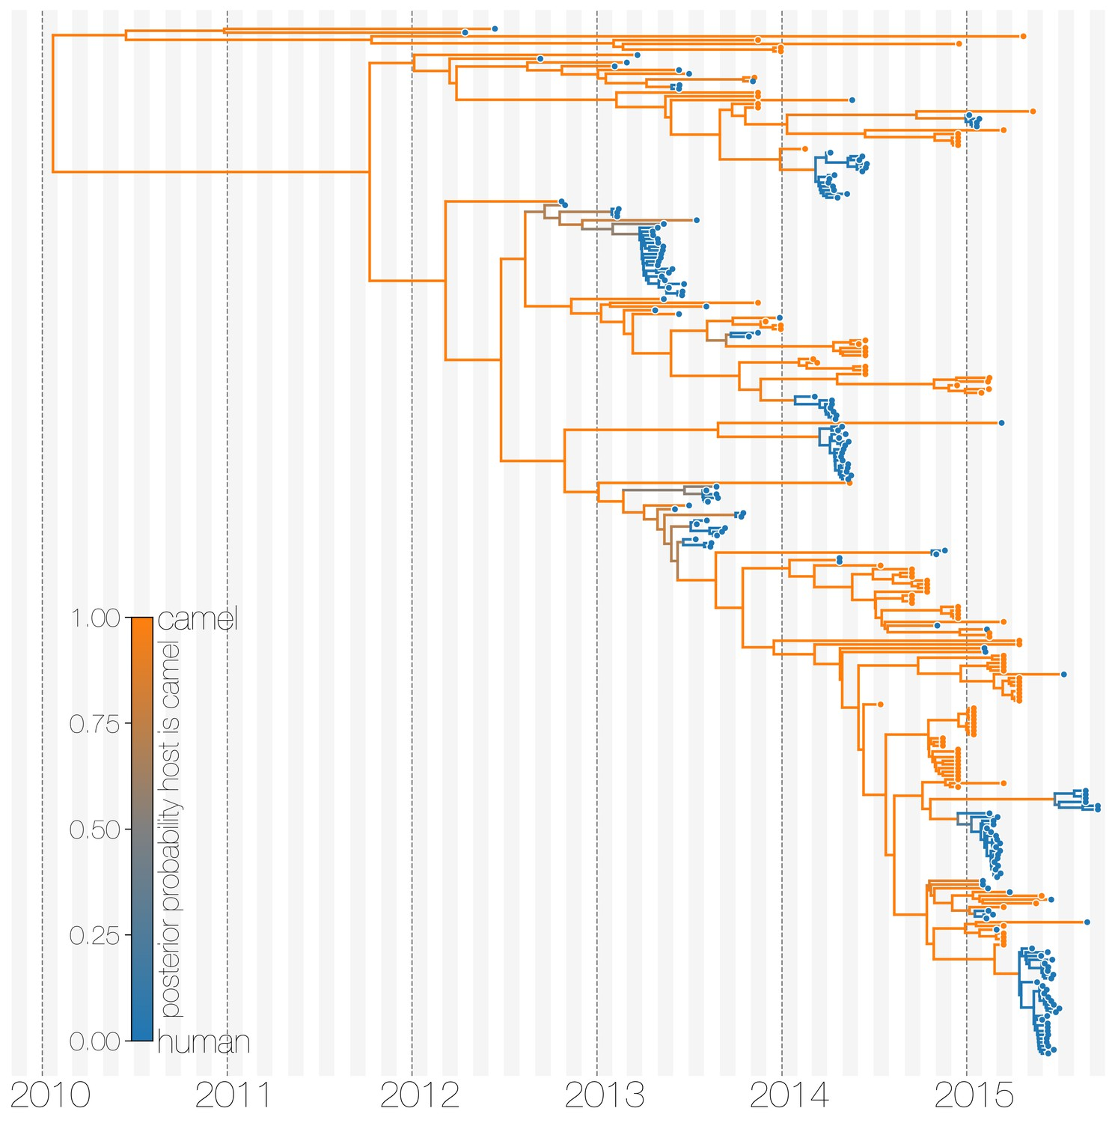
Open a toy tree in Figtree
Inference: Focus on tree structured by host – basically replicate the MERS tree
Questions:
What is the animal source of a zoonotic spill-over event?
How many spill-over events were there?
How prevalent is it in the animal population?
How long has it been circulating in animals?
Is there an intermediate host?
Dudas et al. 2018.doi: 10.7554/eLife.31257

Slide 15
Open a toy tree in Figtree
Inference: Focus on tree-structured by locations.
Question: What is the source of human infections
Was there one spill over event?
Is there an intermediate host?
Closely related sequences group together
E.g. closely related viruses grouped by host (human viruses, with animal ancestors)
The human viruses have a common ancestor, nested in animal diversity
So animal acted as a source
The human viruses are more closely related to one another
The human viruses are more closely related to animal xx than to animal yy (have xx as a sister clade and yy as basal)

Slide 16
Open a toy tree in Figtree
Have a structure with to sister clades(one human, one animal xx) and one animal yy to discuss how you can’t infer directionality of who infected who (between human and animal xx) or if animal yy independently infected both.
But we can say animal yy is the source of the diversity in humans and animal xx
Common ancestor of human and animal xx lies in animal yy
Which taxa has the most diversity?
We don’t know the state of the internal nodes e.g. what host thatr hypothetical ancestor was in
We can try and reconstruct this but not going to do that here

Slide 17
Open a toy tree in Figtree
Inferences:
Second cluster of human viruses
Intendent of other cluster
Represents a separate spill over
Nested in different animal viruses
Maybe with a longer branch – discuss divergence to ancestor

Slide 18
Open a toy tree in Figtree
Inference: Focus on tree structured by geography – Zika?
Questions:
Where did the outbreak start?
Are outbreaks in different areas related?
How is it spreading from area to area?

Slide 19
Summary
Notes:
Feedback:
- Add key takeaway points

