Slide 1



Integrated iot data processing and analysis pipeline using aws and azure
Presented By :
Sandeep Kandagatla #700761272
Pulligila Sai Sudheer Chary #700760830
Khareedu Gopi #700756699
Katta Karthik #700757117
Medasani Likhitha #700756468
Video Presentation

Slide 2
Overview
Revolutionizing Transit Management with IoT
The advent of IoT devices in transit vehicle management has revolutionized operations.
Establishing a robust data processing and analysis pipeline is crucial for leveraging IoT data effectively.
The project aims to address this need by integrating AWS and Azure services for seamless data management.
Scope
- Lifecycle of vehicle transit data, from ingestion to analysis.
- data ingestion, processing, storage, and analysis.
- scalability, efficiency, and real-time data processing.

Slide 3
Cloud service providers and services
Navigating the Skies of AWS and Azure
AWS Services
AZURE Services
AWS API Gateway
AWS Lambda
AWS S3
IAM Role
IAM Policy
CloudWatch
Azure Linked Service
Azure Data Factory
Azure Data Lake Storage Gen2
Azure Blob Trigger Function
Azure Key Vault
Application Insights
Azure SQL

Slide 4
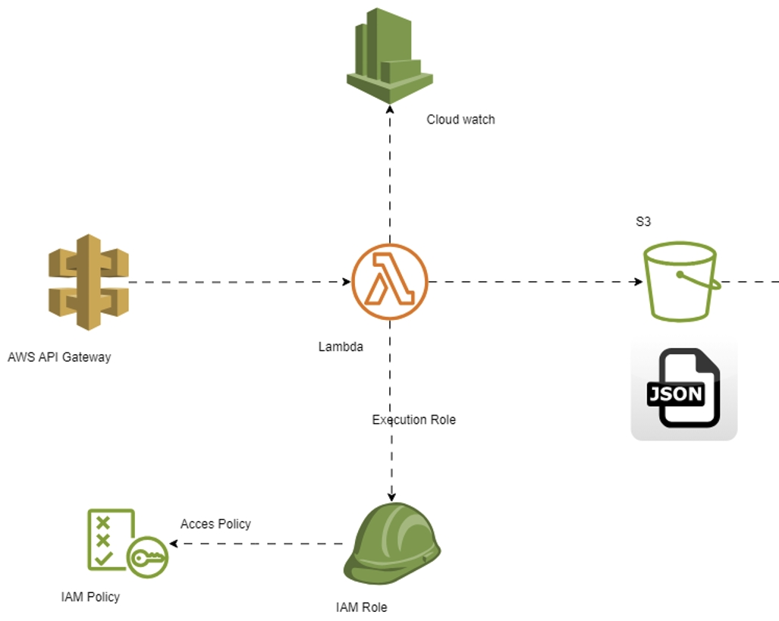

Data Ingestion

Slide 5
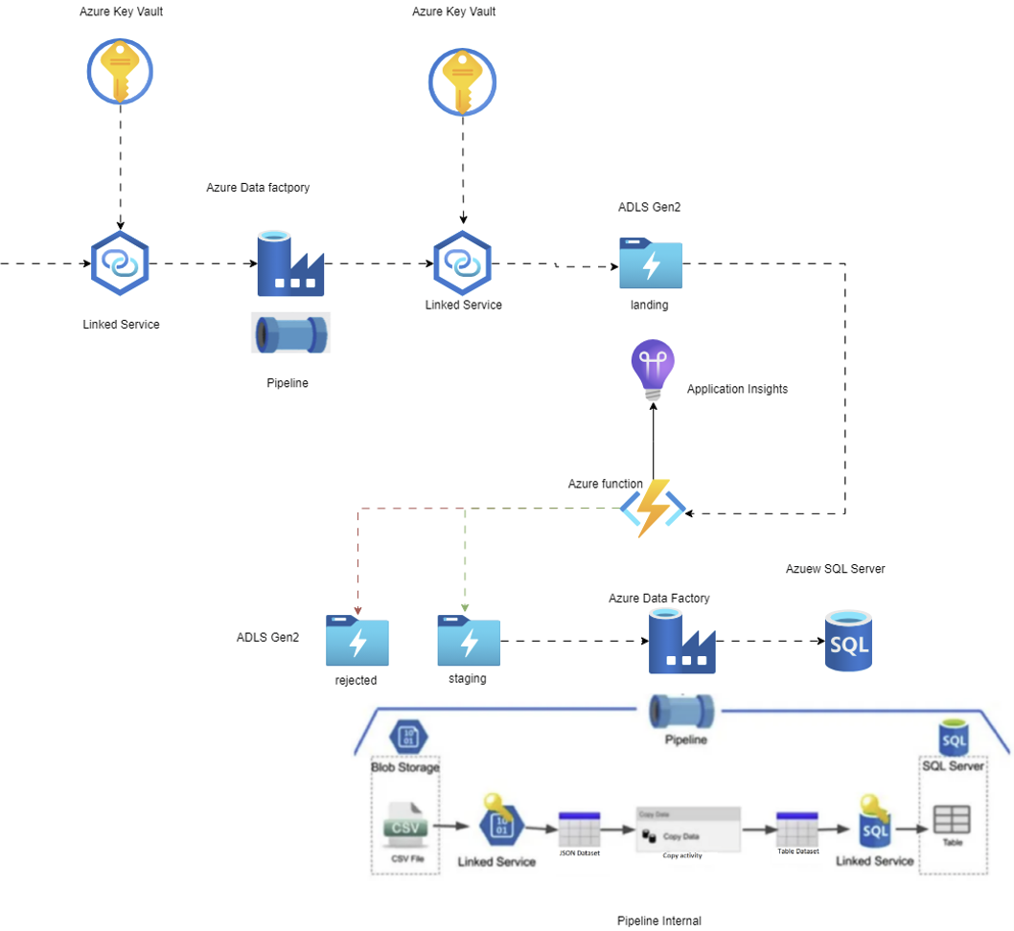

Data pROCESSING

Slide 6
Project MANAGEMENT
Agile
Flexible and iterative approach emphasizing collaboration and adaptability.
Prioritizes delivering working software in incremental iterations.
Jira
- Backlog Management
- Sprint Planning
- Task Tracking
- Burndown Charts
- Collaboration and Communication

Slide 7
Thank You Q&A

