Slide 1

REVIEW-1 ROAD SIGNS DETECTION FOR AUTONOMOUS VEHICLES Project Category: RESEARCH
Guide Name Student Name & Registration Number
Dr K Suresh Putta Sandeep(RA2111026010512)
Assistant Professor V Naveen Kumar(RA2111026010501)

Slide 2
Abstract
Traffic sign recognition is a vital component of intelligent transportation systems, particularly for autonomous vehicles and advanced driver assistance systems (ADAS), ensuring safe and efficient navigation. This study presents an approach for automatic traffic sign recognition using Convolutional Neural Networks (CNNs) implemented with Keras. CNNs are highly effective in image classification tasks, capable of learning complex spatial hierarchies directly from input images. We trained our model on the German Traffic Sign Recognition Benchmark (GTSRB) dataset, which contains diverse traffic sign images captured under varying conditions. The architecture includes multiple convolutional layers followed by pooling and fully connected layers to classify traffic signs accurately. To improve generalization and reduce overfitting, we utilized data augmentation techniques. Optimized with the Adam optimizer and categorical cross-entropy loss, our model achieved high accuracy in identifying traffic signs, demonstrating strong performance in real-world conditions. This research underscores the effectiveness of CNNs in traffic sign recognition, offering significant improvements in accuracy and robustness over traditional machine learning methods, with the potential to enhance road safety in autonomous driving systems.
Keywords:CNN,Keras,Traffic sign recognition,accuracy

Slide 3
Introduction
Traffic sign recognition (TSR) is a key part of smart transportation systems. It plays a vital role in self-driving cars and advanced driver assistance systems (ADAS). This tech allows for the automatic spotting, naming, and understanding of traffic signs from images taken by cameras on vehicles. The process starts with getting images where high-quality cameras keep an eye on the road all the time. Smart image processing methods then make these images clearer. This helps to spot signs in different situations, like changing light or bad weather.
TSR technology's heart beats in its ability to spot and identify signs. To find areas in images that might have traffic signs, it uses detection algorithms. These often tap into deep learning models like YOLO (You Look Once), SSD(Single Shot MultiBox Detector), or Faster R-CNN (Region-based Convolutional Neural Networks). After finding these areas, the tech sorts the signs into groups. These include rules (speed limits stop signs), warnings, or info signs. To do this sorting, it uses convolutional neural networks (CNNs). People train these CNNs with lots of different sign pictures. This helps the networks learn about many types of signs, their colors, shapes, and even how they look when they're old or damaged.

Slide 4
A key feature of TSR is its real-time operation allowing it to make quick choices that have an impact on how vehicles behave. This instant response proves crucial to adjust vehicle speeds, warn drivers about possible dangers, or even take charge in fully self-driving situations. The system also needs to be strong enough to deal with blocked signs different sign locations, and varying sign rules across regions and countries.
As the car industry moves toward more self-driving vehicles, TSR tech keeps getting better. Future work aims to make recognition algorithms more accurate, faster, and tougher. This includes combining TSR with other sensor data, like LiDAR and radar, to improve overall awareness of what's happening. On top of that ongoing studies try to tackle the problems caused by bad weather driving at night, and busy city streets. To wrap up, traffic sign recognition is a key tech that has a big impact on the safety and productivity of today's transport systems making it easier for both driver-assisted and self-driving cars to work .

Slide 5
Literature Survey
Title | Year | Methodology | Identification of gaps and Limitations
Road Traffic Signs Recognition Using Genetic Algorithms and Neural Networks Stephen Karungaru, Hitoshi Nakano, and Minoru Fukum | 2013 | By using Neural Networks model Extracting red regions from the image. Removing noise and isolating potential sign areas. Using genetic algorithms to find regions similar to a stop sign template. Employing a neural network to classify the detected region as a stop sign or not. | Environmental Sensitivity: Strong sunlight and other environmental factors can hinder detection. Image Quality: Poor quality or resized images may lead to incorrect identification. False Positives: The method sometimes misidentifies non-stop signs as stop signs. Processing Time: While faster than traditional methods, real-time processing remains challenging.
Traffic Signs Recognition in a mobile-based application using TensorFlow and Transfer Learning technicsAbdallah Benhamida , Annamária R. Várkonyi-Kóczy,Miklos Kozlovszky | 2020 | This application using TensorFlow and transfer learning techniques. the approach typically involves leveraging pre-trained models and adapting them to the specific task of traffic sign classification. | Mobile Device Constraints: Limited computational capabilities affect model complexity and processing speed. Image Quality and Variability: Performance can be impacted by lighting, occlusions, and visibility. Model Generalization: Limited ability to generalize to new or varied traffic signs. Real-Time Processing: Challenges in maintaining FPS rates for real-time detection. Specificity to Traffic Signs: The model may not perform well on other objects without retraining

Slide 6
Title | Year | Methodology | Identification of gaps and Limitations
Support Vector Machines for Traffic Signs RecognitionMin Shi,Haifeng Wu and Hasan Fleyeh | 2006 | Data Collection and Preprocessing: Collect and preprocess traffic sign images. Feature Extraction: Extract features from images to reduce dimensionality. Training the SVM: Use features to train the SVM, finding the optimal hyperplane for classification. Testing and Evaluation: Test the model on a separate dataset and evaluate using metrics like accuracy, precision, recall, and F1-score. | Scalability: Computationally expensive with large datasets. Feature Dependence: Performance relies on quality of feature extraction. Parameter Tuning: Requires careful tuning of parameters. Handling Noise: Sensitive to noise and outliers. Real-Time Processing: Challenges in processing speed and resource requirements for mobile applications.
An Improved Traffic Signs Recognition and Tracking Method for Driver Assistance SystemNadra Ben Romdhane, Hazar Mliki , Mohamed Hammami | 2009 | Preprocessing: Enhance image quality and reduce noise using techniques like histogram equalization. Detection: Identify traffic sign regions using color segmentation and shape analysis. Feature Extraction: Extract features with Histogram of Oriented Gradients (HOG).Classification: Classify features using a Support Vector Machine (SVM). Tracking: Track recognized signs with the Lucas-Kanade tracker to maintain continuous capture. | Adverse Weather Conditions: Struggles under extreme weather (e.g., heavy rain). Occlusions and Deformations: Issues with heavily occluded or deformed signs. Complex Backgrounds: Difficulties in distinguishing signs from similar backgrounds. Lighting Variations: Impacted by extreme lighting changes.

Slide 7
Title | Year | Methodology | Identification of gaps and Limitations
Real-time traffic sign recognition in three stages Fatin Zaklouta ∗ , Bogdan Stanciulescu | 2014 | Three-Stage Approach :Segmentation: Uses color enhancement and adaptive thresholding to identify red regions. Detection: Utilizes a linear SVM with HOG features to detect traffic sign shapes. Classification: Employs K-d tree and Random Forest classifiers to identify traffic sign content. Optimization Techniques: Red Color Enhancement: Emphasizes red pixels to reduce search space. Spatial Weighting: Improves k-NN search accuracy by prioritizing central image areas. Feature Space Reduction: Uses Fisher’s Criterion to reduce features and speed up classification. | Segmentation Sensitivity: Can fail under poor contrast or illumination conditions. Classifier Dependence: Performance varies with training data size; Random Forests less effective with smaller datasets. Real-Time Constraints: Enhanced segmentation increases processing time, challenging real-time applications. Future Work: Suggests integrating temporal tracking, feature selection, and combining thresholds with other enhancements for improved detection.

Slide 8
Title | Year | Methodology | Identification of gaps and Limitations
Traffic Signs Recognition and Classification based on Deep Feature Learning Yan Lai, Nanxin Wang, Yusi Yang and Lan Lin | 2018 | Data Collection: Images and videos from ordinary driving. Preprocessing: Use YCbCr color space for better feature extraction. Model Architecture: CNN with optimized kernel sizes and connections. Training: SVM classifier trained with CNN-extracted features. Evaluation: Achieved 96.6% accuracy on real-world dataset. An Improved Traffic Signs Recognition and Tracking Method for Driver Assistance System Data Collection: Vehicle-mounted camera data. Preprocessing: Enhance images by adjusting brightness and contrast. Detection and Tracking: Color-based detection and tracking algorithm. Classification: Machine learning model using shape and color features. Evaluation: Improved detection accuracy and tracking robustness. | Traffic Signs Recognition and Classification based on Deep Feature Learning Environmental Variability: Struggles with lighting changes, weather. Computational Cost: High computational requirements for real-time deployment. Generalization: Risk of overfitting to the training dataset. An Improved Traffic Signs Recognition and Tracking Method for Driver Assistance System Real-time Processing: Challenges in processing real-time data due to computational complexity. False Positives: Potential for false positives in complex environments. Robustness: Tracking algorithm can be compromised by obstructions or rapid vehicle maneuvers.

Slide 9
Title | Year | Methodology | Identification of gaps and Limitations
Traffic signs recognition with deep learning Djebbara Yasmina, Rebai Karima, Azouaoui Ouahiba | 2018 | Dataset Preparation: Used the German Traffic Sign Benchmark (GTSB) dataset with 43 classes. Neural Network Architecture: Employed the LeNet-5 CNN, consisting of 5 convolutional layers and a fully connected network. Training Process: Utilized gradient descent with mini-batches to update network parameters. Performance Improvements : Data Augmentation: Applied geometric transformations to balance the dataset. Architecture Modification: Expanded the first layer of the fully connected network. Dropout: Implemented dropout to prevent overfitting, shutting down a percentage of neurons in certain layers. | Unbalanced Dataset: Original dataset had uneven image distribution across classes. Overfitting : Risk of overfitting without proper regularization. Dropout in Convolutional Layers: Applying dropout in these layers decreased performance. Real-world Applicability: Adapting to real images that differ from training models can be challenging.

Slide 10
Title | Year | Methodology | Identification of gaps and Limitations
Traffic-Sign Spotting in the Wild via Deep Features Jinkang Guo, Jianyun Lu, Yanyun Qu* , Cuihua Li Fujia | 2018 | Traffic Sign Collection: Created from driverless car footage, the dataset includes common traffic signs, signposts, and traffic lights, covering variations in illuminance and weather conditions. Detection and Recognition: The task is divided into detecting traffic sign candidate regions and recognizing the signs within those regions using an Inception convolutional neural network and Faster-RCNN, optimized for small targets. Common Traffic Signs: Detected and recognized using a hierarchical method. Signposts: Detected using a two-stage process focusing on key icons or text. Traffic Lights: Recognized using color and location information. | Variations in Appearance: Traffic signs exhibit high inter-class similarity and complicated backgrounds, making detection challenging. Environmental Sensitivity: Traffic lights are sensitive to changes in illumination and weather, affecting recognition accuracy. Small Targets: Traffic signs often occupy small fractions of images, complicating detection. Dataset Limitations: Existing datasets might not cover all possible variations and classes of traffic signs encountered in real-world scenarios.

Slide 11
Title | Year | Methodology | Identification of gaps and Limitations
A real-time and high-precision method for small traffic-signs recognition | 2021 | Baseline: Uses YOLOv4 as the foundation. Receptive Field Block-Cross (RFB-c): Enhances multi-scale contextual feature capture for better small object detection. TSR-SA: Novel framework aimed at improving small traffic sign recognition. Data Augmentation: Implements Random Erasing-Attention (RE-A) to improve robustness by creating occluded traffic signs. Training: Utilizes the TT100K dataset and pre-training on MS COCO, with training on NVIDIA Tesla V100 GPUs. | Small Object Detection: Difficult due to fewer pixels and potential overlap with other objects. Computational Cost: Enhancements might slow down real-time detection. Dataset Constraints: TT100K may not cover all traffic sign variations. Model Complexity: Increased complexity may hinder deployment in resource-limited settings.

Slide 12
Title | Year | Methodology | Identification of gaps and Limitations
Traffic Sign Recognition using Deep learning for Autonomous Driverless Vehicles Suriya Prakash A, Vigneshwaran D , Seenivasaga Ayyalu R , Jayanthi Sree S | 2021 | Image Preprocessing: HSV Color Space: Handles varying lighting conditions. Cropping: Removes unnecessary background. Enhancement: Reduces noise and adjusts grey values. Detection: Captures and extracts traffic signs using a vehicle-mounted camera. Extended LeNet-5 Model: Gabor Kernel: Enhances feature extraction. Adam Optimizer: Improves training efficiency. Evaluation: Uses the GTSRB dataset.Achieves ~98% accuracy in recognition. | Environmental Variability: Changes in lighting, weather conditions, and sign visibility can affect recognition accuracy. Complexity: The extended LeNet-5 model increases computational complexity and requires significant processing power. Dataset Dependency: Performance is highly dependent on the quality and variety of the training dataset. Real-time Constraints: Processing time and frame rate are critical for real-time applications, and achieving optimal performance can be challenging

Slide 13
Research Gaps
Variations in sunlight, shadows, and nighttime conditions can affect detection accuracy.
Signs partially hidden by trees, vehicles, or other objects may not be detected.
Faded or damaged signs can reduce recognition accuracy.
The training dataset must be comprehensive, covering all types of signs and conditions. Limited or biased datasets can reduce model effectiveness.
Differences in sign design, size, and placement across regions can impact recognition.
High computational power is needed for real-time detection and recognition, which can be challenging for on-board vehicle systems.
Advanced models like extended LeNet-5 are resource-intensive, potentially limiting deployment on less powerful hardware.
Rain, fog, and snow can obscure signs, making them difficult to detect and recognize.
Delays in processing and response time can affect real-time performance and safety.

Slide 14
Research Objectives
Model Development: Train and fine-tune convolutional neural network (CNN) models using diverse datasets of road signs from various countries and environments to detect and classify road signs in real-time for autonomous vehicles.
Feature Identification: Extract and analyze important features from road sign images, such as shape, color, and symbol, to enhance the accuracy of sign detection. Apply preprocessing techniques like image normalization, resizing, and data augmentation (rotation, flipping) to improve model robustness.
Model Evaluation: Evaluate the performance of the CNN models using key metrics such as accuracy, precision, recall, F1-score, and intersection over union (IoU). Implement cross-validation and test on independent datasets to ensure the model's generalization capabilities.
Comparison of Algorithms: Compare the performance of various deep learning models (e.g., CNN, Faster R-CNN, YOLO, SSD) to determine the most efficient and suitable model for real-time road sign detection in autonomous driving applications.
Contribution to Autonomous Vehicles: Contribute to the development of safer autonomous driving systems by providing a robust road sign detection solution that enhances the vehicle's decision-making capabilities, ensuring compliance with traffic regulations and improving road safety.

Slide 15
Project SDG
Integrating the goal of "Sustainable Cities and Communities" into a traffic sign recognition project can enhance urban safety and sustainability.
Improving Road Safety: Reduce accidents and improve traffic management by ensuring adherence to traffic rules.
Sustainable Transport Systems: Support efficient public transport and promote eco-friendly driving routes.
Inclusive Urbanization: Make the technology accessible to all, including those with disabilities, and integrate it with smart city infrastructure.
Environmental Impact Reduction: Optimize traffic flow to reduce emissions and improve waste collection efficiency.
Resilient Infrastructure: Develop durable and energy-efficient recognition systems.
Protecting Heritage: Include alerts for heritage sites to guide drivers and protect these areas.
Access to Green Spaces: Provide directions to green and public spaces to encourage their use.

Slide 16
Plan of Action
Project Planning and Research: Define project goals, study existing technologies, and assess feasibility.
Data Collection and Preparation: Collect and accurately label a diverse set of traffic sign images, enhancing the dataset through augmentation.
Model Selection and Development: Choose appropriate algorithms and train a model using the prepared dataset.
System Implementation: Develop software and ensure compatibility with necessary hardware.
Testing and Validation: Test the system in both simulated and real-world environments to ensure accuracy.
Deployment: Install the system in target locations and provide user training and support.
Monitoring and Maintenance: Continuously monitor performance and update the system based on feedback and new data.

Slide 17
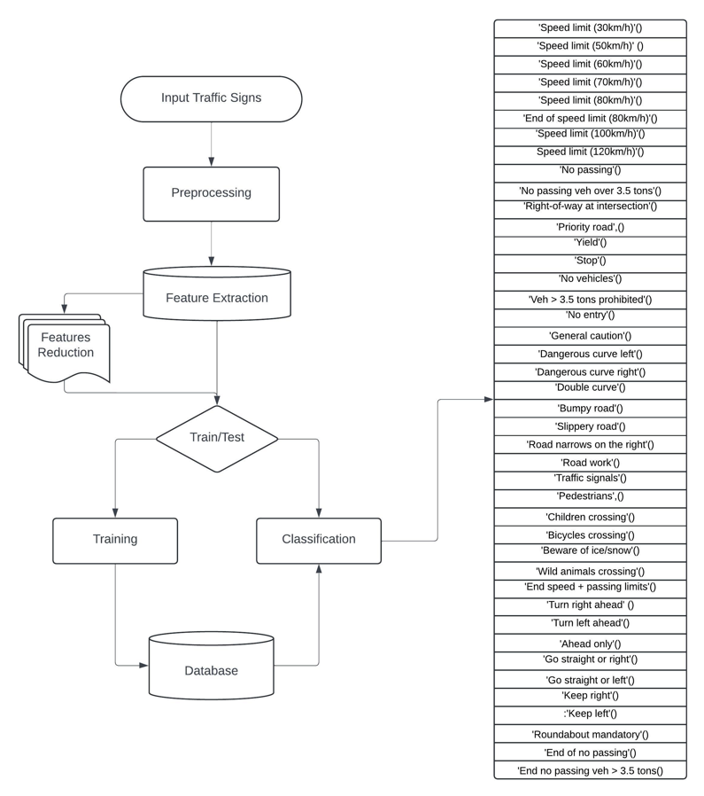
ARCHITECTURE

Slide 18
PROPOSED METHOD
1.Input Layer
The model takes images as input, shaped according to your training data.
2. Convolutional Blocks
First Block:
Two Conv2D Layers: Each with 32 filters (5x5) and ReLU activation, followed by:
MaxPooling (2x2): Reduces image size.
Dropout (25%): Prevents overfitting.
Second Block:
Two Conv2D Layers: Each with 64 filters (3x3) and ReLU activation, followed by:
MaxPooling (2x2): Further reduces image size.
Dropout (25%): Prevents overfitting.
3. Fully Connected Layers
Flatten: Converts 3D feature maps into a 1D vector.
Dense Layer (256 units, ReLU): Processes features.

Slide 19
Dropout (50%): Prevents overfitting.
Output Layer (43 units, Softmax): Produces class probabilities.
To apply deep learning algorithms, we need to follow certain essential steps:
Understanding the problem
Identify data
Select the algorithm
Train the model
Test the model
As we are performing the neural networks in the deep learning algorithm, we need to repeat two steps until the desired output and accuracy are achieved.
Training of networks: we need to train many data points and then try to design the model that will learn the features, which is a slow process due to the large amount of data.
Transfer learning: On the pre-trained model in the above step, we consider those results and perform new tasks. In this process, computation time becomes shorter.
Feature extraction: After all the layers are trained about the features in every object in the dataset, these features are extracted from it, and then output is predicted with accuracy and various measures

