Slide 1
B2B Sales Performance & Pipeline Analysis
SQL Case Study: Optimizing Revenue and Sales Efficiency
Author :
Sandesh Hagavane

Slide 2
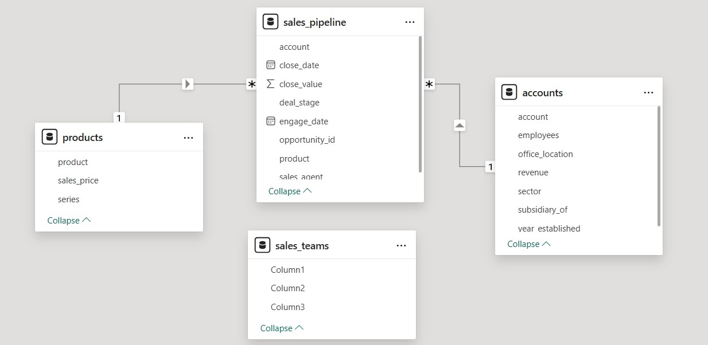
SCHEMA
Brief list of Accounts, Products, Sales Teams, and Pipeline

Slide 3
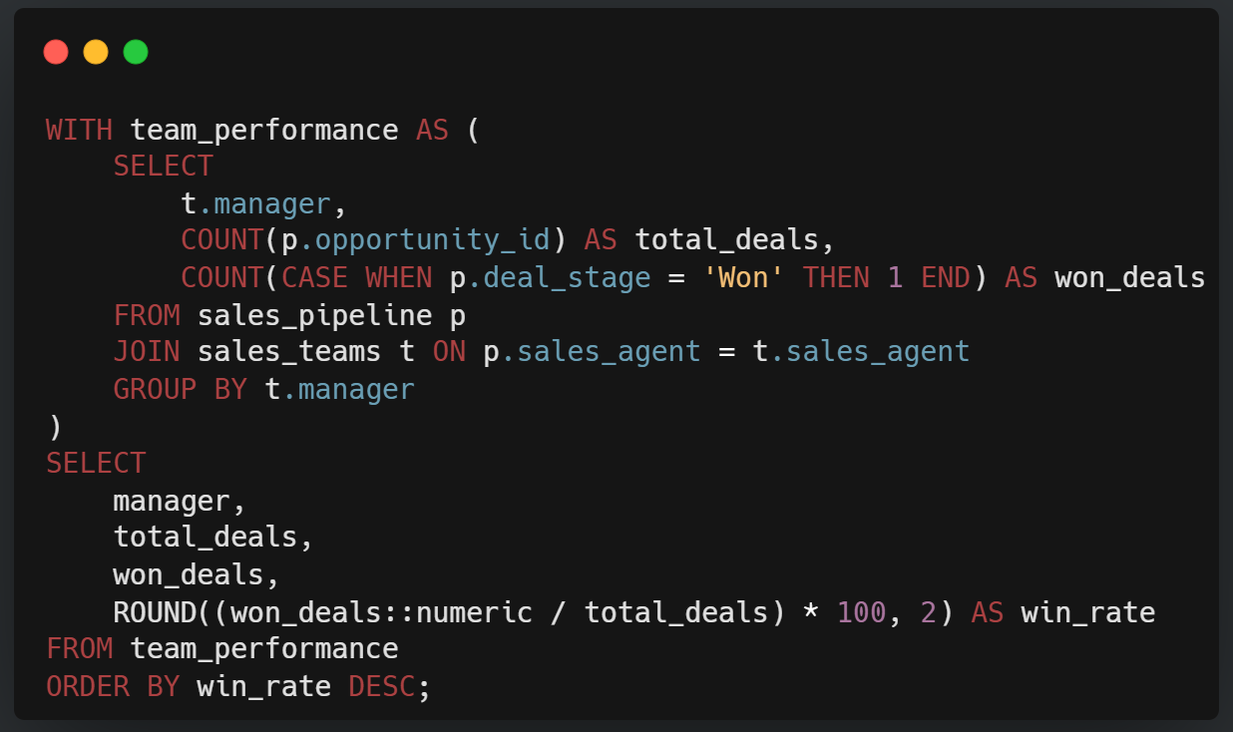
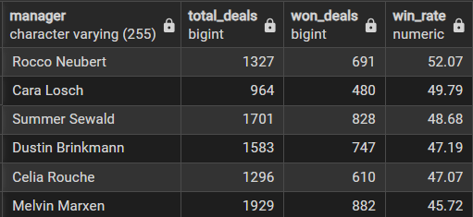
Conversion Mastery by Manager ( Win Ratio )
OUTPUT
Used CTEs and Case Statements to calculate Win %

Slide 4
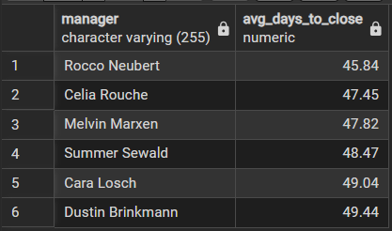
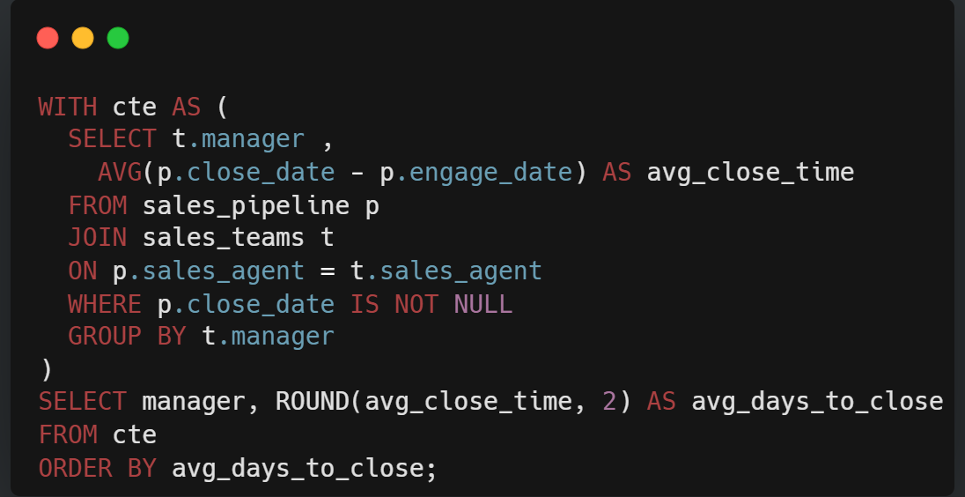
OUTPUT
Sales Velocity: Who Closes Fastest?
"Internal Knowledge Transfer: Conduct a deep-dive into Rocco Neubert’s team’s workflow. Since they maintain the highest win rate while having the shortest sales cycle, their 'Sales Playbook' should be the blueprint for training lagging agents."
Used Date Math to calculate time from engagement to close

Slide 5
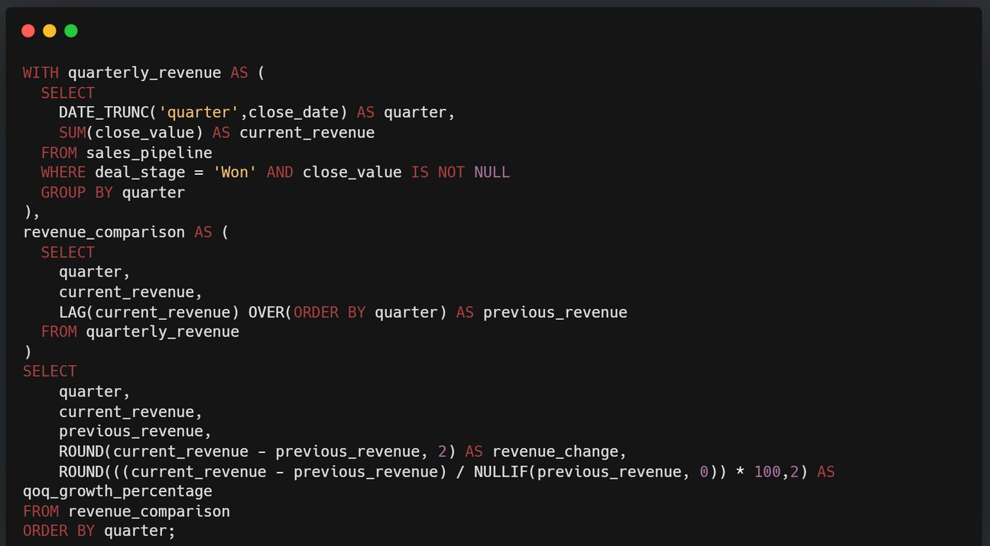
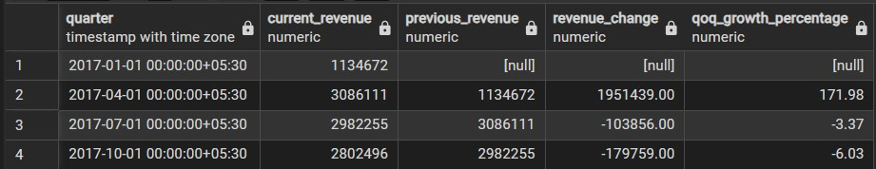
Quarter - Over - Quarter Growth
Used CTEs & Window Functions (LAG) to compare quarterly revenue
OUTPUT

Slide 6
3 Ways to Grow Revenue
Double down on Entertainment Sector : It has our highest average deal value.
Standardize Discounting: High discounts on GTK 500 are hurting margins.
Cross-Train Teams: Use the "Velocity" data to train slower teams.

Slide 7

Thank you for viewing my analysis.
www.linkedin.com/in/sandesh-hagavane-067bb42bb
Open for Data Analyst roles!
sandeshhagavne@gmail.com
https://github.com/SANDESHHAGAVNE/

