Slide 1
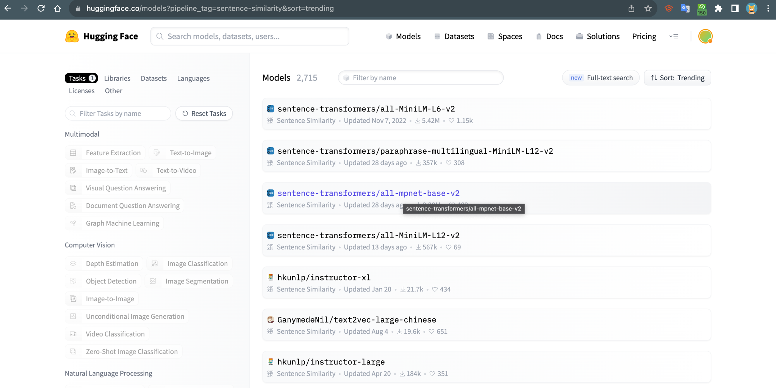

Slide 2
Background
The Life Cycle Assessment (LCA) approach evaluates the environmental footprint of products or activities by examining the entire lifecycle from raw material extraction to disposal. This process requires detailed knowledge of supply chain activities and associated emission factors. However, for large companies with numerous products and services, collecting detailed data across the supply chain is complex and impractical. As an alternative, the Environmentally Extended Input-Output Analysis (EIOA) method is widely used. EIOA is based on the Input-Output Analysis (IOA) economic model, which tracks trade relations between various sectors across different countries. This model is extended to include environmental impacts, creating the Environmentally Extended Input-Output model. This model estimates carbon footprints for producing one dollar of output from sectors or products. It mainly requires monetary value-based activity data from a company, typically purchasing data, and is categorized into a few product groups or economic sectors. Emission factors for each dollar spent on each group or sector are determined using the EEIO framework.
The US Environmentally-Extended Input-Output (USEEIO) model is a lifecycle assessment (LCA) tool that tracks the economic and environmental flows of goods and services in the United States. It combines economic input-output analysis with environmental data to quantify the environmental impacts of economic activities. As a free and open-source dataset, USEEIO is available for download from the US Environmental Protection Agency website. The model categorizes over 380 commodities into groups with similar environmental characteristics, known as commodity classes, and provides emission factors for these classes to estimate environmental impacts from spending data. These classes are aligned with the North American Industry Classification System (NAICS) and the Bureau of Economic Analysis (BEA) codes, ensuring consistency and facilitating integration with other economic and environmental datasets. USEEIO also includes emission factors for 66 summary commodity classes.
We are taking “CaML: Carbon footprinting of household products with zero-shot semantic text similarity” paper as our base reference for this project.
CaML computes the cosine similarity of the product embedding and all the NAICS embeddings, and picks the NAICS code corresponding to the embedding with the highest similarity score as the best match.
Dataset used:
1.NAICS codes from census.gov
2. 6k food products dataset from a retail website the annotated manually.
3.Carbon Emission data obtained from EPA
We are using model: mpnet-base-v2

Slide 3
Our contribution:
Creating a baseline model
Perform Data Mining tasks:
2)FAISS(Aiming to achieve less computational timing)
3) FAISS+Majority Voting (Experiment)

Slide 4
literature review
Text mining techniques used:
Key phase extraction
Converting Text to Lowercase
Replacing Punctuation with Underscores
Removing Stopwords
Lemmatization
Removing Repeating Words Specific to Context

Slide 5
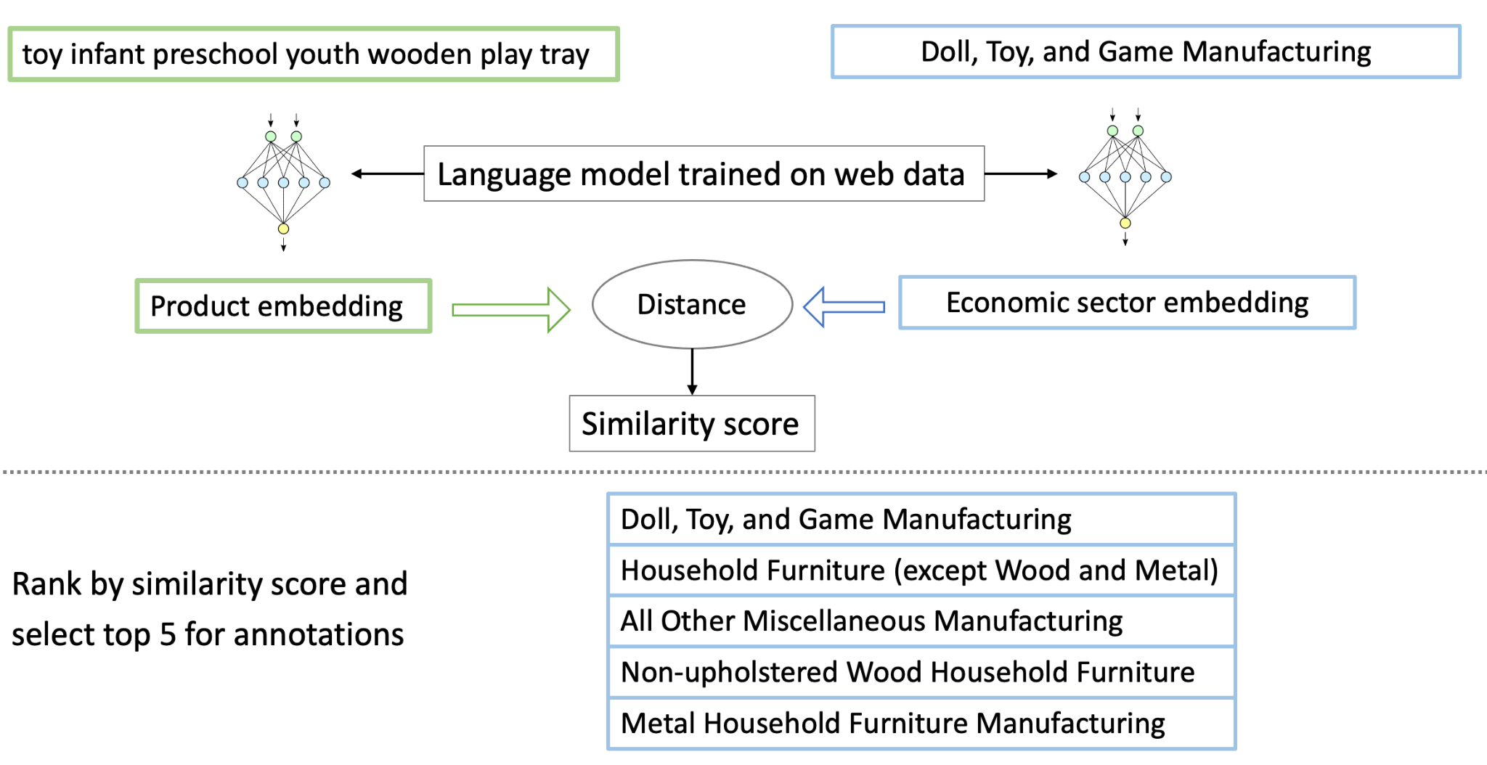
literature review
Faiss paper,
knn paper,
faiss-knn paper,
sbert model

Slide 6

Data collection
Source & Composition:
Origin: Prominent U.S. e-commerce retailer (Amazon).
Total Items: Over 46,646 products.
Categories:
General Merchandise (40,000 items).
Food-Related Items (6,646 items).
Classification & Analysis:
Industry Classification: Linked with NAICS codes for detailed product categorization.
Carbon Emission Data: Integrated (referenced from Yang et al.) for environmental impact insights.
Applications:
Market & Environmental Analysis: Useful for trend studies, consumer behavior, and assessing the carbon footprint.
Research & Development: Aids in market research, economic analysis, and sustainable product assessment.

Slide 7
Methods
AAYUSH Data cleaning
Data Preprocessing

Slide 8
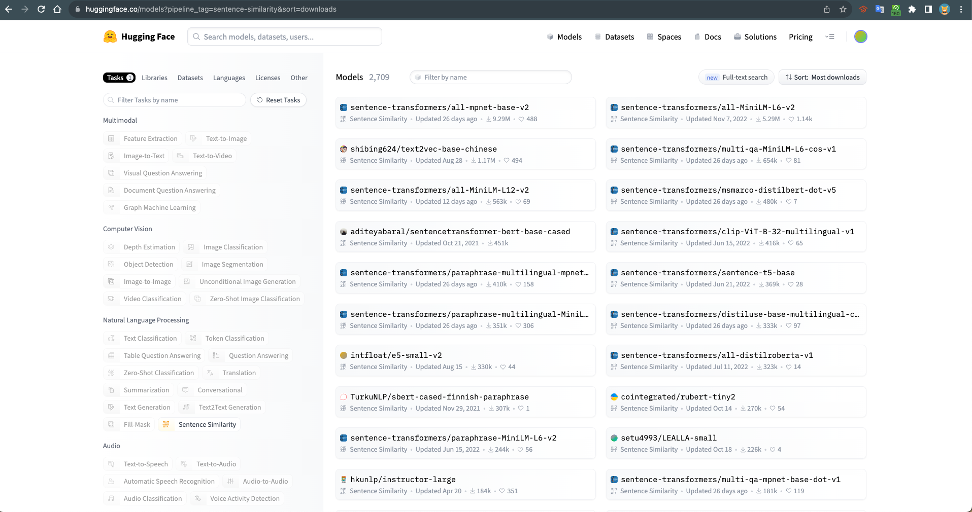
Method- SBERT all-mpnet-base-v2
Why all-mpnet-base-v2 model?

Slide 9
Methods Overview
KNN, paper, year, support (how many papers on this, data mining popularity)-
Papers with code (methods knn)
K Means https://paperswithcode.com/method/k-nn
Faiss- what , why , why for this project(coz of o the cluster nature)
Faiss-KNN: https://towardsdatascience.com/make-knn-300-times-faster-than-scikit-learns-in-20-lines-5e29d74e76bb

Slide 10
SACHIN
5 slides:
Overview of training process
Model 1
Model 2
Model 3
Hybrid 1,2 *&* 1,3

Slide 11
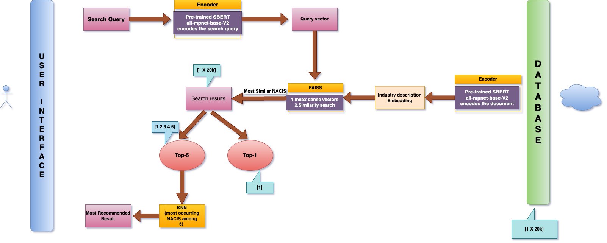

Slide 12
SACHIN
5 slides:
Overview of training process
Model 1
Model 2
Model 3
Hybrid 1,2 *&* 1,3

Slide 13
SACHIN
5 slides:
Overview of training process
Model 1
Model 2
Model 3
Hybrid 1,2 *&* 1,3

Slide 14
SACHIN
5 slides:
Overview of training process
Model 1
Model 2
Model 3
Hybrid 1,2 *&* 1,3

Slide 15
SACHIN
5 slides:
Overview of training process
Model 1
Model 2
Model 3
Hybrid 1,2 *&* 1,3

Slide 16
Future work
Future work, discussion

Slide 17
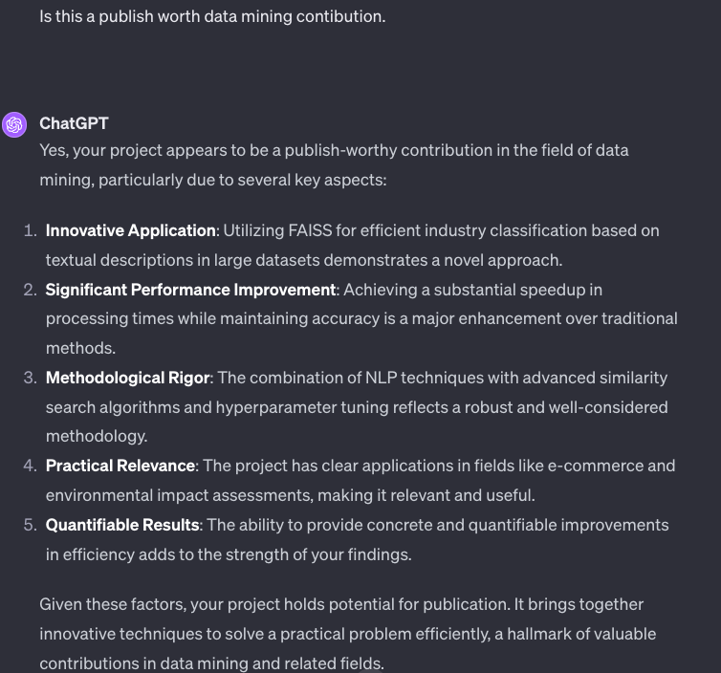
Reflections
FAISS CONTRIBUTION
KNN CONTRIBUTION

