Slide 1
Tracking Monthly
Expense Leakage
in a Business
P.Sanganathan

Slide 2
The Problem
01
Budget overruns
02
Low visibility
Actual expenses frequently exceed planned budgets.
No structured department- or category-wise expense tracking.
03
Expense accumulation
04
Unclear drivers
Small expenses combine into significant overspending.
Management cannot easily identify overspending departments, categories, or repeated overruns.
02 / 11

Slide 3
Our Analytical Approach
01
Budget vs Actual expense analysis
02
Department-wise expense tracking
03
Category-wise expense tracking
04
Year and month-wise expense calculation
05
Identify top overspending departments
06
Calculate budget variance and variance %
07
Measures to reduce unnecessary expenses
03 / 11

Slide 4
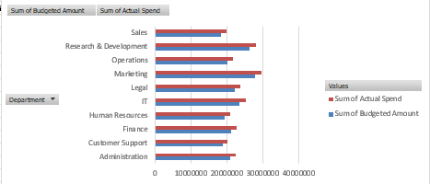
01 / Budget vs Actual Expense
WHAT THIS SHOWS
Comparing planned budgets against actual spending across departments to reveal financial gaps and overspending.
BUDGET VS ACTUAL SPEND BY DEPARTMENT
04 / 11

Slide 5
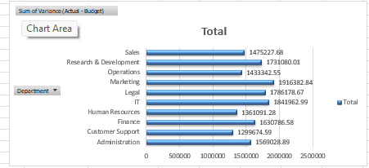
02 / Department-wise Variance
WHAT THIS SHOWS
Analyzing Actual − Budget for each department to pinpoint where major expense leakage is occurring.
TOTAL VARIANCE BY DEPARTMENT
05 / 11

Slide 6
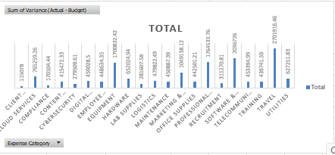
03 / Category-wise Variance
WHAT THIS SHOWS
Breaking down variance by expense category to investigate the sources of overspending and financial outflows.
VARIANCE BY EXPENSE CATEGORY
06 / 11

Slide 7
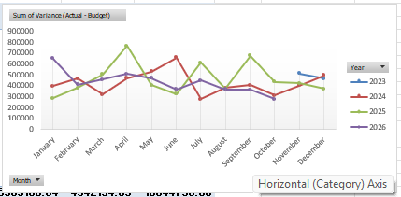
04 / Monthly & Yearly Trends
WHAT THIS SHOWS
Tracking variance over months and years to identify peaks, persistent leakage and time-based patterns.
VARIANCE BY MONTH / YEAR
07 / 11

Slide 8
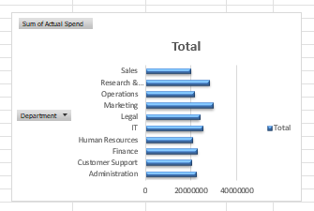
05 / Department Spending
WHAT THIS SHOWS
Comparing total actual spend by department to highlight high-spend areas for closer budget review.
SUM OF ACTUAL SPEND BY DEPARTMENT
08 / 11

Slide 9
From Data to Decisions
01
02
03
COMPARE
IDENTIFY
DIAGNOSE
Budget vs actual
Department variances
Expense categories
04
05
06
MONITOR
PRIORITIZE
IMPROVE
Monthly / yearly patterns
Areas for investigation
Budget and cost controls
09 / 11

Slide 10
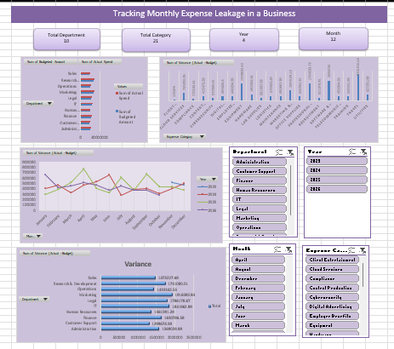
Dashboard Overview & Conclusion
THE BIG PICTURE
The dashboard summarizes expenses by department, category, year and month. It compares planned budgets with actual spending, helping management investigate overspending, reduce unnecessary costs and make more informed financial decisions.
10 / 11

Slide 11
Thank You!
Questions & Answers
TRACKING MONTHLY EXPENSE LEAKAGE IN A BUSINESS

