Slide 1
21AIE304 Bigdata and Management
END SEM PROJECT

Slide 2
TEAM – 03
HARIPRANAV J M ~ CB.EN.U4AIE20021
PRAVIN RAJ A K ~ CB.EN.U4AIE20054
SABHARISH A L ~ CB.EN.U4AIE20061
SAI SANGAVI C ~ CB.EN.U4AIE20063
SAIVARSHA R ~ CB.EN.U4AIE20064

Slide 3
TOPIC
Covid-19 Vaccination and Cases Analysis
Along with
-> 3-Tier Architecture
-> Data Replication [ CAP Theorem ]
-> Data Streaming

Slide 4
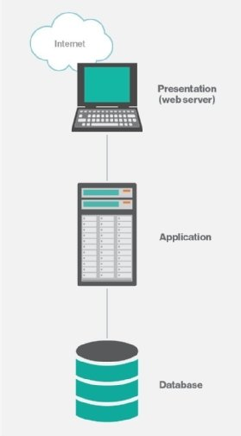
3 Tier Architecture
Most common type of multi-tier architecture in distributed systems is a three-tier client-server architecture.
The entire application is organized into three computing tiers:
Presentation Tier [ Client ]
Application Tier [ Server ]
Database Tier [ Server ]

Slide 5
Presentation Tier
Topmost tier
Purpose is to take request from the client and displays information to the client.
Communicates with other tiers using a web browser as it gives output on the browser.
Developed using languages like- HTML, CSS, JavaScript, other frameworks.

Slide 6
Application Tier
Middle tier
Also known as the logic tier as the information/request gathered through the presentation tier is processed in detail here.
Communicates with other tiers using a web browser as it gives output on the browser.
It also interacts with the server that stores the data.
Processes the client’s request, formats, it and sends it back to the client.
Developed using languages like- Python, Java, PHP, etc.

Slide 7
Data Tier
Last tier
Also known as the Database Tier.
Used to store the processed information so that it can be retrieved later on when required.
Consists of Database Servers like- MongoDB, Oracle, MySQL, DB2, etc.
The communication between the Presentation Tier and Data-Tier is done using middle-tier, i.e. Application Tier.

Slide 8
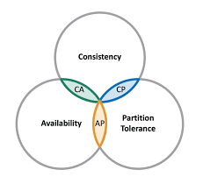
CAP theorem
The three letters in CAP refer to three desirable properties of distributed systems with replicated data:
Consistency (among replicated copies)
Availability (of the system for read and write operations)
Partition Tolerance (in the face of the nodes in the system being partitioned by a network fault).
Our Application enforces CP

Slide 9
Consistency
The nodes will have the same copies of a replicated data item visible for various transactions.
A guarantee that every node in a distributed cluster returns the same, most recent and a successful write.
Consistency refers to every client having the same view of the data.

Slide 10
Availability
Each read or write request for a data item will either be processed successfully or will receive a message that the operation cannot be completed.
Every non-failing node returns a response for all the read and write requests in a reasonable amount of time.
Even if a node fails the other nodes will be able to send the data.

Slide 11
Partition Tolerance
The system can continue operating even if the network connecting the nodes has a fault that results in two or more partitions, where the nodes in each partition can only communicate among each other.
The system continues to function and upholds its consistency guarantees in spite of network partitions.
Distributed systems guaranteeing partition tolerance can gracefully recover from partitions once the partition heals.

Slide 12
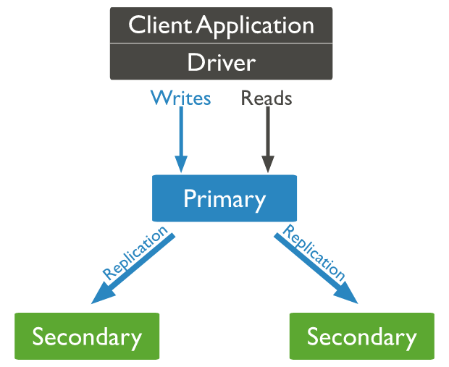
Replication in MongoDB
A replica set is a group of mongod instances that maintain the same data set.
A replica set contains several data bearing nodes .
Of the data bearing nodes, one and only one member is deemed the primary node, while the other nodes are deemed secondary nodes.

Slide 13
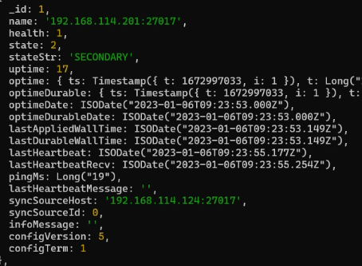
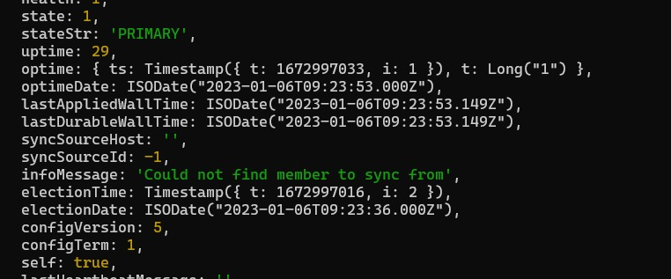
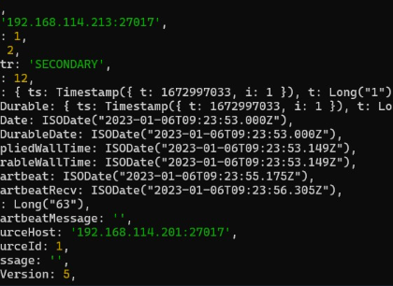
Replication in MongoDB
1 Primary Node 2 Secondary Node

Slide 14
Dataset used and Application Server

Slide 15
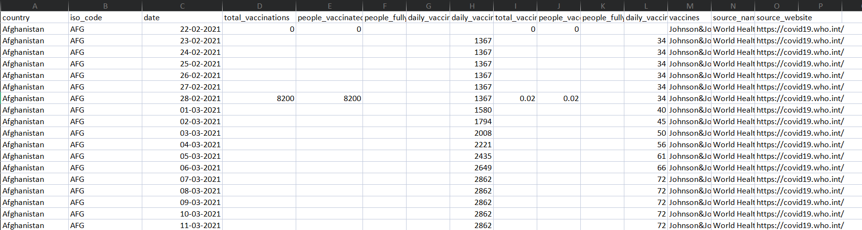
Dataset Used [ Vaccination Data Global ] Global Vaccination Details

Slide 16
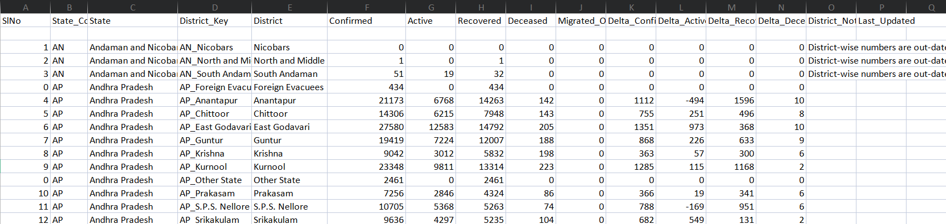
Dataset Used [ District vise Covid cases Analysis India ] Indian District vise covid report

Slide 17
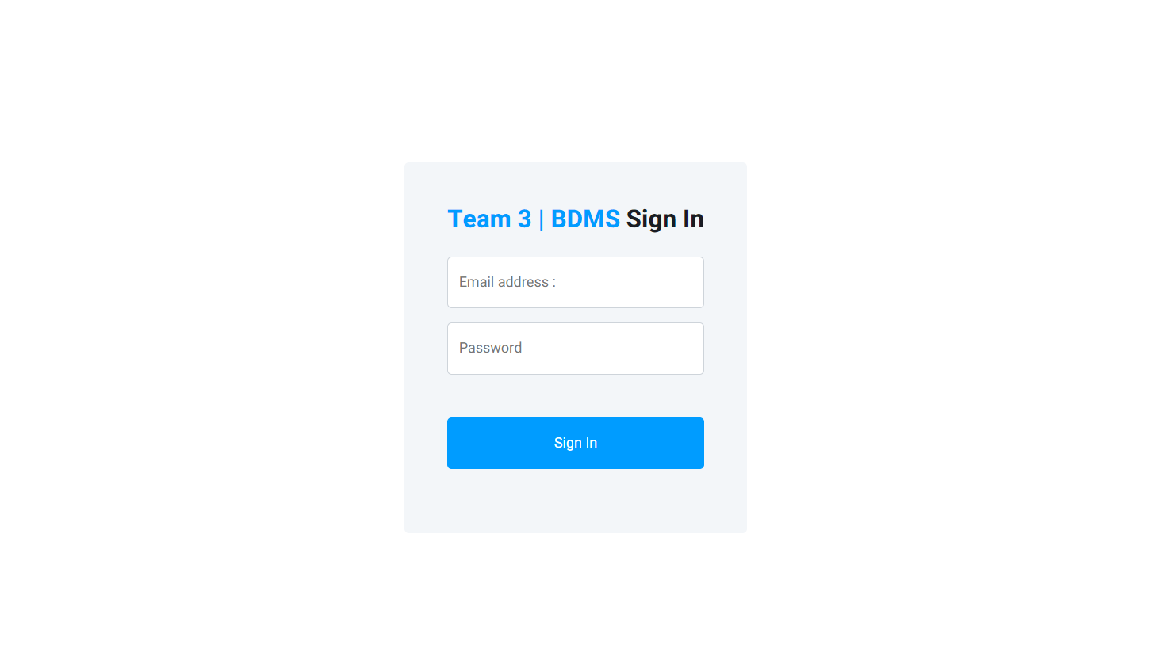
Application Server Login Page

Slide 18
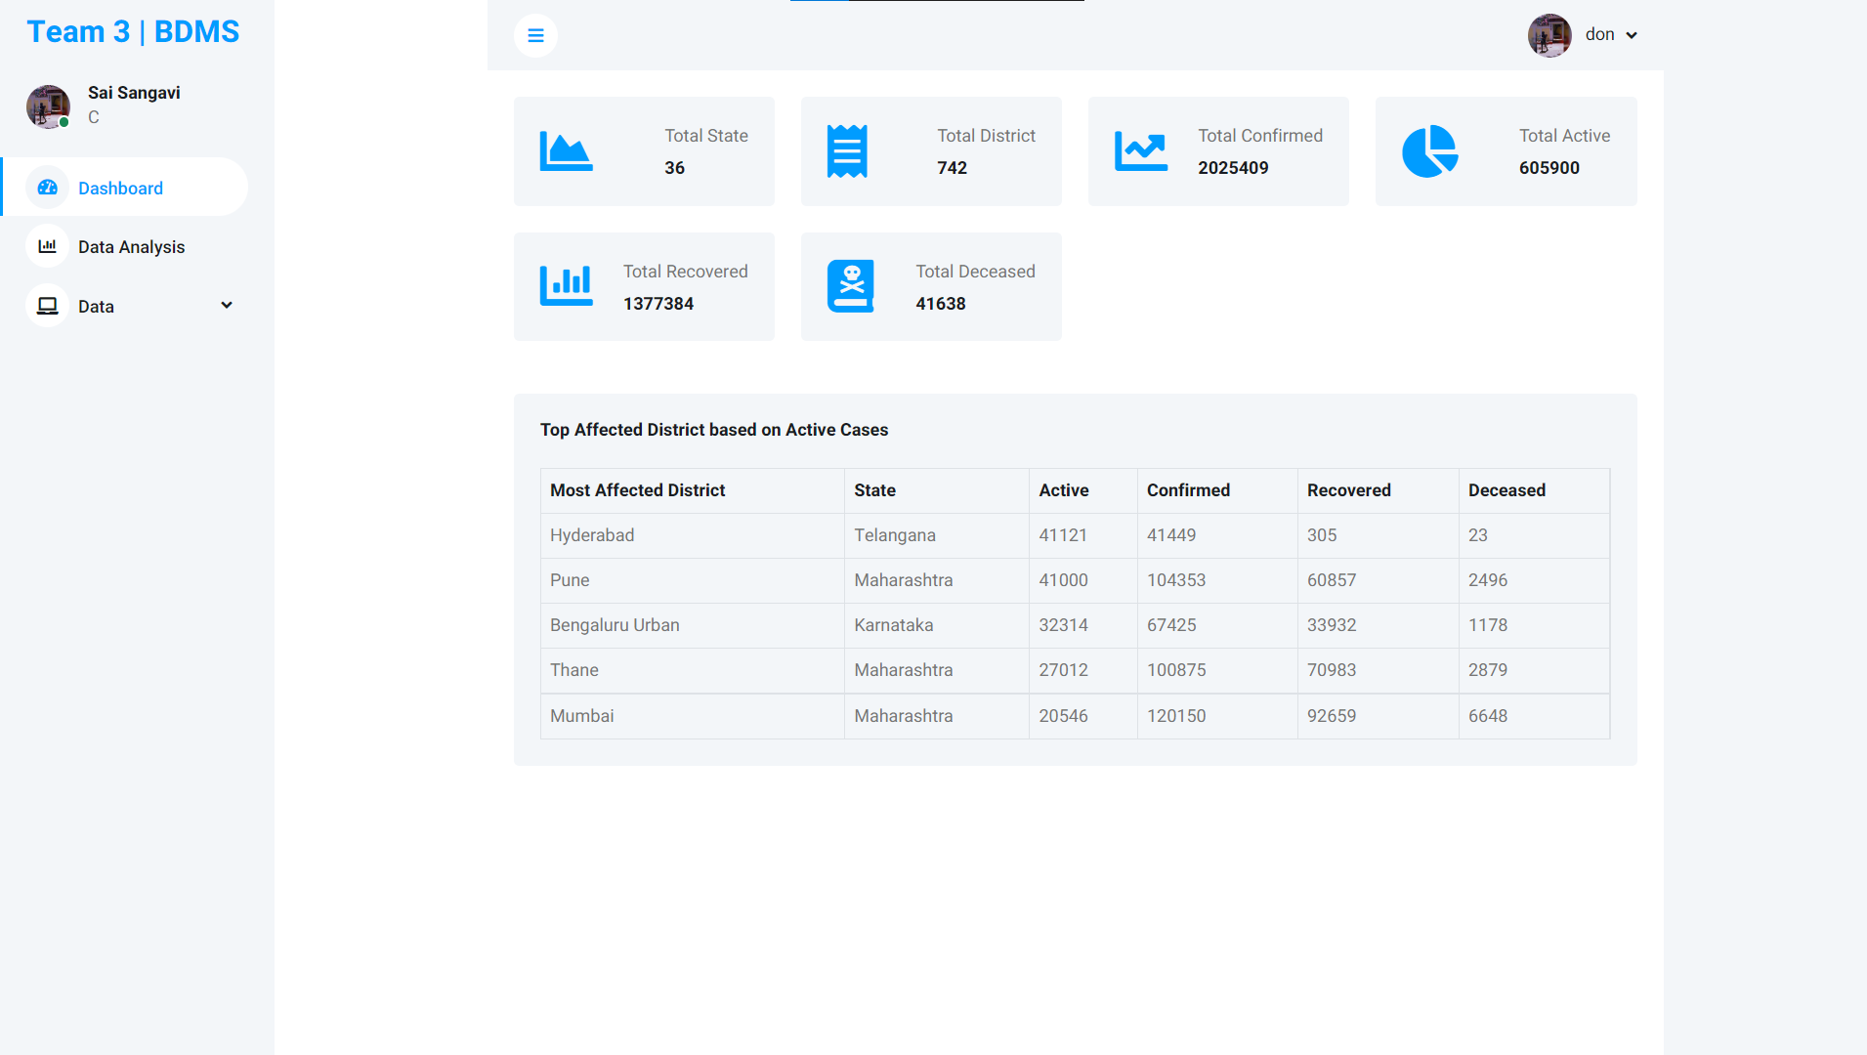
Application Server Dashboard

Slide 19
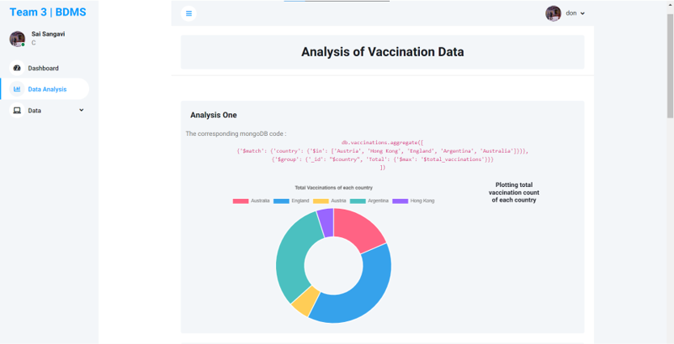
Application Server Analysis Page

Slide 20
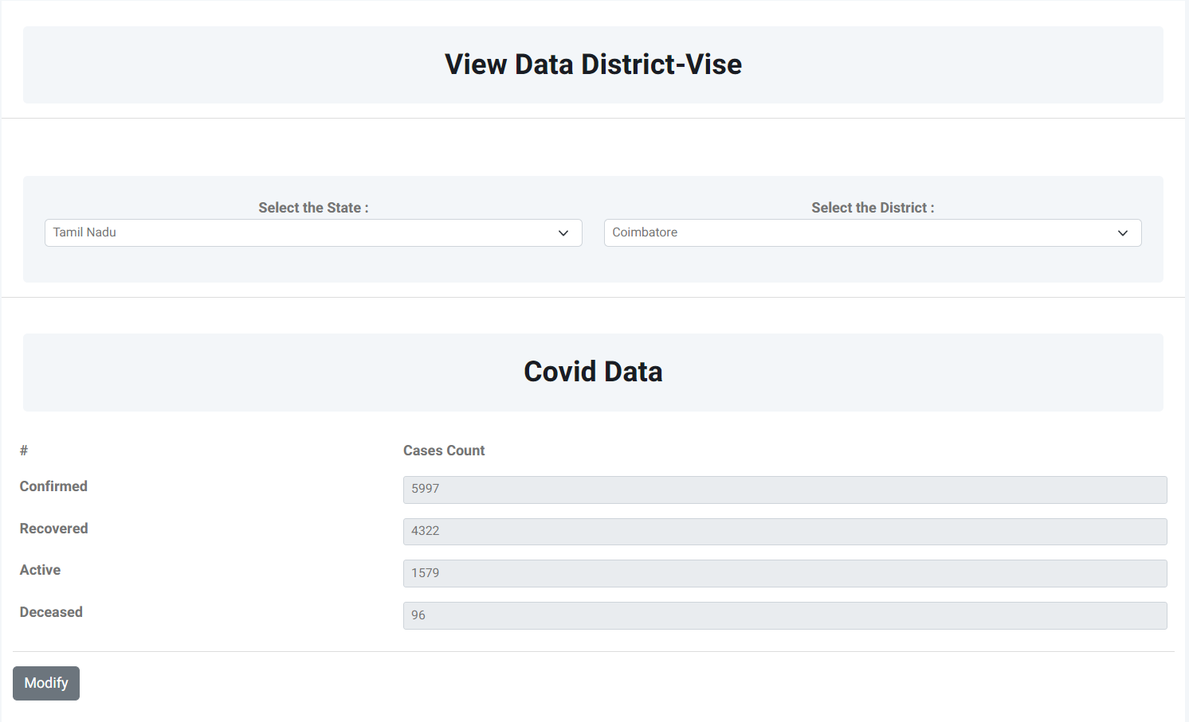
Application Server Data Page

Slide 21
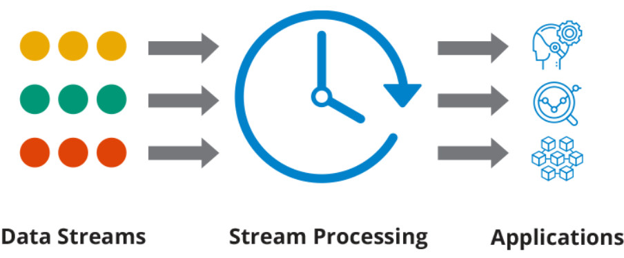
Data Streaming
Data Streaming refers to real-time streaming of the data changes [ Update | Delete | Insert ] happening in the database to an application or any other server
We use mongo DB change stream operation for our project.

Slide 22
Data Streaming Applications
Analytics Dashboards
IoT Event Tracking
Real-Time Trading Applications -

Slide 23
Data Streaming Uses
Filterable
Resumable
In order
Durable
Secure
Easy to use
In order to use change streams in Mongo DB, the database must be in a replica set

Slide 24
Data Streaming
Here we use change stream from Mongo DB to stream real time data
We use a .watch() API with the collection to listen to live change in the collection
db.collectionName.watch()
When a change occurs we listen to the change event and process the data

Slide 25
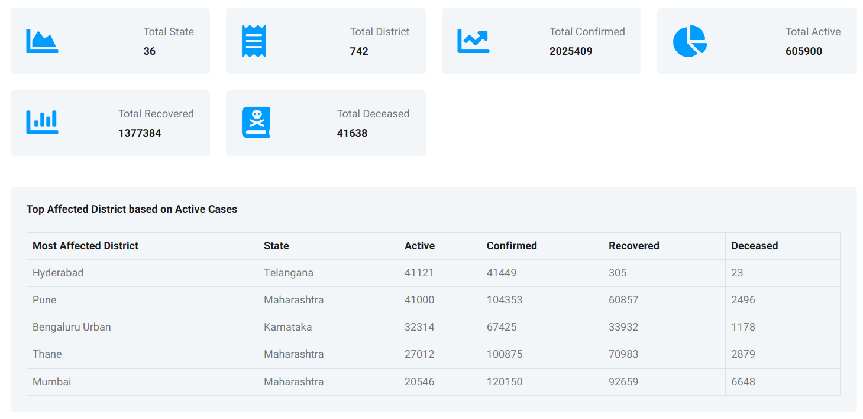
Data Streaming
In this application we listen to the real time change in the district collection and update the data change real-time in the client dashboard.

Slide 26
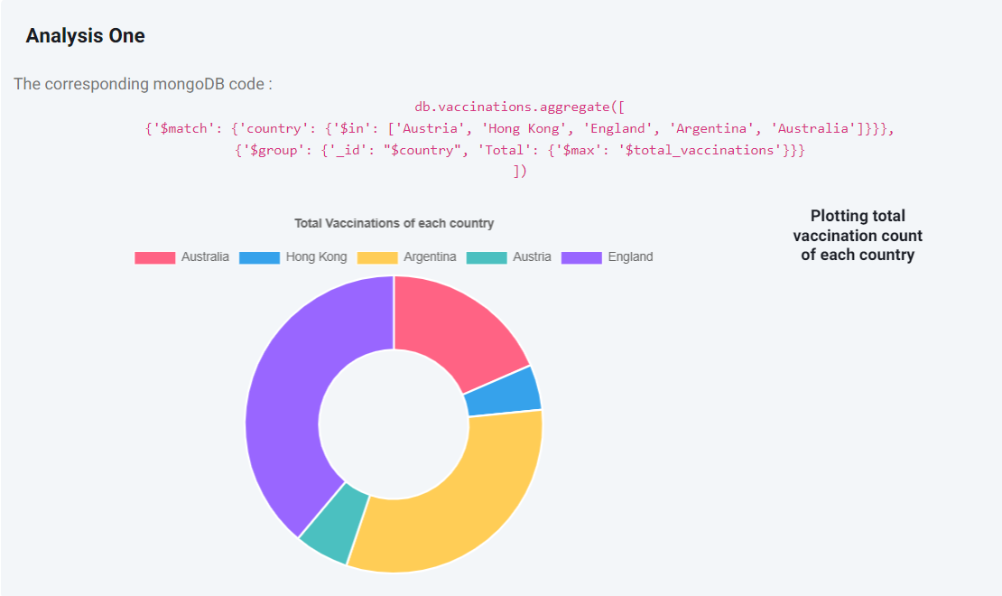
Analysis - 1

Slide 27
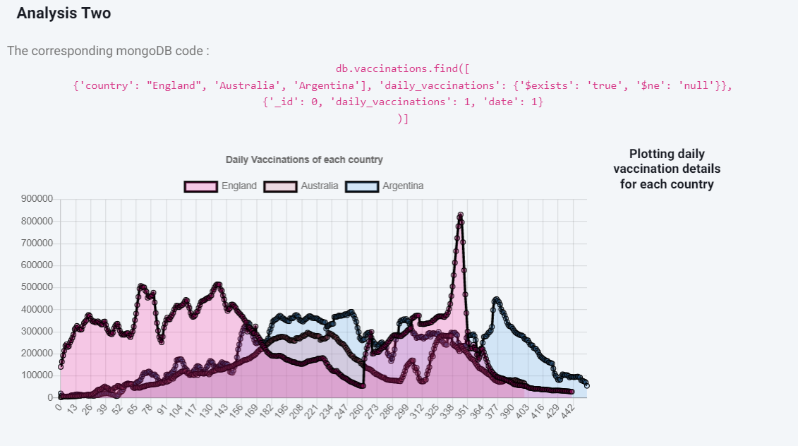
Analysis - 2

Slide 28
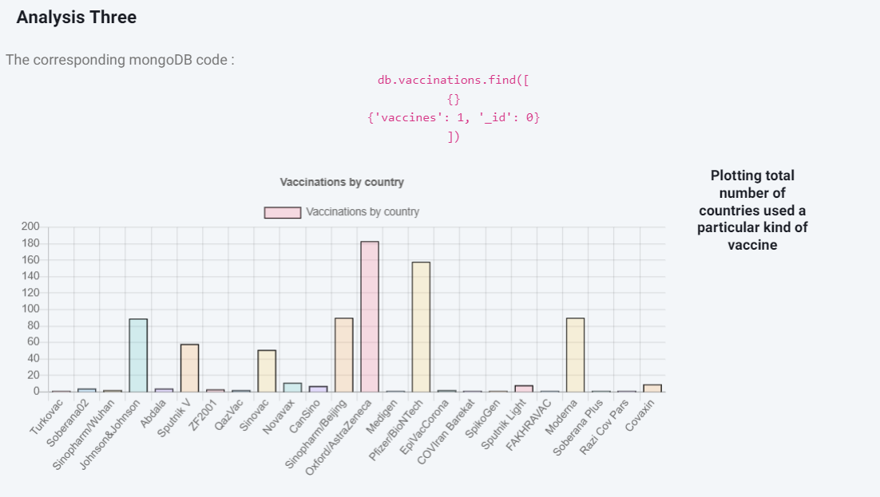
Analysis - 3

Slide 29
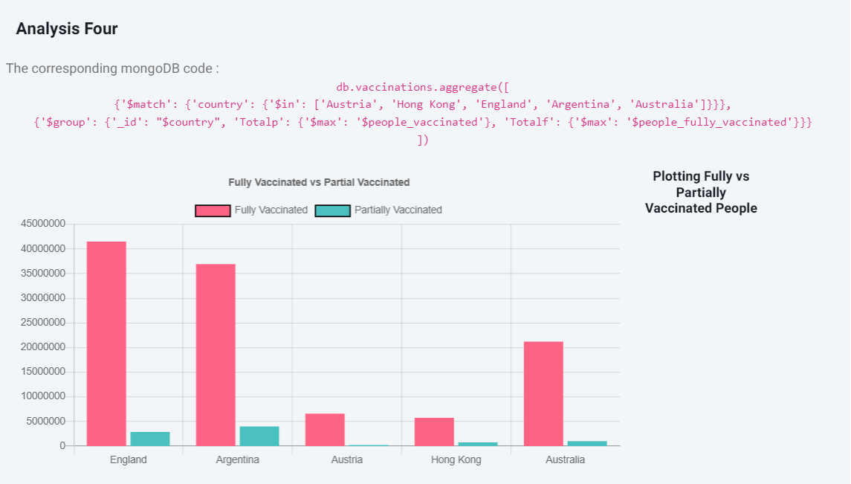
Analysis - 4

Slide 30
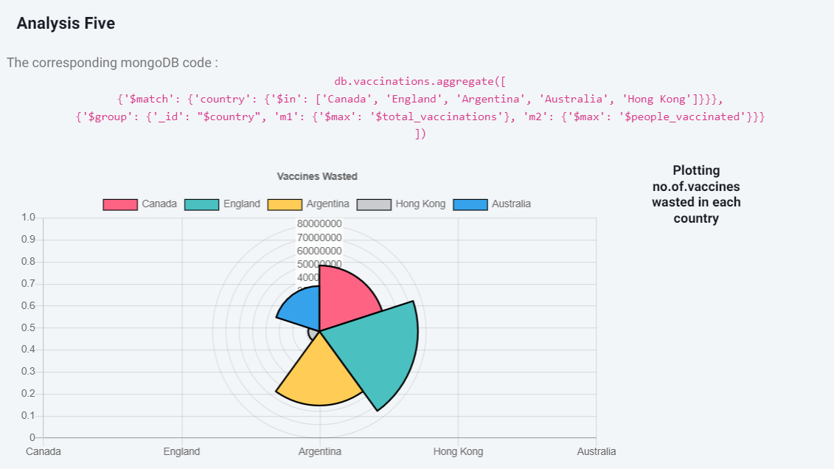
Analysis - 5

Slide 31

Thank you

