Slide 1
INFOTACT DATASCIENce (batch1) final review CUSTOMER SEGMENTATION -maniha fathima m -Sangeetha j

Slide 2
CUSTOMER SEGMENTATION
Customer segmentation is the process of dividing a company's customer base into distinct groups or segments based on shared characteristics, behaviors, or preferences.

Slide 3
K - MEANS CLUSTERING
K-means clustering is a machine learning algorithm that groups data points into clusters based on their similarity. It's an unsupervised learning technique, meaning it uses unlabeled data.
How it works
Select a number of clusters()
Randomly select K points as centroids
Assign each data point to the nearest centroid
Recalculate the centroids based on the new groupings
Repeat until the clusters are satisfactory

Slide 4
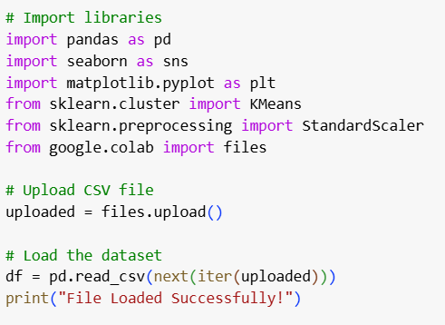
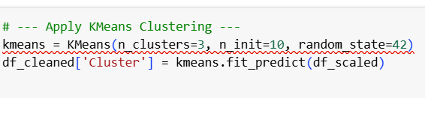
Given dataset

Slide 5
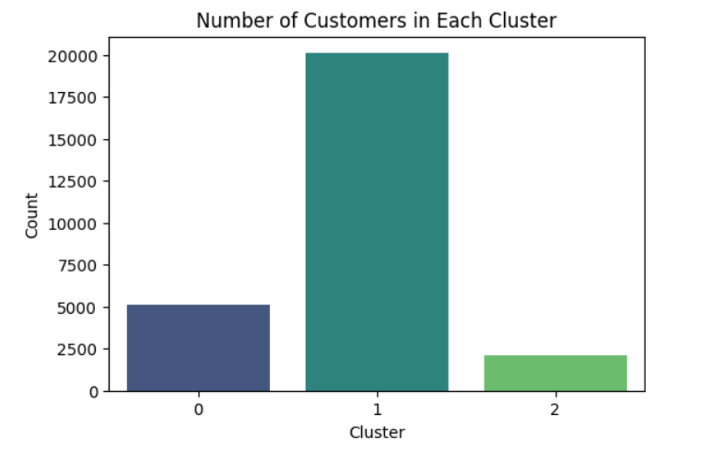
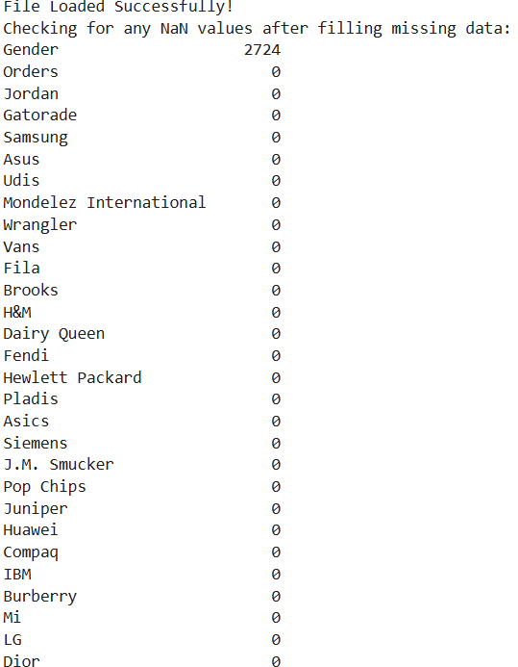
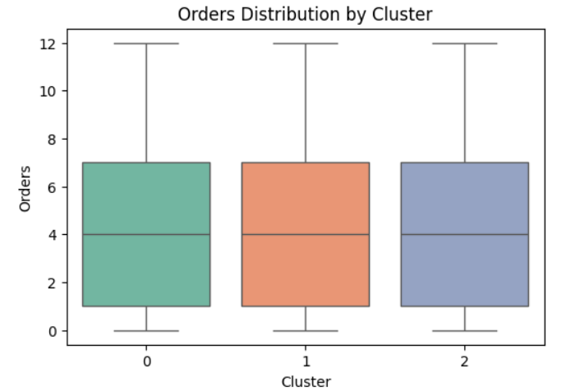
OUTPUT

Slide 6
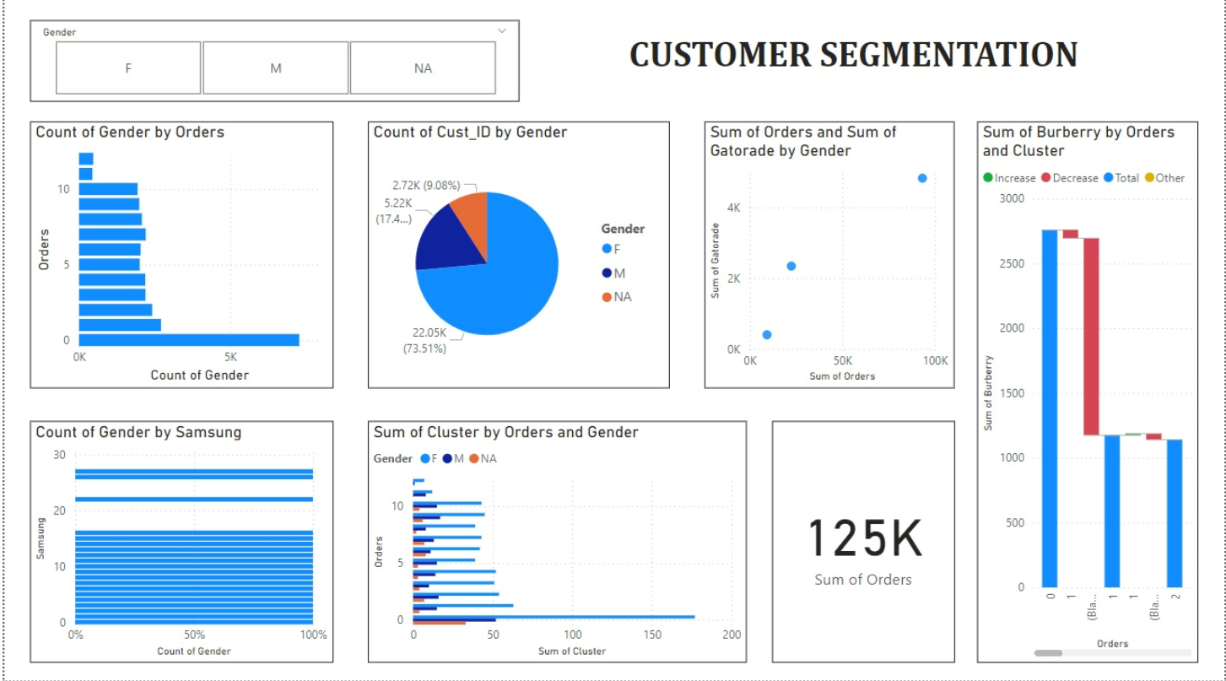
POWERBI - DASHBOARD

Slide 7
Thank you

