Slide 1
KEYLOGGER
IN
CYBER
SECURITY
Presented By,
s.sangeetha
CSE “DEPT”
PCET

Slide 2
OUTLINE;
Introduction
Keylogger
Types
Detect
Prevent
Work
Example
Conclusion
Refference

Slide 3


Slide 4
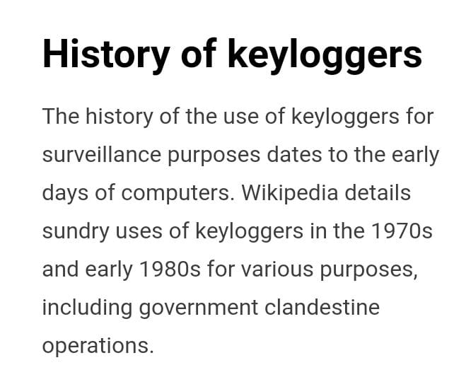

Slide 5


Slide 6
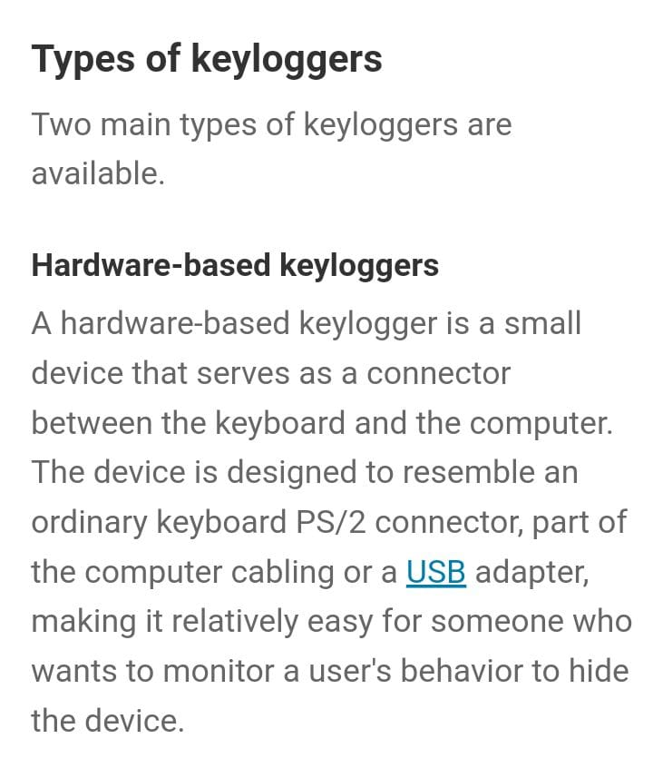

Slide 7
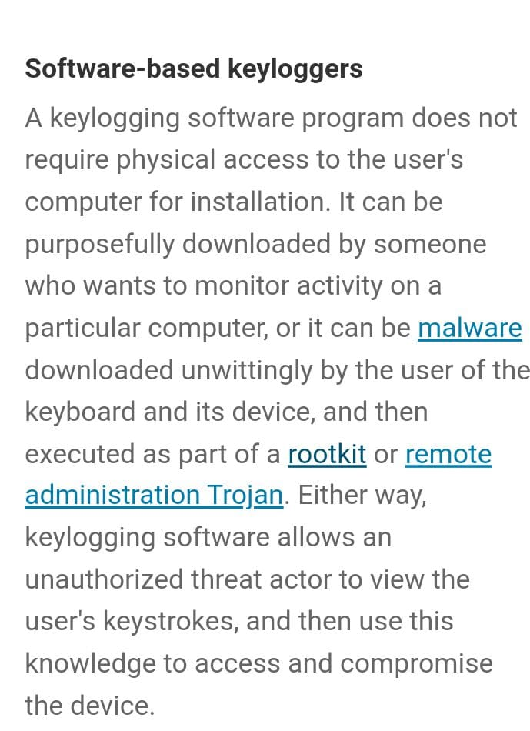

Slide 8


Slide 9
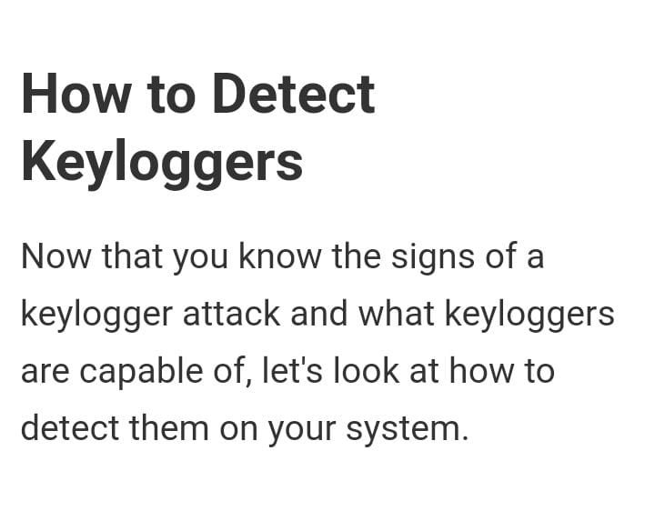

Slide 10
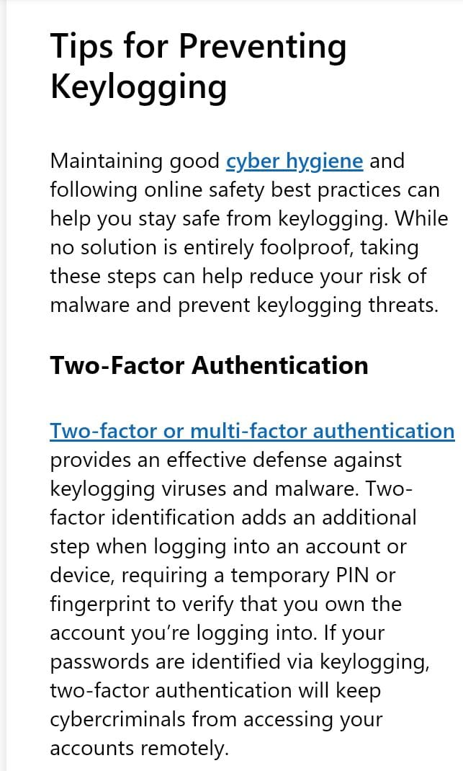


Slide 11


Slide 12
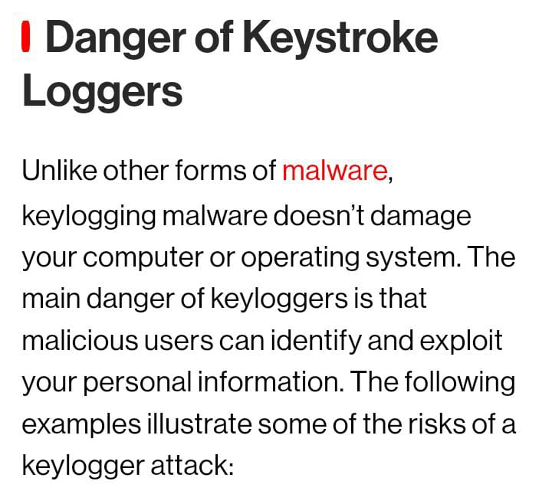

Slide 13
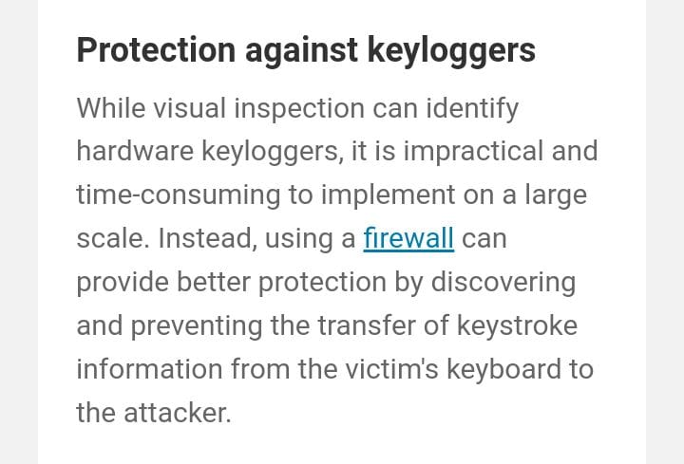

Slide 14
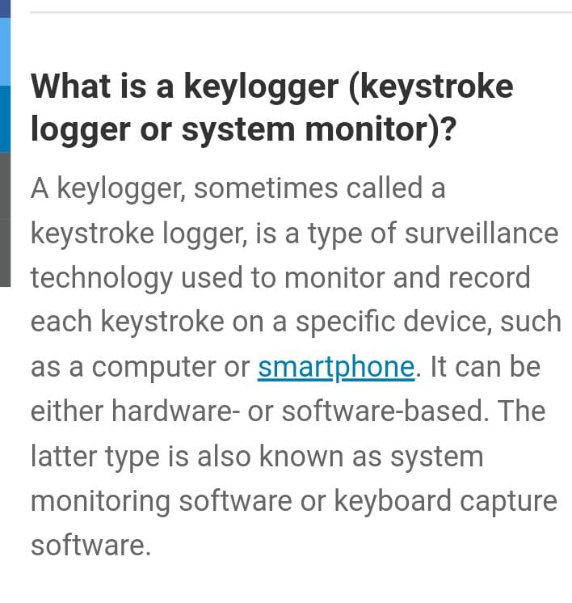

Slide 15
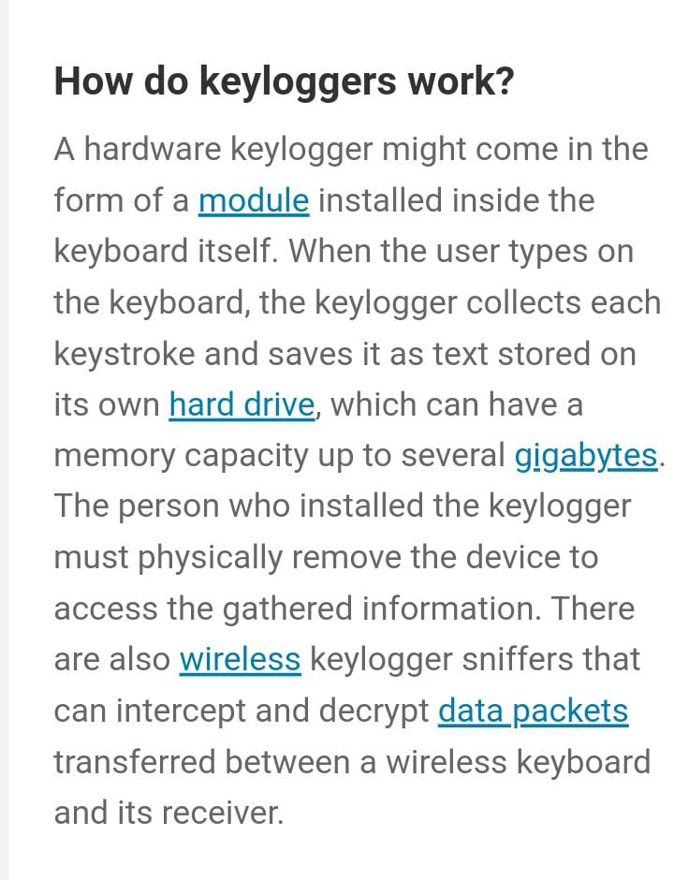

Slide 16
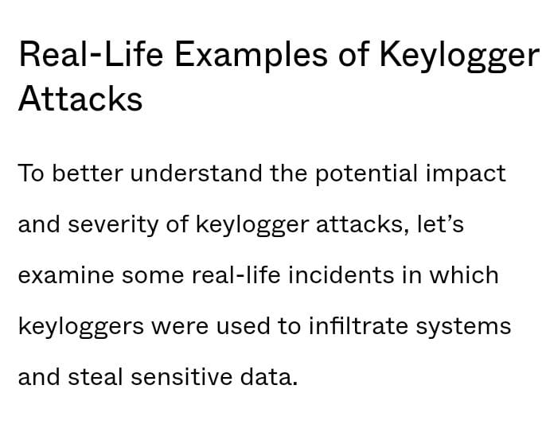

Slide 17


Slide 18
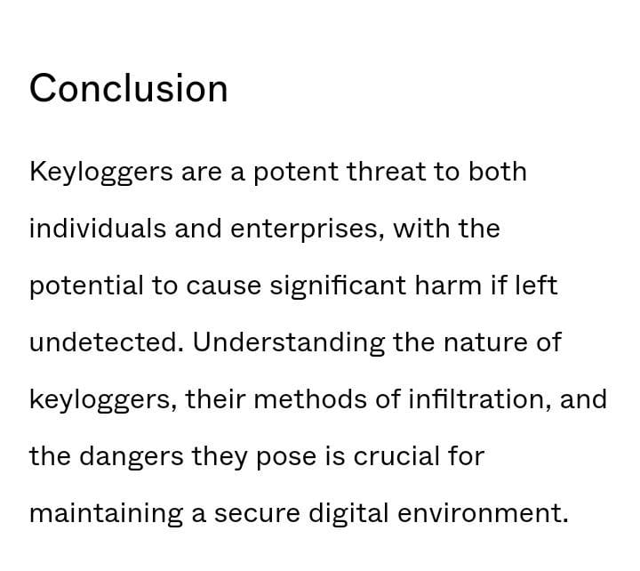

Slide 19
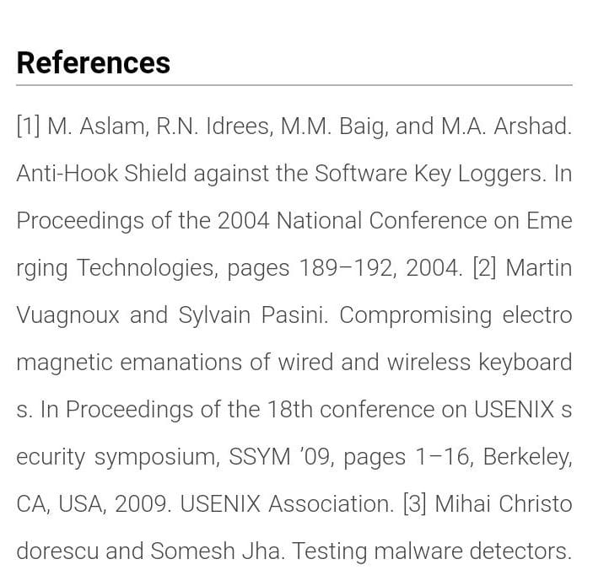

Slide 20
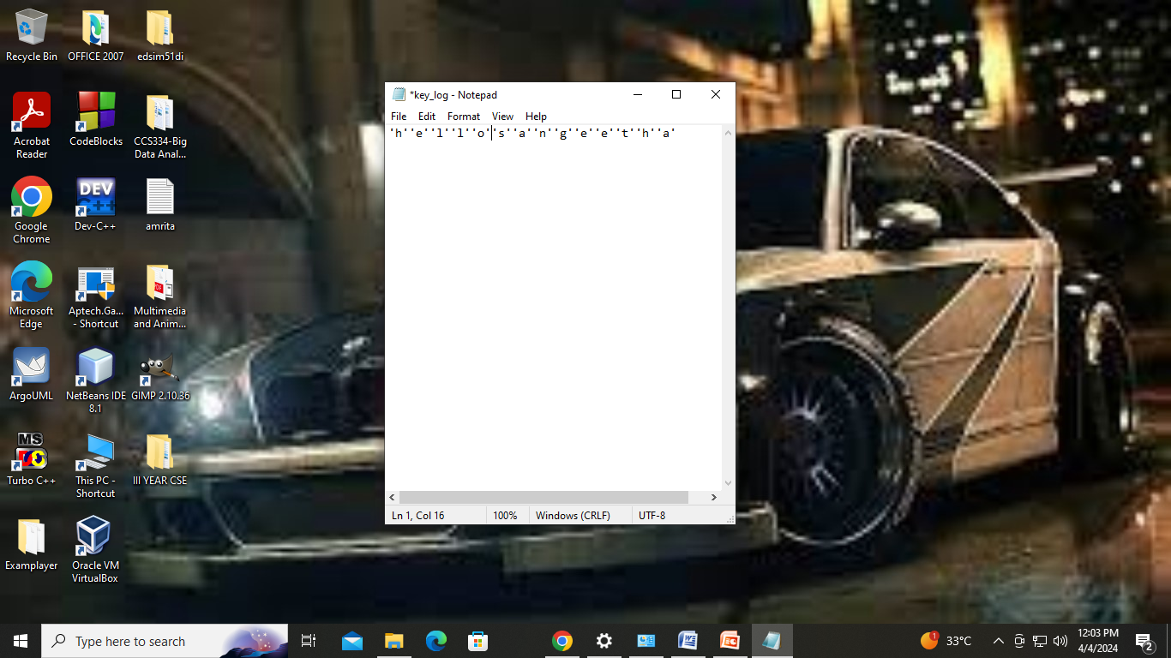

Slide 21
THANK YOU

