Slide 1
Customer Segmentation and Sales Analysis Using RFM Analytics
MARKETING ANALYTICS • MODULE 1
Sample Superstore · 9,994 order lines · 793 customers · 2014–2017
TEAM MEMBERS
SL
Sangram Lembe
SS
Surya S
MA
Manavendra A
MS
Manne Subhash
Notes:
Introduce the team and the topic. We analyse four years of Superstore sales, segment the 793 customers with RFM (Recency, Frequency, Monetary) and turn the segments into marketing actions. Everything is shown in a working Streamlit dashboard.

Slide 2
Problem Statement
01
Why analyse customer and sales data?
The Superstore data holds four years of transactions. The business needs to know where revenue comes from, which customers are valuable, and where retention effort is needed.
1
SALES
2
CUSTOMERS
What products, categories and regions generate the most revenue and profit?
Which customers buy often and contribute the most revenue?
3
RECENCY
4
RISK
Which customers have bought recently, and which ones long ago?
Which customers need targeted retention or win-back activity?
Notes:
Four business questions drive the project: where sales come from, who the valuable customers are, who bought recently, and who is at risk of leaving. Sales analysis answers the first; RFM answers the other three.

Slide 3
Dataset
02
Sample Superstore: transaction data of a US retailer, 2014–2017
ORDER LINES
CUSTOMERS
ORDERS
SALES
9,994
793
5,009
$2.30M
line items in orders
unique customer IDs
unique order IDs
total revenue
KEY COLUMNS (21 IN TOTAL)
COVERAGE
Order ID, Order Date | Order number and purchase date
Customer ID, Segment | Customer key; Consumer / Corporate / Home Office
Category, Sub-Category | 3 categories, 17 sub-categories
Region, State, City | Where the order was delivered
Sales, Quantity | Revenue and units of the line
Discount, Profit | Discount given; profit (can be negative)
Order dates: Jan 2014 – Dec 2017
Categories: Furniture, Office Supplies, Technology
Regions: West, East, Central, South (49 states)
1,862 products · 37,873 units sold
RFM is calculated per customer from their order history
Notes:
The dataset is the Sample Superstore file suggested by our professor: 9,994 order lines, 5,009 orders, 793 customers and $2.30M in sales over 2014–2017. Each row is one product in an order, so orders and customers are counted with unique IDs.

Slide 4
Data Preparation & Cleaning
03
The raw file was checked and repaired before any analysis
ISSUE | FOUND | WHAT WE DID
Exact duplicate rows | 10 | Dropped, first copy kept
Blank cells (date, ship mode, customer, segment, region, category) | 13 | Recovered from rows with the same order, customer, state or sub-category
Text variants ('west', ' Consumer', 'Standard class', extra spaces) | 21 | Trimmed and set to the standard spelling
Dates stored as text | 2 columns | Converted to dates; numbers and ranges checked
Lines sold at a loss | 1,871 | Kept: real losses, mostly from heavy discounts
Very large orders (IQR outliers) | 1,167 | Kept and flagged: they matter for Monetary value
RAW FILE
10,004
rows in Superstore_raw.csv
CLEAN DATA
9,994
rows, ready for analysis
Check: cleaned data matches the original Sample Superstore file cell for cell (0 differences).
Notes:
We deliberately worked from a raw version of the file. It had 10 duplicate rows, 13 blank cells and 21 text problems. Blanks were not guessed: a customer always has the same name and segment, a state is always in the same region, and all lines of an order share its date, so each blank was read back from related rows. After cleaning, the data matches the original Superstore file exactly. Loss-making lines and very large orders were kept because they are real.

Slide 5
Analysis Flow & Tools
04
From raw transactions to customer segments and marketing actions
1
2
3
4
5
CLEAN
AGGREGATE
RFM
SCORE
SEGMENT
Remove duplicates, recover blanks, fix text, check types and ranges
Sales, profit and orders by category, region, month and product
Recency, Frequency and Monetary value for each of the 793 customers
Quintile scores 1–5 for R, F and M; RFM score = R + F + M
Five segments, each with a marketing action
TOOLS
Python + pandas
Plotly
Streamlit
PowerPoint
Cleaning, aggregation, RFM
Interactive charts
Dashboard in the browser
This report
Notes:
The pipeline has five steps. Cleaning and aggregation give the sales view; RFM, scoring and segmentation give the customer view. Everything is coded in Python with pandas, charts are Plotly, and the dashboard is Streamlit.

Slide 6
Sales Overview
05
Technology is the largest category and the West the largest region
TOTAL SALES
TOTAL PROFIT
UNITS SOLD
AVG ORDER VALUE
$2.30M
$286K
37,873
$459
2014–2017
12% profit margin
items
sales per order
Notes:
Over four years Superstore sold $2.30M with $286K profit, a 12% margin. Technology is the largest category at $836K, though the three categories are close. The West ($725K) and East lead the regions; the South is the smallest.

Slide 7
Sales Trend & Seasonality
06
Sales grew 51% from 2014 to 2017, with a strong Q4 every year
SALES GROWTH
+51%
$484K (2014) → $733K (2017)
Q4 SHARE
38%
of yearly sales in Oct–Dec
PEAK MONTH
$118K
Nov 2017
Notes:
Sales dipped slightly in 2015, then grew 29% in 2016 and 20% in 2017. Every year peaks in September, November and December: Q4 brings 38% of yearly sales while Q1 brings only 16%. Marketing campaigns should be ready before the holiday season.

Slide 8
Product Mix & Profitability
07
Phones and Chairs sell the most; Tables and Bookcases lose money
Notes:
Phones and Chairs are the top sub-categories by sales, about $330K each. Copiers are the most profitable. Three sub-categories lose money overall: Tables (−$18K), Bookcases and Supplies. The best-selling single product is the Canon imageCLASS 2200 Advanced Copier with $62K.

Slide 9
Discounts vs Profit
08
Discounts above 20% turn sales into losses
PROFIT LOST
−$135K
on order lines with more than 20% discount
SALES AT RISK
$363K
16% of sales were given a discount above 20%
IMPLICATION
Keep retention and win-back offers at 20% or less, so campaigns grow profit and not just sales.
Notes:
Order lines with no discount earn a 30% margin, and up to 20% discount still earns 12%. Above 20% the business loses money: -15% margin at 21–40% and -77% above 40%. This matters for the RFM actions: discounts for At-Risk customers must stay at or below 20%.

Slide 10
RFM Method
09
Each customer is scored on Recency, Frequency and Monetary value
R
Recency
F
Frequency
M
Monetary
Days since the last order (snapshot 31 Dec 2017). Fewer days = higher score.
Number of unique orders placed. More orders = higher score.
Total sales of the customer over four years. More spend = higher score.
Score 5: ≤ 27 days · Score 1: 226+ days
Score 5: 9+ orders · Score 1: ≤ 4 orders
Score 5: $4.3K+ · Score 1: < $959
SCORING
SEGMENT RULES
Customers are ranked and split into five equal groups (quintiles) of about 159 for each measure.
Each customer gets an R, F and M score from 1 to 5.
RFM score = R + F + M, from 3 to 15.
● | Champions | RFM score 13–15 | 123 customers
● | Loyal Customers | RFM score 10–12 | 255 customers
● | Potential Loyalists | RFM score 8–9 | 141 customers
● | At Risk | RFM score 6–7 | 138 customers
● | Low Value | RFM score 3–5 | 136 customers
Notes:
Recency is measured from 31 December 2017, the day after the last order. For each measure customers are ranked and split into five equal groups, so each score has about 159 customers; ties are split by rank so every group is the same size. The three scores are added to an RFM score from 3 to 15, and the score decides the segment.

Slide 11
RFM Customer Segments
10
48% of customers (Champions + Loyal) bring 71% of sales
Notes:
Loyal Customers are the largest segment with 255 customers. Champions are only 16% of customers but bring 28% of sales. Together, Champions and Loyal Customers are 48% of customers and 71% of sales. At Risk and Low Value are a third of customers but only 14% of sales.

Slide 12
Segment Profiles & Marketing Actions
11
Each segment gets a different action
 | SEGMENT | CUSTOMERS | LAST ORDER | ORDERS | AVG SALES | SALES SHARE | GOAL & ACTION
● | Champions | 123 | 28 days | 9.4 | $5.2K | 28% | Retain: VIP / loyalty tier, early access to new products, referral rewards.
● | Loyal Customers | 255 | 75 days | 7.4 | $3.9K | 43% | Grow value: Up-sell and cross-sell Technology and Furniture; membership offers.
● | Potential Loyalists | 141 | 132 days | 6.0 | $2.5K | 15% | Build habit: Follow-up offer after each order, bundles, free shipping on the next order.
● | At Risk | 138 | 179 days | 4.7 | $1.5K | 9% | Win back: Personalised reminders and a time-limited offer (discount of 20% or less).
● | Low Value | 136 | 378 days | 3.3 | $834 | 5% | Low-cost reach: Newsletters and seasonal campaigns only; keep spend low.
Notes:
Read the table from top to bottom: Champions bought within the last month on average and place more than nine orders, so we reward and keep them. Loyal Customers are the biggest revenue block, so we up-sell. Potential Loyalists need a reason to come back. At Risk customers have not ordered for about six months and get a win-back offer of up to 20% discount. Low Value customers only get low-cost contact.

Slide 13
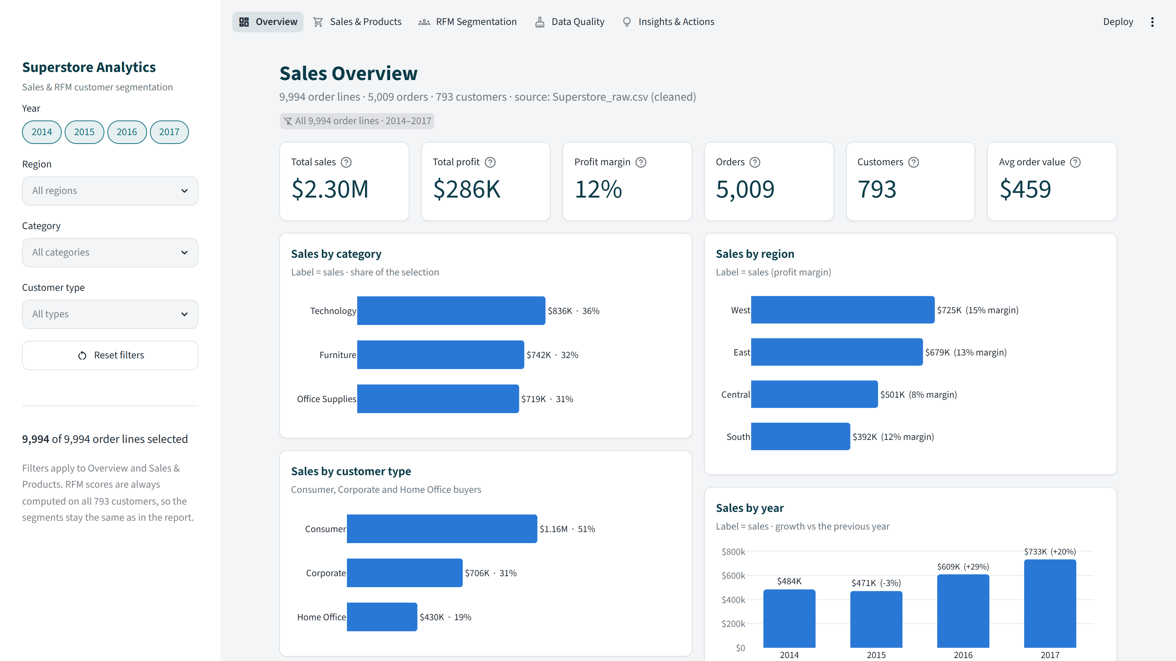
Interactive Dashboard
12
A working Streamlit dashboard with five pages and live filters
1
Overview
KPIs, sales by category, region, customer type and year, monthly trend
2
Sales & Products
Trend explorer, sub-category profit, discounts, top products
3
RFM Segmentation
Scores, segments, R × F grid, customer map and list
4
Data Quality
Full cleaning log and check against the original file
5
Insights & Actions
Six findings with evidence and the action plan
Notes:
This is the Overview page of our dashboard, running live on localhost. The sidebar filters by year, region, category and customer type, and every KPI and chart updates. Demo: pick the West region and Technology to show sales change to $252K. Run it with run_dashboard.bat or: cd dashboard, python -m streamlit run app.py.

Slide 14
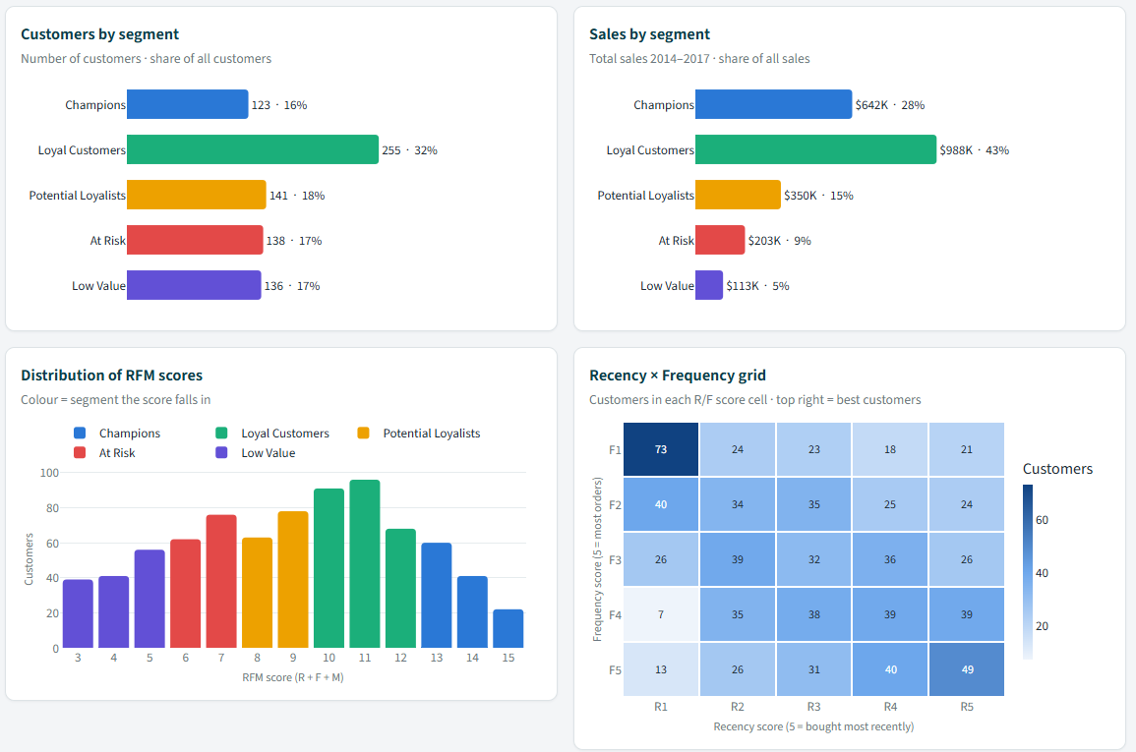
Dashboard: RFM Page
13
Segments, scores and individual customers in one place
Segment charts
Customers and sales per segment, RFM score distribution
R × F grid
How many customers sit in each Recency / Frequency cell
Customer map
Recency vs spend for every customer; highlight one segment
Customer list
Search any customer and download the scored list as CSV
Notes:
The RFM page shows the five segments, the share of sales they bring, how scores are distributed and the Recency × Frequency grid. Below these, the customer map plots every customer by days since last order and total spend, and the customer list lets marketing search a customer and export the scored list.

Slide 15
Key Findings & Next Steps
14
Turning the analysis into marketing decisions
01
CUSTOMER VALUE
02
GROWTH & SEASONALITY
NEXT STEPS
Validate segments with K-Means clustering on R, F and M
Customer lifetime value (CLV) per segment
Track segment movement every quarter
Add profit to the scoring
48% of customers bring 71% of sales. Reward and keep Champions and Loyal Customers.
Sales +51% from 2014 to 2017 and 38% in Q4. Plan campaigns before the holidays.
03
PROFIT LEAKS
04
RETENTION
Discounts above 20% lost $135K; Tables and Bookcases lose money. Cap offers at 20%.
274 customers (35%) are At Risk or Low Value. Win back At Risk first.
Conclusion: sales analysis shows where revenue and profit come from; RFM shows whom to keep, grow or win back.
Notes:
To sum up: revenue depends on a small, valuable customer group; sales are growing with a strong Q4; heavy discounts and a few sub-categories leak profit; and a third of customers are drifting away. Next we will validate the segments with K-Means, estimate customer lifetime value, and track how customers move between segments.

