Slide 1
COMPILER CONSTRUCTION
Module I
Lecture-1
Introduction to Compilers
Neetu Narayan
ASET(CSE)

Slide 2
Module I:
Introduction of Compiler
Cousins of the Compiler
Phases of a Compiler
Grouping of Phases

Slide 3
Recommended Reading​
Textbooks: ​
Alfred V. Aho, Monica S. Lam, Ravi Sethi, Jeffrey D. Ullman, “Compilers: Principles Techniques and Tool”, Second Edition, Pearson Publication, 2007.​
​
A.A Putambekar, “Compiler Construction”, Technical Publications, 2009. ​
​
Reference Book: ​
Des Watson, A Practical Approach to Compiler Construction, First Edition, Springer, 2017​

Slide 4
OBJECTIVES
After completing this section, you will be able to
1 Understand the working of compiler.
1.2 Understand the different phases of compiler.

Slide 5
Module Assessment​
Quiz (Conceptual and Numerical Based)
​
Assignment

Slide 6
Translator
It is a program that takes as input a program written in one programming language i.e. the source program and translates into an equivalent program in another language i.e. the target language.
Source program Target program
Compiler is a translator.
Translator

Slide 7
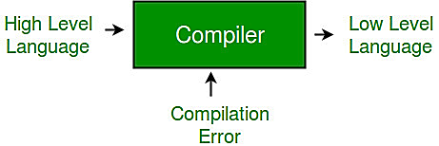
Compiler
Compiler is a software which converts a program written in high level language (Source Language) to low level language (Object/Target/Machine Language).

Slide 8
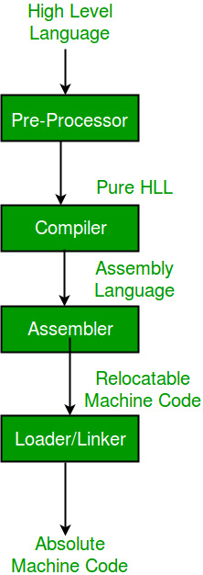
Language processing systems (using Compiler)

Slide 9

Cousins of Compiler(other translators)
Interpreter: It is program that executes other programs. Instead of producing a target program as a translation, it executes a source program statement by statement.
It is slower than Compiler but provides better error diagnostic than Compiler

Slide 10
Cousins of Compiler(other translators)
Preprocessor : It translates programs written in one high level language into another high level language program.
Assembler: It translates assembly language program into machine language program

Slide 11
Structure of a Compiler
Compilation process is a complex process, so it is partitioned into a series of sub processes called Phases.
Phases: A phase is logically an operation which takes as input one representation of source program and produces as output another representation.
There are six different phases of compiler.

Slide 12
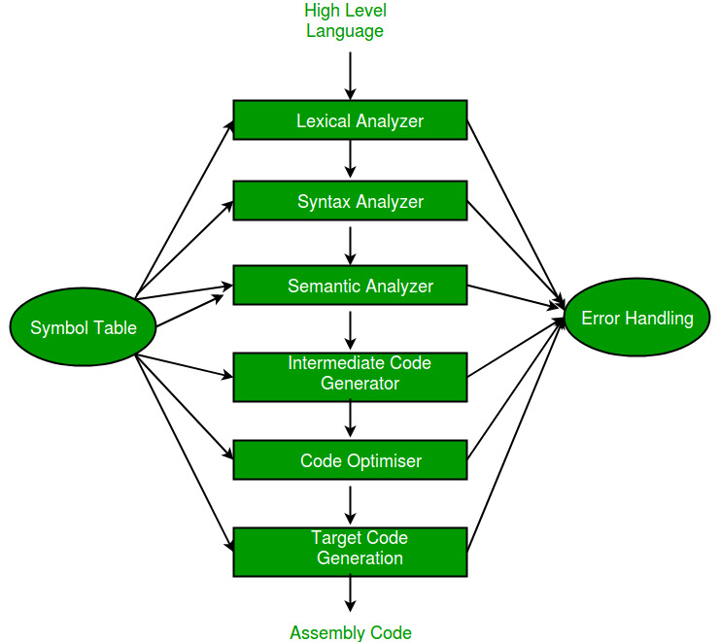
Structure of a Compiler

Slide 13
Analysis-Synthesis model of Compiler
We basically have two parts of compilers:
Analysis part
Synthesis part.
Analysis phase creates an intermediate representation from the given source code.
Lexical Analyzer
Syntax Analyzer
Semantic Analyzer
2. Synthesis phase creates an equivalent target program from the intermediate representation.
Intermediate Code Generator
Code Optimizer
Code Generator

Slide 14
Grouping of Phases
Phases of Compiler are grouped into two:
Front End
Back End
Front End : It consists of those phases or parts of phases that primarily depends on the source language and are independent of the target machine. It includes lexical, syntax analysis, creation of symbol table, semantic analysis and generation of intermediate code. It also includes error handling which goes along with each of these phases.
Back End: It includes those phases or parts of phases that depend on the target machine and independent of the source language. It includes intermediate code generation, code optimization, code generation along with the necessary error handling and symbol table operations.

Slide 15
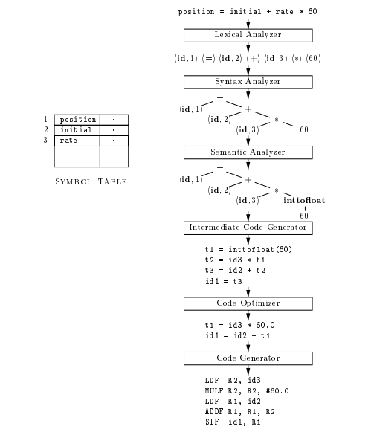
Example

Slide 16
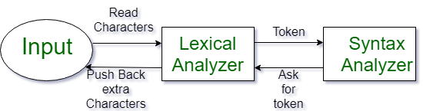
Introduction of Lexical Analysis
Lexical Analysis is the first phase of the compiler also known as a scanner. Its main task is to read the input characters and produce a sequence of tokens that the parser(next phase) uses for syntax analysis.
Lexical Analysis can be implemented with the Deterministic finite Automata.
The output is a sequence of tokens that is sent to the parser for syntax analysis.

Slide 17
Some Important terms:
Pattern: It is a rule which describes a set of lexemes that can represent a particular token in the source program. For eg.- an identifier can be described as a letter followed by letters or digit.
Lexeme: Lexemes are the smallest logical units of a program. It is a sequence of characters present in the source program for which a token is produced. For eg.- 10, int, + , etc
Token: It is a sequence of characters that can be treated as a unit in the grammar of the programming languages.
Classes of similar lexemes are identified by the same token.
For eg: identifier, keyword, operator, constant, delimeter , etc.

Slide 18
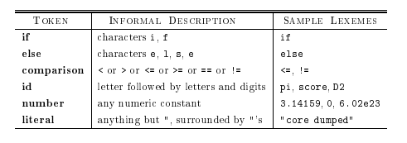
Introduction of Lexical Analysis
Token may have two things: <token-name, token value>
token-name is the type and token value points to an entry in the symbol table for the token.
Example of Non-Tokens:
Comments, preprocessor directive, macros, blanks, tabs, newline, etc.

Slide 19
Symbol Table in Compiler
Symbol Table is an important data structure created and maintained by the compiler in order to keep track of semantics of variable i.e. it stores information about scope and binding information about names, information about instances of various entities such as variable and function names, classes, objects, etc.
It is built in lexical and syntax analysis phases.
The information is collected by the analysis phases of compiler and is used by synthesis phases of compiler to generate code.
It is used by compiler to achieve compile time efficiency.

Slide 20
Symbol Table in Compiler
Items stored in Symbol table:
Variable names and constants
Procedure and function names
Literal constants and strings
Compiler generated temporaries
Labels in source languages
Information used by compiler from Symbol table:
Data type and name
Declaring procedures
Offset in storage
If structure or record then, pointer to structure table.
For parameters, whether parameter passing by value or by reference
Number and type of arguments passed to function
Base Address

Slide 21
Specification of Tokens(Pattern)
Regular expressions are an important notation for specifying patterns.
Regular expression is a grammar. It defines the rule. For the grammar, first we have to define the alphabet
An alphabet is a finite, non-empty set of symbols
We use the symbol ∑ (sigma) to denote an alphabet
Examples:
Binary: ∑ = {0,1}
All lower case letters: ∑ = {a,b,c,..z}
digits ∑ = {0-9}

Slide 22
Regular Expression
A string or word is a finite sequence of symbols chosen from ∑
Empty string is ε (or “epsilon”)
Length of a string w, denoted by “|w|”, is equal to the number of (non- ε) characters in the string
E.g., x = 010100 |x| = 6
x = 01 ε 0 ε 1 ε 00 ε |x| = ?
xy = concatentation of two strings x and y

Slide 23
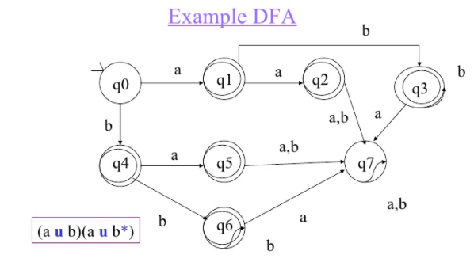
Example of Minimization of DFA

Slide 24

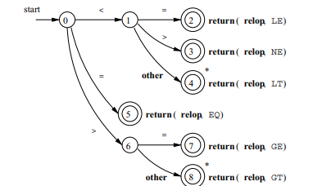
Transition diagram for Different types of Tokens
Identifiers:
Relational Operator

Slide 25

Transition diagram for Different types of Tokens
3. Keyword

Slide 26
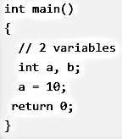
Introduction of Lexical Analysis
Example 1:
Valid Tokens: 'int' 'main' '(' ')' '{' 'int' 'a' ',' 'b' ';' 'a' '=' '10' ';' 'return' '0' ';' '}'

Slide 27
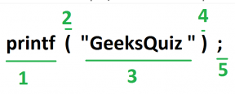
Introduction of Lexical Analysis
Example 2:
Example 3: int max(int i);
Lexical analyzer first read int and finds it to be valid and accepts as token
max is read by it and found to be a valid function name after reading (
int is also a token , then again i as another token and finally ;
Answer: Total number of tokens 7: int, max, ( ,int, i, ), ;
→ There are 5 valid token in this printf statement.

Slide 28
Scanning the Input
The lexical analyzer scans the input from left to right one character at a time.
It uses two pointers
begin ptr(bp):lexeme begin pointer and
forward ptr(fp) to keep track of the pointer of the input scanned.
Initially both the pointers point to the first character of the input string
This reading of characters from secondary storage is very costly. Hence buffering technique is used. A block of data is first read into a buffer, and then second by lexical analyzer. there are two methods used in this context:
One Buffer Scheme and
Two Buffer Scheme.

Slide 29
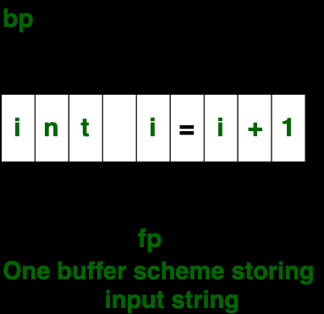
One Buffer Scheme
In this scheme, only one buffer is used to store the input string but the problem with this scheme is that if lexeme is very long then it crosses the buffer boundary, to scan rest of the lexeme the buffer has to be refilled, that makes overwriting the first of lexeme.

Slide 30
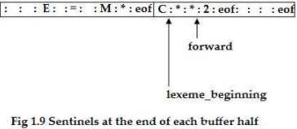
Two Buffer Scheme
To overcome the problem of one buffer scheme, in this method two buffers are used to store the input string. the first buffer and second buffer are scanned alternately. When end of current buffer is reached the other buffer is filled. To identify the boundary of first buffer, end of buffer character should be placed at the end first buffer.
Similarly end of second buffer is also recognized by the end of buffer mark present at the end of second buffer. when fp encounters first eof, then one can recognize end of first buffer and hence filling up second buffer is started. in the same way when second eof is obtained then it indicates of second buffer. alternatively both the buffers can be filled up until end of the input program and stream of tokens is identified. This eof character introduced at the end is calling Sentinel which is used to identify the end of buffer.

Slide 31
LEX
Lex is a program that generates lexical analyzer. It is used with YACC parser generator.
The lexical analyzer is a program that transforms an input stream into a sequence of tokens.
It reads the input stream and produces the source code as output through implementing the lexical analyzer in the C program.
The function of Lex is as follows:
Firstly lexical analyzer creates a program lex.1 in the Lex language. Then Lex compiler runs the lex.1 program and produces a C program lex.yy.c.
Finally C compiler runs the lex.yy.c program and produces an object program a.out.
a.out is lexical analyzer that transforms an input stream into a sequence of tokens.

Slide 32
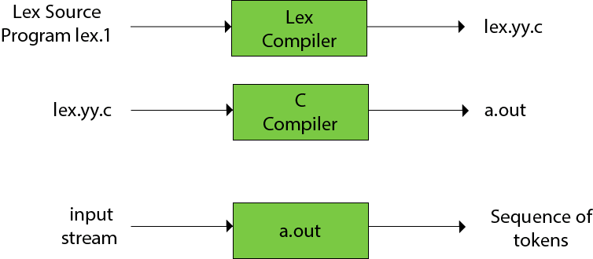
LEX

Slide 33
Bootstrapping
Bootstrapping is widely used in the compilation development.
Bootstrapping is used to produce a self-hosting compiler. Self-hosting compiler is a type of compiler that can compile its own source code.
Bootstrap compiler is used to compile the compiler and then you can use this compiled compiler to compile everything else as well as future versions of itself.
A compiler can be characterized by three languages:
Source Language
Target Language
Implementation Language

Slide 34
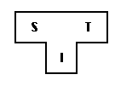


Bootstrapping
The T- diagram shows a compiler ^{S}C_{I}^{T} for Source S, Target T, implemented in I.
Follow some steps to produce a new language L for machine A:
Create a compiler ^{S}C_{A}^{A} for subset, S of the desired language, L using language "A" and that compiler runs on machine A.
Create a compiler ^{L}C_{S}^{A} for language L written in a subset of L.

Slide 35
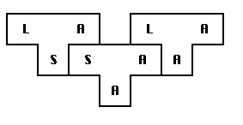
Bootstrapping
3. Compile ^{L}C_{S}^{A} using the compiler ^{S}C_{A}^{A} to obtain ^{L}C_{A}^{A}. ^{L}C_{A}^{A} is a compiler for language L, which runs on machine A and produces code for machine A.

Slide 37


