Slide 1
AI Movie Studio Creator
Project-Based Assessment: Domain-Specific Generative AI Chatbot
Presented by: [Your Name]

Slide 2
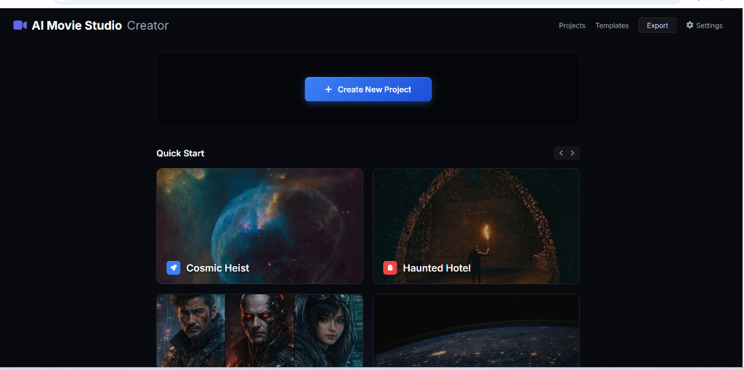
Project Overview & Objectives
Goal: Solve real-world creative bottlenecks using Generative AI.
Domain: Film Concept Development & Screenwriting.
Innovation: Automating the 'Blank Page' problem for storytellers.
Societal Impact: Democratizing film-making tools for indie creators.

Slide 3
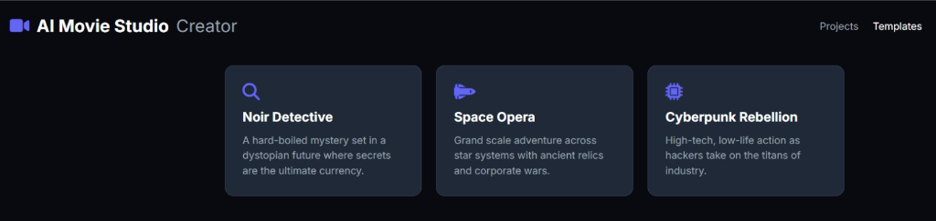
Domain Selection & Specificity
Focus: Tailored for screenwriters and producers.
Originality: Domain-specific templates (Noir, Space Opera, Cyberpunk).
Logic: Uses narrative structures (Hero's Journey, Conflict/Resolution).
Constraints: Strictly filtered for movie-related queries only.

Slide 4
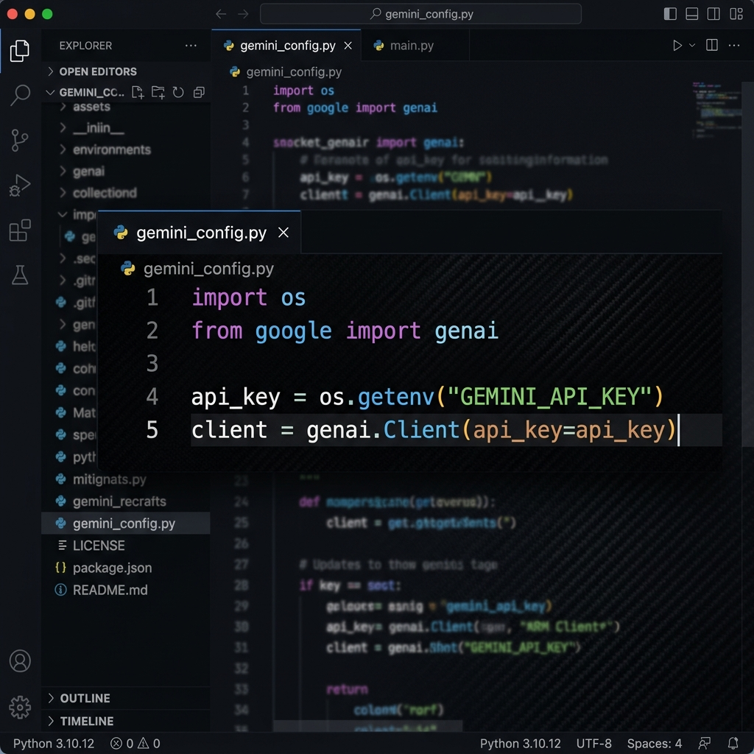
API & Security Configuration
Engine: Powered by Google Gemini GenAI APIs.
Security: Managed via Environment Variables (.env).
Performance: Low-latency responses with fallback mock data.
Integration: Python Backend (FastAPI) + Google GenAI Client.

Slide 5
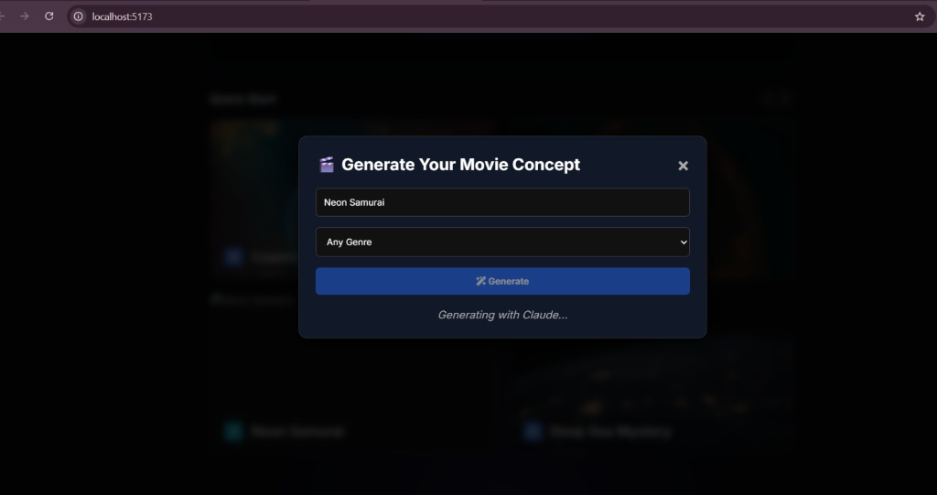
User-Centric Concept Design
Interactive Modals: Streamlined input for story ideas.
Genre Control: Dynamic prompt building based on selection.
Accessibility: Simple, intuitive UI for high-speed brainstorming.

Slide 6
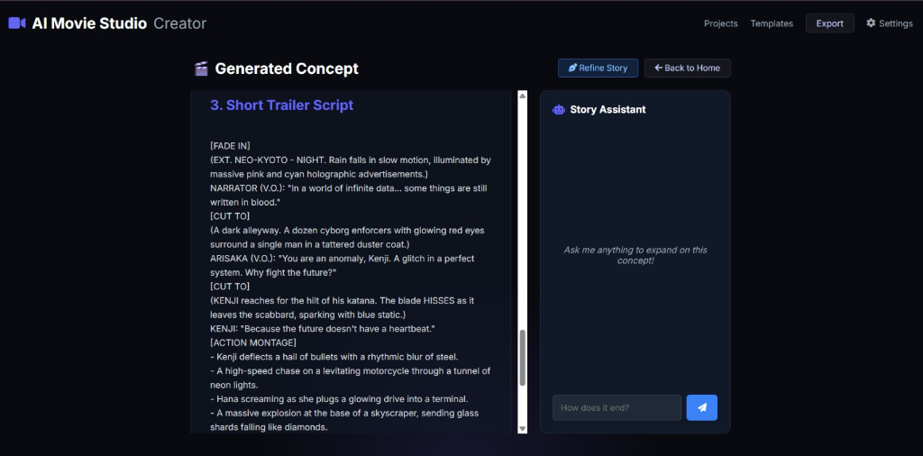
AI-Driven Storytelling
Core Output: Title, Plot Summary, Characters, and Trailer Scripts.
Story Assistant: Context-aware chat for real-time refinement.
Transparency: Users can view the model's logic and constructed prompt.

Slide 7
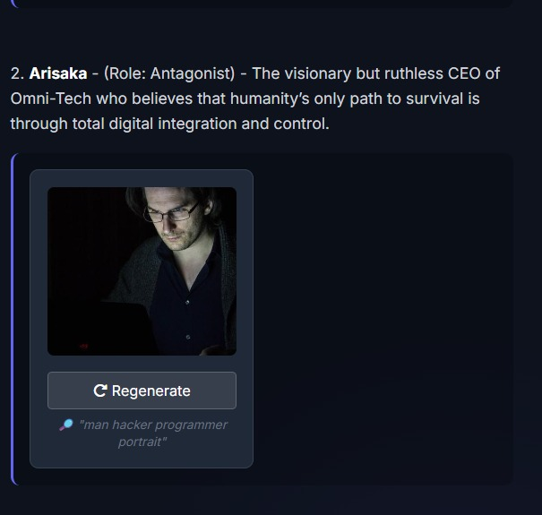
Multi-modal Concept Assets
Visuals: AI-generated character portraits and mood boards.
Audio: Narrated trailer previews powered by ElevenLabs.
Innovation: A one-stop studio for script and production prep.

Slide 8
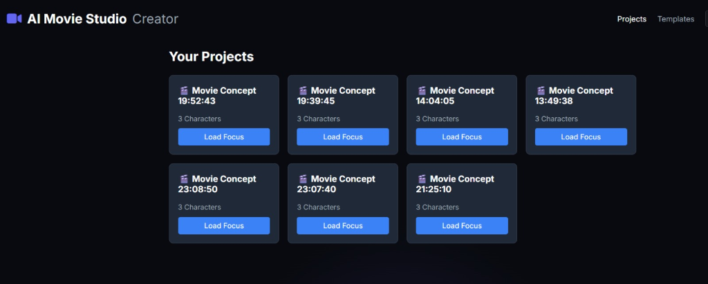
Project Management & State
Consistency: Persistent project storage with metadata.
Quick Start: Pre-defined industry-standard templates.
Scalability: Easily add new genres and model instructions.

Slide 9
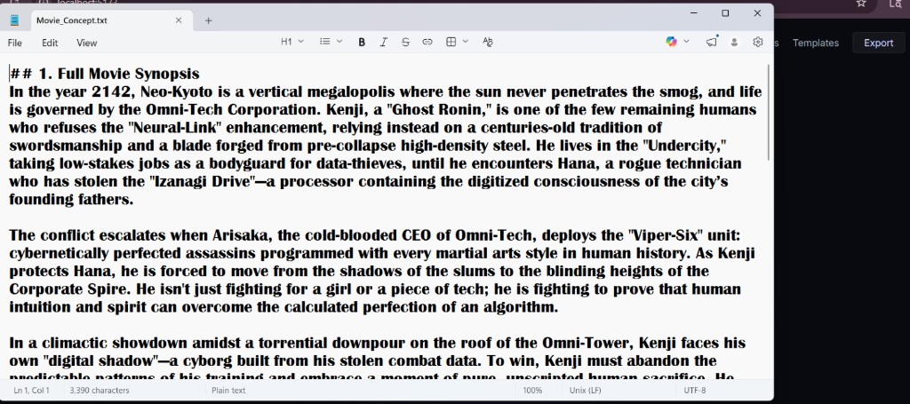
Deliverables & Output
Export: Full scripts downloadable as .txt for production.
Prototypes: Fully functional web app (Vite + FastAPI).
Documentation: Structured reports and presentation slides.

Slide 10
Evaluation Rubrics
1. Problem ID & Innovation (10 Marks): Clarity, Originality, Impact.
2. Technical Execution (10 Marks): API Design, Prompt Engineering.
3. Presentation & Q&A (10 Marks): Demo effectiveness, Depth of insight.
Total Score: 30 Marks

