Slide 1
Crowdfunding Platform For Entrepreneurs and Innovators with Transparent Wallet-Based Transactions
Batch No: 48
Team Members:
Sanjana B (211521205133)
Sara Pricilla A (211521205138)
Swetha E V (211521205163)
Guided By:
Mrs M.Ramya M.E.,
Assistant Professor
Department of Information Technology
Panimalar Institute Of Technology

Slide 2
Abstract
Unifies crowdfunding and joint ventures.
Built using React.js, Express.js, Tailwind CSS, Bootstrap, MySQL.
Nodemailer with SMTP is used for email .
Provides domain-based investment analytics.
Improves funding efficiency and transparency.

Slide 3
Introduction
Connects entrepreneurs with global investors.
Offers a secure, scalable web-Based platform.
Enables real-time chat and funding.
Includes verification ,updates & fund tracking.
Promotes inclusive joint venture models.

Slide 4
Existing System
Most platforms separate crowdfunding and joint ventures.
Basic matching limits meaningful inventor-investor connections.
Verification and transparency features are often missing.
Lack of proof uploads reduces project credibility.
Domain-based analytics are rarely provided to users.

Slide 5
Proposed System
Built with React, Tailwind, and Bootstrap UI.
Express.js and MySQL power the backend.
JWT, encryption, sessions ensure data security.
Supports onboarding, uploads for proof, analytics, negotiations.
Nodemailer with SMTP handles email notifications.

Slide 6
Literature Survey
S. No | Year | Title | Author | Methodology | Merits | Demerits
1. | 2024 | Designing a Funding Platform for Startup and Investor Evolving Needs in the Entrepreneurial Ecosystem: The Orange Mill-A Case Study’, MS thesis, University of Twente. | Smit, K. | Case study analysis focusing on platform design tailored to startup and investor needs. | Provides practical insights by examining real-world entrepreneurial ecosystem dynamics. | Findings may have limited generalizability beyond the specific case studied.
2. | 2023 | ‘Innovative Funding Platforms for Startups: Enhancing Investor Engagement and Startup Growth’, Post-Print. | Nguyen and Park. | Post-print analysis of innovative funding models and their impact on startup-investor interactions. | Highlights modern strategies to boost investor engagement and accelerate startup growth. | Lacks implementation-specific details, making practical application more challenging.

Slide 7
Literature Survey
S. No | Year | Title | Author | Methodology | Merits | Demerits
3. | 2022 | Evaluating Startups: The Role of Resource Providers’ Experience in Funding Decisions’, Post-Print. | Kim and Lee | Post-print evaluation using empirical analysis of funding decisions based on resource providers' experience. | Reveals how investor experience influences the evaluation and selection of startups. | May not account for platform-specific or sector-specific variations in funding behavior.
4. | 2021 | Start-up Subsidies and the Sources of Venture Capital’, Journal of Business Venturing Insights, Vol. 16, pp. e00272. | Berger, M. and Hottenrott, H. | Quantitative analysis examining the relationship between government start-up subsidies and venture capital sources. | Provides empirical evidence on how public funding influences access to private venture capital. | May not fully capture long-term startup performance or regional policy differences.

Slide 8
System Requirements
Hardware Requirements
Processor: Intel i5 or AMD equivalent
RAM: 8 GB minimum
Storage: SSD with at least 256 GB free space.
Software Requirements
Nodejs with expressjs
MySQL Workbench
Nodemailer with SMTP
Reactjs,Tailwind css,Bootsrap

Slide 9
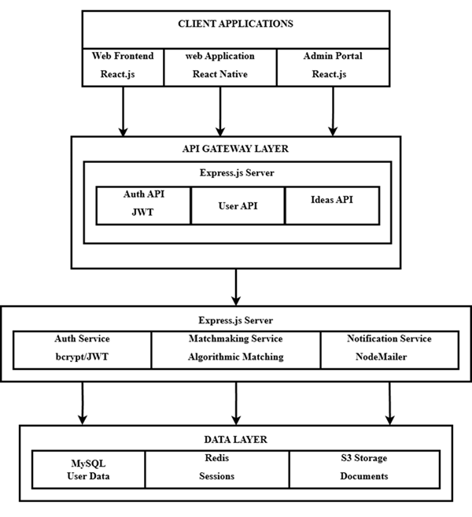
System Architecture

Slide 10
Module 1:Secure Authentication and Role Differentiation
Users are assigned specific roles such as investor, creator, or admin.
Login is secured using JSON Web Tokens (JWT) to authenticate and authorize users.
Passwords are encrypted using bcrypt before storing in the database for security.
Sessions are validated to maintain secure access throughout user interaction.
Unauthorized role access is blocked with redirection or appropriate error messages.

Slide 11
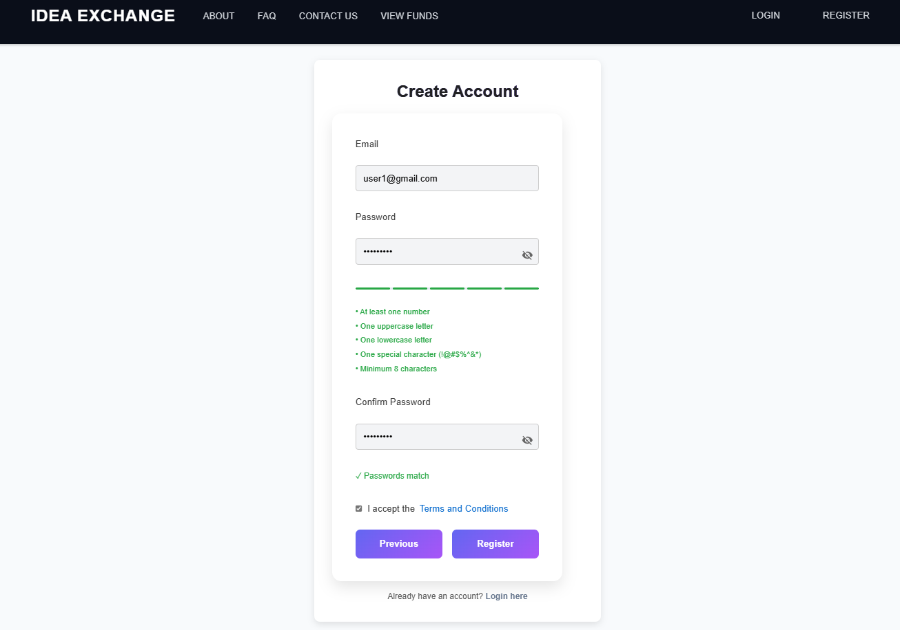

Slide 12
Module 2:Dashboard Setup for Investors
Investors have access to dashboard displaying their investment and project interests.
The dashboard presents summaries of funded projects, ongoing campaigns.
Visual elements like charts help track investment and domain-wise distributions.
Notifications related to project milestones or funding status are shown in real time.
An intuitive layout ensures easy navigation and quick access to information.

Slide 13
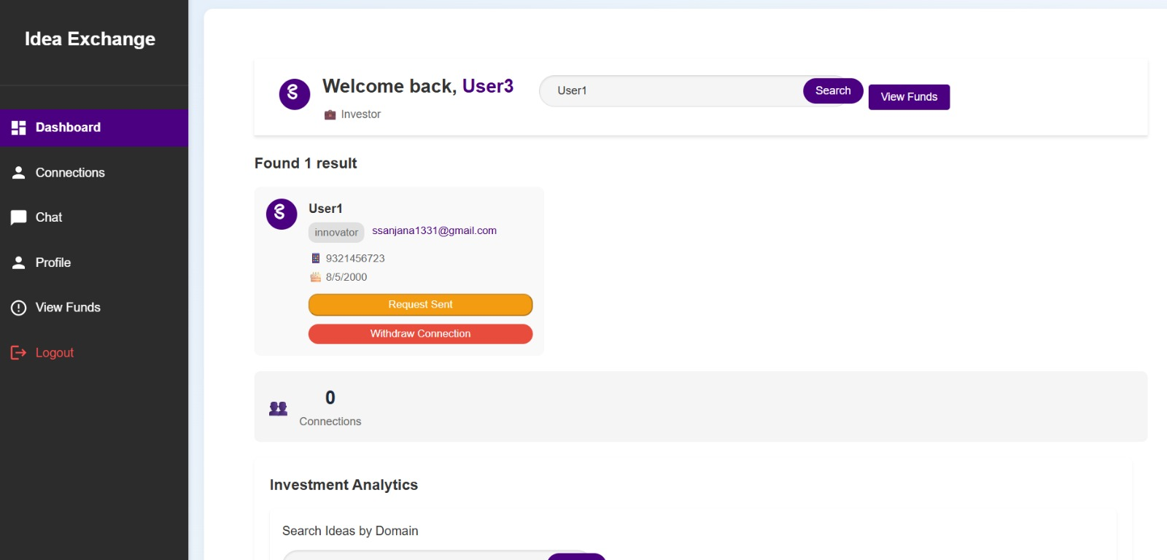

Slide 14
Module 3:Dashboard Setup for Innovators
Innovators have a dedicated dashboard to track their submitted projects.
Displays funding progress, number of investors, and remaining target amount.
Allows uploading of proof documents to enhance project credibility.
Shows real-time updates on investor interest and domain-specific engagement.
Provides easy access to edit project details, respond to investor queries, and monitor feedback.

Slide 15
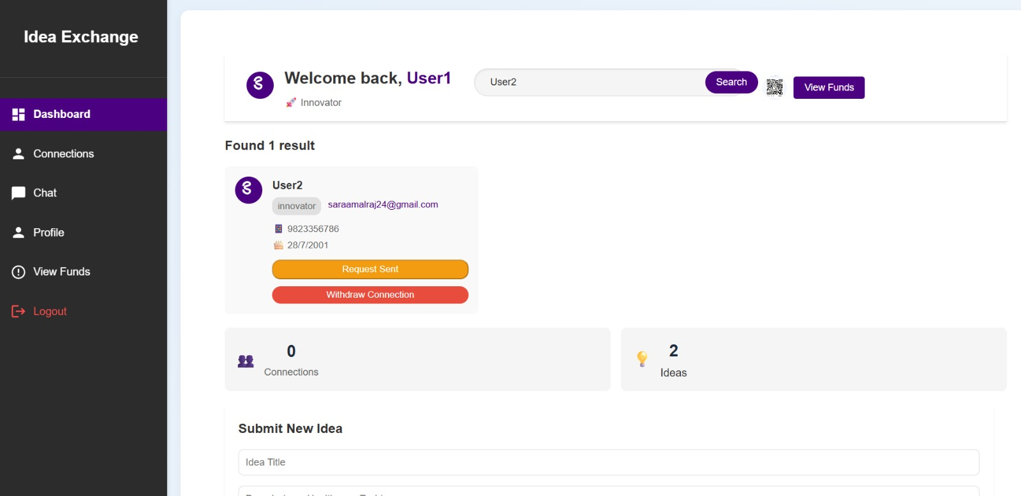

Slide 16
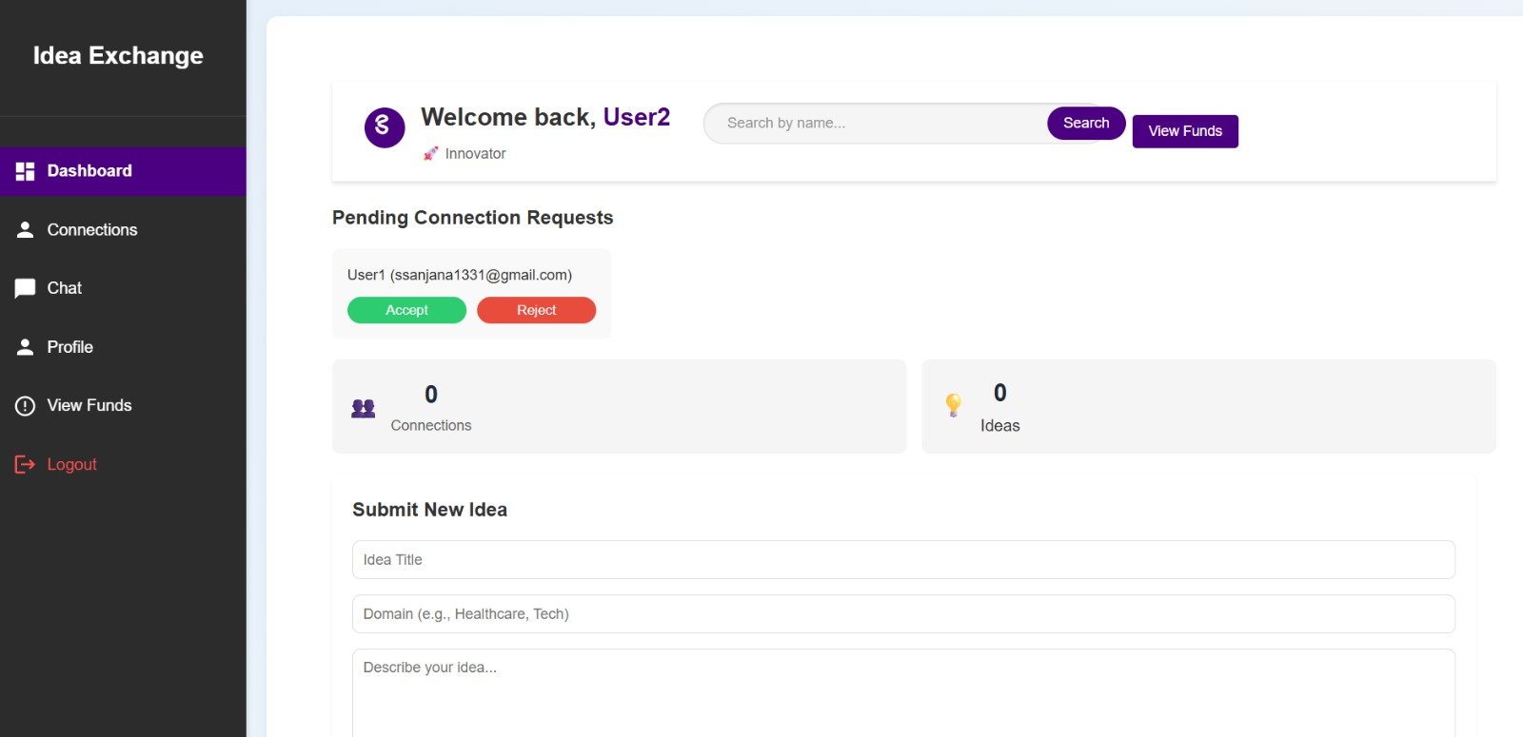

Slide 17
Module 4:Analytical Tools for Decision Support
Displays domain-wise analysis to help investors understand which sectors are receiving more interest.
Provides insights into funding status and creator credibility based on uploaded proof.
Helps investors compare multiple projects using visual aids like graphs indicators.
Tracks overall investment patterns and trends to support informed decision-making.
Offers data-driven suggestions tailored to investor preferences and past activity.

Slide 18
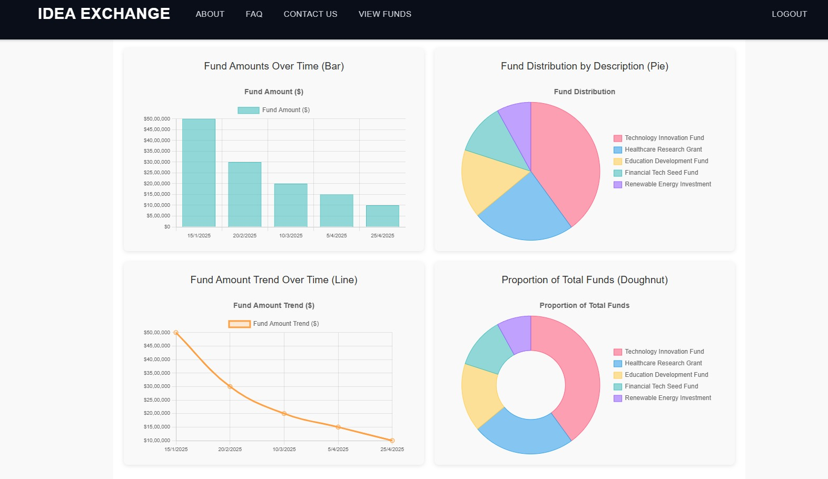

Slide 19
Module 5:Session Handling and Reliability
Maintains active user sessions securely using JWT tokens to prevent unauthorized access.
Automatically expires sessions after a set time of inactivity to enhance security.
Ensures seamless user experience with session persistence across navigation.
Handles logout and session invalidation properly to prevent misuse.
Displays appropriate messages when sessions expire or access is restricted.

Slide 20
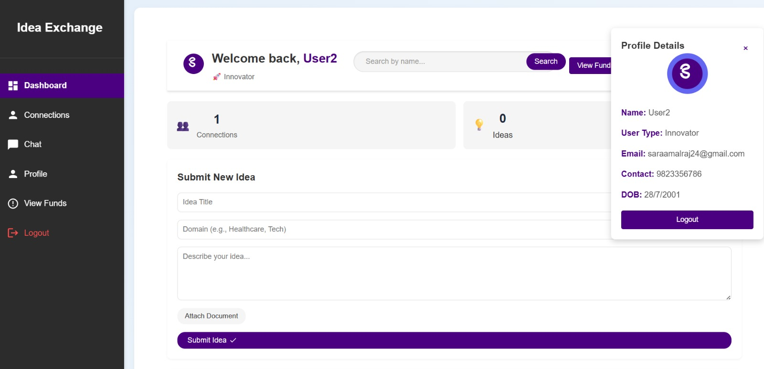

Slide 21
Module 6:Platform Responsiveness and User Feedback
Ensures consistent performance across devices and screen sizes.
Uses frameworks like Tailwind CSS and Bootstrap for smooth layout transitions.
Real-time feedback through toasts or alerts improves user interaction and clarity.
Quick loading times and minimal lag enhance overall user satisfaction.
Feedback forms are available for continuous platform improvement.

Slide 22
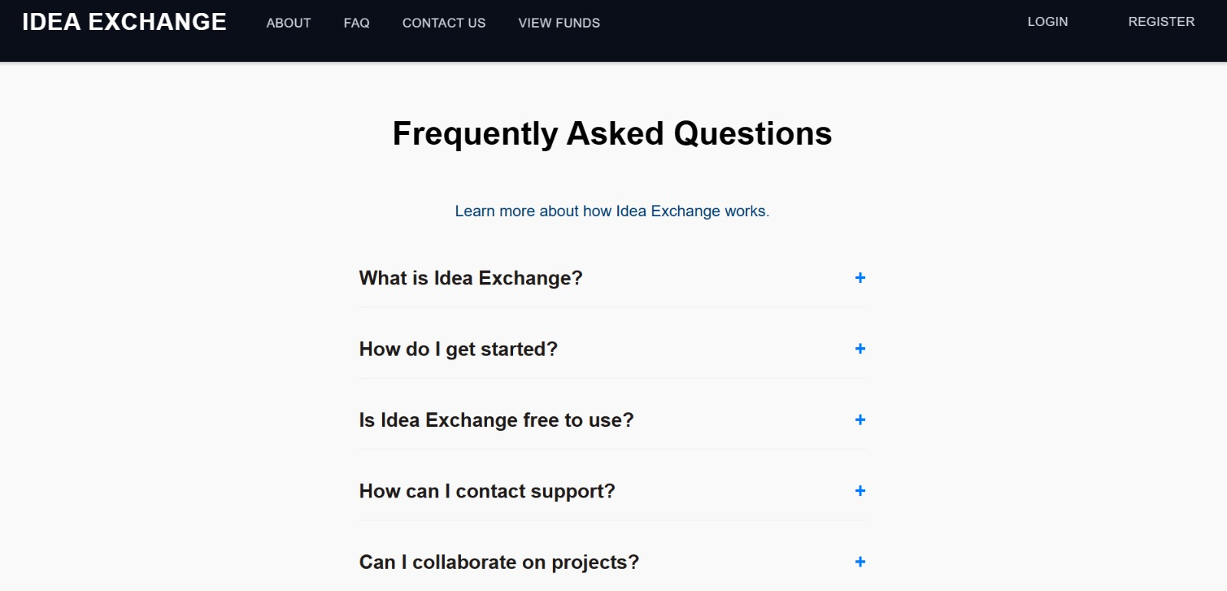

Slide 23
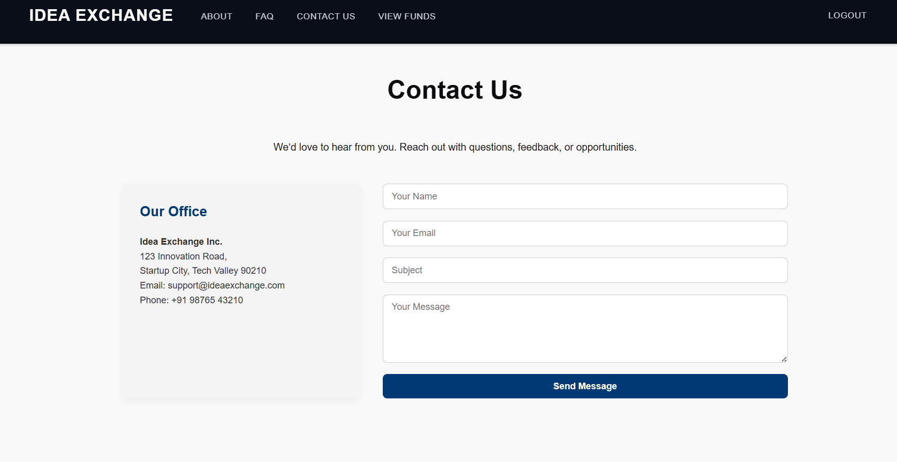

Slide 24
Module 7:Enhancing Credibility and Usability
Allows creators to upload valid proof documents to establish project authenticity.
Displays verification indicators or badges for trustworthy campaigns.
Clean, user-friendly interface simplifies navigation and boosts usability.
Clear labeling and guided workflows help users understand each step of the process.
Transparent project details and funding statistics build trust with investors.

Slide 25
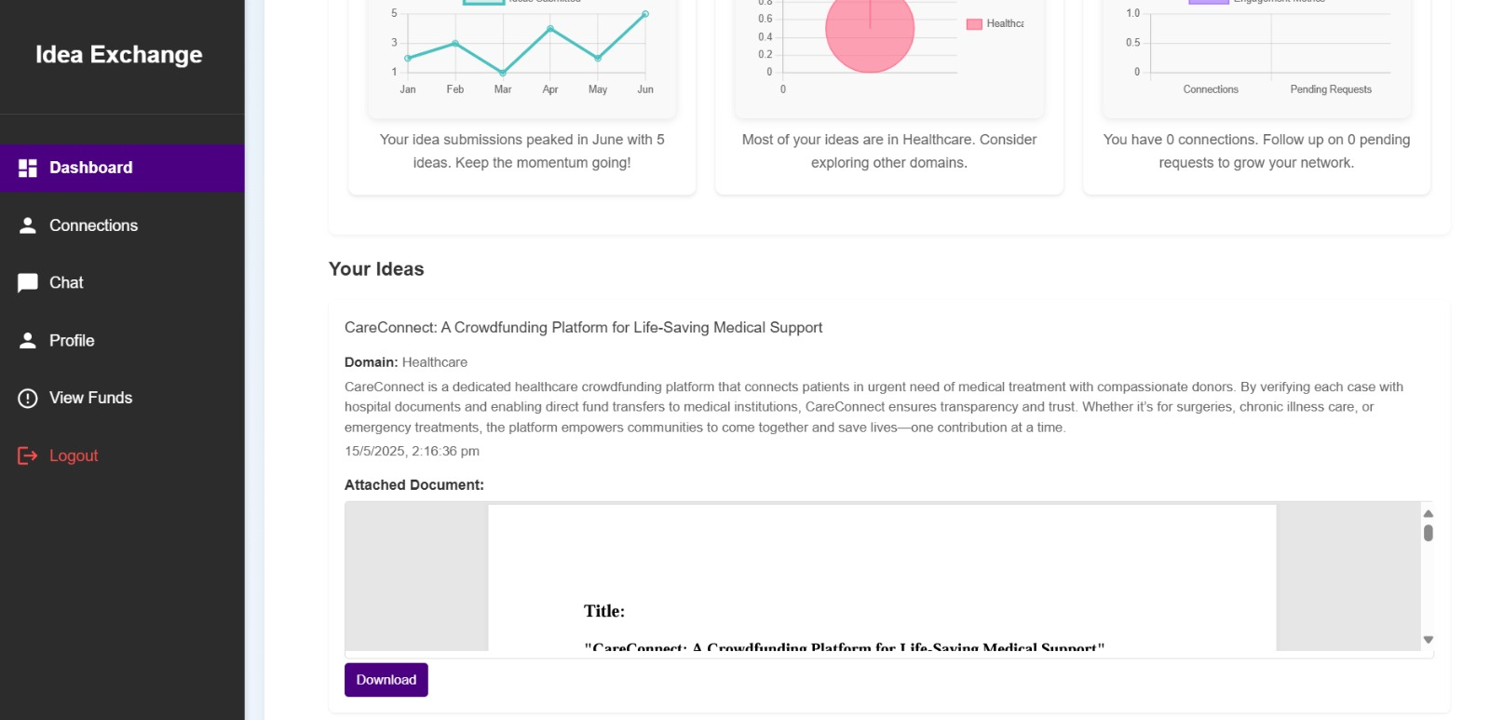

Slide 26
Source Code
app.post('/api/payments', authenticateUser, async (req, res) => {
const { receiver_id, amount, password } = req.body; console.log('Payment request:', { sender_id: req.user.userId, receiver_id, amount }); if (!receiver_id || !amount || amount <= 0 || !password) {
return res.status(400).json({ success: false, message: 'Receiver ID, valid amount, and password are required', errorCode: 'MISSING_FIELDS' });
}
const isValid = await bcrypt.compare(password, users[0].password);
if (!isValid) {
return res.status(401).json({ success: false, message: 'Invalid password', errorCode: 'INVALID_PASSWORD' });
}
const [connection] = await pool.query(
'SELECT * FROM connections WHERE (user1_id = ? AND user2_id = ?) OR (user1_id = ?

Slide 27
AND user2_id = ?)',
[req.user.userId, receiver_id, receiver_id, req.user.userId]);
if (connection.length === 0) {
return res.status(403).json({ success: false, message: 'Users are not connected', errorCode: 'NOT_CONNECTED' });
}
const [receiver] = await pool.query('SELECT user_type FROM users WHERE id = ?', [receiver_id]);
if (receiver.length === 0) {
return res.status(404).json({ success: false, message: 'Receiver not found', errorCode:
'RECEIVER_NOT_FOUND' });
}
if (receiver[0].user_type !== 'innovator') {
return res.status(403).json({ success: false, message: 'Payments can only be made to innovators',

Slide 28
errorCode: 'INVALID_RECEIVER' });}
const [result] = await pool.query(
'INSERT INTO payments (sender_id, receiver_id, amount) VALUES (?, ?, ?)’,
[req.user.userId, receiver_id, amount]); res.json({
success: true,
payment_id: result.insertId,
message: 'Payment recorded successfully',});
} catch (error) {
console.error('Record payment error:', error);
res.status(500).json({ success: false, message: 'Failed to record payment', errorCode: 'SERVER_ERROR' });
}
});

Slide 29

Output-Landing Page

Slide 30
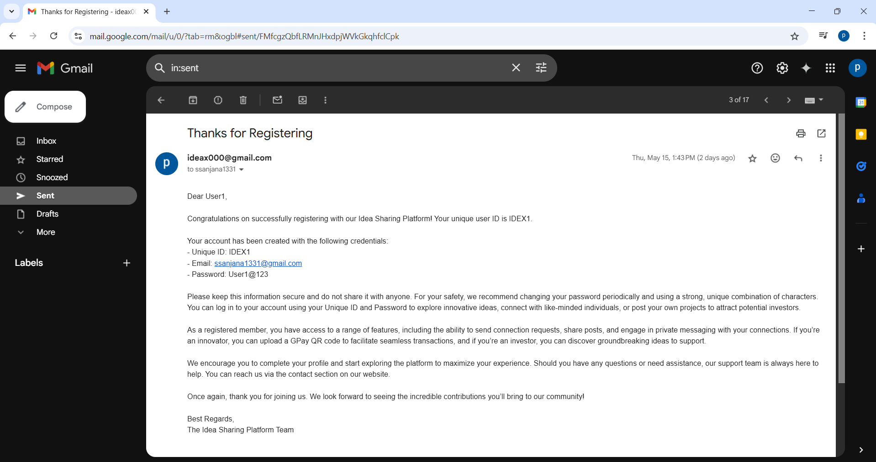
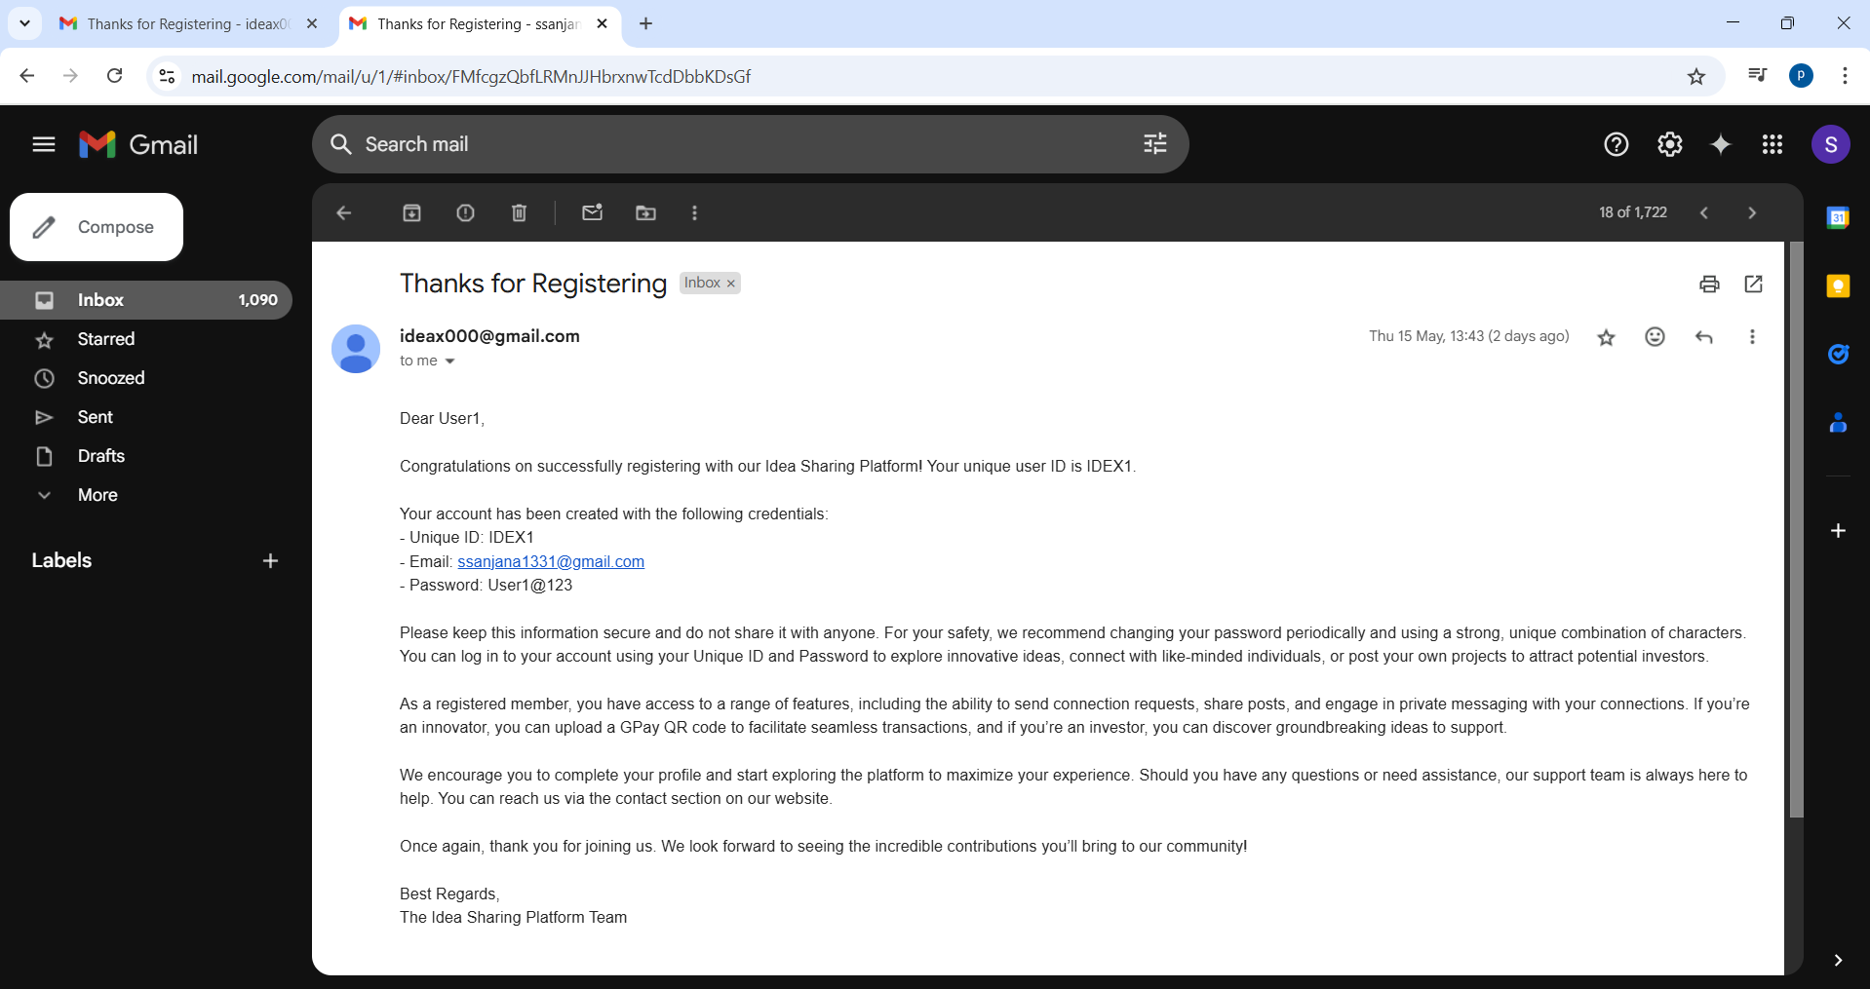
Email Authentication

Slide 31
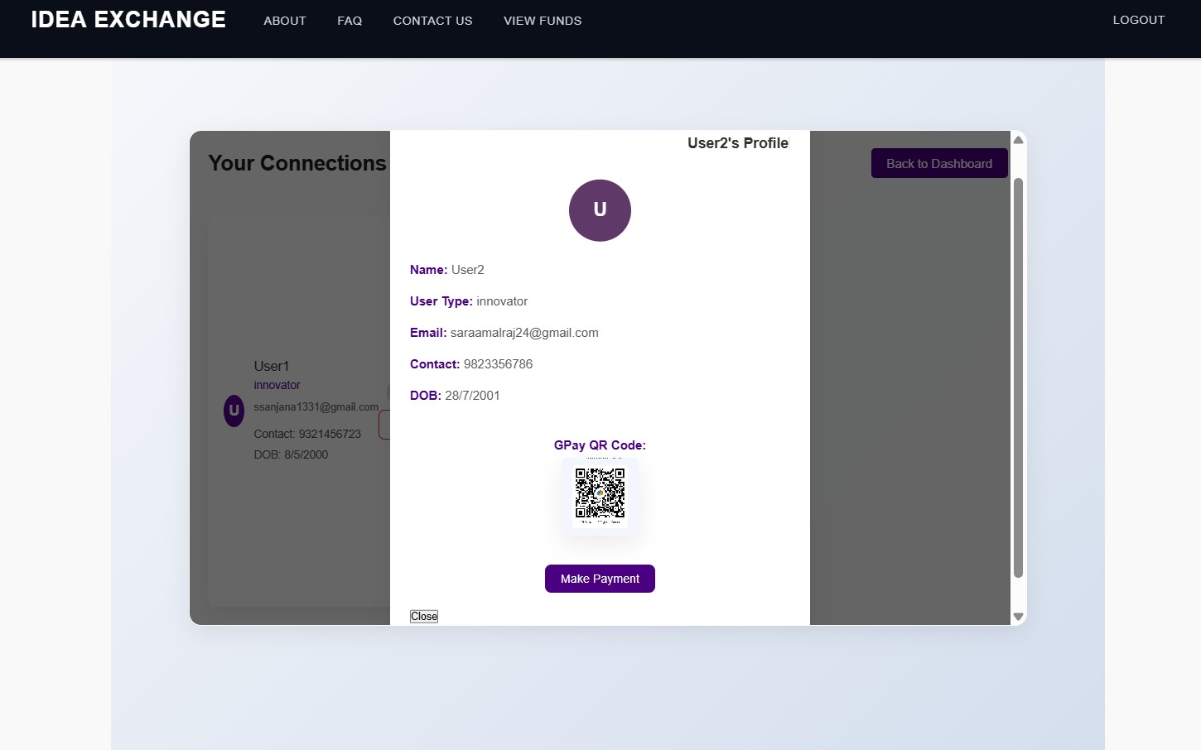
Payment Gateway

Slide 32
Conclusion
Bridges crowdfunding and joint venture investment models.
Built with React, Express, MySQL, and JWT security.
Supports onboarding, file uploads, domain-based analytics.
Secured with SMTP mailing for smooth communication.
Enables innovation with structured, inclusive interactions.

Slide 33
Future Enhancement
Add multi-language support to expand user accessibility.
Enable third-party payment gateway integration for secure transactions.
Introduce mobile application support for broader platform reach.

Slide 34
References
Liang, C. (2024) ‘The Impact of Open Source Communities on Financing Dynamics of Diverse Entrepreneurs’.
Lin, Y.K. and Maruping, L.M. (2022) ‘Open Source Collaboration in Digital Entrepreneurship’, Organization Science, Vol. 33, No. 1, pp. 212- 230.
Lutfiani, N., et al. (2022) ‘Artificial Intelligence Based on Recommendation System for Startup Matchmaking Platform’, 2022 IEEE Creative Communication and Innovative Technology (ICCIT), IEEE.
Martinez et al. (2024) ‘Maintaining Investor-Entrepreneur Relationships Post-Funding: An Institutional Perspective’, Post-Print.
Nguyen and Park. (2023) ‘Innovative Funding Platforms for Startups: Enhancing Investor Engagement and Startup Growth’, Post-Print.
Singh and Patel. (2024) ‘Open Source Contributions as Signals of Entrepreneurial Competence in Tech Startups’, Post-Print.
Smit, K. (2024) ‘Designing a Funding Platform for Startup and Investor Evolving Needs in the Entrepreneurial Ecosystem: The Orange Mill-A Case Study’, MS thesis, University of Twente.
Wesley II, C.L., et al. (2022) ‘Will the Startup Succeed in Your Eyes? Venture Evaluation of Resource Providers During Entrepreneurs' Informational Signaling’, Journal of Business Venturing, Vol. 37, No. 5, pp. 106229.
Xiao, Y., et al. (2025) ‘Institutional Logics and the PostFinancing Relationship Between Investors and Entrepreneurs’, Journal of Management Studies, (2025).
Zhao and Wang. (2023) ‘Collaborative Financing Models in Early-Stage Ventures: Bridging Public and Private Capital’, Post-Print.

Slide 35
Thank you

