Slide 1
SANJANA B(211521205133) B.Tech IT Panimalar Institute of Technology
Naan Mudhalvan - GenerativeAI
Final Project
3/21/2024 Annual Review

Slide 2
PROJECT TITLE Handwritten Digit Recognition using CNN Handwritten digit recognition using Convolutional Neural Networks (CNNs) involves loading the MNIST dataset, preprocessing the data, building a CNN model, training it on the dataset, and evaluating its performance. The CNN architecture typically consists of convolutional layers to extract features from the images, pooling layers to reduce dimensionality, and fully connected layers for classification. ReLU activation is commonly used in the hidden layers, and softmax activation in the output layer for multi-class classification. After training, the model is evaluated on a separate test set to measure its accuracy. Techniques such as data augmentation and hyperparameter tuning can be used to improve the model's performance.
3/21/2024 Annual Review

Slide 3


AGENDA # Problem Statement # Project Overview # Who are the end users? # Your solution and its value proposition # The wow in your solution # Modelling # Results # Conclusion
3/21/2024 Annual Review

Slide 4

PROBLEM STATEMENT The project aims to develop a Convolutional Neural Network (CNN) capable of classifying realistic handwritten digits from the MNIST dataset. The MNIST dataset consists of 28x28 grayscale images of handwritten digits (0-9), and the objective is to create a CNN that results in effective digit recognition.
3/21/2024 Annual Review

Slide 5

PROJECT OVERVIEW This project aims to develop a Convolutional Neural Network (CNN) model for recognizing handwritten digits. The model will be trained on the MNIST dataset, which consists of 28x28 grayscale images of handwritten digits (0-9). The CNN architecture will include convolutional layers to extract features, pooling layers to reduce dimensionality, and fully connected layers for classification. ReLU activation will be used for the hidden layers, and softmax activation for the output layer. The trained model will be evaluated on a separate test set to measure its accuracy. The project will also explore techniques to improve the model's performance, such as data augmentation and hyperparameter tuning.
3/21/2024 Annual Review

Slide 6

WHO ARE THE END USERS? The end users for handwritten digit recognition using Convolutional Neural Networks (CNNs) are diverse and include industries and applications where automated digit recognition is beneficial. This includes banking and finance for recognizing handwritten digits on checks, postal services for sorting mail based on handwritten zip codes, educational institutions for grading handwritten exams, and technology companies for developing handwriting recognition features in digital devices. Additionally, individuals interested in machine learning and computer vision may also utilize such models for personal projects or research purposes.
3/21/2024 Annual Review

Slide 7

YOUR SOLUTION AND ITS VALUE PROPOSITION The solution for handwritten digit recognition using Convolutional Neural Networks (CNNs) offers a robust and accurate method for automating the recognition of handwritten digits. By leveraging CNNs, the model can effectively learn and extract features from handwritten digits, enabling it to classify them with high accuracy. This solution provides value by streamlining processes that require digit recognition, such as digitizing handwritten documents, sorting mail based on handwritten zip codes, and automating grading of handwritten exams. It offers improved efficiency, accuracy, and cost-effectiveness compared to manual digit recognition methods, making it a valuable tool for industries and applications where digit recognition is essential.
3/21/2024 Annual Review

Slide 8

THE WOW IN YOUR SOLUTION The use of Convolutional Neural Networks (CNNs) for handwritten digit recognition offers a truly remarkable capability to accurately interpret and classify handwritten digits. This technology can transform traditional manual tasks, such as digitizing handwritten documents or grading exams, into seamless and automated processes. The CNN model's ability to learn intricate patterns and features from the input data, coupled with its high accuracy in digit recognition, showcases the power of deep learning in solving complex real-world problems. Its potential to significantly enhance productivity and efficiency in various industries is truly impressive, making it a groundbreaking solution in the field of machine learning and computer vision.
3/21/2024 Annual Review
8

Slide 9
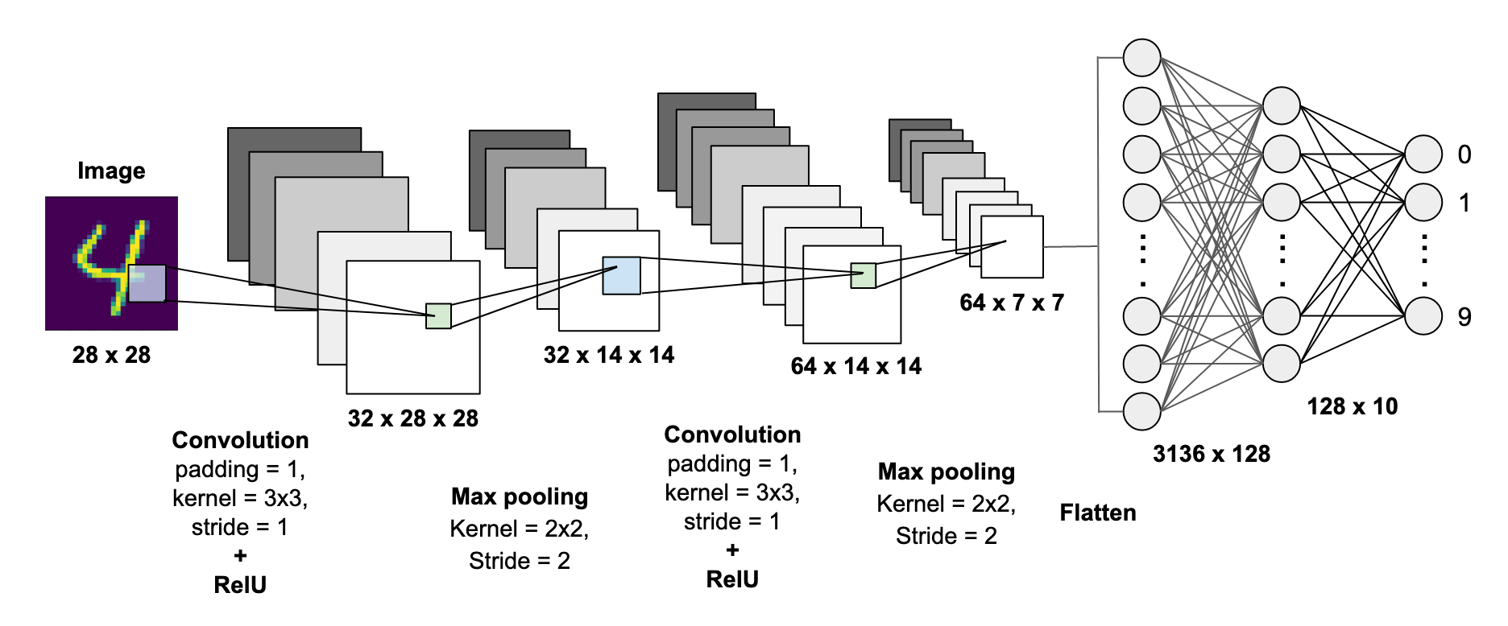
MODELLING
3/21/2024 Annual Review
9

Slide 10
MODELLING
Data Preparation: Load the MNIST dataset, which contains 28x28 grayscale images of handwritten digits (0-9). Preprocess the images by scaling the pixel values to a range of 0 to 1 and reshaping them to the required input shape for the CNN.
CNN Architecture Design: Design the CNN architecture, typically consisting of convolutional layers, pooling layers, and fully connected layers. Convolutional layers use filters to extract features from the input images, while pooling layers reduce the spatial dimensions. Fully connected layers perform the final classification based on the extracted features.
Model Compilation: Compile the CNN model with an appropriate optimizer (e.g., Adam) and a loss function (e.g., categorical crossentropy for multi-class classification).
3/21/2024 Annual Review
10

Slide 11
MODELLING
Model Training: Train the CNN model on the training dataset. During training, the model learns to classify digits by adjusting its weights based on the difference between predicted and actual labels.
Model Evaluation: Evaluate the trained model on a separate test dataset to measure its accuracy and performance. This step ensures that the model generalizes well to unseen data.
Hyperparameter Tuning: Experiment with different hyperparameters (e.g., learning rate, batch size) and model architectures to improve the model's performance.
Prediction: Use the trained model to make predictions on new handwritten digit images, demonstrating its ability to recognize digits accurately.
3/21/2024 Annual Review
11

Slide 12
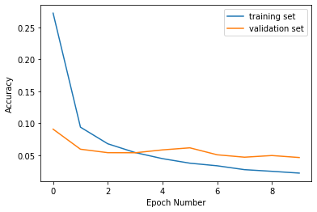
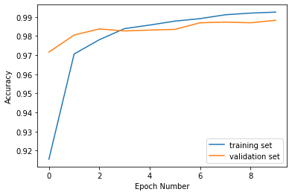
RESULTS Loss plot curve for training and validation Accuracy plot curve for training and validation Convolutional Neural Networks (CNNs) in Python achieved over 99% accuracy in classifying digits from the MNIST dataset, demonstrating their effectiveness. The model's performance was validated by visualizing the training history, showing decreasing loss and increasing accuracy over epochs, highlighting CNNs' power in recognizing handwritten digits for various applications.
Demo Link
3/21/2024 Annual Review
12

Slide 13
CONCLUSION Convolutional neural network (CNN, or ConvNet) can be used to predict Handwritten Digits reasonably.The model has been successfully developed for handwritten digit recognition with Python, Tensorflow, and Machine Learning libraries. Handwritten Digits have been recognized by more than 98.9% validation accuracy.
Demo Link
3/21/2024 Annual Review
13

