Slide 1
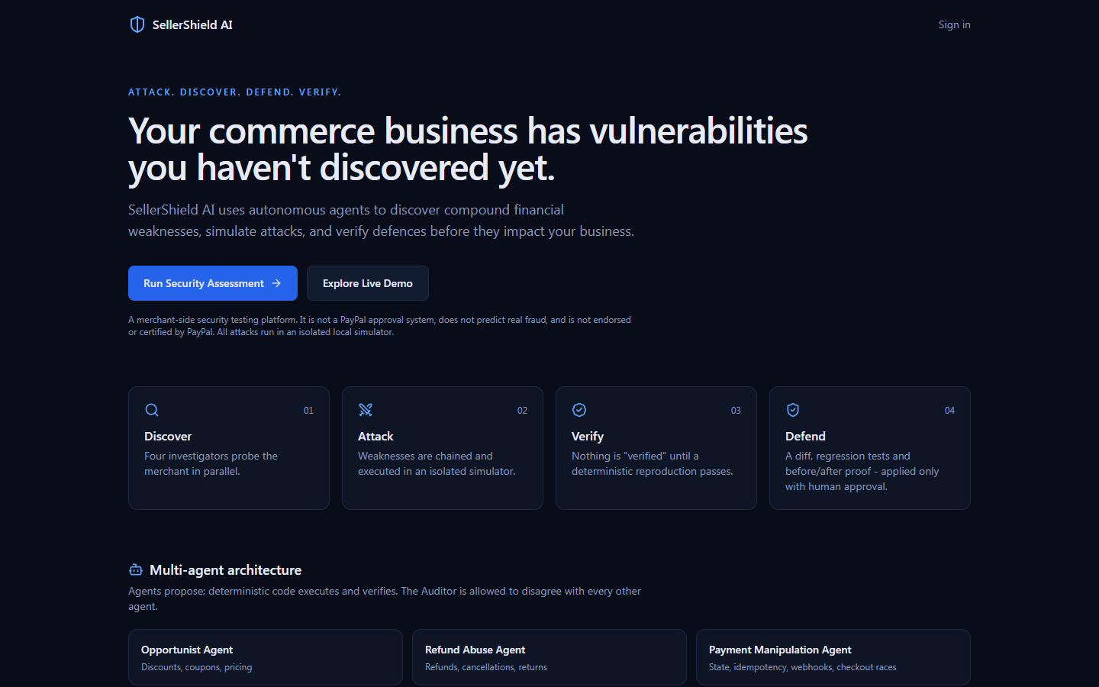
SellerShield AI
AI-Powered Autonomous E-Commerce Security Platform
Discover. Connect. Verify. Defend. Remember.
Merchant-side security testing and financial-resilience prototype
Team: [Team name] · [Member 1] · [Member 2] · [Member 3]
Stack: Next.js · React Flow · Express/TypeScript · Prisma/SQLite · Zod · optional Gemini/Groq AI · optional PayPal Sandbox

Slide 2
The problem
Commerce logic fails in combinations: a discount rule, a refund formula and a retry path can each look harmless.
Isolated checks report them separately, not as one money-losing sequence.
AI-generated findings are often unverified: teams need evidence and a fix they can trust.
coupon + refund formula + retry
=
one financial attack
SellerShield AI · 2/10

Slide 3
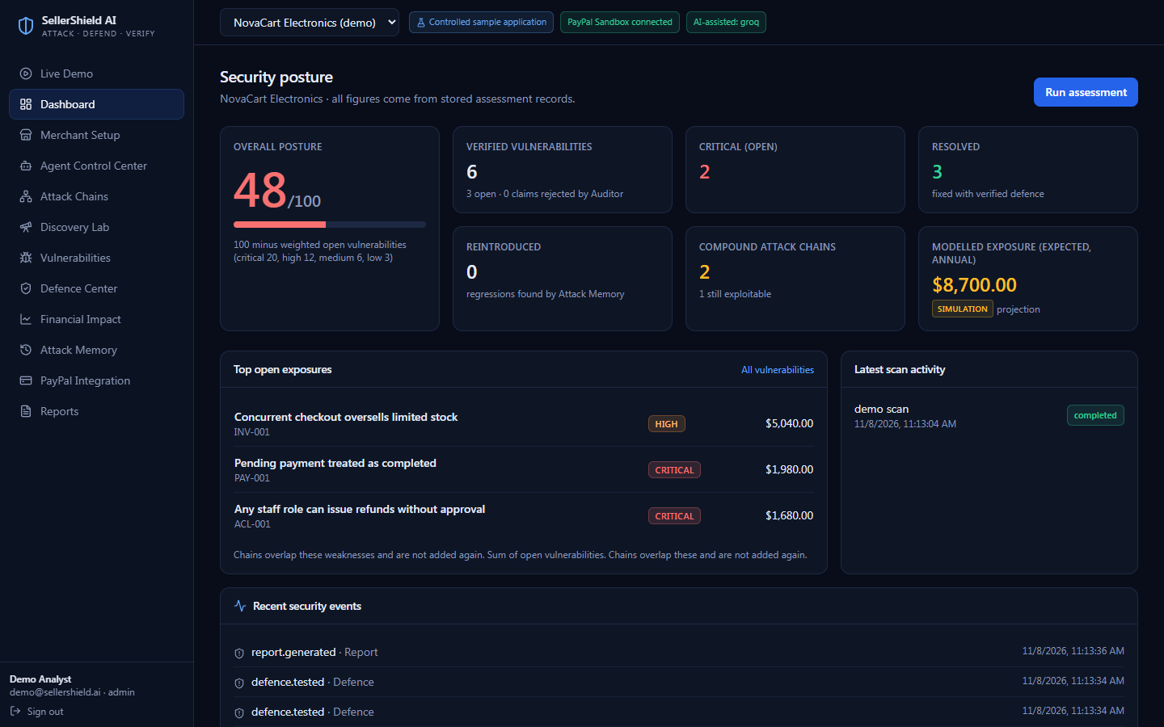
Our solution
Discover
weaknesses
Connect
into attack chains
Verify
independently
Defend
with a real diff
Remember
so fixes cannot silently regress
New: an attacker that invents attack sequences (verified by replay) · a PayPal red team with ledger reconciliation · verified fixes shipped as draft pull requests. Exposure is always a labelled simulation.
SellerShield AI · 3/10

Slide 4
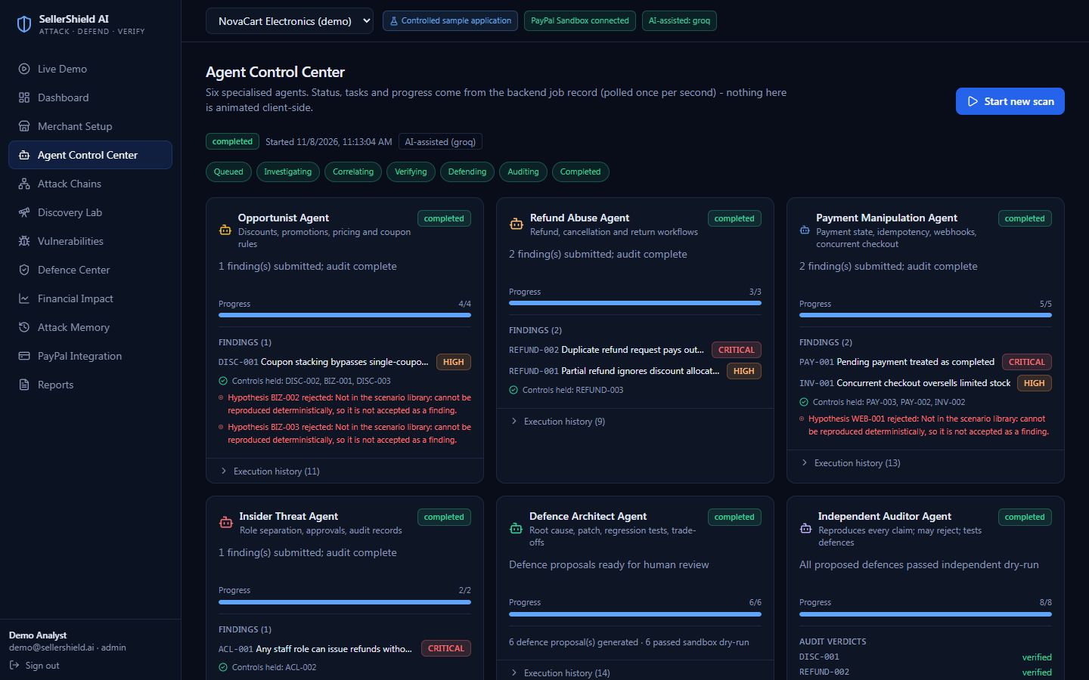
Six-agent architecture
1 Opportunist
discounts, coupons, pricing
2 Refund Abuse
refunds, cancellations
3 Payment Manipulation
state, idempotency, races
4 Insider Threat
roles, approvals, audit
5 Defence Architect
diff + plan + tests
6 Independent Auditor
reproduces, may reject
Agents run deterministic probes; an LLM (optional, not tested live) may only reorder them.
SellerShield AI · 4/10

Slide 5
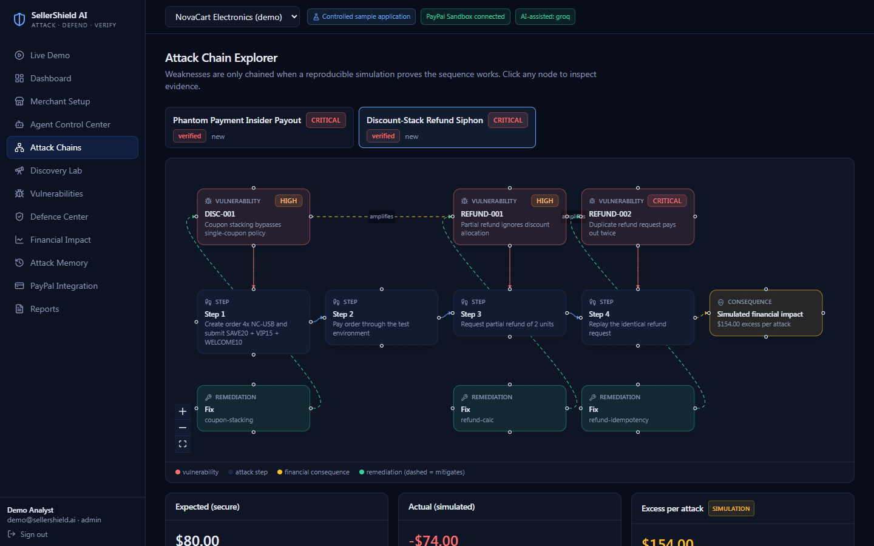
Compound attack: Discount-Stack Refund Siphon
$126
collected
$200
refunded
$80
correct outcome
$154
excess per attack
Exploited separately: $34 + $20 + $30 = $84. Chained: $154.
Phantom Payment Insider Payout: $240 per attack (isolated $90 + $120).
All values are simulated.
1 Stack 3 coupons: pays $126 (policy: one coupon)
2 Refund 2 units: pays $100 at list price
3 Replay the request: pays $100 again
SellerShield AI · 5/10

Slide 6
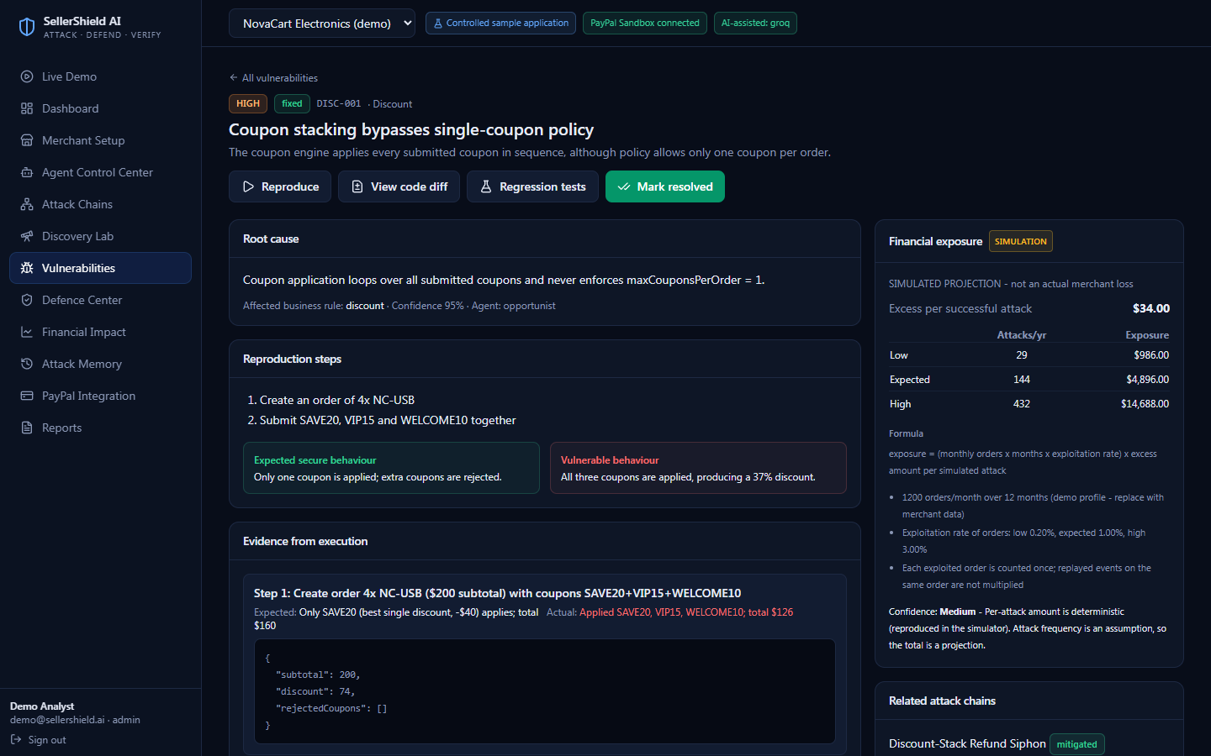
Independent Auditor
A finding is a claim until the Auditor reproduces it from fresh state, twice.
Checks ledger invariants and recomputes the dollar figure.
Rejected in tests: inflated claim, unknown test case, attack that no longer reproduces.
Can correct severity. Only reproduced findings count as verified.
SellerShield AI · 6/10

Slide 7
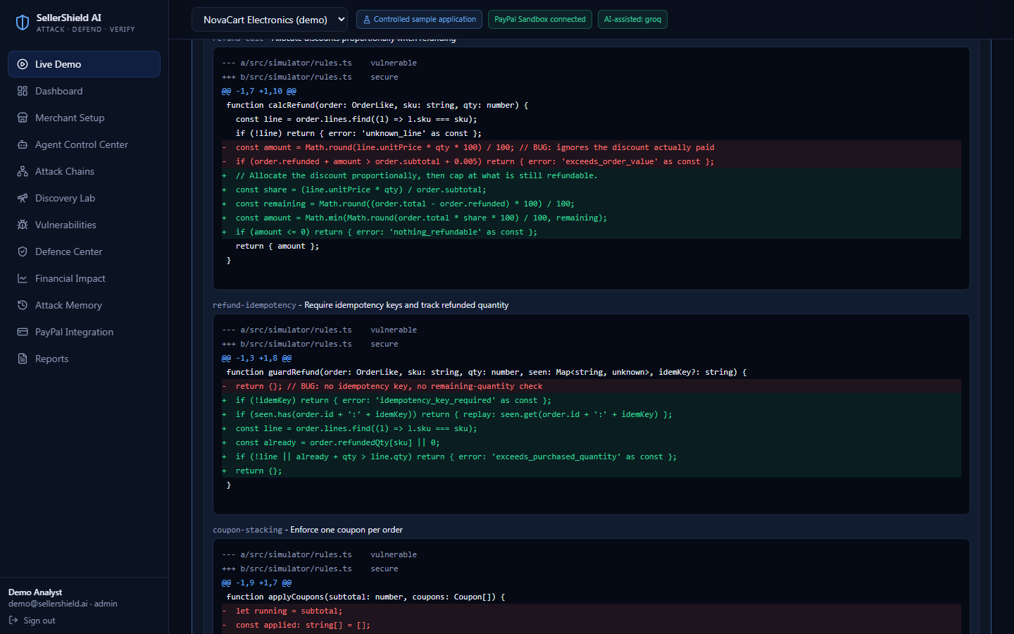
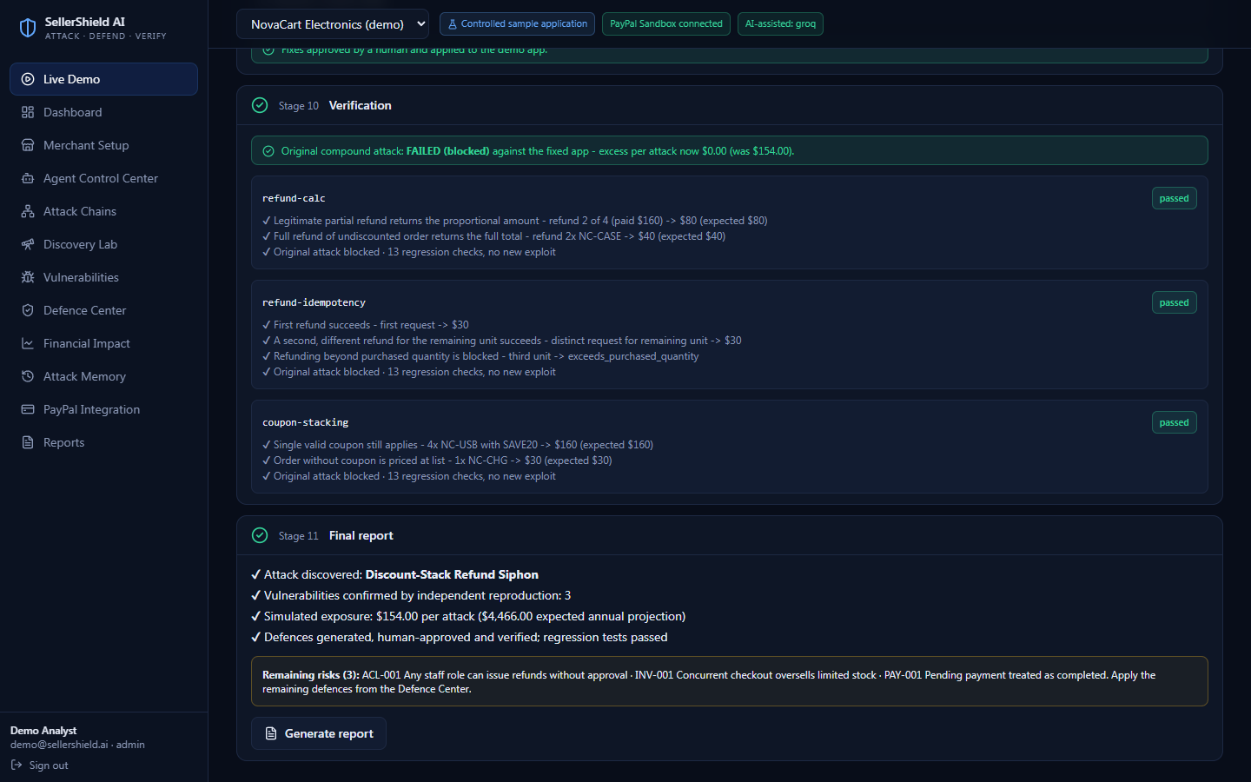
Autonomous defence: real diff, human approved
- const amount = Math.round(line.unitPrice * qty * 100) / 100; // BUG
+ const share = (line.unitPrice * qty) / order.subtotal;
+ const remaining = round(order.total - order.refunded);
+ const amount = Math.min(round(order.total * share), remaining);
Generate → review diff → approve → explicit confirmation → apply to the demo app only → regression tests → rollback. Nothing touches production.
SellerShield AI · 7/10

Slide 8
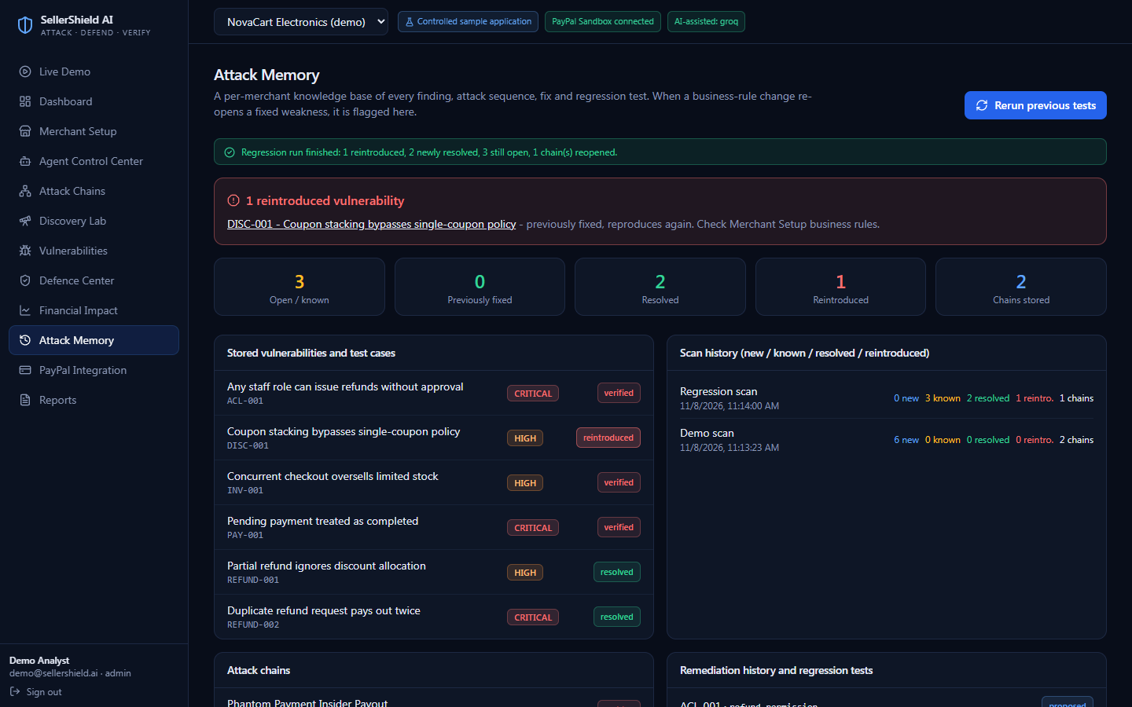
Regression memory
1 Fix verified, tests saved
2 Attack blocked
3 Rule changed: coupon stacking back on
4 Rerun previous tests
5 DISC-001 flagged: reintroduced
SellerShield AI · 8/10

Slide 9
Technology and roadmap
Implemented and tested
Implemented, NOT tested
Planned
Next.js 15 · React Flow · Recharts
Express + TypeScript + Zod · JWT cookie · RBAC
Prisma + SQLite
Deterministic simulator, 13 scenarios
82 backend tests · 21-check Chrome E2E
JSON + PDF reports
PostgreSQL (schema + compose)
PayPal Sandbox calls and webhook signature verification
Live LLM calls
Render deployment
More simulated apps
Source-aware analysis of uploaded repos
Queue workers
Merchant-calibrated model
Live-Sandbox CI
SellerShield AI · 9/10

Slide 10
Security Should Not Stop at Detection.
SellerShield AI transforms security findings into verified, actionable defence and continuous protection.
Website: [URL] · GitHub: [repo URL] · Team: [names / contacts]

