Slide 1


Statistics
Chandramouli Das

Slide 2
Statistics
Statistics is a branch of Mathematics that deals with the scientific collection, organization, presentation, analysis and interpretation of numerical data, in order to obtain useful and meaningful information.
Branches of Statistics :
Descriptive Statistics : Focus on collecting, summarizing and presenting a set of data. Example – Average number of sixes and fours in every IPL match.
Inferential Statistics : Analyzes sample data to draw conclusions about population. Example – Exit polls of elections.

Slide 3
Need of Statistics in Data Science
Data is the key components in data science and machine learning field. We need the help of statistics to understand and extract inner information from data.
Used for Data Cleaning and Data analysis
It is needed to calculate key numeric values like mean, median, mode etc.
Every machine learning Algorithm is based on basic statistics.
We need to statistics to check hypothesis testing.

Slide 4
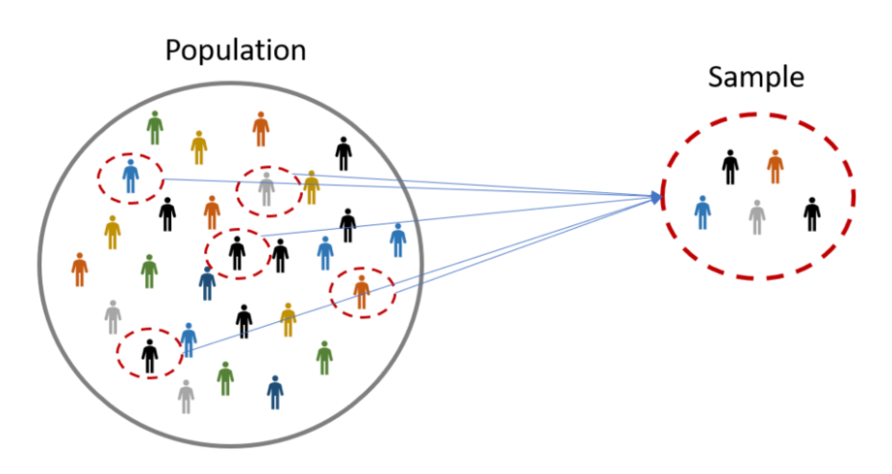
Important Terms
Data : Any quantitative or qualitative information.
Population : Set of similar items or events which are of interest for some question or experiment.
Sample : Fraction or percentage of population.

Slide 5
Important Terms
Parameter : Any statistical information or attribute taken from a population. It is a true value since its source is population itself.
Statistic : Estimate of a population parameter.

Slide 6
Variables
A variable is any characteristics, number, or quantity that can be measured or counted.
A variable may also be called a data item
It is called a variable because the value may vary between data units in a population. It may change the value over time.
Examples of variables - Age, sex, business income and expenses, country of birth, capital expenditure, class grades, eye color and vehicle type.
In Data Science or Machine learning there are broadly two types of variables – Continuous Variables and Categorical Variables.

Slide 7
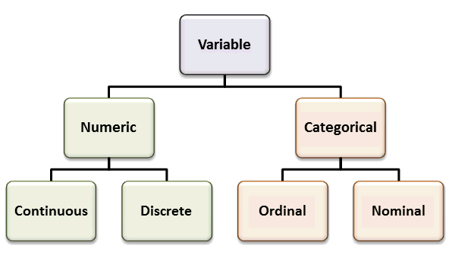
Variables

Slide 8
Numeric Variables
Numeric variables have values that describe a measurable quantity as a number, like 'how many' or 'how much'.
Two Types – Continuous Variable and Discrete Variable
Continuous – Continuous variables are numeric variables that have an infinite number of values between any two values. Continuous Variables would (literally) take forever to count. In fact, you would get to “forever” and never finish counting them.
Example - height of students in a class, weight of students in a class, the time it takes to get to school, distance traveled between classes.
Discrete – A Discrete variable is a variable whose value is obtained by counting. Discrete variables are countable in a finite amount of time.
Example – number of students present, number of red marbles in a jar number of heads when flipping three coins, students’ grade level.

Slide 9
Categorical Variables
A categorical variable is a variable that can take on one of a limited, and usually fixed number of possible values, assigning each individual or other units of observation to a particular group or nominal category based on some qualitative property.
Two Types – Ordinal Variable and Nominal Variable
Ordinal – Categorical Variables which follow a certain order come under Ordinal Categorical Variables.
Example - Student's grade in an exam (A, B, C or Fail), Days of the week can be ordinal with Monday = 1 and Sunday = 7., Educational level, with the categories Elementary school, High school, College graduate and Ph.D. ranked from 1 to 4.
Nominal – Categorical Variables which don’t follow any order come under Nominal Categorical Variables.
Example – Postcode, customer service rating: good, average, bad, Vehicle make

Slide 10
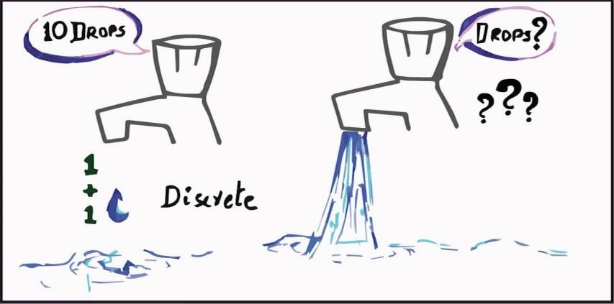
Quantitative/ Numerical Data
Described by a number
Discrete or continuous
Using operations such as average make sense
Bank Balance
Number of employees in a company
Time

Slide 11
Discrete Data
Discrete data can assume only certain values.
Typically, this type of data can be counted.
Number of bedrooms
Number of cars passing a toll
booth
Number of children in a family

Slide 12

Continuous Data
Can take any value in a specific range.
Outcome of measuring.
Time to reach school
Weight of tomatoes
Height of a student

Slide 13
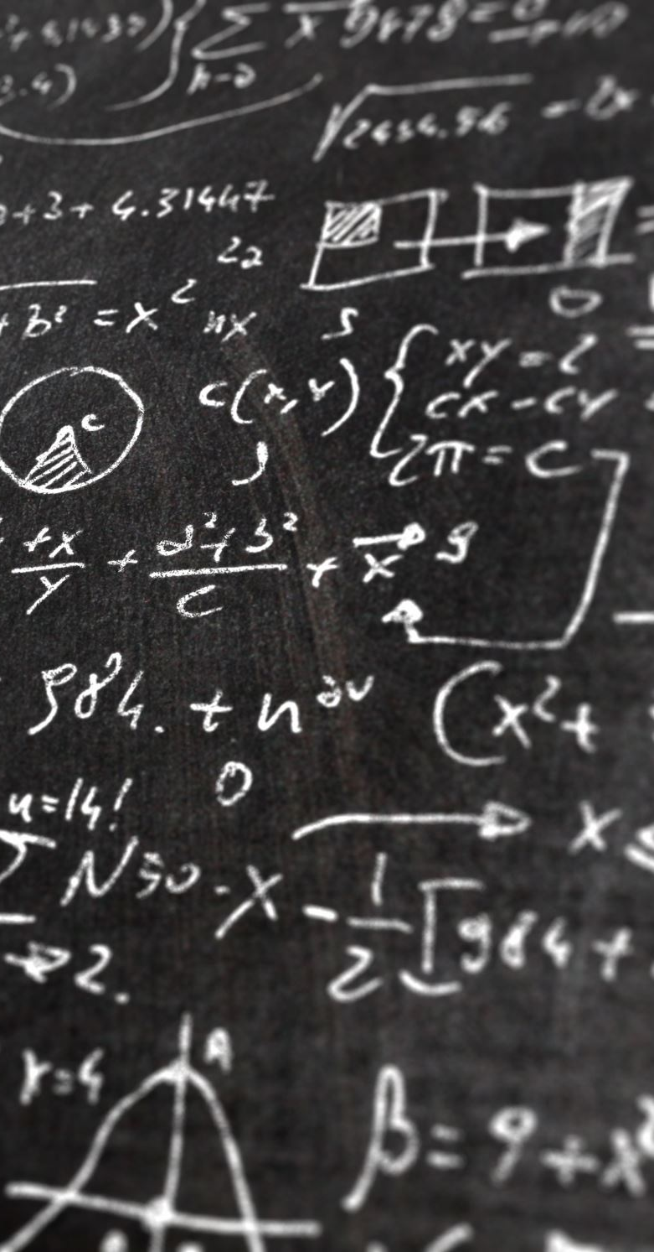



Qualitative/Categorical Data
Also known as categorical data
Describes data that fits into categories
Take on values that are names or labels
Gender
Color of ball
Nationality

Slide 14
Customer ID | First Name | Last Name | Gender | Age | Region | Job Classification | Date Joined | Balance
100000001 | Simon | Walsh | Male | 21 | England | White Collar | 5-Jan-15 | 113810.15
400000002 | Jasmine | Miller | Female | 34 | Northern Ireland | Blue Collar | 6-Jan-15 | 36919.73
100000003 | Liam | Brown | Male | 46 | England | White Collar | 7-Jan-15 | 101536.83
300000004 | Trevor | Parr | Male | 32 | Wales | White Collar | 8-Jan-15 | 1421.52
100000005 | Deirdre | Pullman | Female | 38 | England | Blue Collar | 9-Jan-15 | 35639.79
300000006 | Ava | Coleman | Female | 30 | Wales | Blue Collar | 9-Jan-15 | 122443.77
100000007 | Dorothy | Thomson | Female | 34 | England | Blue Collar | 11-Jan-15 | 42879.84
200000008 | Lisa | Knox | Female | 48 | Scotland | Other | 11-Jan-15 | 36680.17
300000009 | Ruth | Campbell | Female | 33 | Wales | White Collar | 11-Jan-15 | 74284.35
100000010 | Dominic | Parr | Male | 42 | England | White Collar | 12-Jan-15 | 10912.45
100000011 | Dominic | Lewis | Male | 40 | England | White Collar | 12-Jan-15 | 39667.83
100000012 | Benjamin | Grant | Male | 39 | England | White Collar | 12-Jan-15 | 32281.62
Customer ID
Date Joined
Name
Surname
Gender
Region
Job Classification
Date Joined
Balance
Age
Balance
Age

Slide 15


Flight ID | Origin | Destination | Economy Class Rate | Passengers Economy Class | Economy Class Revenue | Travel Time (in mins) | Total Flight Capacity
SQ5430 | SIN | KUL | 206.1 | 250 | 51525 | 55mins | 285
SQ118 | SIN | KUL | 206.1 | 200 | 41220 | 60 mins | 253
SQ5330 | SIN | KUL | 206.1 | 230 | 47403 | 55 mins | 290
SQ5426 | SIN | KUL | 206.1 | 200 | 41220 | 60 mins | 270
SQ5304 | SIN | KUL | 206.1 | 288 | 59356.8 | 55 mins | 326
SQ5429 | SIN | KUL | 206.1 | 270 | 55647 | 55 mins | 326
SQ5118 | SIN | KUL | 206.1 | 230 | 47403 | 60 mins | 290
SQ5430 | SIN | KUL | 206.1 | 280 | 57708 | 60 mins | 326
SQ5330 | SIN | KUL | 206.1 | 222 | 45754.2 | 55 mins | 270
Economy Class Rate Passengers Economy Class Economy Class Revenue Total Flight Capacity
Passengers Economy Class Total Flight Capacity
Flight ID Origin Destination
123
abc
Economy Class Rate Economy Class Revenue Travel Time (in mins)
Travel Time (in mins)
Travel Time (in mins)

Slide 16
Probability Distributions
A sample of data will form a distribution
The distribution provides a parameterized mathematical function that can be used to calculate the probability for any individual observation from the sample space.
This distribution describes the grouping or the density of the observations, called the probability density function
A summary of these relationships between observations is called a cumulative density function.

Slide 17
Distributions
Continious Variable Distributions
Normal Distributions
Uniform Distributions
Exponential Distributions
Chi-Squared Distribution
Categorical Variable Distributions
Bernoulli Distribution
Binomial Distribution
Poisson Distribution

Slide 18
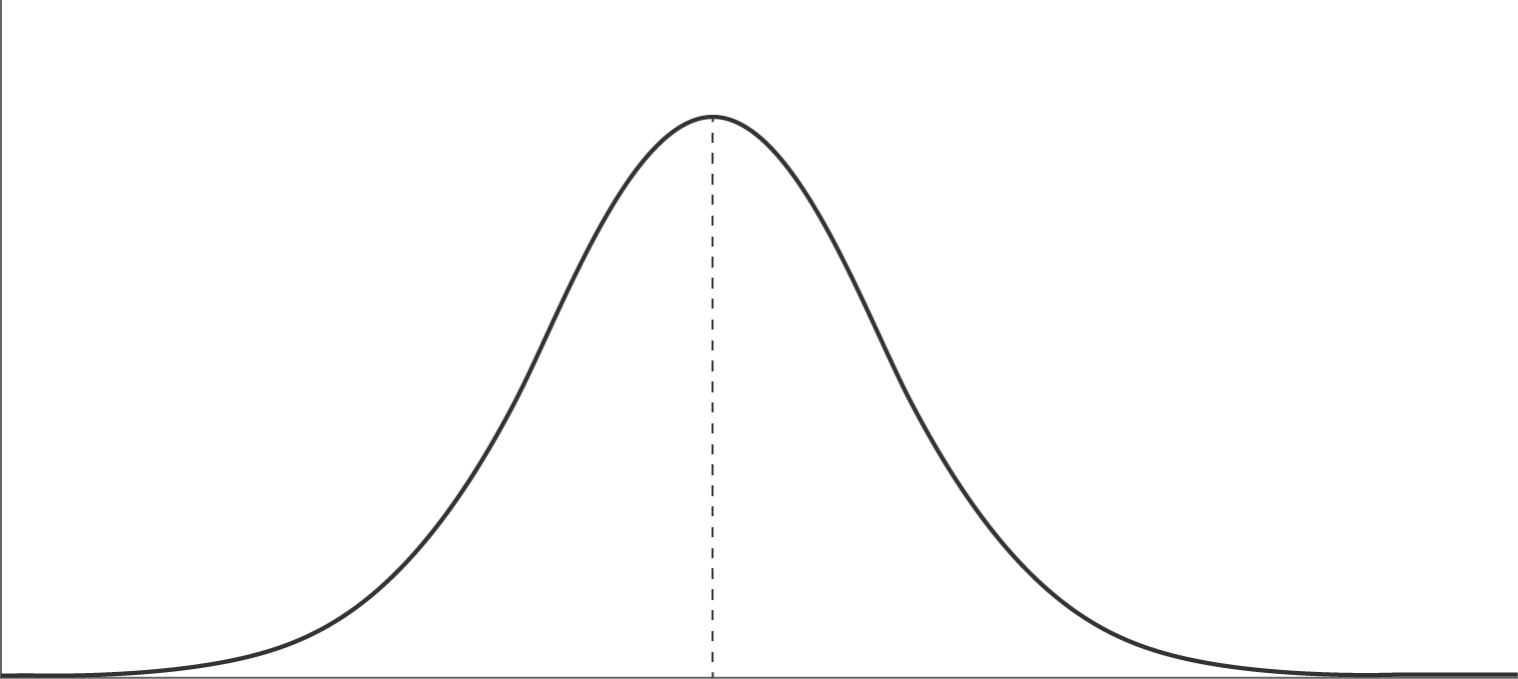
Frequency Distribution : Time needed to reach from A to B
Normal Distribution
Minimum Time
Average Time
Maximum Time

Slide 19
Descriptive Statistics
Central value of metric
Mean & Median
Spread of values in the metric
Variations in the metric
Max, Min, Range, Inter Quartile Range
Standard Deviation, Coefficient of variation
DESCRIPTIVE STATISTICS

Slide 20

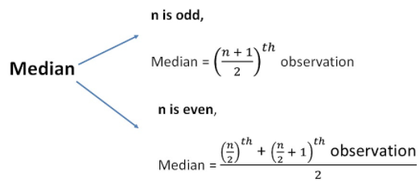
Measures of central tendency : Mean, Median
Data
1
2
3
4
5
6
7
8
9
100
Mean = 14.5
Median = 5.5
Arrange the numbers from smallest to largest
Mean is not a robust measure if it is used in silo, it is affected by the presence of extreme values
Median is a robust measure & not affected by the presence of extreme values
Extreme Value

Slide 21
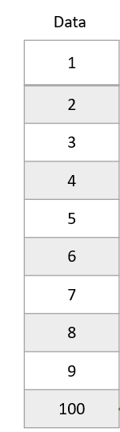
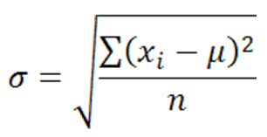
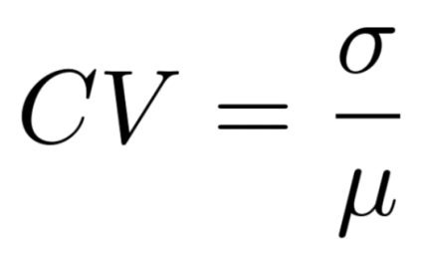
Measures of Dispersion : Standard Deviation, Coefficient of Variation
Standard Deviation
Measures average change from the mean
Coefficient of variation
Measures standard deviation per unit mean

Slide 22
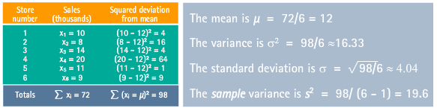
Measures of Dispersion : Standard Deviation, Coefficient of Variation
Coefficient of variation = 4.04/12 * 100 = 33%

Slide 23
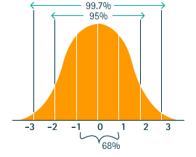
Measures of Dispersion : Standard Deviation – Normal Distribution
To interpret the standard deviation use the Empirical Rule which states that for data from a normal distribution, approximately:
68% of the observations will fall within 1 standard deviation of the mean.
95% of the observations will fall within 2 standard deviations of the mean.
99.7% of the observations will fall within 3 standard deviations of the mean.

Slide 24
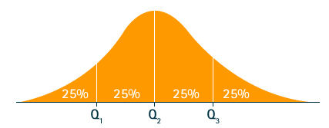

Measures of Dispersion : Quartiles
The median that you just learned about would give you the middle of the data. But what if you wanted to look closer at the top 25% of the data? Suppose you want to create a segment of most valued customers where “most valued” customer is defined as among the top 25% of buyers by average value.
A quartile is when you partition it into four equally sized groups. Then you can analyze the data in a particular quartile.

Slide 25
Central Limit Theorem
The Central Limit Theorem states that the sampling distribution of the sample means approaches a normal distribution as the sample size gets larger.
No matter what the shape of the population distribution, It is always be a normal distribution at the end.
CLT Visualization - https://onlinestatbook.com/stat_sim/sampling_dist/

Slide 26
Percentiles
A percentile (or a centile) is a measure used in statistics, indicating the value below which a given percentage of observations in a group of observations falls.
Percentiles are commonly used to report scores in tests, like the SAT, GRE and LSAT.
If you know that your score is in the 90th percentile, that means you scored better than 90% of people who took the test.
The 25th percentile is also called the first quartile.
The 50th percentile is the median
The 75th percentile is also called the third quartile.

Slide 27
Outliers
An outlier is a data point that differs significantly from other observations.
It may indicate the experimental error or human error.
An outlier is an observation which is way different from other observations that makes it suspicious.
Outliers always need special attention, it needed to be taken care of otherwise it may manipulate the statistical result.
Removing an outlier is not a solution for every cases.
Sometimes outliers are also used to detect some abnormal activities.

Slide 28
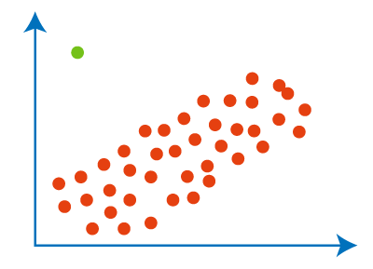
Outliers

Slide 29
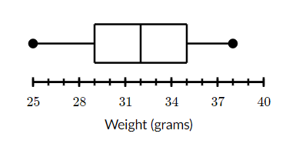
Box-Whisker Plot
Maximum
Weights (grams) :
25, 37, 29, 34, 30, 29, 35, 35, 28, 38
Order data from smallest to largest :
25, 28, 29, 29, 30, 34, 35, 35, 37, 38
Find median :
(30+34) / 2 = 32
First quartile : Median of data points to the left of median
25, 28, 29, 29, 30
Third quartile : Median of data points to the right of median
34, 35, 35, 37, 38
Third quartile Q3
Median
First quartile Q1
Minimum

Slide 30
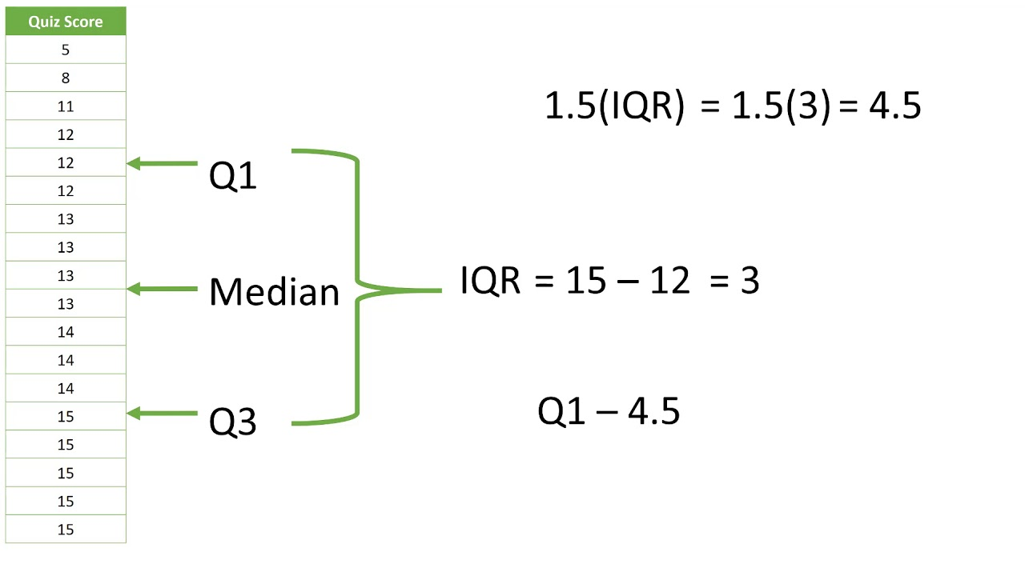
Box-Whisker Plot : Outlier Detection
Outliers at lower end < 12 - 4.5 < 7.5
Outliers at upper end > 15 + 4.5 > 19.5
Q3 + 4.5

Slide 31
Box-Whisker Plot
A
B
C
0 20 40 60 80
Which segment is highly homogenous?
Which segment is skewed?
Which segment is symmetrical?

Slide 32
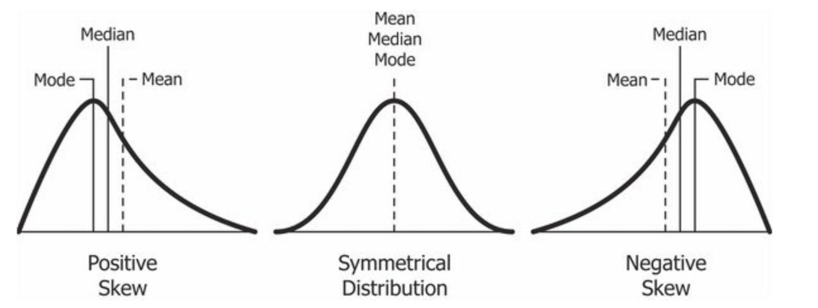
Skewness -
Skewness is a measure of the symmetry of a distribution. The highest point of a distribution is its mode. The mode marks the response value on the x-axis that occurs with the highest probability. A distribution is skewed if the tail on one side of the mode is fatter or longer than on the other, it is asymmetrical.
No Skewness – Symmetrical Distribution
Positive Skewness – the tail on the right side is longer than on the left
Negative Skewness - the tail on the left side is longer than on the right side

Slide 33
Exploratory Data Analysis : Single Variable
Realize the underlying story in the variable by performing:
One variable analysis using descriptive toolkit –
Descriptive Statistics (mean, std dev)
Histogram (distribution)
Box Plot (outlier detection)
For every variable that you plan to use
Look for need for variable transformation, identify problems like –
Outliers
Missing value

Slide 34
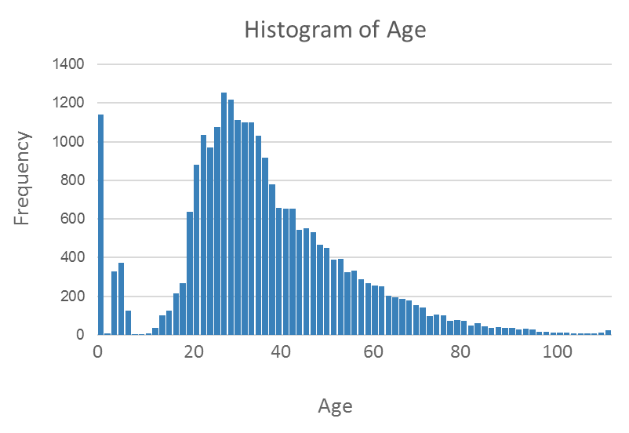
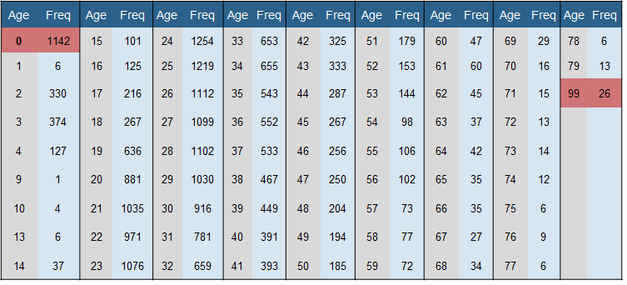
Histograms
A histogram is a plot that lets you discover, and show, the underlying frequency distribution (shape) of a set of continuous data.

Slide 35
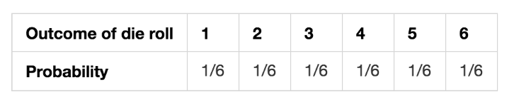
Probability
A probability distribution is a list of all of the possible outcomes of a random variable along with their corresponding probability values.
It indicates the likelihood of an event or outcome.
Following is the notation to describe probabilities:
p(x) = the likelihood that random variable takes a specific value of x.
The sum of all probabilities for all possible values must equal 1.
The probability for a particular value or range of values must be between 0 and 1.
E.g.-

Slide 36
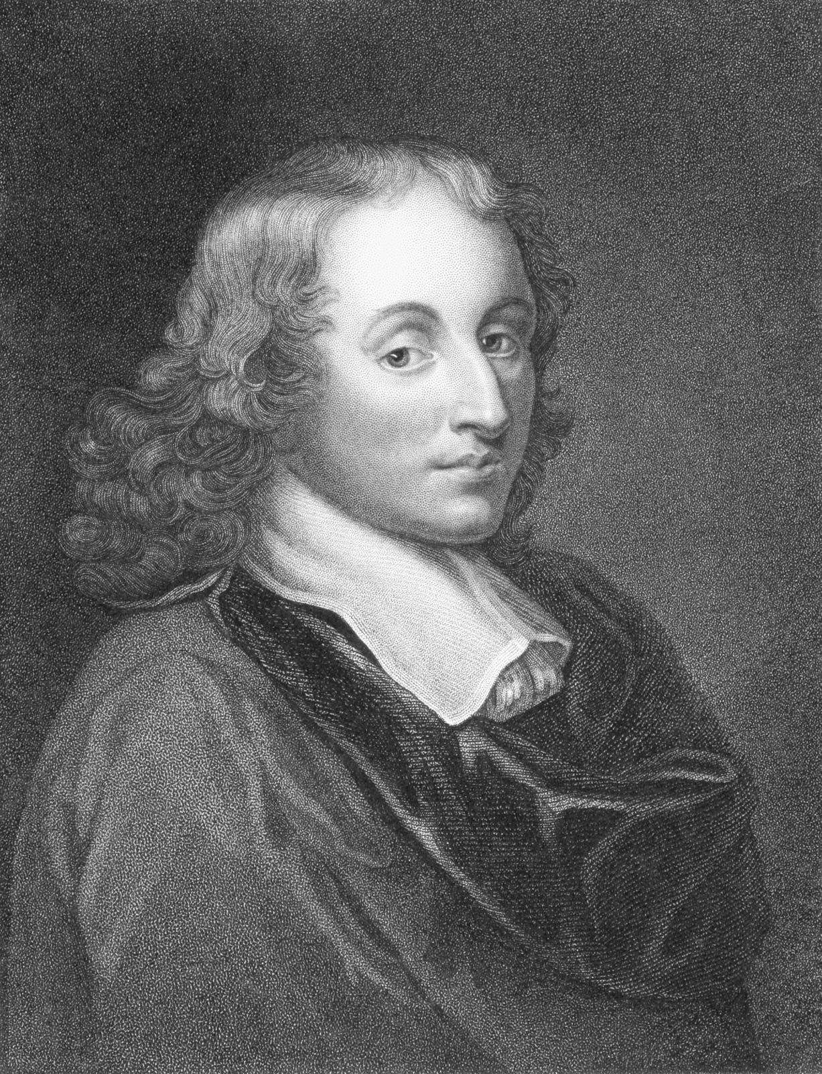
Probability
The theory of probability had its origins in games of chance and gambling. Probability originated from a gambler’s dispute in 1654 concerning the division of a stake between two players whose game was interrupted before its close. The problem was proposed by a well-to-do gambler, the Chevalier de Mere to prominent mathematicians including Blaise Pascal who shared his thoughts with Pierre de Fermat.
The correspondence which ensued between the two mathematicians was fundamental in the development of modern concepts of probability.
Blaise Pascal

Slide 37
Sampling
Population
The "population" in statistics includes all members of a defined group that we are studying or collecting information on for data driven decisions.
Example : all the votes cast in an election
Sample
It is a part of the "population".
Can be biased or un-biased (also know as random sample).
Example:
A portion of votes collected to predict the election outcome through "Exit Poll".
Population
Sampling is a process in which a predetermined number of observations are taken from a larger population.
There are two major types of sampling:
Simple random sampling
Stratified sampling
Sample1
Sample2
Sample3

Slide 38
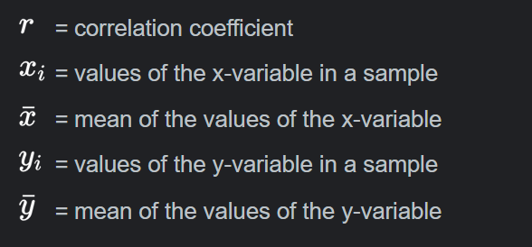
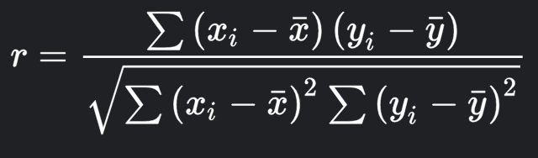
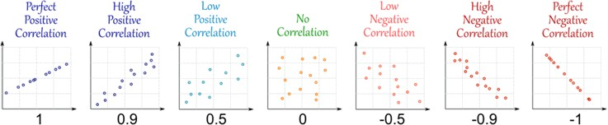
Correlation Coefficient

Slide 39
Statistical Significance
Hypothesis - When we perform an analysis on a population sample — the analysis could be descriptive, inferential, or exploratory in nature — we get certain information from which we can make claims about the entire population. These are just the claims; we can’t be sure if they’re true. This kind of claim or assumption is called a hypothesis.
Null Hypothesis - A null hypothesis is a type of hypothesis used in statistics proposes that there is no difference between certain characteristics of a population.
Alternative Hypothesis - The alternative hypothesis is a position that states something is happening, a new theory is preferred instead of an old one (null hypothesis).
Z-Score – Z score gives us an idea how far the mean is from a given data point.
P- Value - In statistics, the p-value is the probability of obtaining results at least as extreme as the observed results of a statistical hypothesis test, assuming that the null hypothesis is correct.

Slide 40

Fair Coin Example
Problem - I am claiming that it is a fair coin.
H0 – It is a fair coin
H1 – It is Not a Fair Coin
T1 – 0.5 = Head
T2 – 0.25 = Head
T3 – 0.12 = Head
T4 – 0.06 = Head
T5 - 0.03 = Head
T6 -0.01 = Head

Slide 41
Statistical Significance
In 2015 millennial were watching 26.5 hours of TV a week with standard daviation 10 hrs. today you surveyed 50 millennials and found that they watch 24 hours of Tv per week. Has the parameter decreased ?
H0 = It has not decrease i.e. mean >26.5
H1 = It has decrease i.e. mean <26.5
µ ¯x=µ = 26.5
a ¯x = a / N = 10/ 50 = 1.41
¯x = 24
Z =( ¯x - µ ¯x)/ a ¯x = (24-26.5)/1.41 = -1.77
P = 0.0384 = 3.84% <5%

