Slide 1

Create an Extempore for the following topics
*IT in automobiles
*IT in metro Rail
*IT in avionics

Slide 2
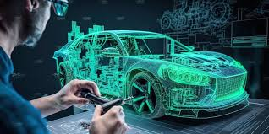
IT IN AUTOMOBLIES

Slide 3
1. IT in Automobiles
What Is a Connected Car?
A connected car is a vehicle that uses internet connectivity to communicate with outside systems. These systems can include apps that can unlock your car, GPS and vehicle to vehicle communication.
These days, computer chips and sensors are lodged inside everying from washing machines to light bulbs to working attrie. But few industries are being transformed by the mass connect-ification of objects, aka the Internet of Things, like car manufacturing.
Internet- and cloud-connected cars vacuum up and transmit heaps of data — between 20 to 200 megabytes per day, according to Darren Mann, vice president of global operations at Seattle-based Airbiquity, which has been used by the likes of GM, Ford and Toyota. That data is then used to design safer roadways, predict equipment malfunction and improve the in-car entertainment experience. In 2022, Micron released a 1.5 terabyte SDcard that can provide connected cars with even more data storage opportunities.

Slide 4
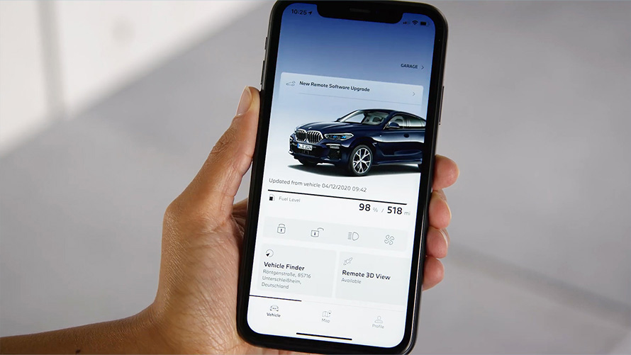
Remote Software Updates
Connected cars are simplifying life for both drivers and manufacturers — especially when it comes to software upgrades.
“Vehicles have become increasingly more complex over time,” Mann said. “Traditionally, the only way to update cars that came off the factory line was by returning them to a dealer. Obviously that’s not only an inconvenience for the consumer, [it] becomes very costly for the car manufacturer.”
Thanks to IoT-connectivity, a car’s many software-reliant components can be updated “over the air.” Mann said a non-working headset, for example, is more likely to require an over-the-air software update rather than a trip to the manufacturer. Even a vehicle’s electronic control units are remotely updatable.
OTAs can enhance vehicle performance too. Serial software-updater Tesla, has sent OTA software fixes for everything from battery performance to suspension lifts.
Mann predicts that other automotive IoT developments will include more updates that are specifically related to features enhancement and offered via a pay-as-you-go subscription model. A provider could remotely pipe in, say, Audible’s audiobook service if a driver is taking a long vacation and traveling by car.
Changing technology means staying on top of new liabilities — and being able to deploy fixes with the click of a button rather than dealing with issues case by case. When a new vulnerability is identified, Mann said, IoT-connected onboard software lets manufacturers “immediately distribute a patch that addresses that vulnerability in a matter of days or minutes.”
Benefits of IoT In the Automotive Industry
Remote Software Updates

Slide 5
Predictive Maintenance
One of the great promises of automotive IoT is predictive maintenance. A constellation of computer chips and sensors placed throughout a connected car collect performance data, which is processed in the cloud to predict when a part might require maintenance long before it gives up the ghost.
In a truly connected environment, a driver could even pass along a maintenance alert to the manufacturer or mechanic. The most complex systems would incorporate AI to give the predictive algorithm even greater forecasting powers.
Predictive maintenance can lower costs for consumers with its ability to collect data and the potential to adjust car settings to prevent wear and tear over time. It could also save dealerships and mechanics money too by working to optimize inventory management with notifications about upcoming repairs.

Slide 6
Making Parking Easier
American drivers spend on average a whopping 17 hours per year looking for parking. That’s a collective annual cost of $73 billion in time, fuel and emissions loss. Automotive IoT could help combat the time and money drivers spend on parking. The potential for connected cars to make parking easier is being recognized by the market too, with smart parking predicted to be valued at more than $16 million by 2028.
Using mapping data to find open parking spots can be done through companies like Otonomo, which inputs car data into the cloud and uses it for analysis of parking, traffic and more. Focusing on transportation planning in urban areas, the company offers a platform that city planners can use to measure parking availability and the duration of parking.

Slide 7
Infotainment
In nearly every new car produced today, there is a screen at the center of the dashboard — this is the vehicle’s infotainment system. With connected cars in-car entertainment, or infotainment, is another growing facet of the automotive IoT industry.
Infotainment systems can range from vehicle-specific systems like Kia’s UVO or Jeep’s Uconnect to mobile-compatible systems like Samsung's Exynos Auto and Android Auto. Some of the major perks of infotainment for drivers includes speech activated navigation, texting and calls. Connected cars and infotainment systems go hand in hand nowadays as infotainment systems couldn’t work without IoT connectivity.
The connected car allows for direct integration of vehicle audio systems with personal smart devices. Apple’s CarPlay, for instance, lets drivers make calls through the console and can add Spotify, Audible, Pandora and a host of other voice-enabled apps to the dashboard.

Slide 8
Traffic Prediction
Traffic is at best an inconvenience. At worst, it’s a breeding ground for crashes. An increasing number of IoT sensors in CCTV cameras and along highways and bridges constantly collect data to help alleviate traffic burdens and predict likely congestion points before they materialize. In order to more effectively achieve that goal, public safety agencies and IoT companies around the country have joined forces.
Connected cars are able to exchange information with each other, with the help of signal phase and timing information, cars with IoT capabilities are able to predict and report traffic patterns. Predicting traffic can help drivers travel more fuel efficiently and enhance safety on the road.
As more signal phase and timing data becomes available through connected cars, prediction will likely become more accurate. Autonomous vehicles are also paving the way for better traffic patterns and car connectivity. A simulation study found autonomous vehicles decreased travel time by 17 percent.

Slide 9

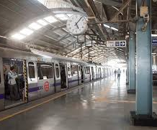
*IT in metro Rail

Slide 10
Real-Time Tracking and Monitoring
Information Technology (IT) systems enable real-time tracking of trains, allowing operators to monitor their exact location and status. This capability ensures timely operations and effective schedule management. Passengers benefit from this technology through digital displays and mobile apps that provide accurate arrival and departure information.
Overview: Real-time tracking and monitoring in metro rail systems involve the continuous observation and management of train operations using advanced IT solutions. This technology ensures that trains run on schedule, enhances passenger safety, and improves overall operational efficiency.
Key Components:
Sensors and Data Collection: Sensors installed on trains and along the tracks collect various types of data, including speed, location, and mechanical status. These sensors continuously transmit data to a central monitoring system.
Data Transmission: The collected data is transmitted in real-time to the Operational Control Centre (OCC) via secure communication networks. This ensures that the data is up-to-date and can be acted upon immediately.

Slide 11
Central Monitoring System: The OCC uses Supervisory Control and Data Acquisition (SCADA) systems to visualize and analyze the data. SCADA systems provide a comprehensive view of the entire metro network, allowing operators to monitor train movements, track conditions, and system health.
Real-Time Analysis: Advanced analytics and machine learning algorithms process the incoming data to detect anomalies, predict potential issues, and optimize train schedules. This real-time analysis helps in making informed decisions quickly.
Alerts and Notifications: In case of any irregularities or emergencies, the system generates alerts and notifications for the operators. This enables prompt responses to incidents, minimizing disruptions and ensuring passenger safety.
Benefits:
Enhanced Safety: Real-time monitoring ensures that any potential safety hazards are detected and addressed immediately, reducing the risk of accidents.
Operational Efficiency: Continuous monitoring and data analysis help in optimizing train schedules, reducing delays, and improving the overall efficiency of the metro system.
Predictive Maintenance: By analyzing data from sensors, the system can predict when maintenance is needed, preventing breakdowns and extending the lifespan of equipment.
Improved Passenger Experience: Real-time information about train schedules and delays is communicated to passengers, enhancing their travel experience and reducing uncertainty.

Slide 12
Automated Fare Collection: Modern metro systems utilize IT for automated fare collection, incorporating contactless payment methods such as smart cards and mobile apps. This innovation speeds up the boarding process, reduces the need for physical tickets and cash transactions, and minimizes human errors and operational costs.
Passenger Information Systems: IT has significantly enhanced passenger information systems, offering real-time updates on train schedules, delays, and other important announcements. These systems improve the overall travel experience by keeping passengers well-informed and reducing uncertainty during their commute.
Predictive Maintenance: Predictive maintenance, powered by IT, uses sensors and data analytics to monitor the condition of various components in the metro rail system. This proactive approach identifies potential issues before they become critical, ensuring the smooth operation of the metro and reducing downtime.
Safety and Security: IT plays a crucial role in ensuring the safety and security of metro rail systems. Surveillance cameras, emergency communication systems, and automated incident detection technologies are employed to protect passengers and staff. These systems enable quick responses to any incidents, enhancing the overall security of the metro rail network.

Slide 13

Introduction to IT in Avionics
Avionics, a combination of aviation and electronics, encompasses the electronic systems used in aircraft, satellites, and spacecraft. These systems include communication, navigation, flight control, and various other functionalities essential for the operation and safety of modern aviation.
Key Components of Avionics
1. Communication Systems Avionics communication systems are essential for ensuring effective communication between the aircraft and ground control, as well as between aircraft. These systems include radios, satellite communication systems, and data link systems.
2. Navigation Systems Navigation systems in avionics help pilots determine their position and navigate safely. These include GPS, inertial navigation systems (INS), and radio navigation systems.
3. Flight Control Systems Modern flight control systems, often referred to as fly-by-wire systems, replace traditional manual flight controls with an electronic interface. These systems enhance the safety and efficiency of aircraft operations.

Slide 14
Emerging Technologies in Avionics
Artificial Intelligence (AI) and Machine Learning (ML) are revolutionizing avionics by enabling advanced automation and predictive maintenance. These technologies help in analyzing vast amounts of data to predict potential failures and optimize flight operations. By leveraging AI and ML, avionics systems can enhance safety, efficiency, and reliability, making them indispensable in modern aviation.
Internet of Things (IoT):The Internet of Things (IoT) is transforming the aviation industry by connecting various sensors and devices on aircraft, enabling real-time monitoring and data collection. In avionics, IoT enhances operational efficiency, safety, and the overall passenger experience. By embedding sensors in aircraft components, IoT facilitates predictive maintenance, allowing airlines to identify and address potential issues before they become critical. This proactive approach reduces downtime and maintenance costs while improving the reliability of the fleet.
Additionally, IoT optimizes fuel management by analyzing real-time data to ensure efficient fuel consumption. It also improves ground operations through asset tracking solutions, providing real-time monitoring of valuable resources. Smart airport solutions, powered by IoT, offer personalized services and real-time updates to passengers, enhancing their travel experience.

Slide 15
Overlyapp: This platform allows you to create AR experiences in a few simple steps without any coding. You can upload your designs and content, and then publish them to the platform.
Blippbuilder by Blippar: This tool offers a drag-and-drop interface to create AR experiences. It integrates with Sketchfab for free 3D assets and allows you to publish your AR scenes to the web or social media.
Web-AR.Studio: A universal online platform for creating AR and WebAR projects without any coding or 3D skills.
PlugXR: This platform supports creating image-based AR without coding. It’s designed to be user-friendly and accessible for those without programming skills.

Slide 16

Challenges and Future Directions
Safety and Certification Ensuring the safety and reliability of avionics systems is paramount
. Integration and Interoperability Integrating new technologies with existing avionics systems can be challenging

